Slide 1

English Home Learning
Booklet
Name:…………………………………………………………………………..
Teacher:………………………………………………………………………

Slide 2
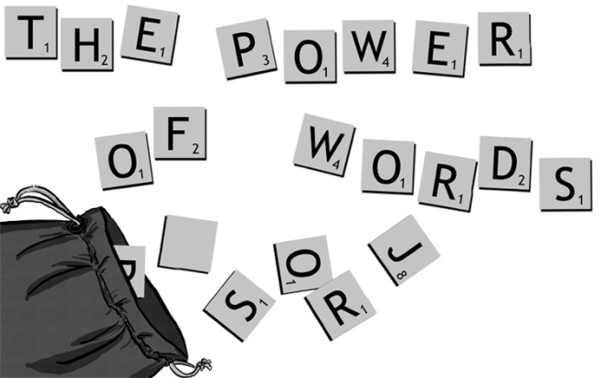

Section one: Vocabulary
Spelling list 1
Read notes on Dictionary Detective and Dictionary and thesaurus skills
Complete New words beginning with A and B
Complete Vocabulary Choices task
Read and complete Root words task
Read the extract The Pet
Answer the questions in full on The Pet
Self Assessment: What do I still need to practise from this section?

Slide 3
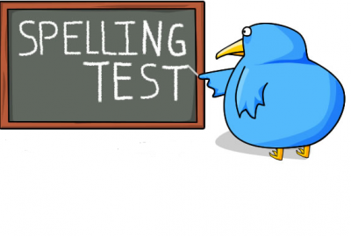
Spelling test 1
Practice these key spellings
 | Read | Write | Cover and write
Connective | Equally
 | Similarly
 | Likewise
 | Compared with
 | Comparing
Commonly misspelt words | Acceptable
 | Accidentally
 | Accommodate
 | Acquire
 | A lot
English subject words | Novel
 | Author
 | Analyse
 | Emphasise
 | Language

Slide 4
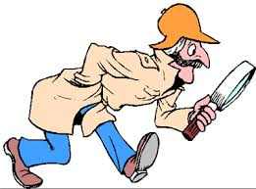
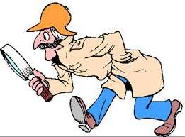
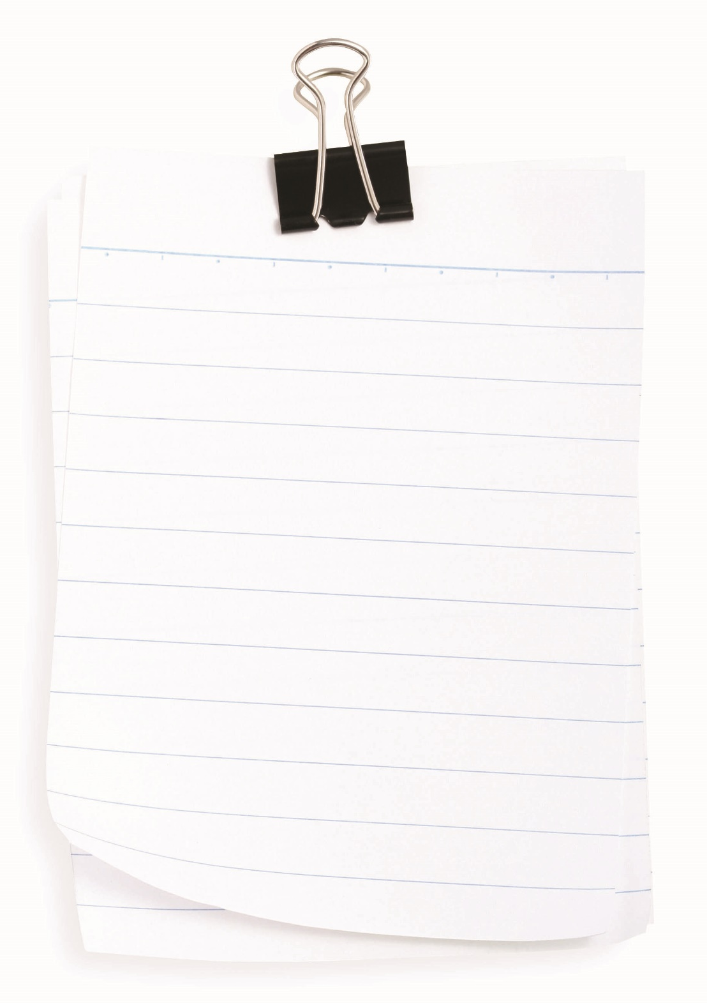

Dictionary detective
Using a dictionary is important in all your work – not just English – to help the reader understand what you mean in a precise way.
Gaining a bigger understanding of vocabulary will inevitably help you improve your overall grades.
The next few pages will help you find some exciting words to use in your work across the term, year and different subjects.
Each week you will be expected to find a new word that you will be able to fit into your work and share with your class.
We will work our way through the alphabet as the year goes on. For example, week 1 you will need to find an ambitious word beginning with A.

Slide 5
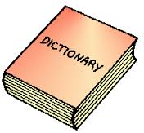

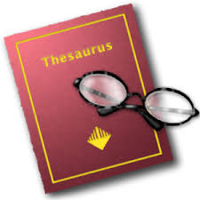

Dictionary and thesaurus skills
When using a dictionary and a thesaurus it is important to know how to use it properly otherwise your sentences won’t make any sense!
The dictionary is in alphabetical order.
You may need to look for the root word . (See section on root words)
When you find your word it will look like this
The word you are looking for.
Which word class does your word fit into?
There may be several definitions for your word, each definition starts with a new number.
abominable ► adjective 1 very unpleasant and causing disgust. 2 informal very bad.
One definition may signify if it is a formal or informal expression.
Once you have checked the definition of your word check that it fits into your sentence properly, is this what you want to show your reader? Is it the right word class?
If it is not, use the thesaurus to find one that says exactly and precisely what you want to.
The thesaurus works the same way as a dictionary, in alphabetical order.
There are two sections synonyms and antonyms
If you are using a combined dictionary and thesaurus the synonyms will come under the dictionary definition.
SYNONYMS loathsome, detestable, hateful, obnoxious, despicable, contemptible, disgusting, revolting, repellent, repulsive, repugnant, abhorrent.
ANTONYMS good, admirable.
Synonym – a word with similar meaning.
Antonym – a word with the opposite meaning.
Remember, once you have found your new word look it up in the dictionary before you put it in your sentence to check that it really makes sense and conveys what you want to say.

Slide 6
Letter
Word
A
Definition
Sentence (using your word):
Synonyms
Antonyms
Letter
Word
B
Definition
Sentence (using your word):
Synonyms
Antonyms

Slide 7
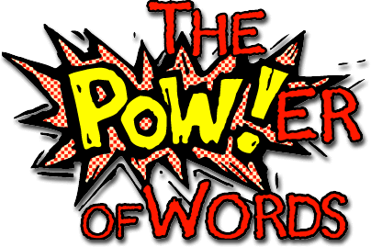

Vocabulary choices
The words you choose when writing - creatively or in analysis - are vital to what you are telling the reader. For example, are you telling the reader “Tommo cried because he was sad” or are you describing, “Tommo’s face glistened with tears through sorrow”?
There are different levels of words: relevant, interesting and ambitious, however this doesn’t mean you have to fill your work with exceptionally long words. Often the most interesting work uses a variety of all these words.
Using your skills from the dictionary and thesaurus pages, fill in the blanks in the table below.
Relevant | Interesting | Ambitious
Said | Shouted
Sad
Happy
Evil
Nice
 |  | Barbaric
 | Moody
 |  | Cascade
Rush
 | Drab
 | Brutal
Attack
 |  | Conventional
Remember
You have a word bank on the back of this booklet, and in your reading booklet, to record any words you find interesting and could use in your work!

Slide 8


Root words
A root word is the base word to construct a longer word with a slightly different meaning.
Understanding how to structure words will help us when spelling and constructing longer words. It will also help when we read a text and don’t understand a word, we can deconstruct it to help us!
First, we need to understand what a prefix and a suffix is:
Prefix – letters placed before the root word.
Suffix – letters placed after the root word.
Example:
Un employ ment
The prefix here is un – which means not / against / opposite
The root word is employ – give work to someone.
The suffix here is ment – which is a condition or state of being.
When you put your understanding of all these words together then you get the following meaning. A person who is in a state of not having a job or work.
Task:
Find as many words as you can from the root word given. Remember that the root word can go at the beginning, middle or end of the new word.
GOLD TARGET: Can you find two examples of your own?
Root word | What other words can be made from this root?
Use
Friend
Faith
Act
Cycle
Be
Fix
Marked by: Date:
TS:

Slide 9
Read the text carefully and answer the questions below in full sentences.
As you work your way through the booklet the texts in the comprehension section will become more challenging, building your vocabulary knowledge and inference skills throughout the year.
The Pet
Peter Johnson loved pets. He had done so ever since he was a child. He was always kind to animals. He put out milk for stray cats. He hung up seeds for birds. He went to the park each day to feed the ducks. But his pride and joy was his dog Rex. It was a German Shepherd.
Rex was good at tricks. He did what Peter told him to do. He could shake paws and roll over and play dead. Peter even trained Rex to go to the shop each day to fetch him his newspaper. Rex sat outside the shop and barked until Mr Patel came out with the paper. Mr Patel gave it to Rex who trotted home with it in his mouth. It was always a bit soggy and wet but Peter didn’t mind. His dog was smart.
Now Rex liked to fetch things for Peter. He would bring him his slippers. He would bring him toys and balls and sticks. In fact Rex was always looking out for things to bring Peter. This was because Peter gave Rex a sweet when he did. It was his reward.
One day Peter was sitting in his garden when Rex came running up to him. Rex had a piece of dirty fur in his mouth. He dropped it in Peter’s lap. Then sat down and looked at Peter hopefully.
‘What’s this then boy?’ said Peter. ‘’Some old toy you’ve found?’
Peter picked up the lump of fur and looked at it. To his horror he saw it wasn’t an old toy at all. It was the dead body of the pet rabbit that belonged to the little girl next door.
‘My goodness, Rex,’ said Peter. ‘This is Flopsy. You’ve killed her you bad dog!’ Rex hung his head in shame. He was sorry for the rabbit but even more sorry that Peter didn’t give him a sweet.
Peter jumped up and ran into the house. He put the rabbit in the sink and wiped the dirt from its fur. He looked hard to see if Rex had left any tooth marks on Flopsy’s skin but he didn’t find any. ‘Perhaps Rex scared this poor little rabbit to death,’ said Peter to himself. ‘I feel so bad about this.’
Then a dreadful thought popped into Peter’s head. Emma, the girl next door would be very upset indeed to find out that Rex had killed her pet. She would cry and weep and tell her Dad. Emma’s Dad was a very big man indeed. He would be so angry with Rex. Peter didn’t know what he could do to save his dog. But he had to do something. Then he had an idea.

Slide 10

He washed the rabbit with soap and shampoo. He plugged in his hair drier and dried Flopsy’s fur. Then he combed it and brushed it until her fur shone. When Flopsy was quite dry Peter hid her under his coat and crept out into the garden.
He looked over the fence and made sure nobody was next door. Then Peter climbed over the fence and ran to Flopsy’s hutch. He opened the door and put the rabbit back inside. He tried to make her look as life-like as he could. Peter even put a carrot in her paws. Then he heard a car door slam out in the street. Emma and her Dad were coming home. Peter was so scared he jumped over the fence and dashed back into his own house. Rex hid under the table. He knew his master was upset with him but he didn’t know why.
Peter waited in fear for Emma’s Dad to come knocking at the door. But he didn’t come that day or the next or the day after. In the end Peter could stand it no more and went out into his garden. He saw Emma’s Dad.
‘Hello,’ said Emma’s Dad. ‘I haven’t seen you for a few days. Are you all right?’
Peter gulped. Then he said,’ Yes I’m fine. How about you? Is everything OK?’
Emma’s Dad scratched his head. He looked puzzled. ‘Well, not really,’ he said.
‘Oh,’ said Peter. ‘What’s up?
‘Well,’ said Emma’s Dad. ‘A strange thing happened a few days ago. Emma and I came home and we found her pet rabbit Flopsy dead in its hutch.’
‘That’s awful,’ gasped Peter.
‘That’s not the strange bit,’ said Emma’s Dad. ‘No, the weird thing is that the rabbit died that morning and I’d already buried it in the garden before we went out!’
Questions
Find 3 things we learn about Peter in the story: In the story we learn that Peter’s surname is Johnson. We know this because in the story it says “Peter Johnson”.
Why was Rex special? Give at least 3 examples from the text.
What did Rex do wrong? How did this make him feel?
Why is Peter worried?
What did Peter do? Why?
What do you think Peter should have done? Why?
What was the effect of the twist? How did it make you feel?
Gold target: Highlight any ambitious words you can find in the text.
Highlight 8 relevant words in the text and, using a thesaurus, find more exciting words to replace them.

Slide 11
Answer your questions in detail here:

