Slide 1




Title: Keeping Healthy
Learning Challenge: To list and explain how different factors can affect our physical and mental health
Learning Outcomes
SPaG Focus Writing paragraphs | Numeracy Focus | SMSC Healthy Living | Terminology: Physical Mental
Challenge
Super Challenge
  Identify factors that affect our physical and mental health.
  Describe the factors that affect our physical and mental health
  Explain how different factors can affect our physical and mental health
  judgements.
  Explain how physical and mental health are linked.
EMERGING
DEVELOPING
SECURE
MASTERY

Slide 2


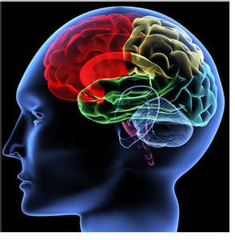
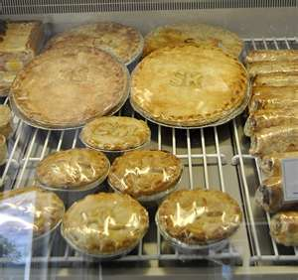
Plsyhiac health __________________________
Ililntentig health __________________________
Etnlaoimo health __________________________
Scliao health __________________________
Can you remember the different aspects of our health which can affect our self concept?
Unscramble the anagrams!

Slide 3


Write down 10 things you have done in the past 24 hours which could affect your physical health (long/short term)

Slide 4

Write down 10 things you have done in the past 24 hours which could affect your mental health (long/short term)

Slide 5
Circle the things which you believe affect your physical health
Balanced diet Exercise
Learning Sleep
Active lifestyle (hobbies etc.)
Being social (spending time with friends and family)

Slide 6
Circle the things which you believe affect your mental health
Balanced diet Exercise
Learning Sleep
Active lifestyle (hobbies etc.)
Being social (spending time with friends and family)

Slide 7
Is there a link between our physical and mental health?
What do you think? Write a paragraph to explain your thoughts

Slide 8

Balanced diet: Match up the following
Carbohydrate
Protein
Fat
Vitamins
Salts
Fibre
A) Gives us energy
B) Good ones keep us warm and give us good skin and hair
C) Are important for growth and development
D) Improves muscle health and strength
D) Helps to control our blood pressure but it can be bad for us if we have too much
E) Helps digestion

Slide 9
Why is a balanced diet important for both our physical and mental health?

Slide 10


Alcohol
Watch the following clips and fill in the table
http://www.youtube.com/watch?v=05EXvD4H38A&feature=related
https://www.youtube.com/watch?v=ZzxoLN25FAw

Slide 11
Alcohol
Effects on Physical Health
Effects on Mental Health

Slide 12


Drugs
This is a link to the BBC series ‘Drugs Map of Britain’
Watch at least 5 minutes of each episode.
Then complete the table.
https://www.bbc.co.uk/iplayer/episodes/p03nydkc/drugs-map-of-britain

Slide 13
Drugs
Effects on Physical Health
Effects on Mental Health

Slide 14

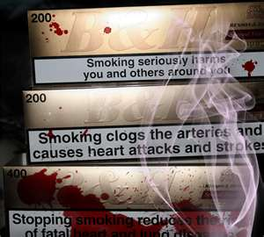
Tobacco
This is a link to the BBC series ‘Drugs Map of Britain’
Watch at least 5 minutes of each episode.
Then complete the table.
https://www.youtube.com/watch?v=eI2rXveqhBI
https://www.youtube.com/watch?v=UtXRlHaWAms

Slide 15
Tobacco
Effects on Physical Health
Effects on Mental Health

Slide 16
Fill in the next table.
You do not have to write the whole thing, just the number
You can use a number more than once
What is the difference between a long and short term effect on our health?
Being happy
Having more confidence
Terminal illnesses/fatal illnesses
Unhealthy skin/hair
Maintaining a healthy weight
Having healthy bones
Keeping your brain active
Depression
Stress
Poverty
Being fit
Having good personal relationships
Having bad personal relationships
Physical addiction
Paranoia
Mental health problems
Healthy hair/skin

Slide 17
Activity | Short term effect | Long term effect
Addictive substance abuse
Balanced diet
Regular exercise
Spending time with friends and family/Being active/hobbbies

