Slide 1
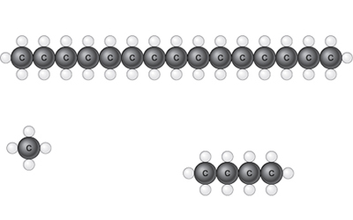
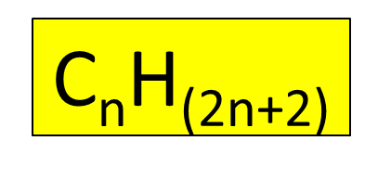
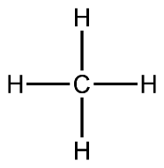
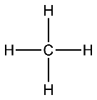
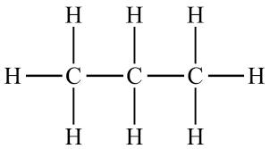
Crude oil is a mixture of different compounds, called hydrocarbons.
What do you think hydrocarbons contain?
Carbon can have 4 bonds
This hydrocarbon is carbon bonded to 4 hydrogen atoms.
It is called methane and has the formula CH₄
See if you can fill in the rest of the grid below to show alkanes
Name | Number of Carbon Atoms | Chemical Formula | Chemical Structure
Methane | 1 | CH₄
Ethane | 2
Propane | 3
Butane | 4 | C₄H₁₀

Slide 2
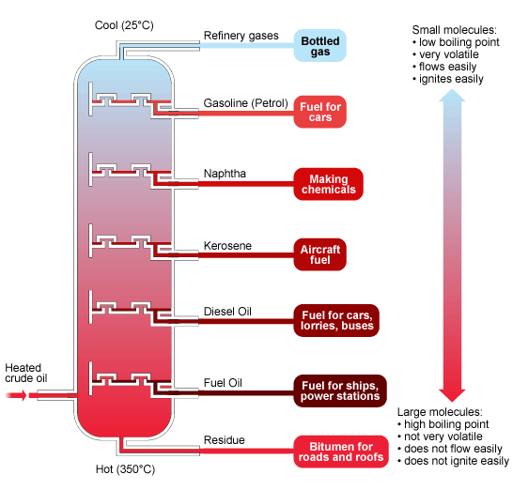
Alkanes are hydrocarbons with a single bond. They are found in crude oil. It is important to separate the different alkane so that they can be used for different uses.
Fractional distillation
The different hydrocarbons have different lengths.
This means that they have different boiling points.
Fractional distillation involves heating crude oil so that it evaporates. The bottom of the column is hotter than the top. Due to the oil condensing at different temperatures the oil ends up turning to a liquid at different heights and can be separated off

Slide 3
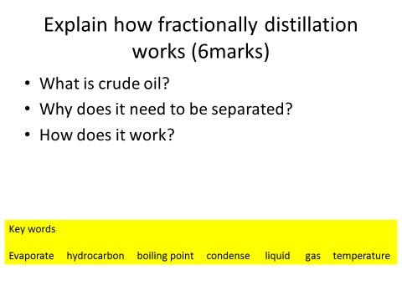

Slide 4
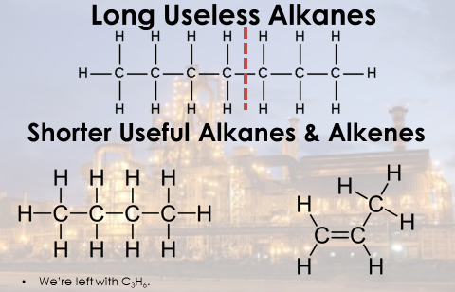
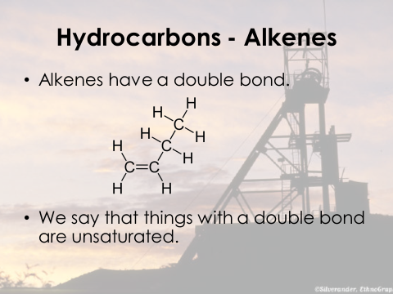
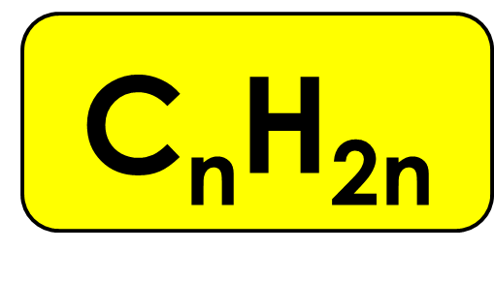
Cracking
Some long alkane chains which are not useful can be split into shorter alkenes. At alkene is a hydrocarbon with a double bond. This process is called cracking
http://www.bbc.co.uk/schools/gcsebitesize/science/aqa_pre_2011/oils/polymersrev1.shtml
See link for animation of how this happens
General formula

Slide 5
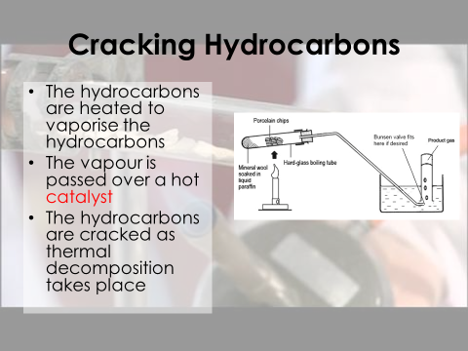
Complete the table below to show alkenes
Number of Carbon Atoms | Name of Alkene | Chemical Formula
2 | Ethene | C₂H₄
3 |  | C₃H₆
4 |  | C₄H₈
5 | Pentene
6 | Hexene

Slide 6
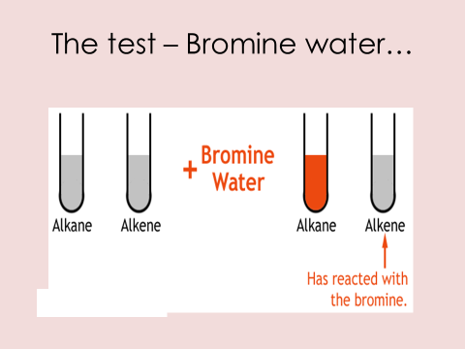
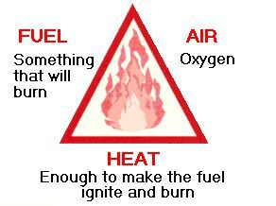
To test for an alkene add bromine water (orange/brown) and it will decolourise the bromine water
What is needed for combustion?

Slide 7
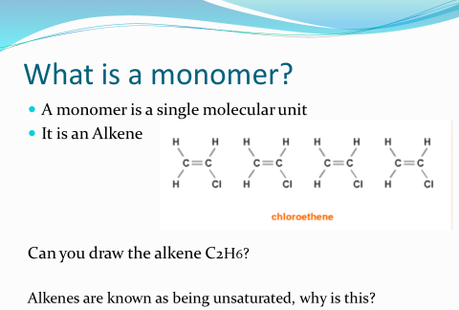
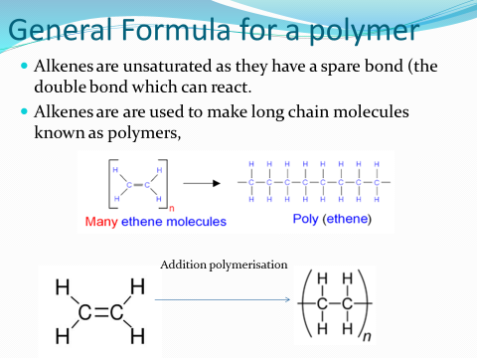
http://www.bbc.co.uk/schools/gcsebitesize/science/ocr_gateway/carbon_chemistry/making_polymersrev3.shtml

Slide 8
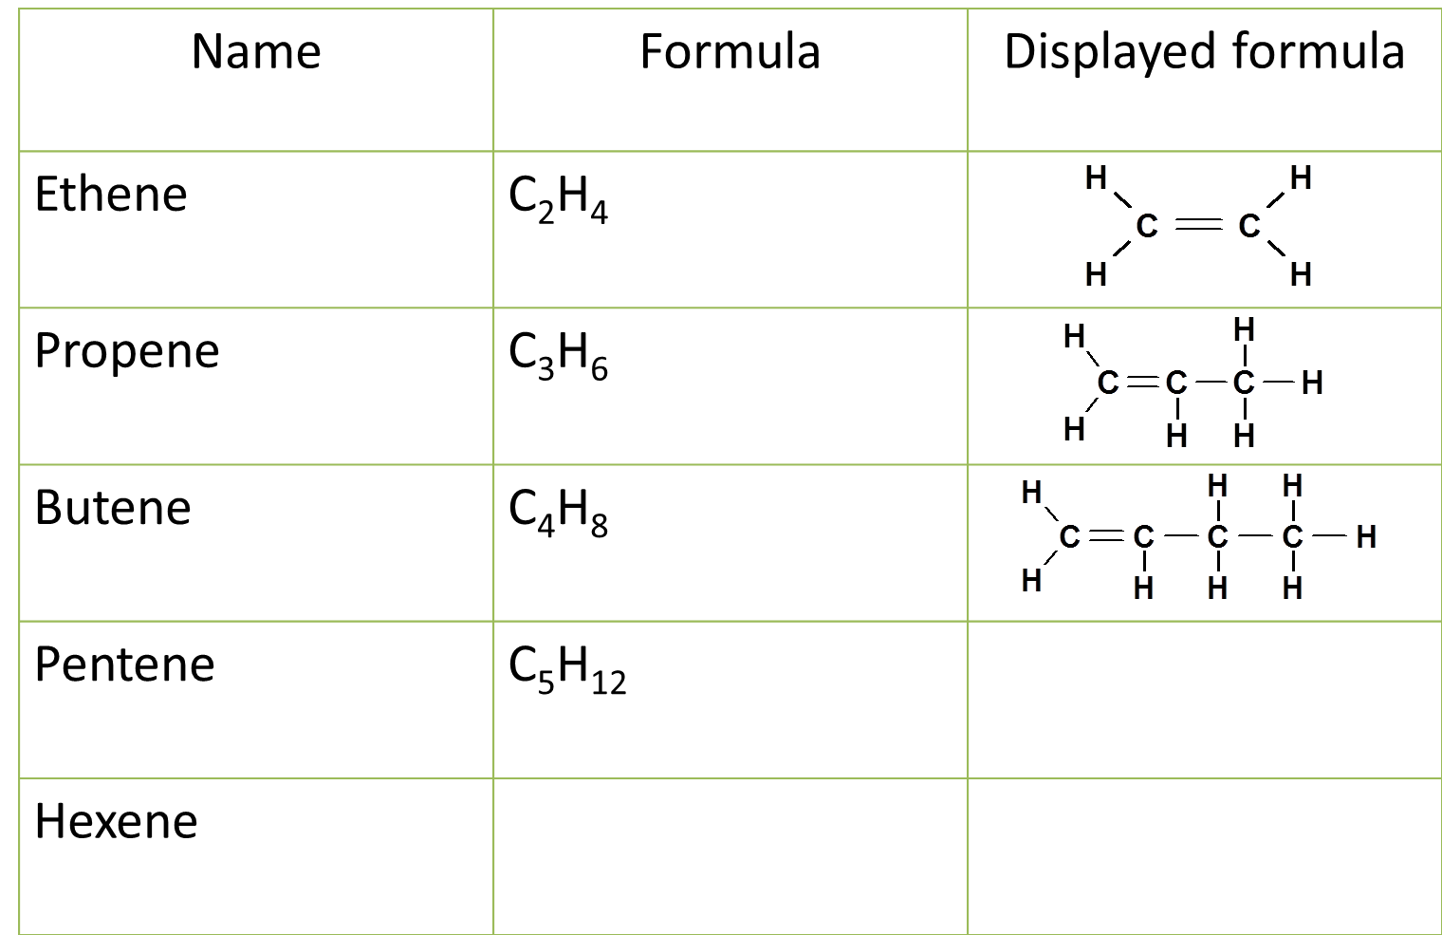
Hydrocarbons
Oil is made up of hydrocarbons chains of hydrogen and hydrogen. Complete the table

Slide 9
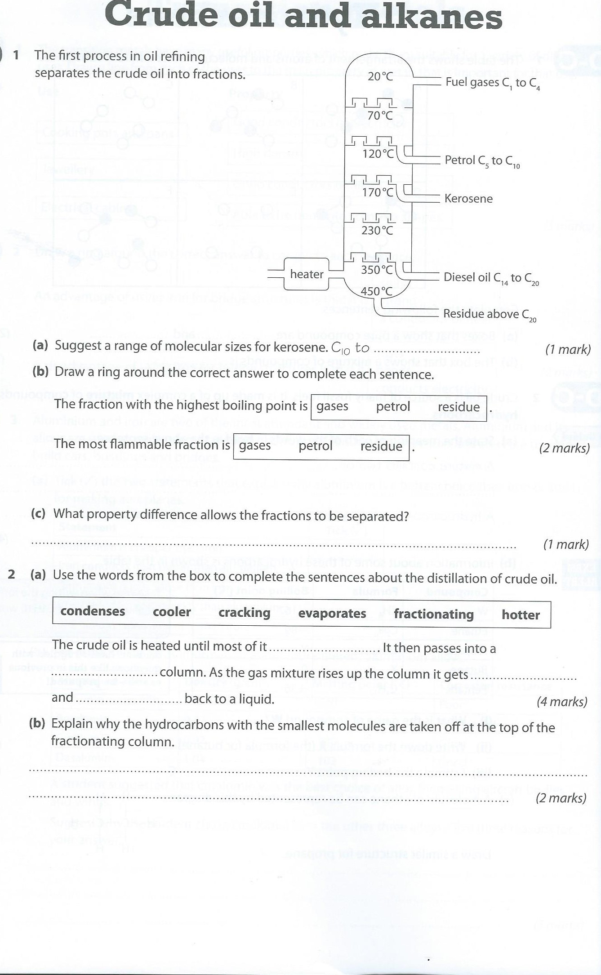
Use text boxes to fill in the answers

Slide 10
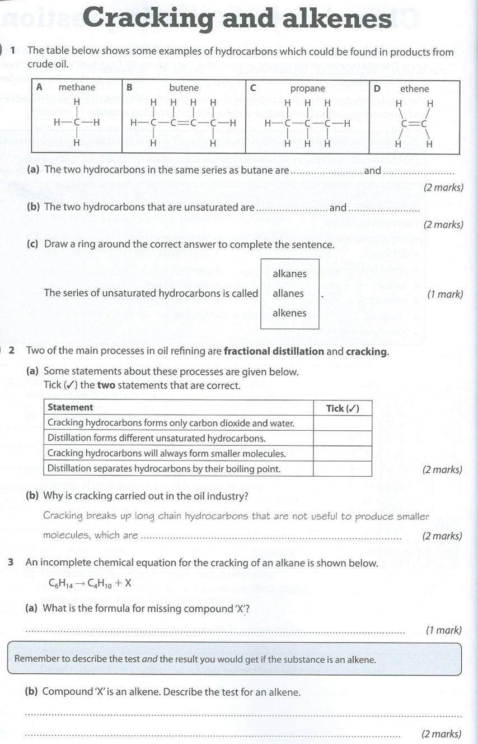

Slide 11
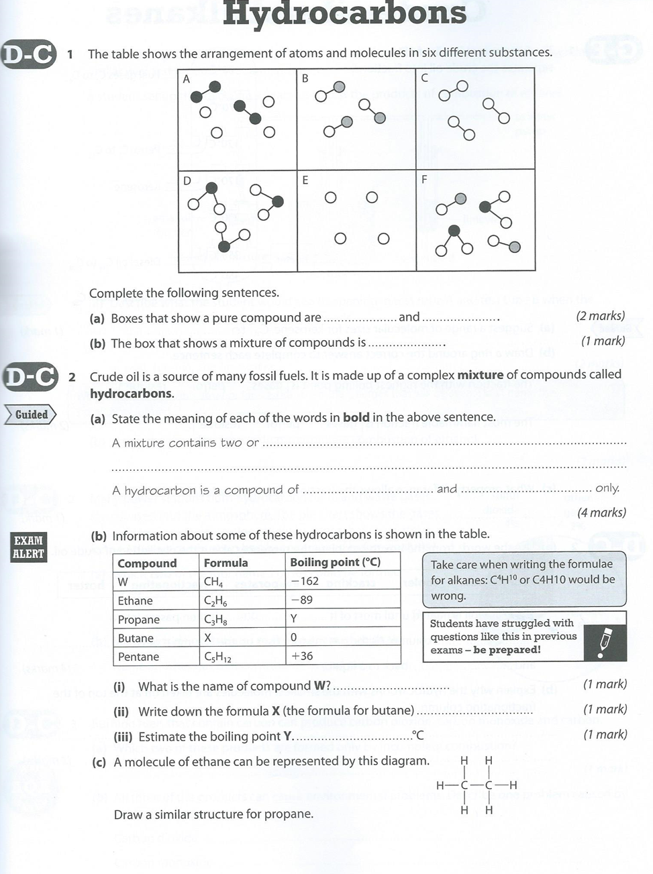

Slide 12
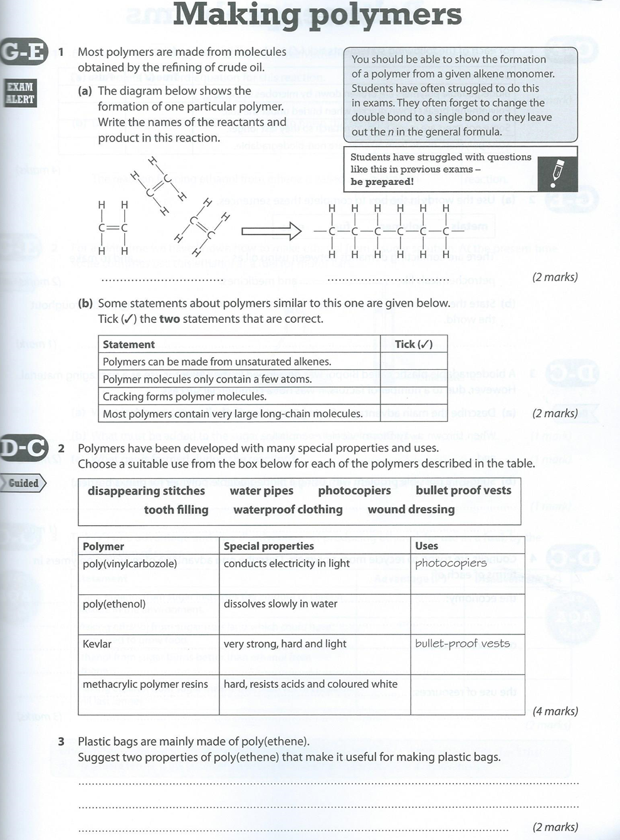

Slide 13
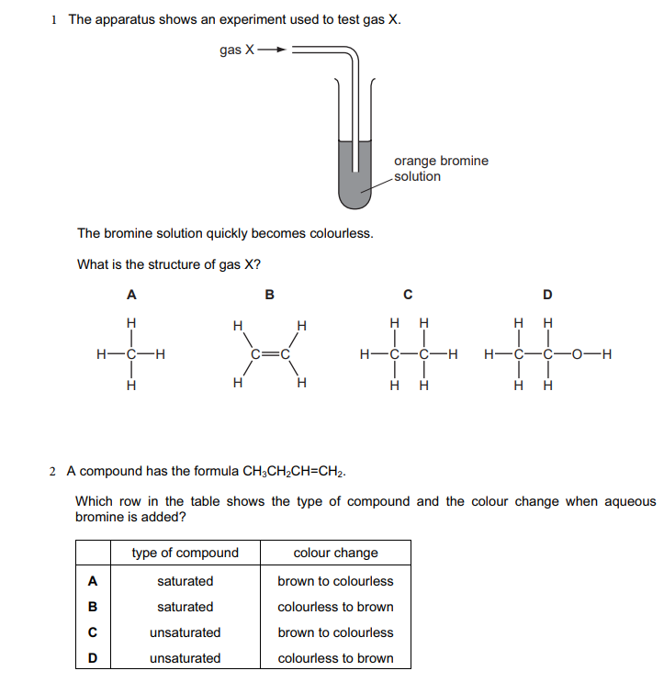

Slide 14


