Slide 1
Science work pack
Either print and write on sheets or type your answers onto the document

Slide 2
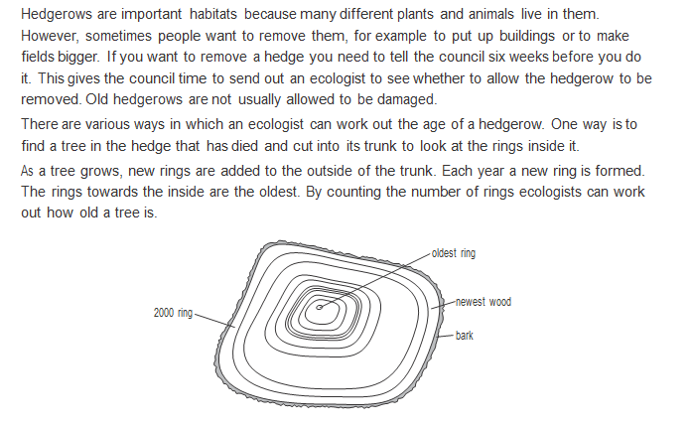
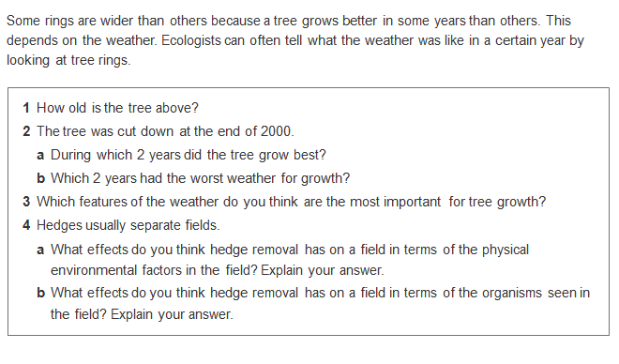

Slide 3
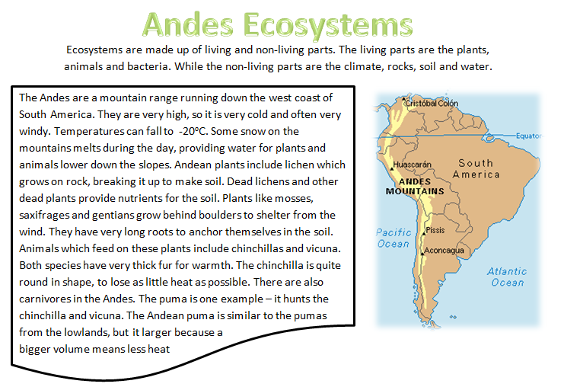
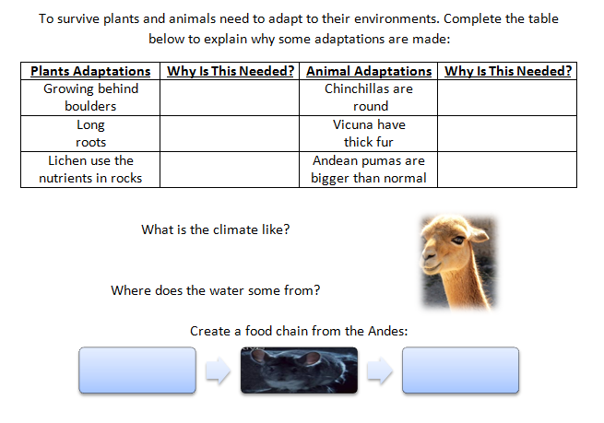
To………………………………..
……………………………………..
To………………………………..
……………………………………..
To………………………………..
……………………………………..
To………………………………..
……………………………………..
To………………………………..
……………………………………..
To………………………………..
……………………………………..
_ _ _ _ _ _
_ _ _ _

Slide 4
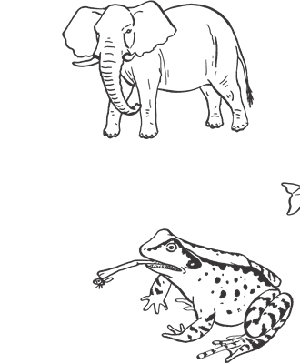
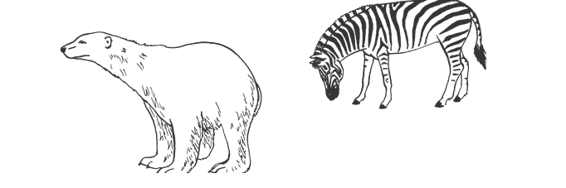
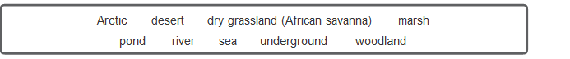
For each animal state what habitat it lives in and what adaptations it has to live in that habitat.
Habitat- _________________
Adaptations- _____________
________________________
Habitat- _________________
Adaptations- _____________
________________________
Habitat- _________________
Adaptations- _____________
________________________
Habitat- _________________
Adaptations- _____________
________________________

Slide 5
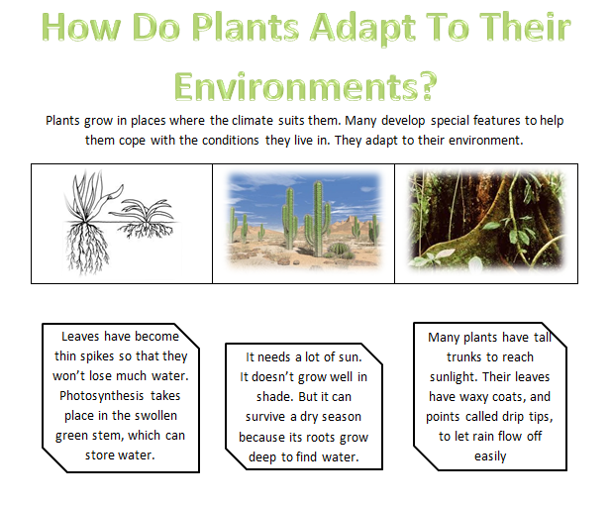
Draw a line to match the plant pictures.
Which plants grow in the wettest area?
___________________________________________________
What helps them cope with the rain?
____________________________________________________
Which area is the driest? ____________________________________________________
How have plants adapted so they can grow here? ________________________________________________________________________________________________________

Slide 6
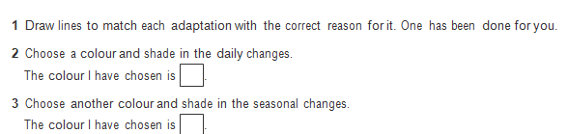
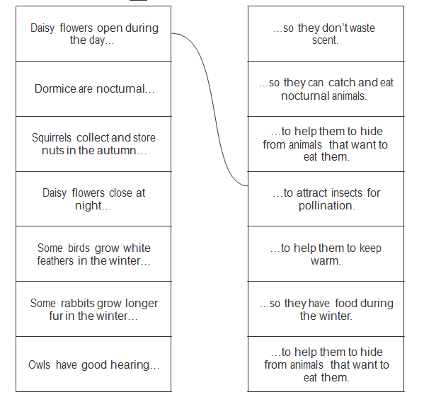

Slide 7
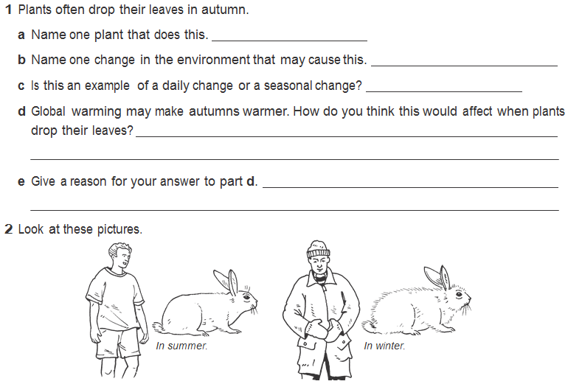
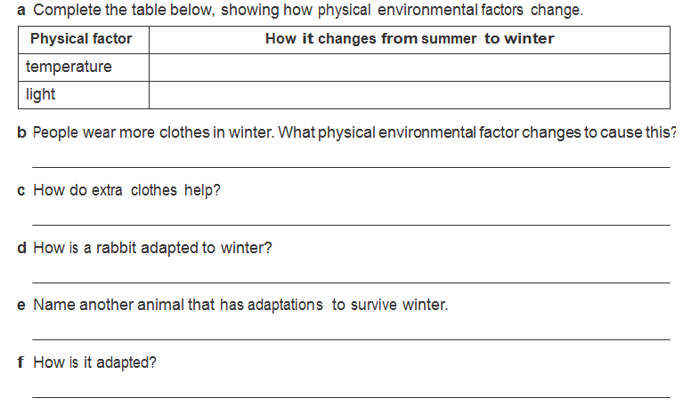

Slide 8
  The table shows some physical environmental factors that change. Tick the correct columns to show whether these factors change daily, or only change with the seasons (some factors may have ticks in both columns). Fill in the last column to show how humans behave to cope with these changes.
  The first one has been done for you.
Change | Daily change | Seasonal change | An example of how humans adapt to cope with the change
Length of daylight |  | / | Human use lights in the evening
Temperature outside
Amount of rain
Amount of snow
Wind
Height of tide

Slide 9
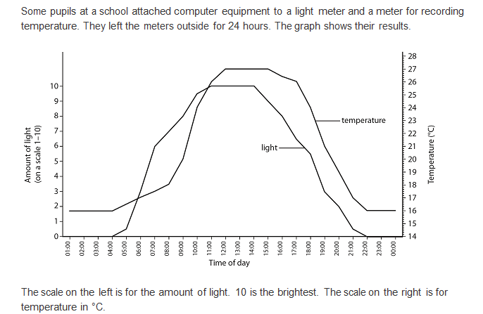
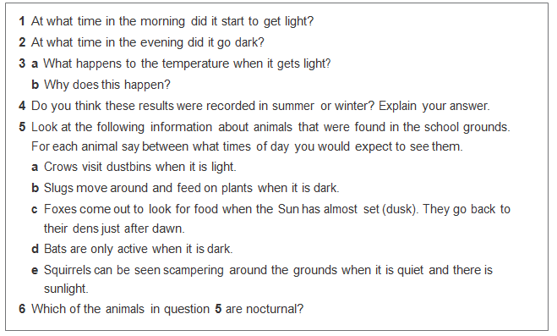

Slide 10
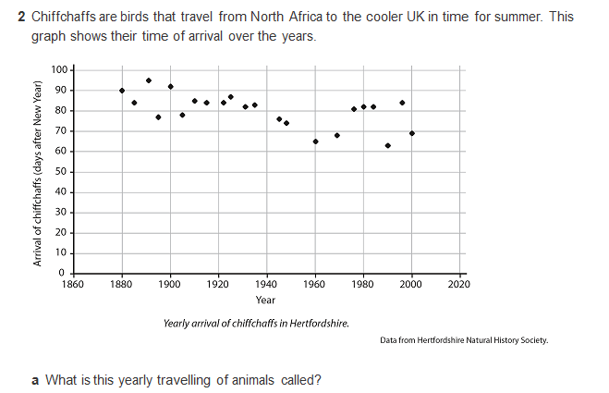
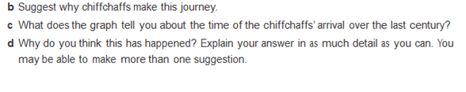


Slide 11
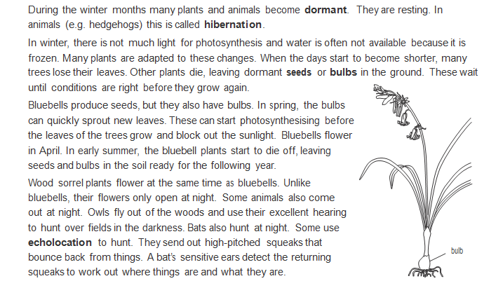
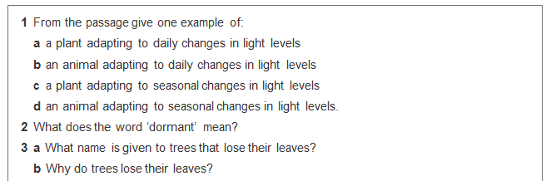

Slide 12
4a. Draw a diagram to show a bluebell in April, July and December. Show what happens above and below ground
b. Why does a bluebell produce leaves and flowers so early in the year?
………………………………………………………………………………………………………………………………….
………………………………………………………………………………………………………………………………….
………………………………………………………………………………………………………………………………….
c. Why do bluebells produce leaves during winter?
………………………………………………………………………………………………………………………………….
………………………………………………………………………………………………………………………………….
5a. When do wood sorrel have flowers?
………………………………………………………………………………………………………………………………….
b. Why do their flowers only open at night?
………………………………………………………………………………………………………………………………….
6a. What name is given to animals that are active at night?
………………………………………………………………………………………………………………………………….
b. Give an example of this sort of animal and explain how it is adapted to hunting at night.
………………………………………………………………………………………………………………………………….
………………………………………………………………………………………………………………………………….
………………………………………………………………………………………………………………………………….

Slide 13
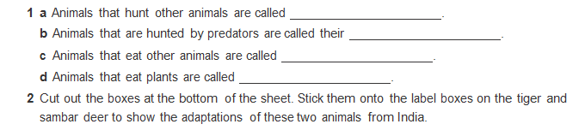
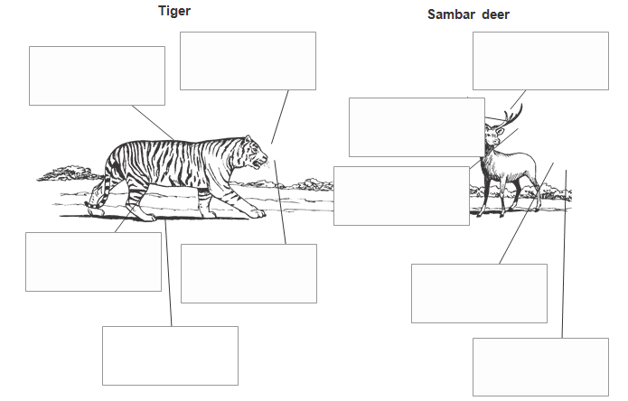
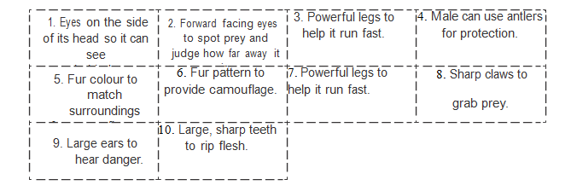
Match the numbers with the correct box

Slide 14
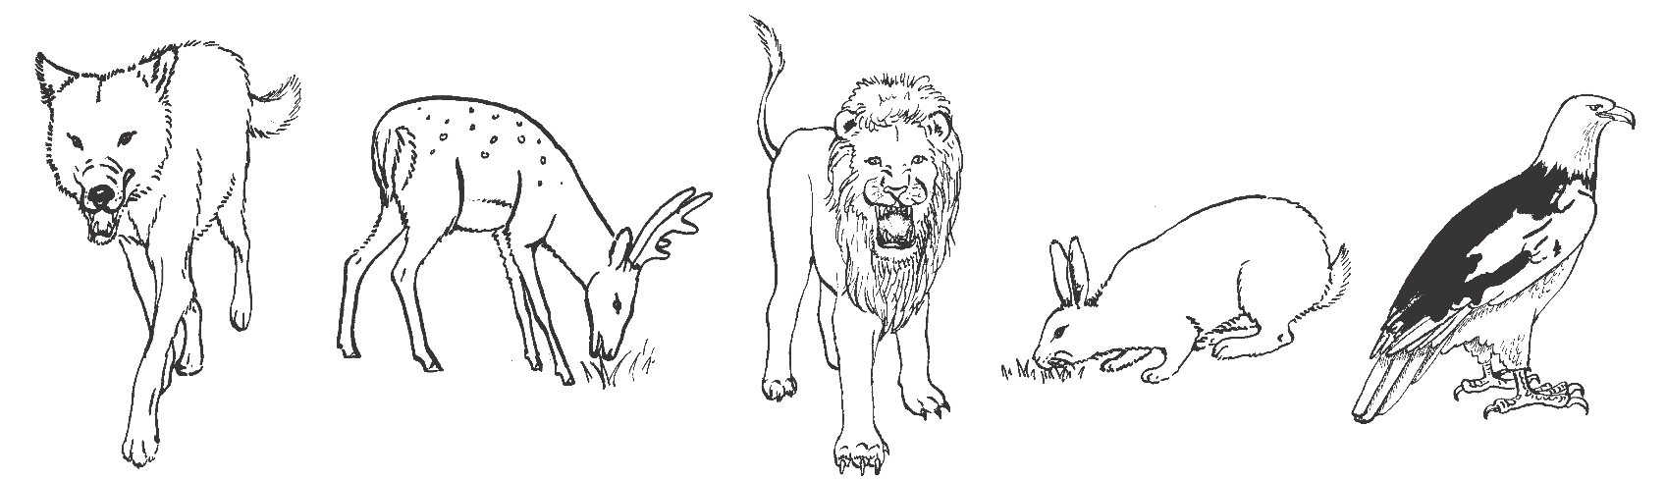
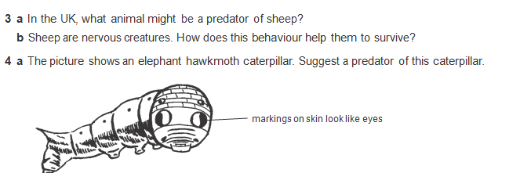
Predator or prey?
Adaptation to avoid being eaten or to catch prey
b. Suggest how thus caterpillar avoids being eaten

Slide 15
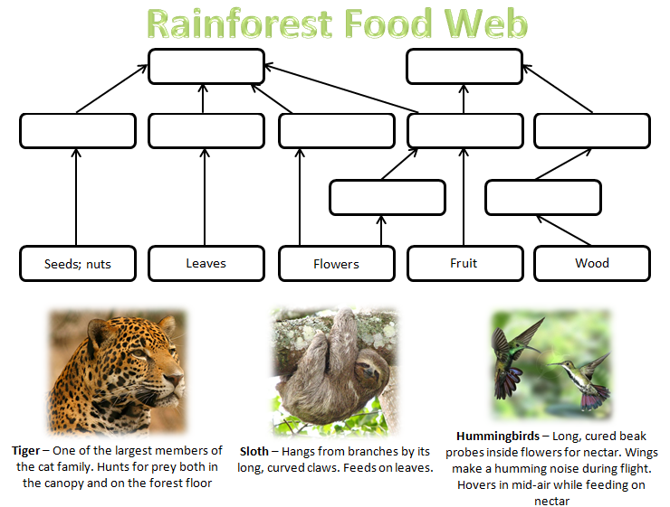
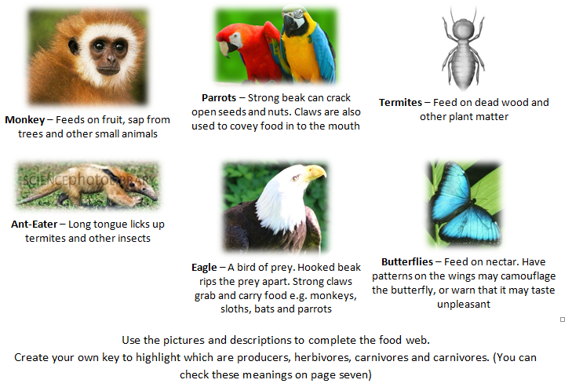

Slide 16
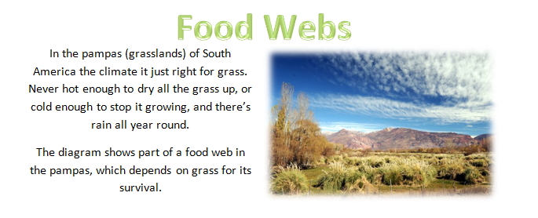
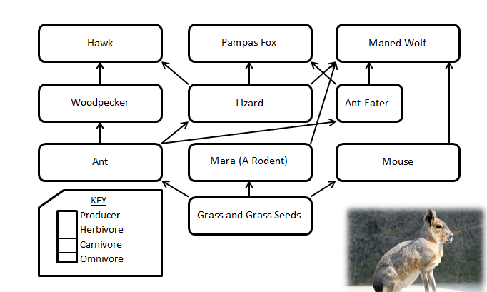
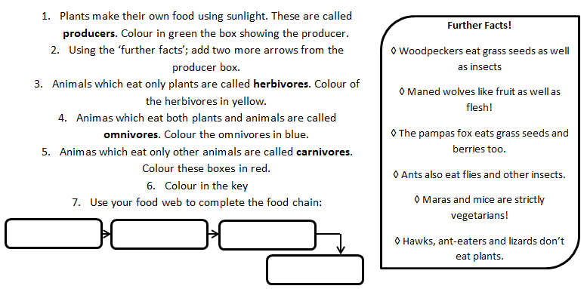

Slide 17
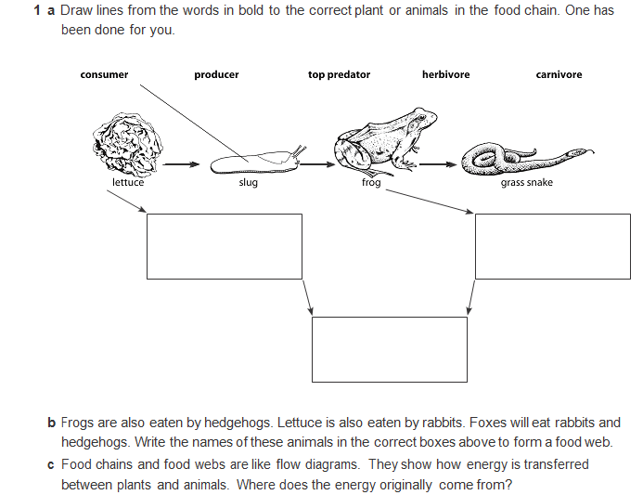
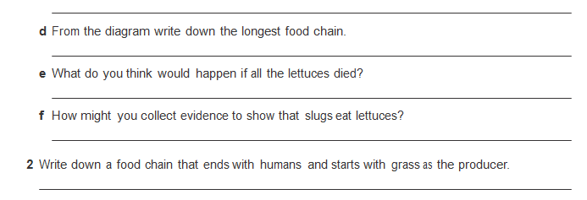

Slide 18
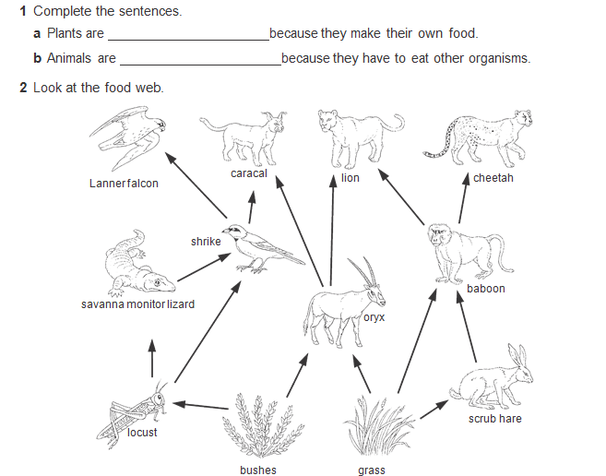
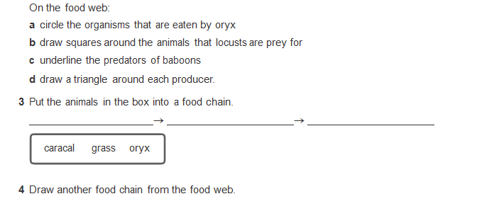

Slide 19
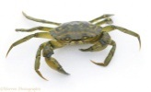




Assessment task
An ecologist has been studying a rock pool for a week. Notes were taken as shown below.
Organism | What they eat
Shore crab | Green seaweed, shrimp, small fish, whelks
Sea anemone | Plant plankton, animal plankton
Small fish | Shrimp, sea anemone, whelks
Seagulls | Small fish, crabs
Whelks | Green seaweed
Draw a food web and label the food web using the keywords
Keywords: Carnivore, herbivore, predator, consumer, prey, producer

Slide 20
What changes might happen daily in the rock pool? __________________________________
____________________________________________________________________________
____________________________________________________________________________
What changes might happen throughout the year to the habitat?_______________________
____________________________________________________________________________
____________________________________________________________________________
What are the predators in this food web and what adaptations do they have?
____________________________________________________________________________________________________________________________________________________________________________________________________________________________________________________________________________________________________________________
What are the producers in the food chain and what adaptations do they have ?
____________________________________________________________________________________________________________________________________________________________________________________________________________________________________________________________________________________________________________________
What are the prey in the food chain and what adaptations do they have?
____________________________________________________________________________________________________________________________________________________________________________________________________________________________________________________________________________________________________________________
emerging | Linked some animals and plants together to show what they eat. Stated why 2 animals are suited to living there
developing | Drawn 2 food chains with 3-4 links Identified a producer, predator and prey Describe a seasonal or daily change
Secure/martered | Drawn a simple food web that links at least 3 food chains Used the keywords to describe how plants and animals get their food (producer, primary consumer, carnivore) Describe at least one adaptation that helps a predator and prey to survive Describe a daily and seasonal change that affects the habitat.
What level would you give your work?
What was good about your work?
What could you do to improve next time?

Slide 21
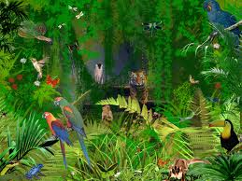
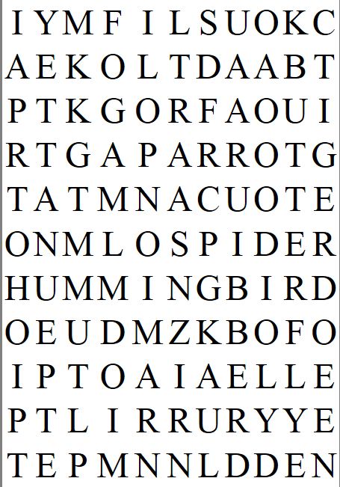
Jungle Wordsearch
Some of the things hidden in the picture above are also hidden in the wordsearch below…you have been given the first letter of each word to help you:
B­­________________
F________
H____________________
L__________
M__________
P__________
S________
S__________
S__________
T________
T______
T__________

Slide 22
Keywords
Adaptation | A change in an organism that makes it better suited to it’s environment
Community | A group of organisms which live in an area
Consumer | An organism which feeds on another organism
Ecosystem | The living and non-living things in an area (animals, plants, rocks, weather)
Environment | The non-living factors in an area such as the weather
Habitat | The place where organisms live
Organism | A living thing such as a plant or animal
Primary consumer | An organism which eats a producer
Predator | An animal which eats other animals
prey | Something which is killer by a predator
producer | A plant which produces food for organisms
Secondary consumer | An organism which is third in the food chain

