Slide 1
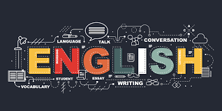
English Home Learning
Booklet
Name:…………………………………………………………………………..
Teacher:………………………………………………………………………

Slide 2
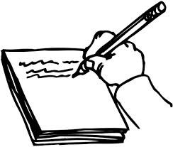
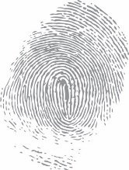
Section two: Simple sentences
Spelling list 2
Complete New words beginning with C and D
Read section on Simple sentences
Complete both tasks on Simple sentences
Read section on Nouns
Complete tasks on Nouns
Complete task on Pronouns
Read and complete section on Verbs
Read the extract The Storm
Answer the questions to The Storm in full
Self Assessment: What do I still need to practise from this section?

Slide 3
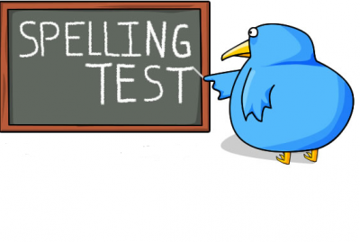
Spelling test 2
You will be tested on your spellings in every
literacy lesson.
You are expected to get at least 17/20 right each time. If you do not manage this you will need to re-take the test at another time.
 | Read | Write | Cover and write
Connective | Consequently
 | Therefore
 | Although
 | Moreover
 | However
Commonly misspelt words | Amateur
 | Apparent
 | Argument
 | Because
 | Believe
English subject words | Analysis
 | Connective
 | Adjectives
 | Compare
 | Genre

Slide 4
Letter
Word
C
Definition
Sentence (using your word):
Synonyms
Antonyms
Letter
Word
D
Definition
Sentence (using your word):
Synonyms
Antonyms

Slide 5
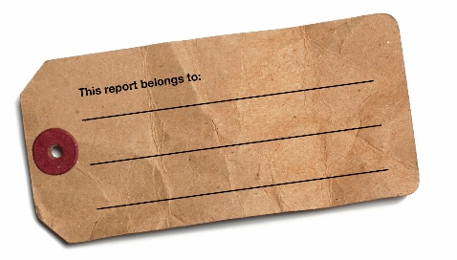



Simple Sentences
In a simple sentence you only need one main clause – a clause is a group of words that may be used as a whole sentence, or as part of a sentence.
You will need the following elements to make up the sentence:
A capital letter at the beginning
A full stop at the end
Must contain a subject (noun)
Must contain a verb
Subject (noun)
Verb
Capital letter
Full stop.
The prince smiled.
Task
In these sentences underline the subject and circle the verb.
The pop singer played a guitar.
The angry dog barked loudly.
The sheep grazed on the hillside.
My favourite football team won the cup.
Submarines travel underwater.
Subject (noun)
Who or what the sentence is about.
Gold target: Can you create 5 simple sentences?
Verb
A doing word or a being word.
Marked by: Date:
TS:

Slide 6


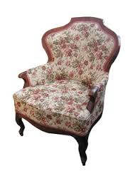


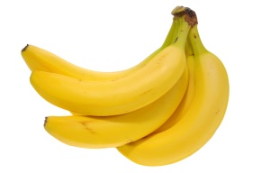
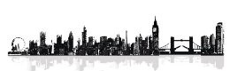
A common noun is a general name of a person or object.
e.g. A boy went into the library to borrow a book.
Abstract nouns are something you can’t see, feel, hear, smell or touch.
e.g. The misery of the withering armchair.
Common nouns
Abstract nouns
What type of noun?
Collective nouns
Proper nouns
A collective noun is the name of a group of people or things.
e.g. a collection of bananas.
A proper noun is the particular / precise name for a person, place or thing.
e.g. Mrs Jones walked across Tower Bridge in London.

Slide 7
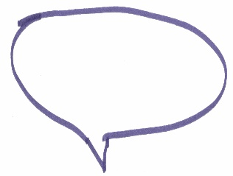
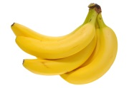
Task
Can you put all the nouns in the correct boxes?
window
shoe
iPhone
armchair
Mr Jones
cloud
hatred
A babel of words
Jamaica
book
honesty
Common noun
beauty
Abstract
nouns
rain
grace
patience
London
Swanley
banana
A herd of sheep
infinite
Collective
nouns
Proper nouns
Jenny
sadness
chicken pie
tears
popcorn
Asda
Harry Potter
misery
box
hope
Marked by: Date:
TS:

Slide 8
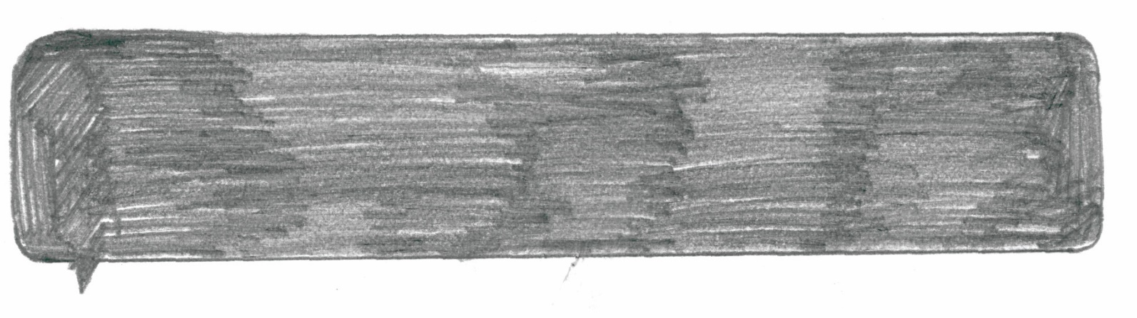
There is one more type of noun that we haven’t looked at – pronoun. A pronoun is used to replace one of the other nouns. For example, James is the first choice for the job. He has applied for it twice.
The most common pronouns
it | I
you | he
They | we
she | who
them | me
him | one
her | us
something | nothing
anything | himself
everything | someone
themselves | everyone
itself | anyone
myself | herself
Task: You are attending an Easter Egg hunt. Write a diary
account about the events of the day. Think about different
types of nouns we have studied.
Marked by: Date:
TS:

Slide 9

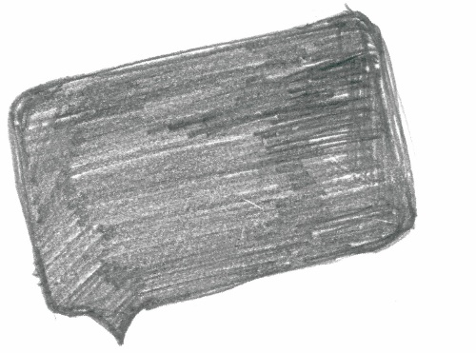
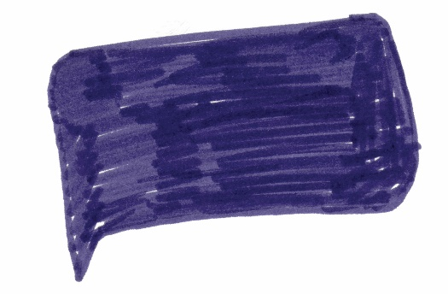
Verbs
There are three types of verb that we are going to be looking at, by using more than one in a sentence you will be able to extend your writing and express your ideas more clearly.
Modal verb + Auxiliary + Main verb = verb phrase
We use a modal verb to show if we believe something is certain or possible.
We can also use them when asking permission or making offers / requests.
The auxiliary verb helps the main verb out and always comes before.
The most common are Be, Do and Have.
The main verb is often described as the ‘doing’ word.
The main verb can be present (are, like) or past tense (saw, laughed).
Examples
We are here. | I like it. | Everybody saw the accident.
We laughed. | Everybody is watching. | Everybody has worked hard.
Everybody has been working hard. | They will come. | He might have arrived.
Task 1: Identify the main, auxiliary and modal verbs in the opening of the story.
“There must be a way to get out” screamed Donna. Everybody stood silent, looking at the floor. We were trapped.
Task 2: Write the next paragraph of the story and identify all the different verbs you use.
Marked by: Date:
TS:

Slide 10
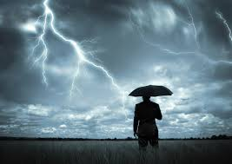
Read the text carefully and answer the questions below in full sentences.
The Storm
“Crack-crack…kowowww! Thunder, and then a shock of lightening etched its reflection upon the corrugated metal siding,” Rowan read aloud.
She worked to read clearly, with depth and emotion. Her eyes scanned the next paragraph. She took a breath to continue, but was interrupted by her younger brother Nolan, stretched out on the living room couch, flicking a pencil against his forehead.
“I was never a big fan of onomatopoeia,” Nolan said, in his usual, supercilious manner. “It is impossible to write words that truly sound like a thunderstorm, a jar opening, or a falling tree, yes? But please, do continue.”
Rowan sucked her teeth. “That’s why I can’t stand doing this in front of you, Nolli. You are no help at all. Haven’t you something better to do?”
“Ha! Better than to annoy you before your moment of reckoning? I don’t think so.” Nolan's enjoyment of getting under his big sister’s skin was fully conspicuous.
“Nolli, please keep quiet!” Mother Ann broke in. “This is important. Rowan presents in less than an hour. She needs to focus. Row, sweetheart, please continue.”
Mother Ann's comments seemed to assuage Rowan’s irritation. She cleared her throat and continued where she had left off. “Farmer John knew this was a storm of epic proportion. Even the cows retreated to their hutches. Not one person in the…”
“The cows retreated? The cows retreated?” Nolan chortled upon hearing the repetition of this line in his own voice. “That’s great. Even the stupid cows retreated! Oh, man. That must have been one heck of a storm-a-brewin’. Mama, I’m scared!” Nolan howled at the ceiling and curled up into a tight little ball of laughter.

Slide 11
“Nolli!” Mother Ann shouted suddenly, her thunderous voice tantamount to the rumbling storm Rowan was attempting to capture in her reading. Nolan gave a little start. "You have no idea how difficult it is to speak in front of a crowd. Your sister has been preparing for this presentation for weeks and I swear if you don't..."
Mother Ann continued to castigate Nolan most thoroughly, scolding him for his rudeness and lack of respect. Then, feeling as though she had achieved the intended effect, she sighed rather contentedly and reclined in her chair. Sometimes she reminded even herself the fury by which, if completely necessary, she could quell any quarrel.
Nolan had fallen silent and was now sitting upright, his hands folded before him.
He actually appeared a bit remorseful.
“Oh, Mother,” Rowan sighed, crumpling to the floor, despondent . “It’s no use.
‘The Storm’ shall be the end of me.”
“Ahh, but Rowan, my dear,” Mother rejoined. “This is but a mere shower!”
Questions:
Questions
As used in paragraph 3, what is the definition of onomatopoeia?
Find an example of onomatopoeia in the text.
Why does Rowan get upset with Nolan?
As used in paragraph 3, what is the definition of supercilious?
What does this tell us about the character of Nolan?
In the middle of the story, the author writes, "Mother Ann's comments seemed to assuage Rowan’s irritation." How could you re-write this sentence keeping the same meaning?
Write a minimum of five sentences explaining what we know about the character Mother Ann and how we know this.
Gold target: Highlight 2 examples of each type of noun we have looked at in this section.
Choose one of your highlighted abstract nouns and explain why it makes the sentence more interesting.

Slide 12
Answer your questions in detail here:

