Slide 1
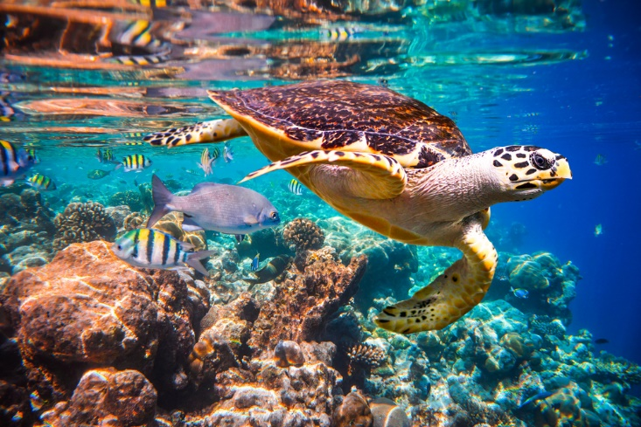
Science work pack
*Week 2
If you are stuck try using https://www.bbc.co.uk/bitesize/subjects/zng4d2p
for help
There is online learning available at:
app.senecalearning.com/dashboard/join-class/4ggjlziov1
You need to sign up using an email address. When asked to type in the school it is St Matthias academy. This should take you to straight to the learning page, if you are asked for a class code it is: 4ggjlziov1. There are tutorials and then questions.
Please work on the assignments and I can see what has been completed and how well you are doing.
Miss Grant

Slide 2
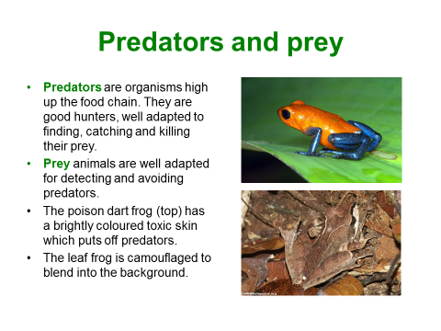
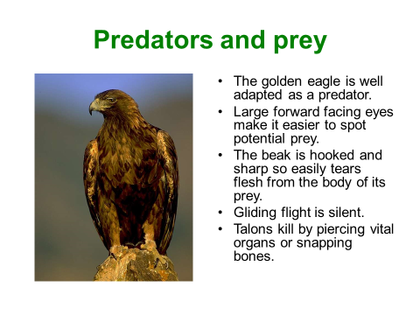

Slide 3
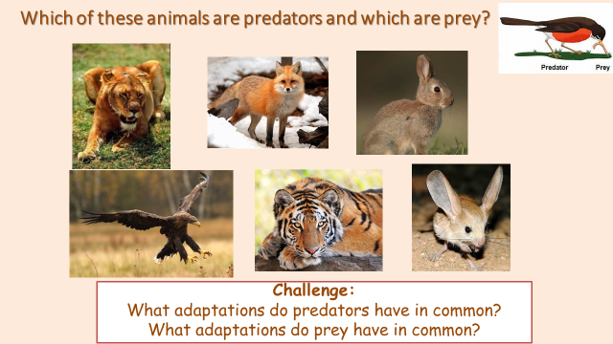
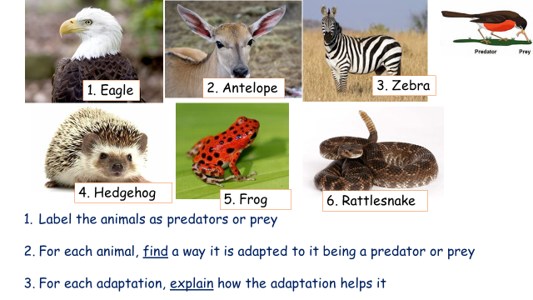
Animal | Adaptation | Explanation of how the adaptation help it

Slide 4
Choose either a predator or prey.
You must draw and label your animal:
Label:
Diagram with features
Details of how the features work
Explain how the features help the animal to survive

Slide 5
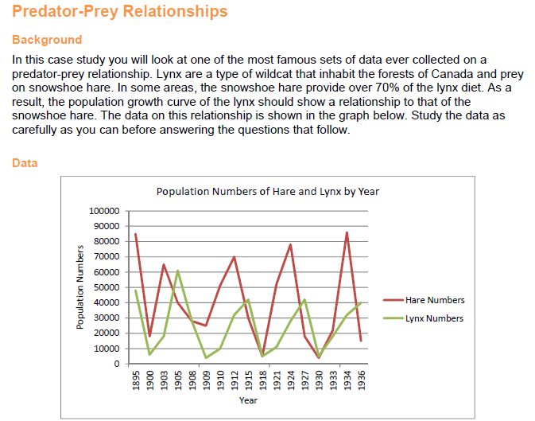
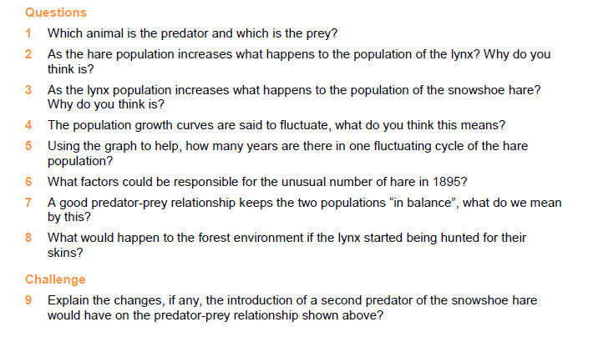

Slide 6
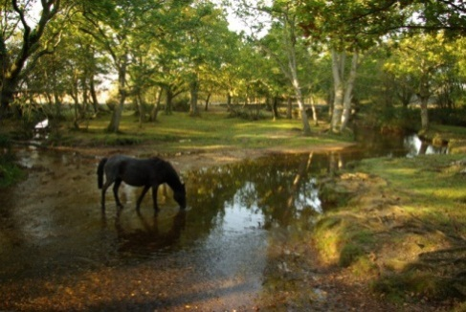
If people use an ecosystem without damaging it then what they are doing is ____________________.
Ecosystems
Use the words below to complete the sentences
HINT: Cross through the word when you have used it
A F____ W is a diagram that shows how animals and plants are linked by eating.
When a species dies out it is e________________.
A p_________________ is an animal which eats other animals.
In England there is a famous National Park called The New F___________, where wild ponies are part of the ecosystem.
The scientific name for a type of plant or animals is s_____________.
E____________________ includes sunshine, rain and wind.
In a r__________________ there are lots of trees growing.
A plant makes its own food, so it is called a p_________________.
An e__________________ can be any size. It could be as small as a pond or as big as a rainforest.
A really dry place is called a d_________________.
Something that breaks down dead materials is called a d________________.
Everything around us is our e___________________.
Things which grow in the soil and make their own food are called p__________________.
A h__________________ is an animals which only eats plants.

Slide 7
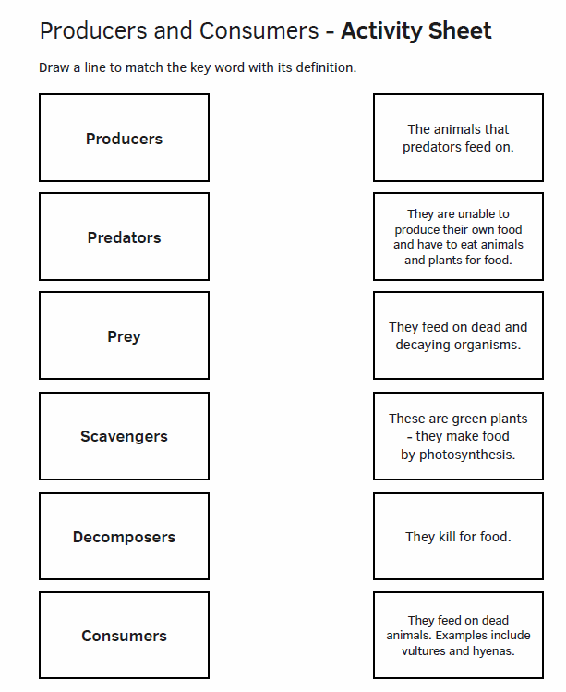

Slide 8
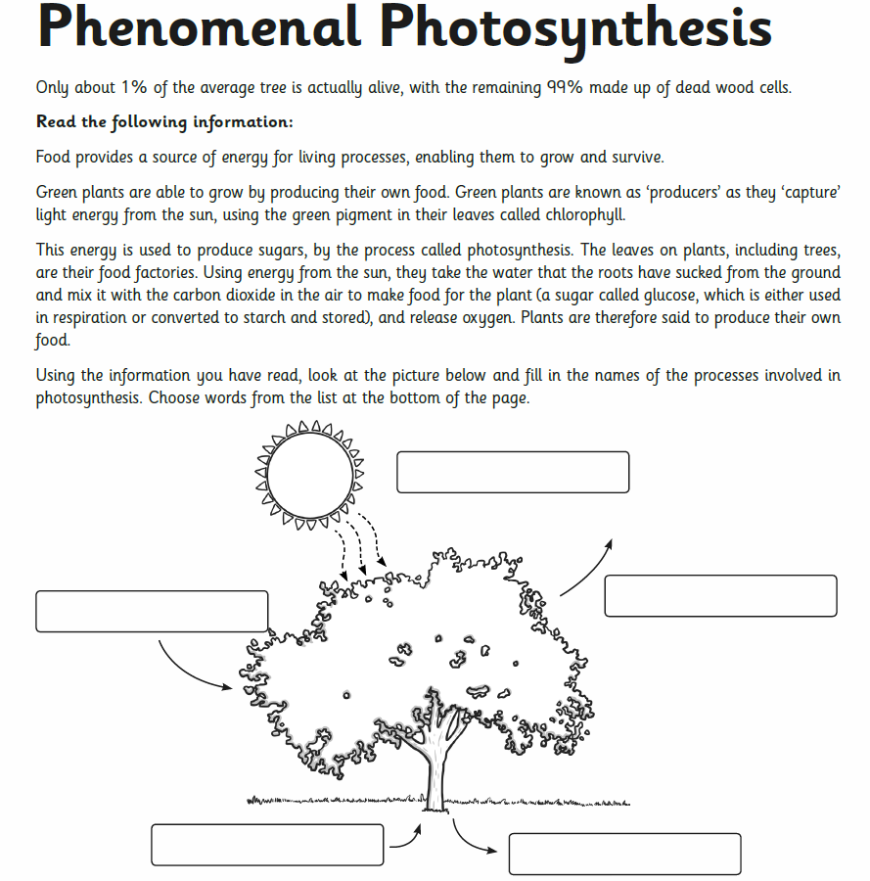

Slide 9
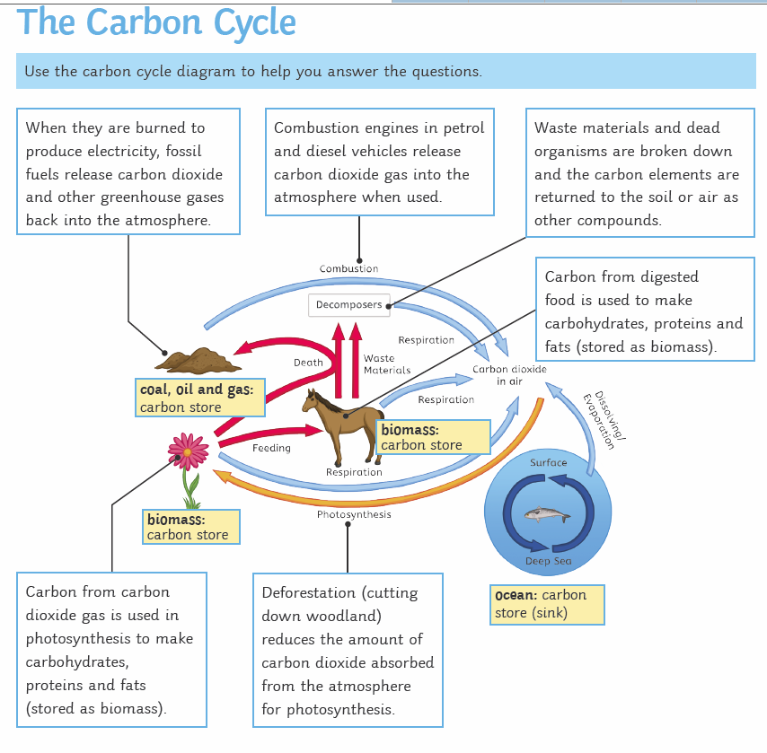

Slide 10
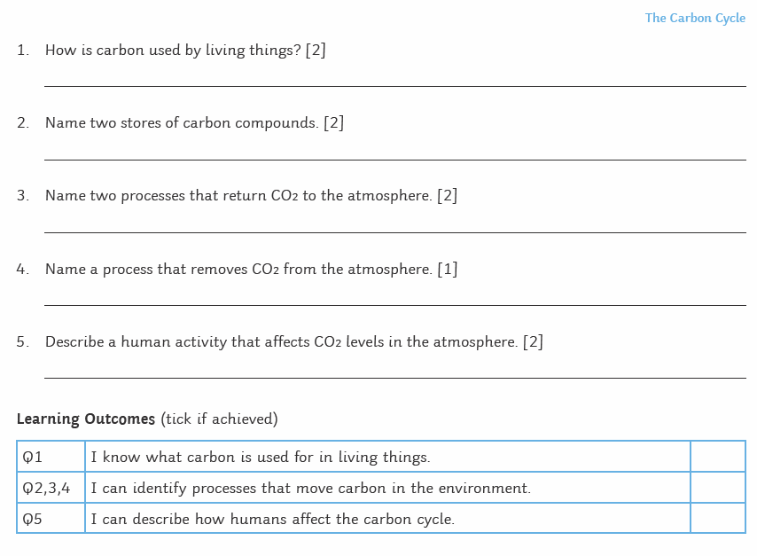

Slide 11
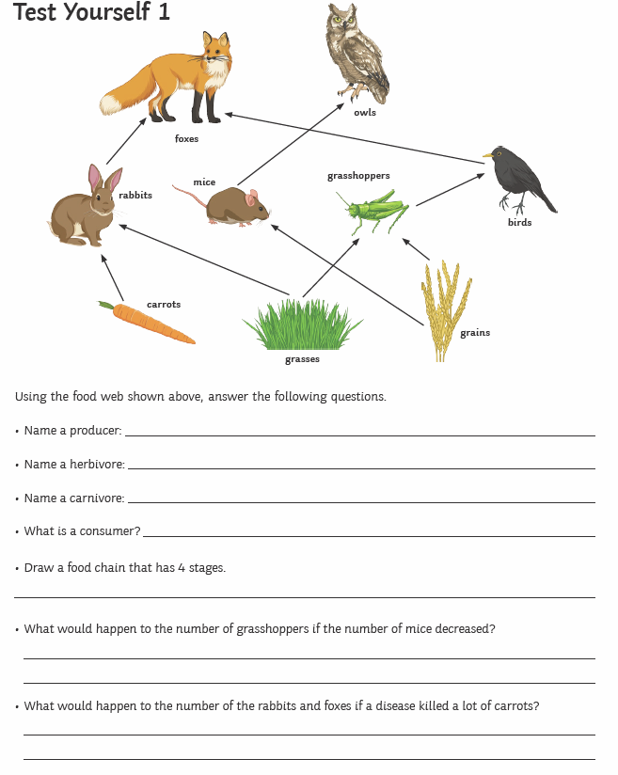

Slide 12
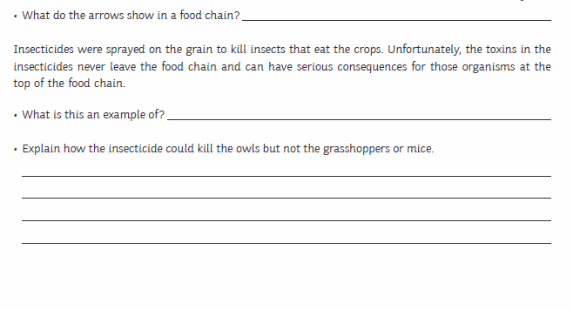
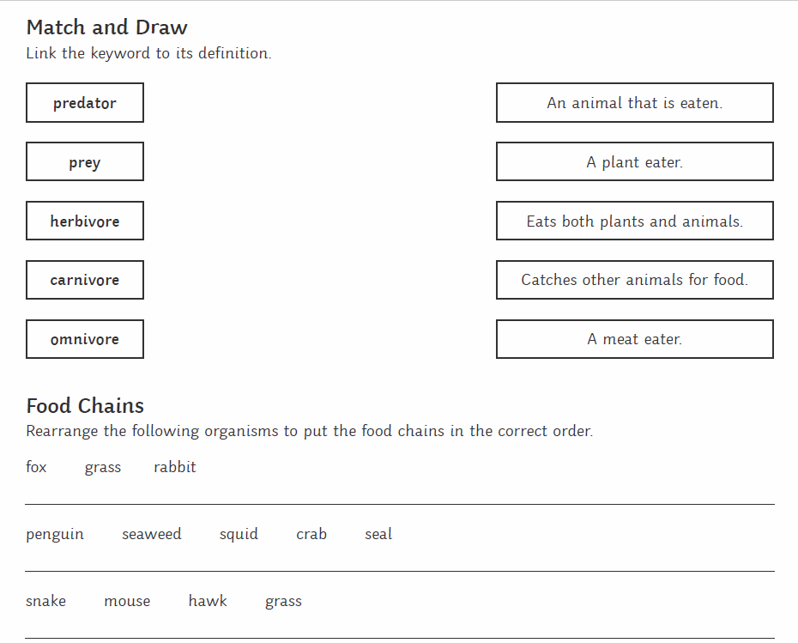

Slide 13
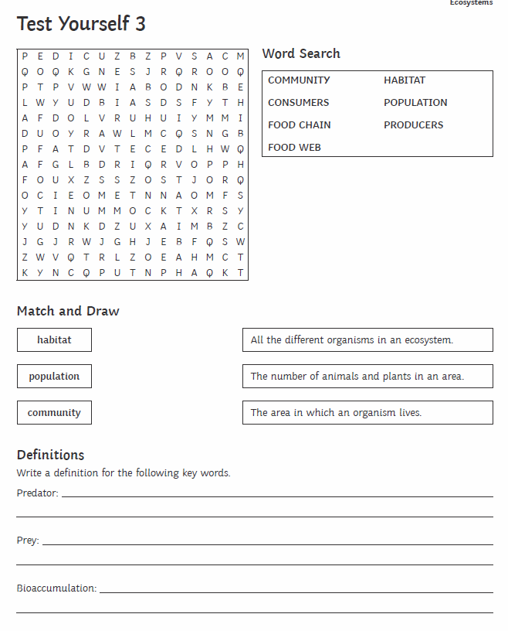

Slide 14
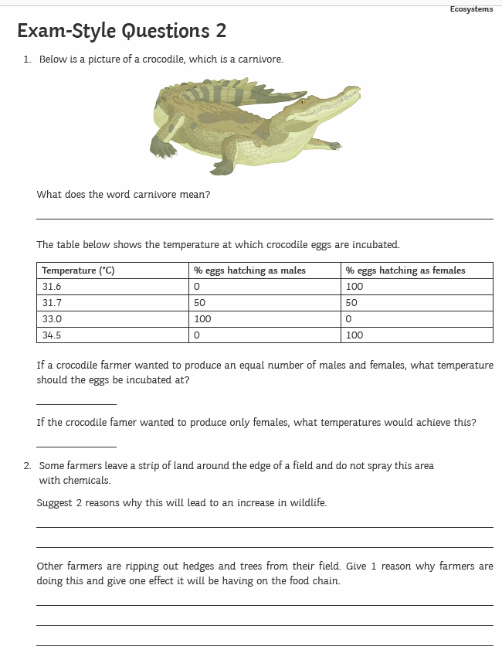

Slide 15
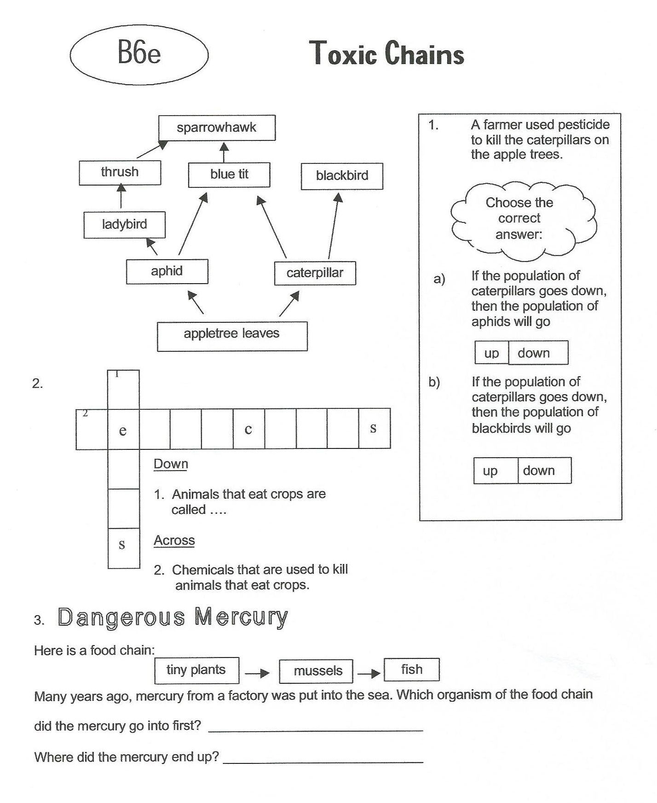

Slide 16
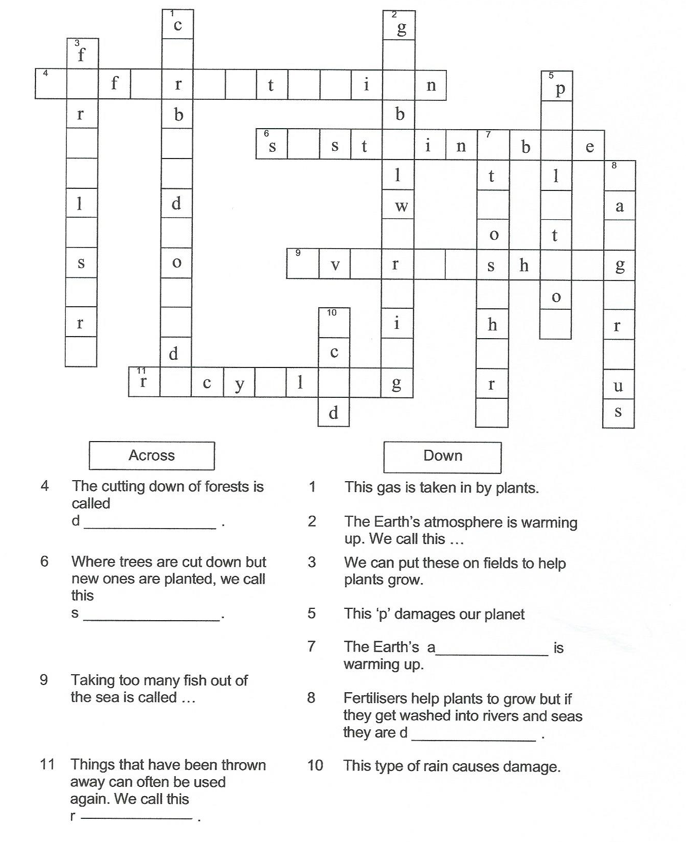

Slide 17
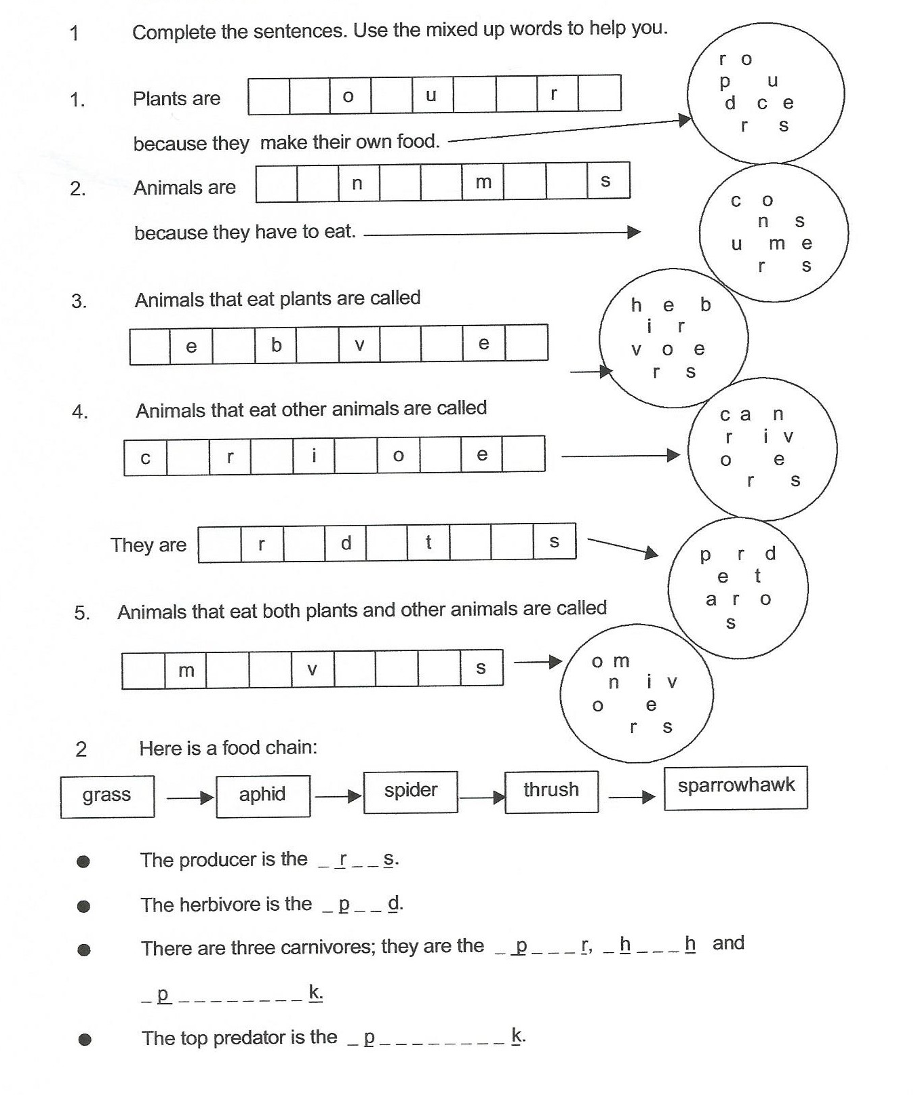

Slide 18
Keywords
Adaptation | A change in an organism that makes it better suited to it’s environment
Community | A group of organisms which live in an area
Consumer | An organism which feeds on another organism
Ecosystem | The living and non-living things in an area (animals, plants, rocks, weather)
Environment | The non-living factors in an area such as the weather
Habitat | The place where organisms live
Organism | A living thing such as a plant or animal
Primary consumer | An organism which eats a producer
Predator | An animal which eats other animals
prey | Something which is killer by a predator
producer | A plant which produces food for organisms
Secondary consumer | An organism which is third in the food chain

