Slide 1
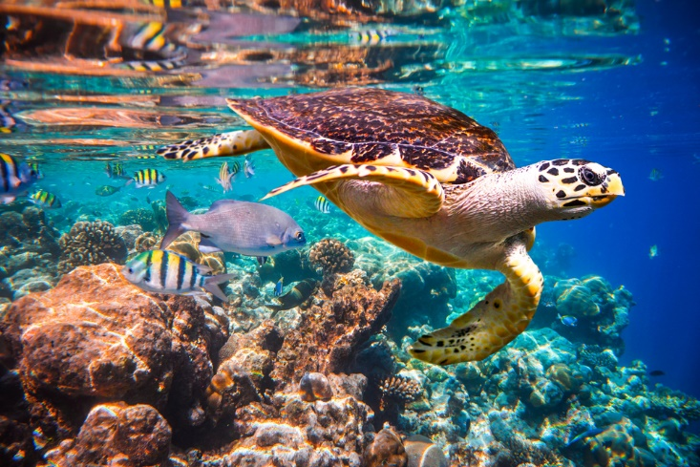
Science work pack
Week 2
If you are stuck try using https://www.bbc.co.uk/bitesize/subjects/zng4d2p
for help
There is online learning available at:
app.senecalearning.com/dashboard/join-class/4ggjlziov1
You need to sign up using an email address. When asked to type in the school it is St Matthias academy. This should take you to straight to the learning page, if you are asked for a class code it is: 4ggjlziov1. There are tutorials and then questions.
Please work on the assignments and I can see what has been completed and how well you are doing.
Miss Grant

Slide 2
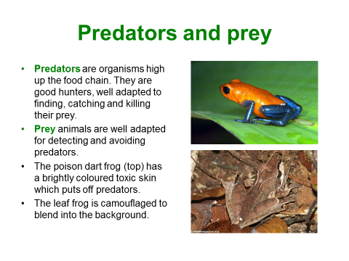
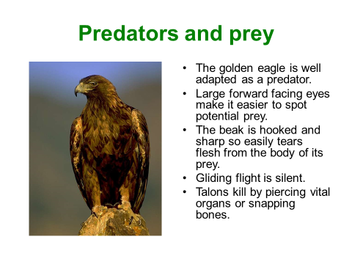

Slide 3
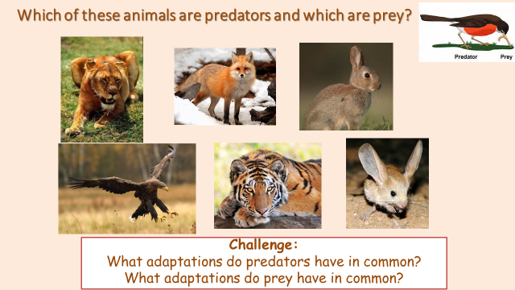
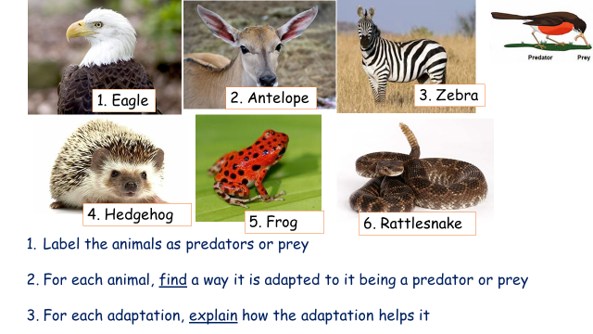
Animal | Adaptation | Explanation of how the adaptation help it

Slide 4
Choose either a predator or prey.
You must draw and label your animal:
Label:
Diagram with features
Details of how the features work
Explain how the features help the animal to survive

Slide 5
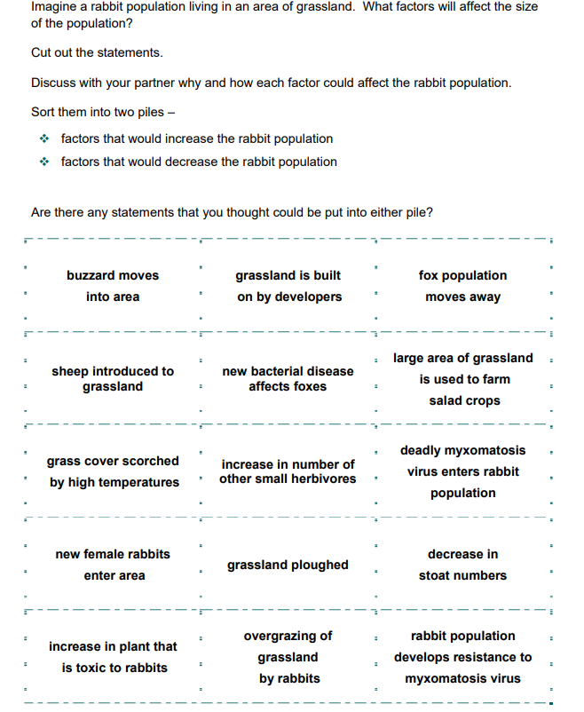
Put an for things which will increase the rabbit population (numbers)
Put an for things which will decrease the rabbit population (numbers)t
T
The first one has been done for you

Slide 6
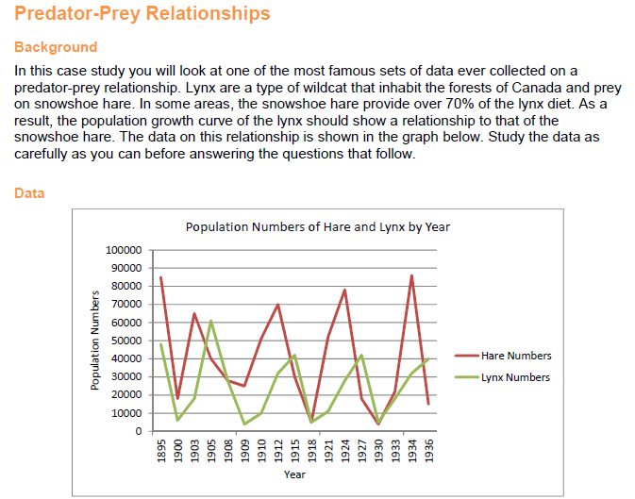
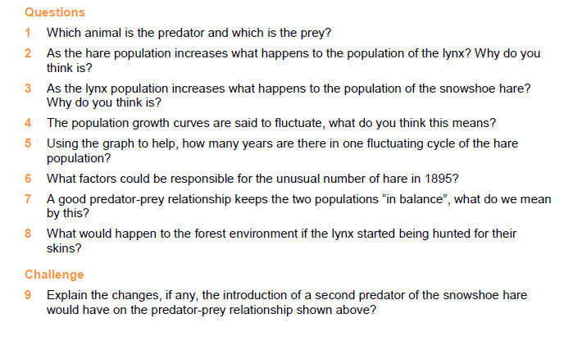

Slide 7
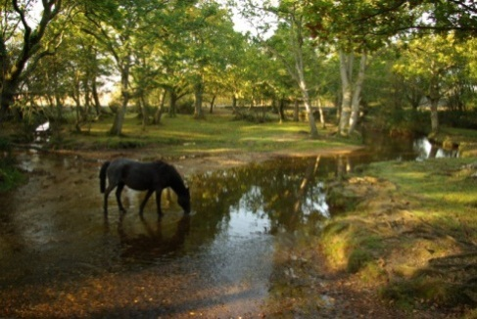
If people use an ecosystem without damaging it then what they are doing is ____________________.
Ecosystems
Use the words below to complete the sentences
HINT: Cross through the word when you have used it
A ____________________ is a diagram that shows how animals and plants are linked by eating.
When a species dies out it is ____________________.
A ____________________ is an animal which eats other animals.
Trees which lose their leaves in winter are ____________________.
In England there is a famous National Park called The New ____________________, where wild ponies are part of the ecosystem.
The scientific name for a type of plant or animals is ____________________.
Most plants grow in ____________________.
____________________ includes sunshine, rain and wind.
In a ____________________ there are lots of trees growing.
A plant makes its own food, so it is called a ____________________.
An ____________________ can be any size. It could be as small as a pond or as big as a rainforest.
Fir trees are ____________________.
A really dry place is called a ____________________.
Something that breaks down dead materials is called a ____________________.
In the Amazon Basin there is ____________________.
Everything around us is our ___________________.
Things which grow in the soil and make their own food are called ____________________.
A ____________________ is an animals which only eats plants.

Slide 8
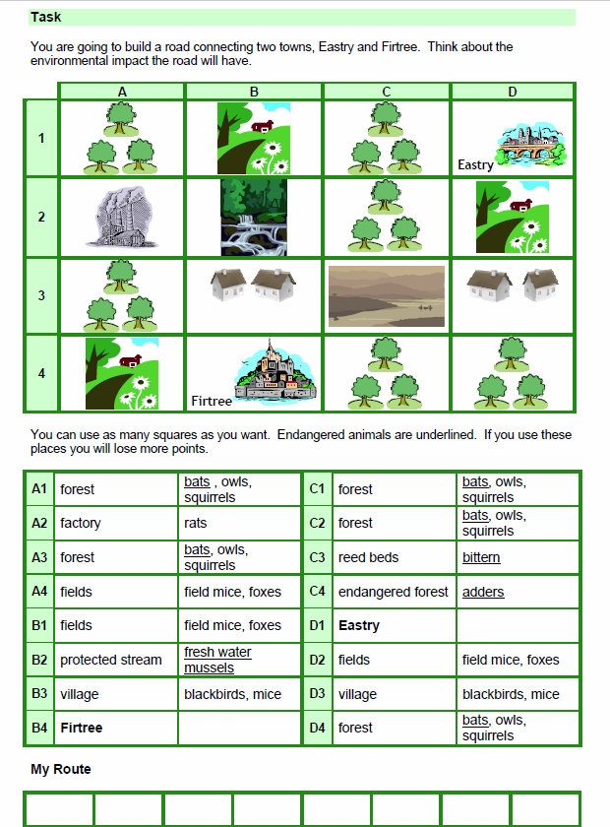

Slide 9
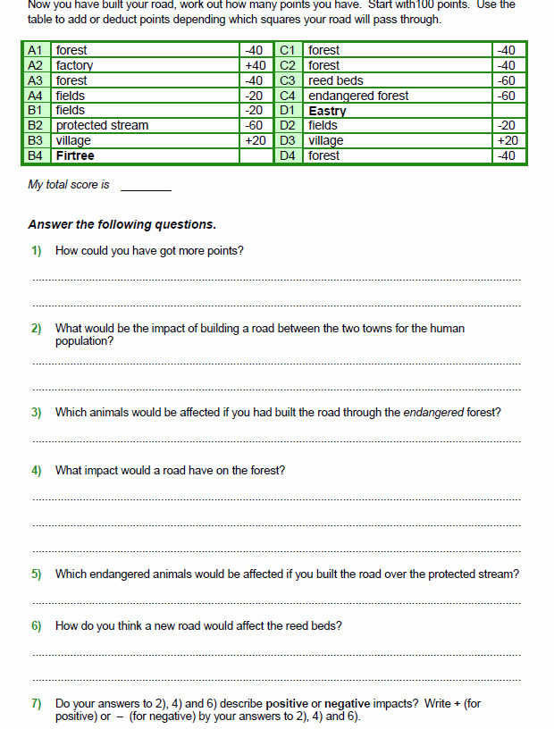

Slide 10
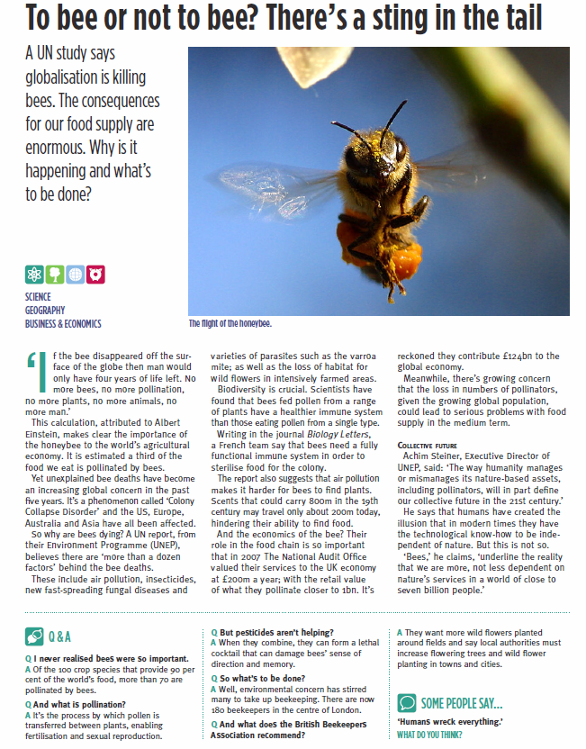

Slide 11
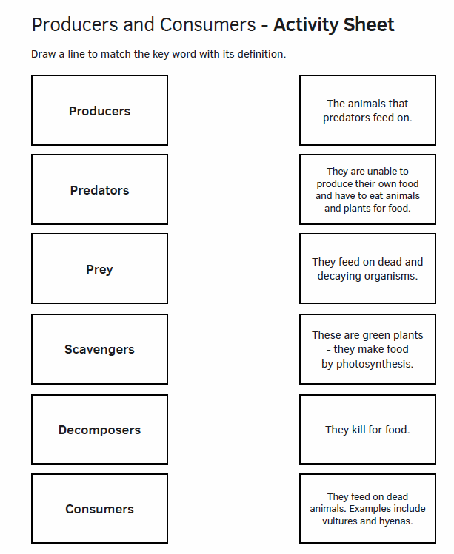

Slide 12
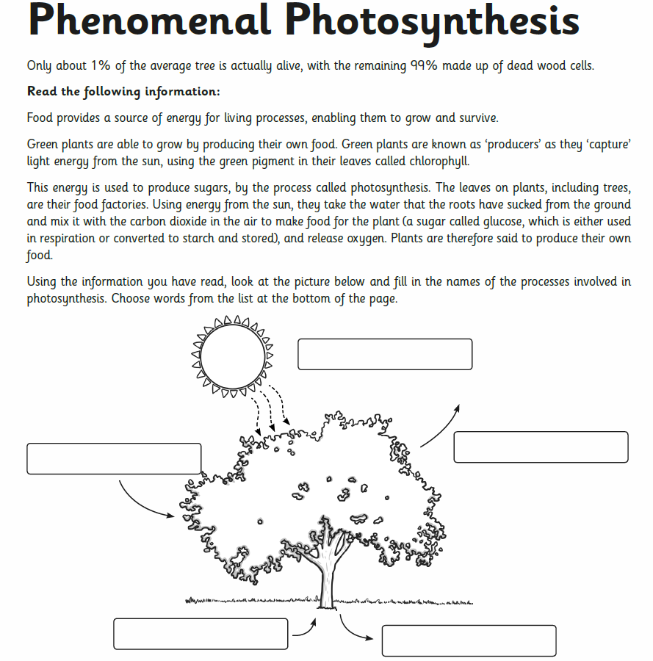

Slide 13
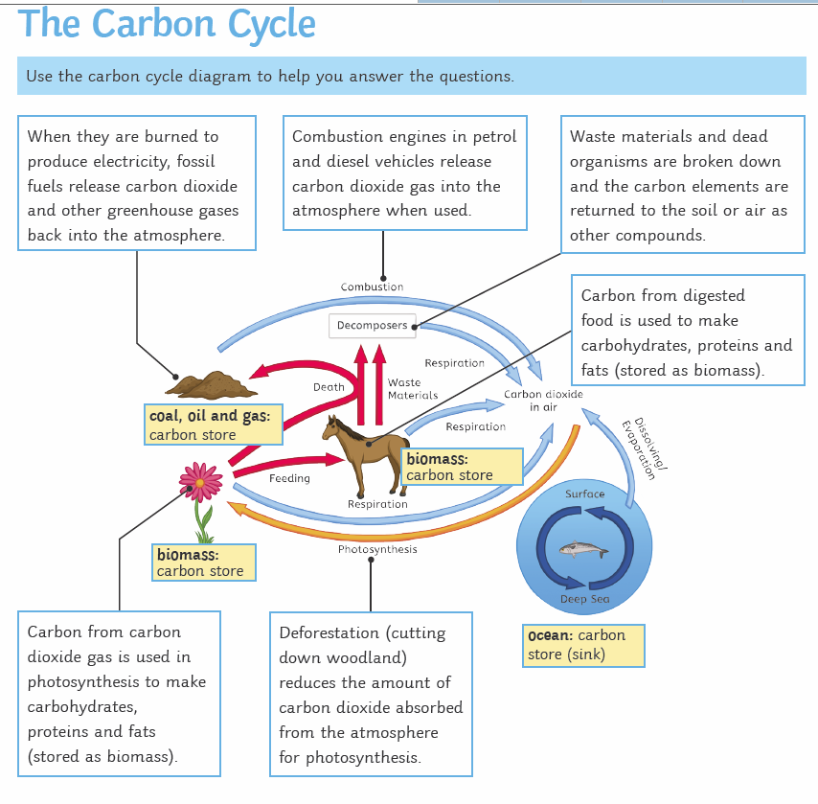

Slide 14
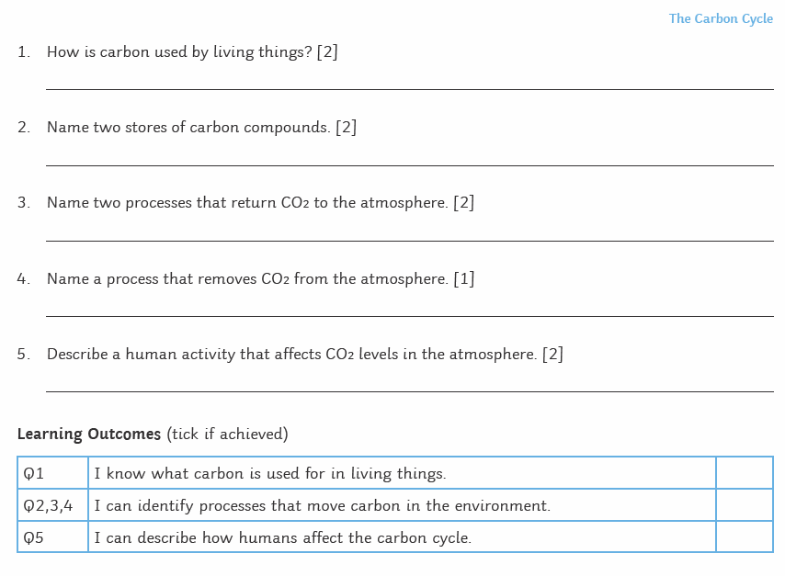

Slide 15
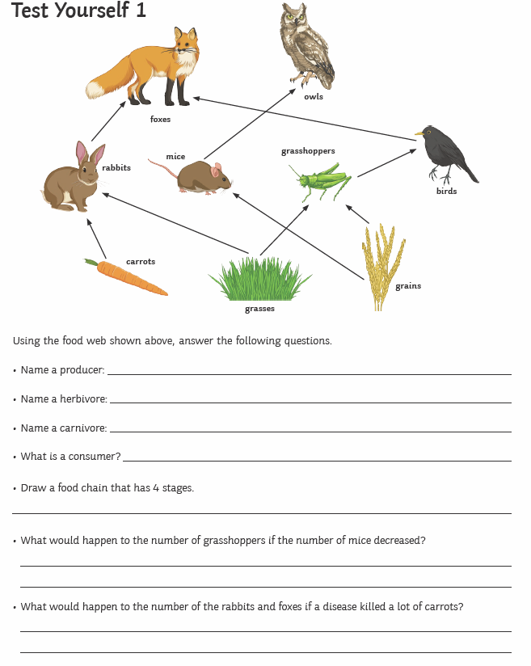

Slide 16
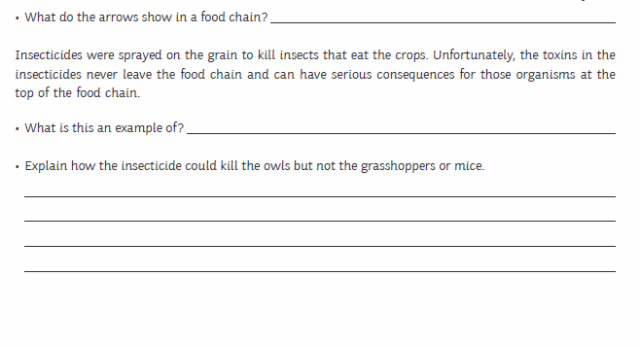
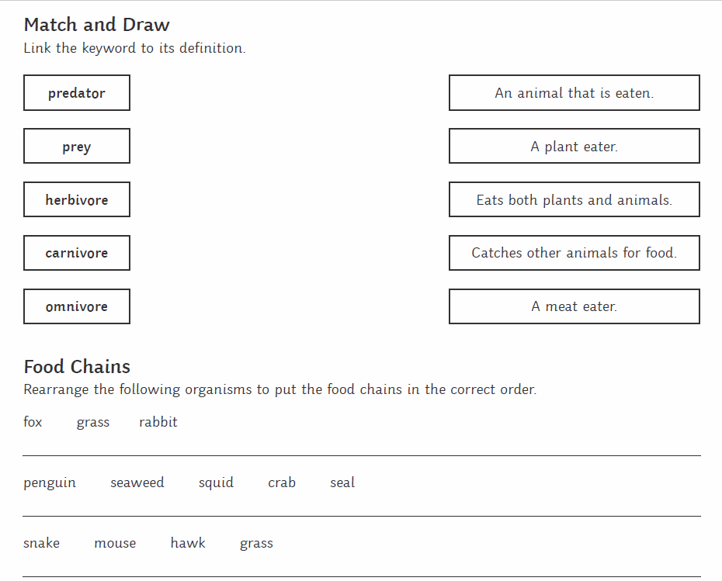

Slide 17
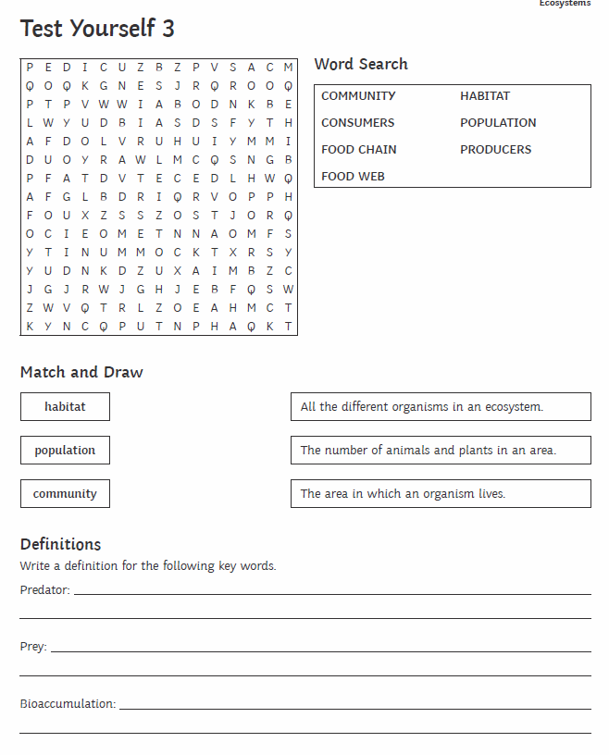

Slide 18
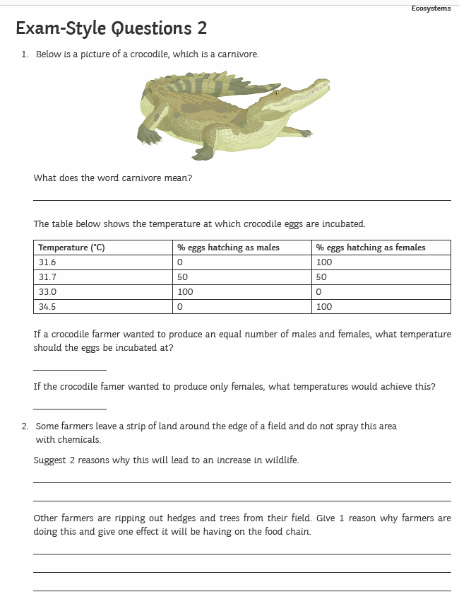

Slide 19
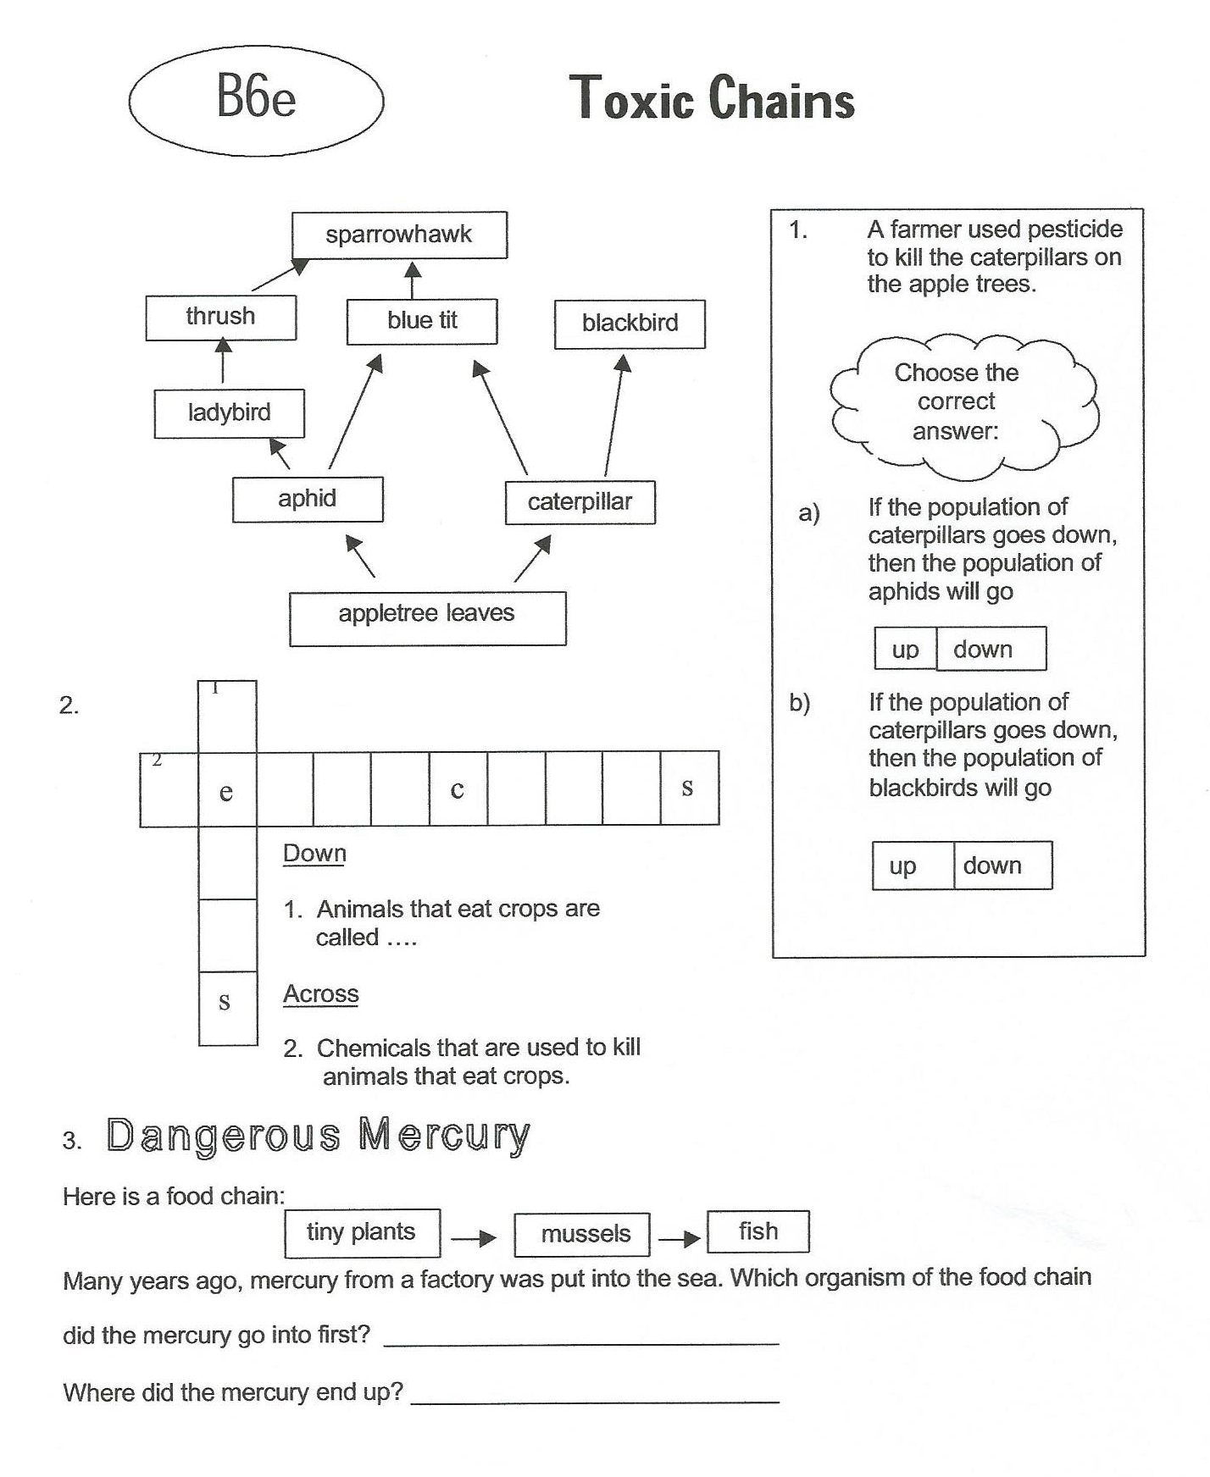

Slide 20
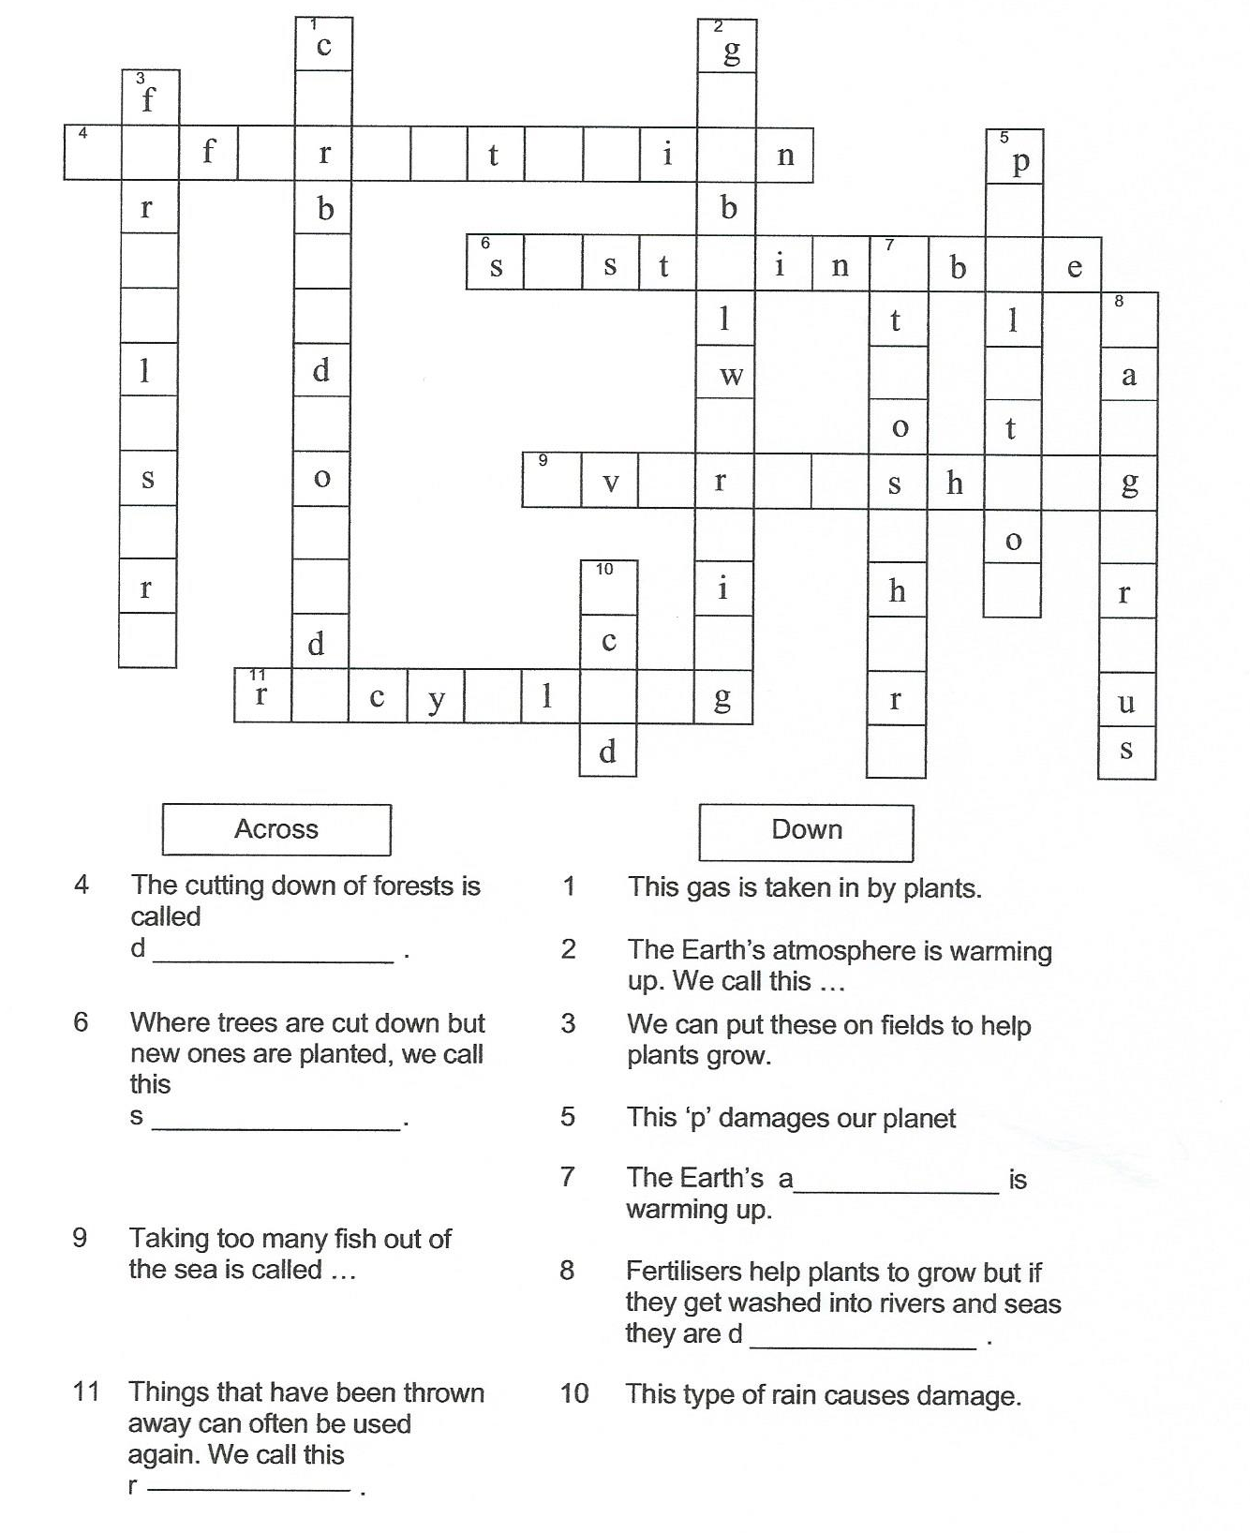

Slide 21
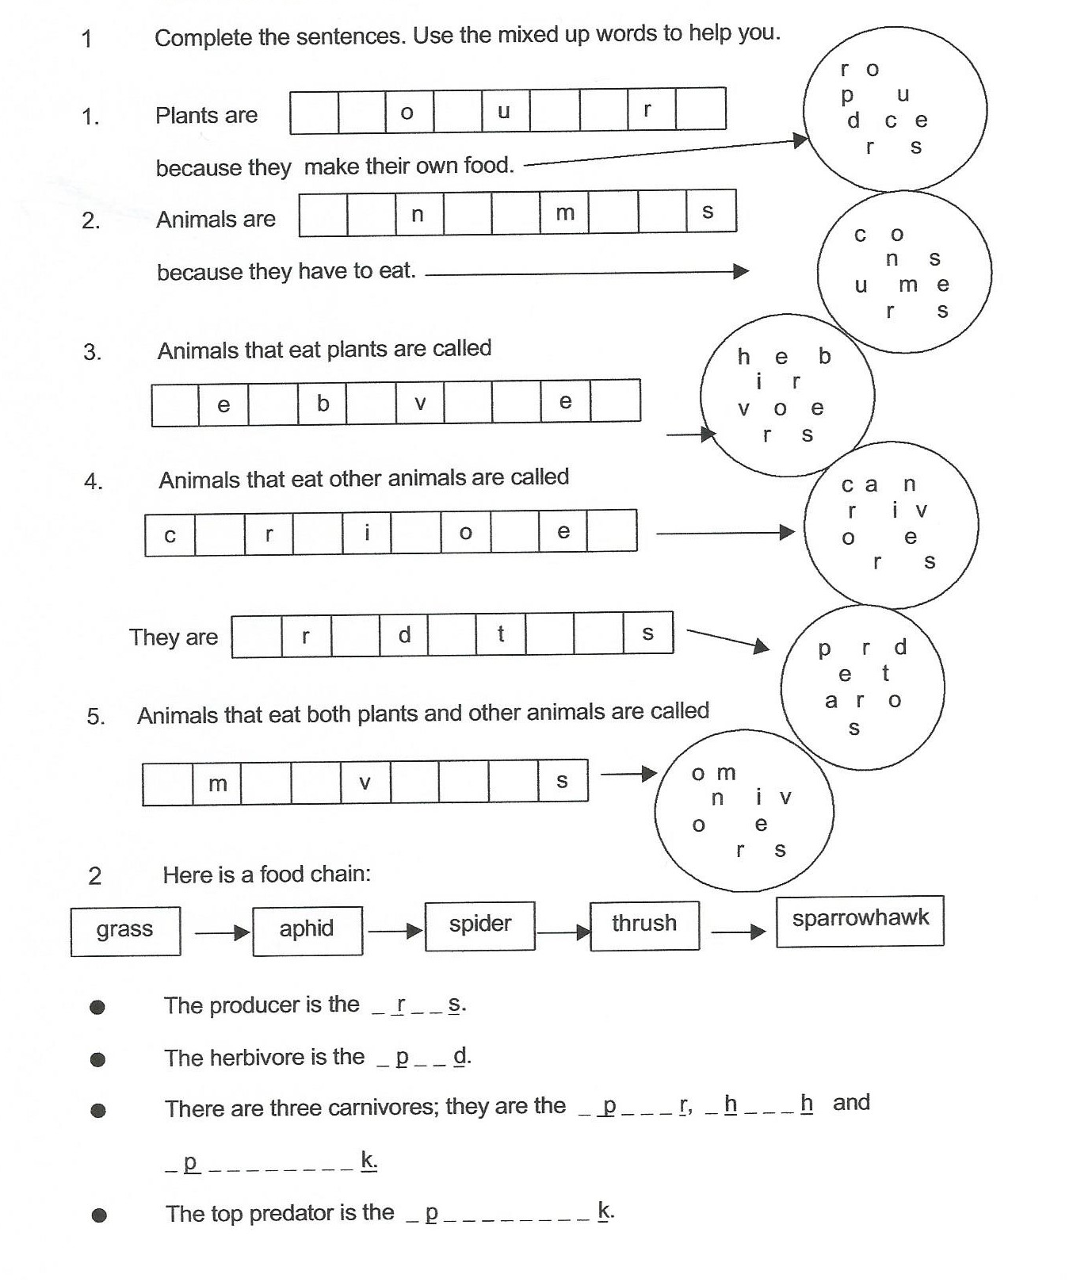

Slide 22
Keywords
Adaptation | A change in an organism that makes it better suited to it’s environment
Community | A group of organisms which live in an area
Consumer | An organism which feeds on another organism
Ecosystem | The living and non-living things in an area (animals, plants, rocks, weather)
Environment | The non-living factors in an area such as the weather
Habitat | The place where organisms live
Organism | A living thing such as a plant or animal
Primary consumer | An organism which eats a producer
Predator | An animal which eats other animals
prey | Something which is killer by a predator
producer | A plant which produces food for organisms
Secondary consumer | An organism which is third in the food chain

