Slide 1
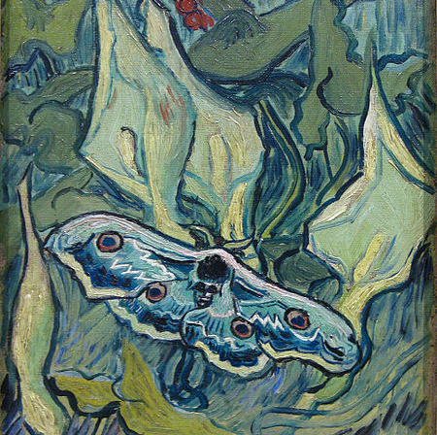

BUTTERFLIES
Butterflies (Van Gogh series) Butterflies is a series paintings made by Vincent van Gogh in 1889 and 1890. Van Gogh made at least four paintings of butterflies and one of a moth. The metamorphosis of the caterpillar into a butterfly was symbolic to Van Gogh of men and women's capability for transformation.

Slide 2
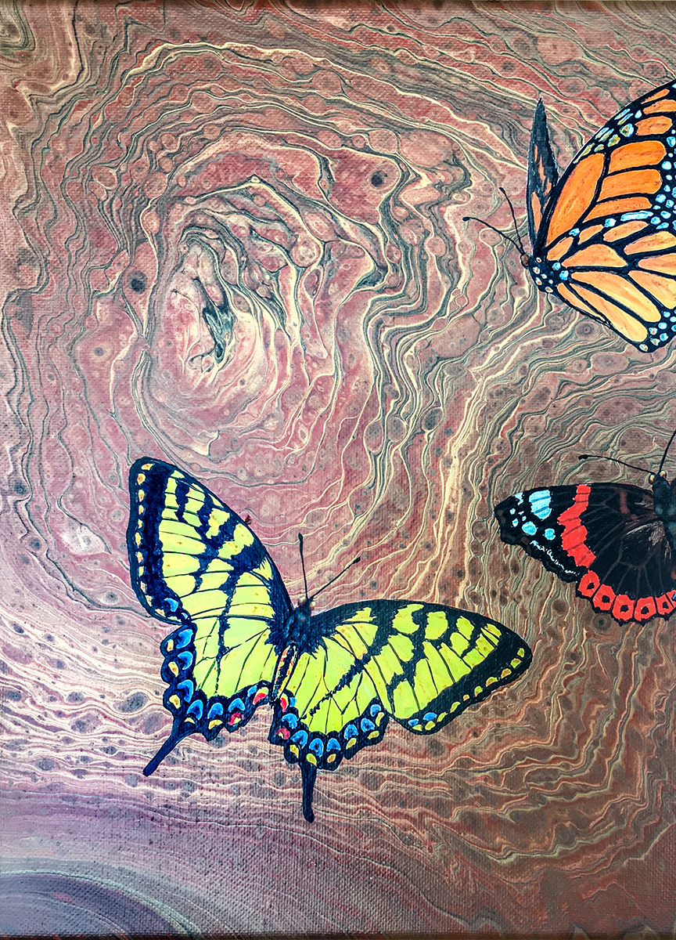
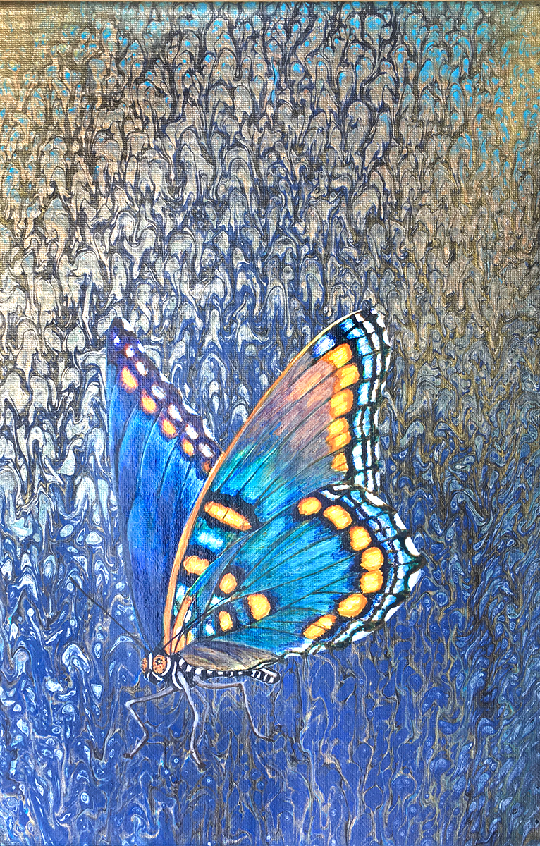
Lucy Arnold
Nature is my primary source of inspiration, and color my main mode of expression. It is often the small, intimate details of nature that attract my eye. I depict real species in my natural history paintings, as I can’t imagine life forms more wonderful and bizarre than those actually found here on Earth.

Slide 3
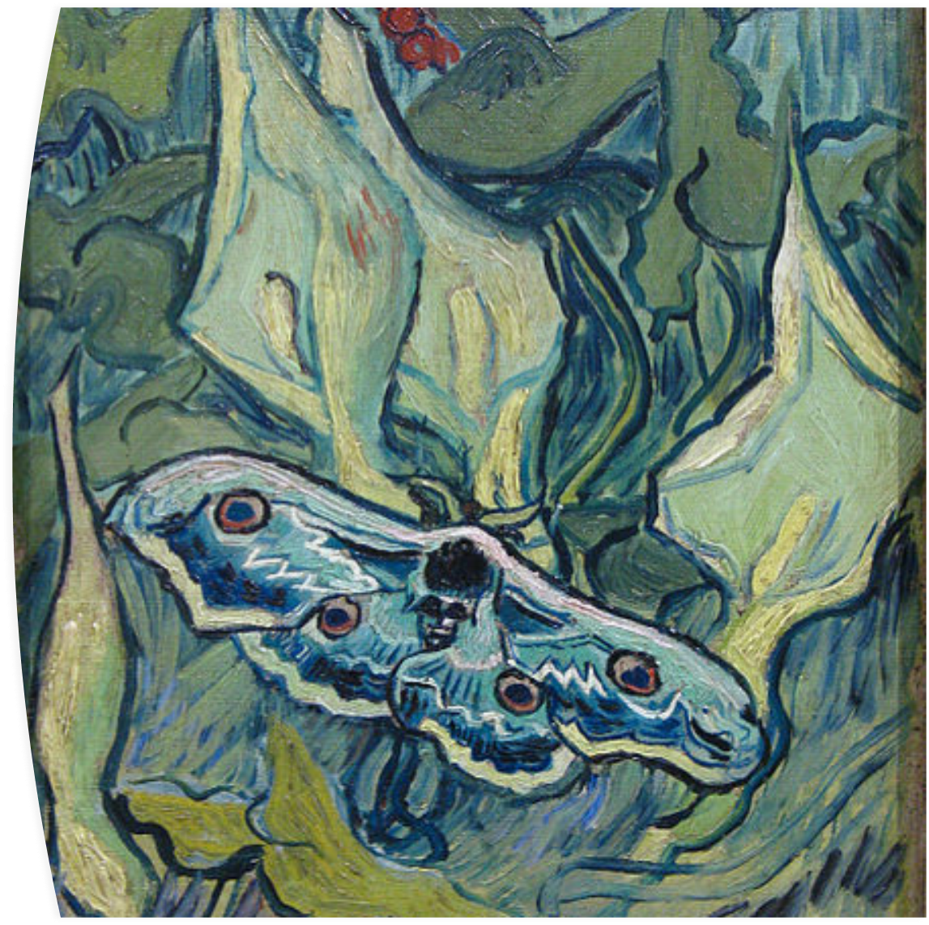
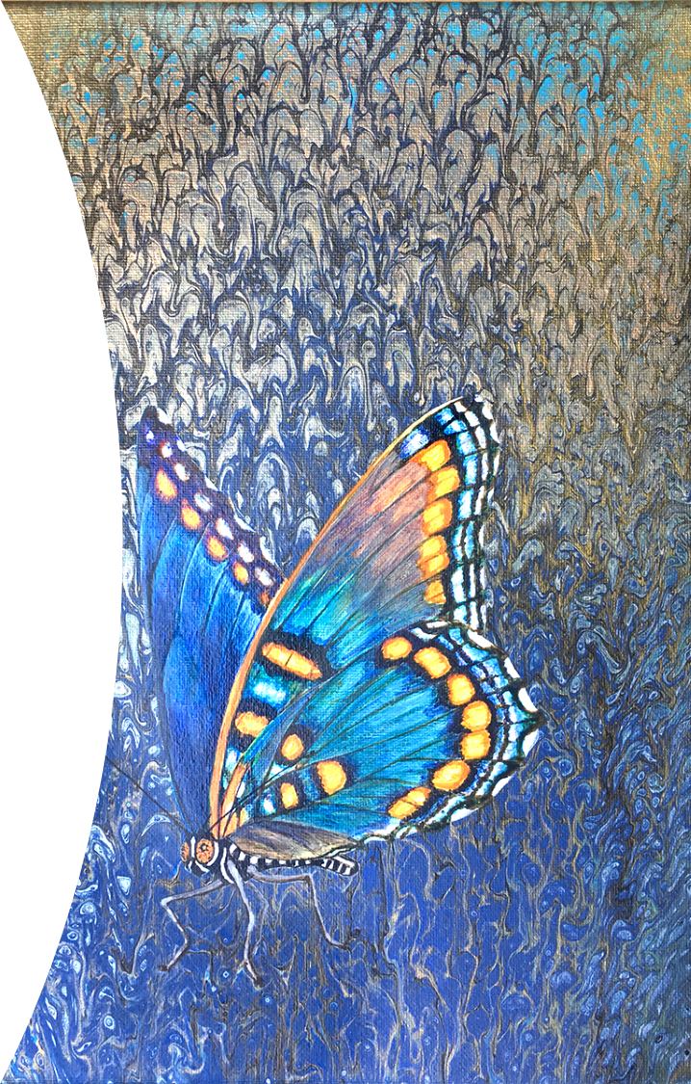
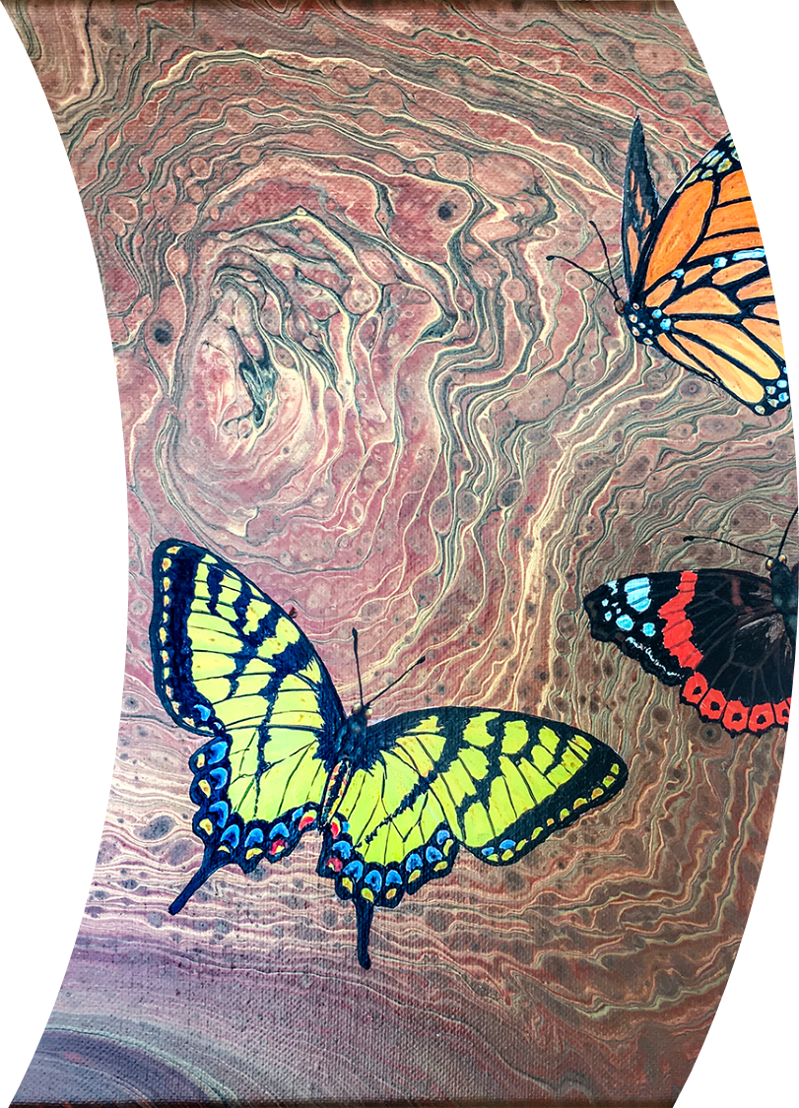
Keywords
Vibrant bright sad happy depressing foreboding relaxing butterfly leaves
Dark thick texture marbling effect lines
Choose one of the artworks based on butterflies and analyse. Remember to describe the colours, mood, style and marks used. Interpret it-has it a meaning?

Slide 4
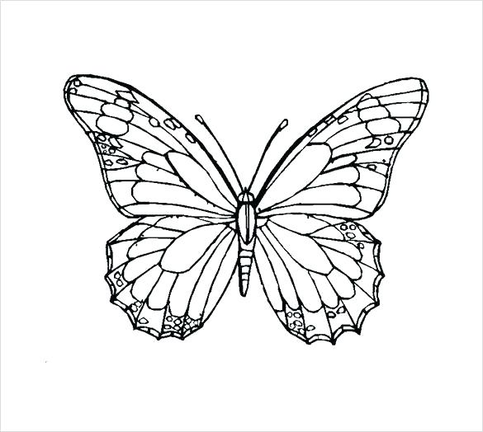

Observe and draw.
Add colour using your medium of choice.

Slide 5
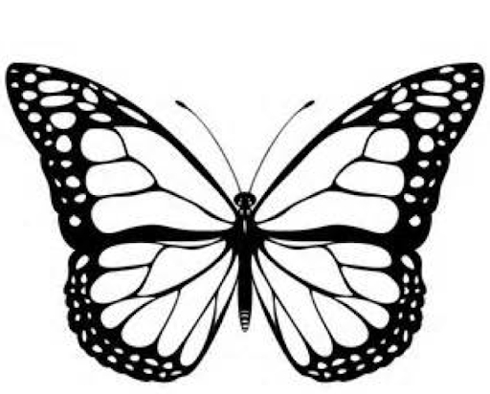
Grid Drawing
art@stmatthias

Slide 6

Draw the other half

Slide 7
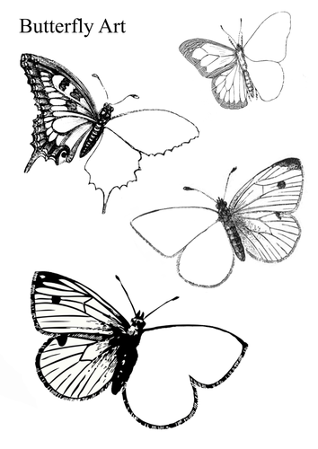
Draw the missing sides.
Add colour using your medium of choice.

Slide 8
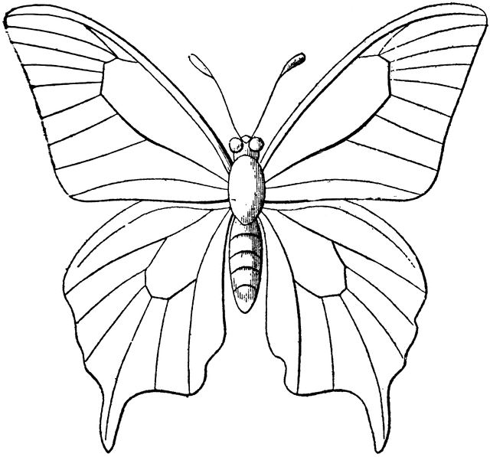
Colour me
Use pens, coloured pencils or paints.
Try to keep in the lines

