Slide 1

English Home Learning
Booklet
Name:…………………………………………………………………………..
Teacher:………………………………………………………………………

Slide 2


Section three
+ Subordinate
clauses
Spelling list 3
Complete New words beginning with E and F
Read section on Commas and subordinate clauses
Complete both tasks on Simple sentences
Read section on Nouns
Complete tasks on Nouns
Complete task on Pronouns
Read and complete section on Verbs
Read the non fiction extract Chocolate
Answer the questions to Chocolate in full
Self Assessment: What do I still need to practise from this section?

Slide 3

Spelling test 3
You will be tested on your spellings in every
literacy lesson.
You are expected to get at least 17/20 right each time. If you do not manage this you will need to re-take the test at another time.
 | Read | Write | Cover and write
Connective | Despite
 | Except
 | Although
 | Additionally
 | Furthermore
Commonly misspelt words | Calendar
 | Category
 | Cemetery
 | Changeable
 | Collectible
English subject words | Writer
 | Evaluate
 | Response
 | Example
 | Library
Topic specific words

Slide 4
Letter
Word
E
Definition
Sentence (using your word):
Synonyms
Antonyms
Letter
Word
F
Definition
Sentence (using your word):
Synonyms
Antonyms

Slide 5

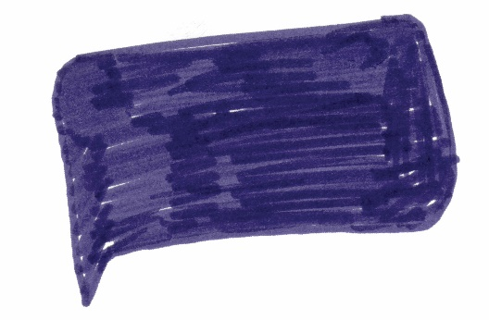
Put the correct commas and full stops into the sentences below.
Think – do they make sense?
Task
After we left Grandma Mummy and I skipped about in the park.
Stinking bad breath swollen purple gums easy bruising bleeding eyeballs tiredness and death
Without saying another word she hurried into the airport’s shop and bought a copy for herself
Marc was the first to recover sitting by the kitchen he had been out of the line of fire and hadn’t been hit
The choir was singing “Isn’t she lovely?” and for some reason the choir was made up of chipmunks and Libby was in charge of them
Write two examples of your own for each of the following:
Subordinate clause (1):
Subordinate clause (2):
List (1):
List (2):
Marked by: Date:
TS:

Slide 6
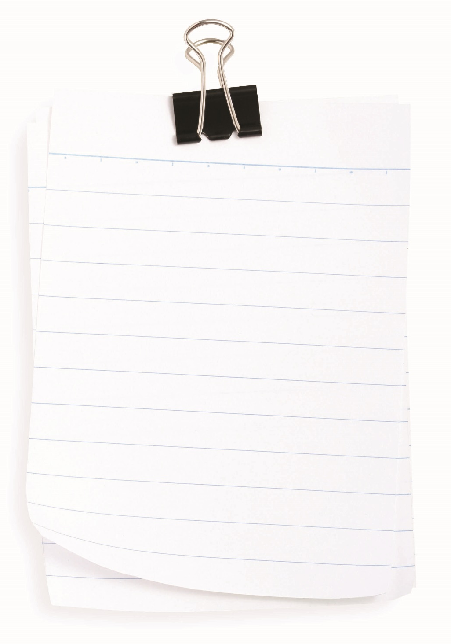
Punctuation marks are the traffic signals of language: they tell us to slow down, notice this, take a detour, or stop.
of all the punctuation marks, the comma is the most used and misused. Commas can create havoc when they are in the wrong spot, and the results can be hilarious. This little dot with a tail has the power to change the meaning of a sentence by connecting things that shouldn’t be connected or breaking apart things that should stay together.
How to use a comma correctly
A comma should never take the place of a full stop.
It should be used to separate a main clause from a subordinate clause. (See page on Simple sentences in section 2)
It should be used when listing items, for example, I would like sausage, two eggs, beans and toast. Please note that and is used to separate the final two items though.
Tip: Try to think how a passage may sound if you read it out loud – does it sound like the end of a sentence? Then you need a full stop not a comma.

Slide 7

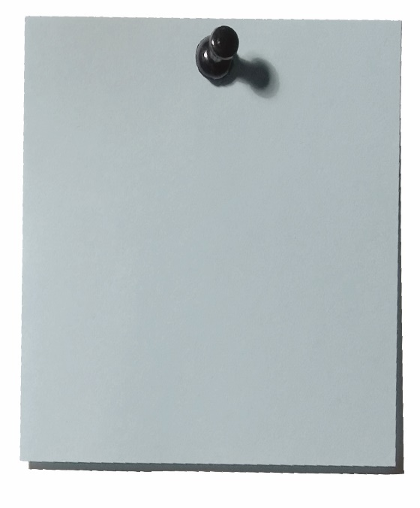
Different types of sentence
There are three different types of sentence, we are going to look at the basic way to write these and when you learn more about punctuation you can extend these in different ways.
In section two we looked at how to structure a simple sentence using a main clause. We are now going to look at how to construct a complex sentence and a compound sentence.
The prince smiled.
This is our main clause, to make it into a complex sentence you need to add a subordinate clause.
Subordinate clause
Part of a sentence that doesn’t make sense on it’s own.
The subordinate clause can go at the beginning, middle or end of the sentence.
The prince smiled, while skipping down the road.
While skipping down the road, the prince smiled.
The prince, while skipping down the road, smiled.
Examples of Complex sentences
How to write a compound sentence – this one is much easier!
A complex sentence is basically two main clauses stuck together with a connective – and, if, so, but, yet etc.
The prince smiled. He was happy.
The prince smiled because he was happy.
By adding one connective in the middle you have transformed your sentence.
Try to use a variety of connectives in your work.

Slide 8


Task
Highlight the subordinate clause in these complex sentences.
The sun was shining, trying to peep out from behind the cloud.
Running at full speed, the cheetah pounced on it’s prey.
The wizard, not seeing the gremlin, tucked his wand inside his cloak.
Shining in the autumn sun, the knight’s armour looked reflected his bravery.
The wind echoed through the trees, ripping the leaves from their branches.
Task
Re-write these simple sentences turning them into different variations of complex and compound sentences.
Gold target: You must have at least 5 complex sentences with the subordinate clause in different places.
I love chocolate.
The frog jumped really high.
The perfume smelt like roses.
The window was frosted.
Babies cry all the time.
I can use simple sentences in my writing.
Ben walked home from school.
The princess was annoyed.
Marked by: Date:
TS:

Slide 9



Apostrophes
There are two reasons to use an apostrophe:
Possession
To show that one thing owns another.
The lady’s hat.
The lady owns the hat.
Omission
Where you need to miss a letter out.
You’ve left some letters out.
‘You have’ becomes ‘you’ve’.
Task 1: add in any missing apostrophes from the sentences below.
Task 2: write down as many words as you can with omitted letters.
1. My best friends sister is called Jodie.
2. I havent done my homework.
3. If they go to the shops theyll miss the football.
4. Frank Lampards goal this weekend was brilliant
5. There werent any eggs left after Jamie dropped the box.
6. Weve won lots of cups this year; were Kents best school.
7. Im always late for school in the morning, its my dads fault
8. There arent many cars Id drive but I like BMWs
9. I shouldve caught the 10.30 bus but I was late.
10. Patricks car is not very reliable, its always breaking down.
Can’t
Marked by: Date:
TS:

Slide 10
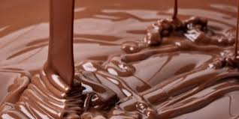
Read the text carefully and answer the questions below in full sentences.
Chocolate
Non-fiction reading
Chocolate –– there’s nothing quite like it, is there? Chocolate is simply delicious. What is
chocolate? Where does it come from?
Christopher Columbus was probably the first to take cacao beans from the New World to Europe in around 1502. But the history of chocolate goes back at least 4,000 years! The Aztecs, who lived in America, thought that their bitter cacao drink was a divine gift from heaven. In fact, the scientist Carolus Linnaeus named the plant Theobroma, which means “food of the gods.”
The Spanish explorer Hernando Cortez went to America in 1519. He visited the Mexican emperor Montezuma. He saw that Montezuma drank cacao mixed with vanilla and spices. Cortez took some cacao home as a gift to the Spanish King Charles. In Spain, people began to drink Cortez’s chocolate in a drink with chili peppers. However, the natural taste of caocao was too bitter for most people. To sweeten the drink, Europeans added sugar to the cacao drink. As a sweet drink, it became more popular. By the 17th century, rich people in Europe were drinking it.
Later, people started using chocolate in pasttriies, like pies and cakes. In 1828, Dutch chocolate makers started using a new process for removing the fat from cacao beans, and getting to the center of the cacao bean. The Dutch chocolate maker Conrad J. van Houten made a machine that pressed the fat from the bean. The resulting powder mixed better with water than cacao did. Now, some call van Houten’s chocolate “Dutch chocolate.”
It was easy to mix Dutch chocolate powder with sugar. So other chocolate makers started trying new reciipes that used powdered chocolate. People started mixing sweetened chocolate with cocoa butter to make solid chocolate bars. In 1849, an English chocolate maker made the first chocolate bar. In the
19th century, the Swiss started making milk chocolate by mixing powdered milk with sweetened chocolate. Milk chocolate has not changed much since this process was invented.

Slide 11
Today, two countries - Brazil and Ivory Coast - account for almost half the world’s chocolate. The United States imports most of the chocolate in the world, but the Swiss eat the most chocolate per person. The most chocolate eaten today is sweet milk chocolate, but people also eat white chocolate and dark chocolate.
Cocoa and dark chocolate are believed to help preventt heart attacks, or help keep them fromhappening. They are supposed to be good for the circulatory system. On the other hand, the high fat content of chocolate can cause weight gain, which is not good for people’s health. Other health claims for chocolate have not been proven, but some research shows that chocolate could be good for the brain.
Chocolate is a popular holiday gift. A popular Valentine’s Day gift is a box of chocolate candies with a card and flowers. Chocolate is sometimes given for Christmas and birthdays. Chocolate eggs are sometimes given at Easter.
Chocolate is ttoxiic to some animals. An ingredient in chocolate is poisonous to dogs, cats,
parrots, small rodents, and some livestock. Their bodies cannot process some of the chemicals found in chocolate. Therefore, they should never be fed chocolate.
Questions
How did people first consume chocolate?
Why did Linnaeus name the plant Theobroma?
What is the definition of divine?
What is the impact of using this word in the text?
What is the definition of the word toxic?
Can you find three ambitious words to replace the word toxic?
Summary: Write 10 bullet points picking out the most important parts of the article.
Gold target: Highlight 3 examples of omission using an apostrophe.
Highlight four simple sentences and extend two into complex sentences and two into complex sentences.

Slide 12
Answer your questions in detail here:

