Slide 1

Science work pack
*week 3
Helpful websites to support with the work or for interest:
https://www.bbc.co.uk/bitesize/guides/z2wmxnb/revision/1
https://mysteryscience.com/ https://thekidshouldseethis.com/
There is online learning available at:
app.senecalearning.com/dashboard/join-class/4ggjlziov1
You need to sign up using an email address. When asked to type in the school it is St Matthias academy. This should take you to straight to the learning page, if you are asked for a class code it is: 4ggjlziov1. There are tutorials and then questions.
Please work on the assignments and I can see what has been completed and how well you are doing.
Miss Grant

Slide 2
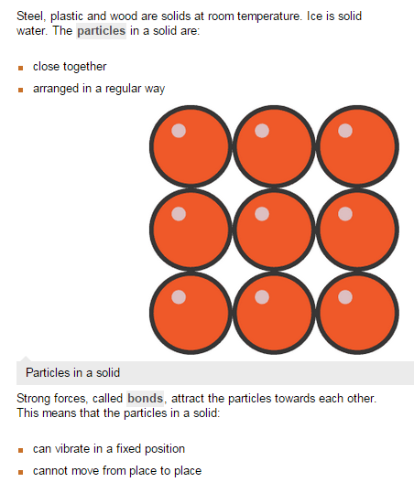
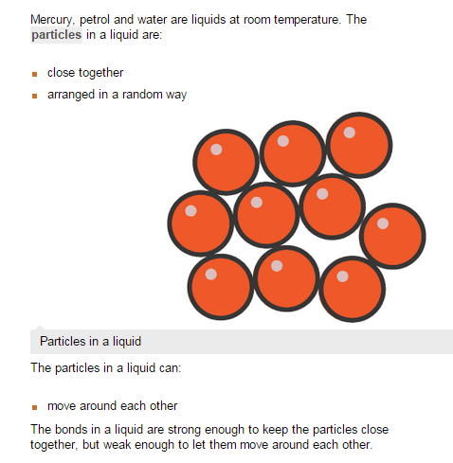
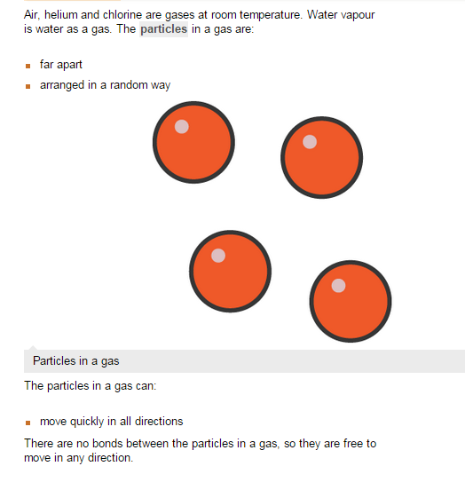
States of matter
Solids
Liquid
Gas
When talking about State it means if something is solid, liquid or gas

Slide 3
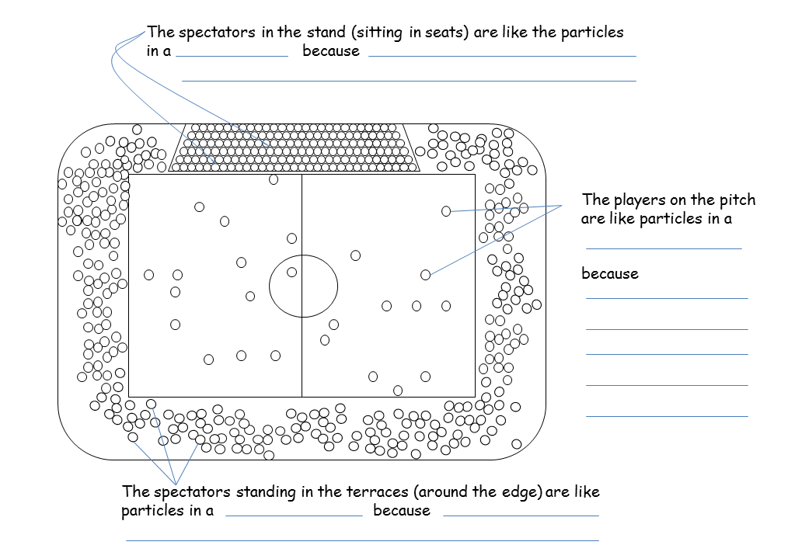
Solids, Liquids and Gases
Solids quickly liquids randomly gas regular sliding vibrate
The particles in ________ are very close together and in a ________ pattern. They can _________ about a fixed point. Particles in a ________ are still close together but are arranged ___________ (not in a pattern). They can move by _________ over each other. Particles in a ______ are far apart. They can move _______ in any direction.
Draw diagrams to represent the particle in a solid, liquid and gas
Solid | Liquid | Gas

Slide 4
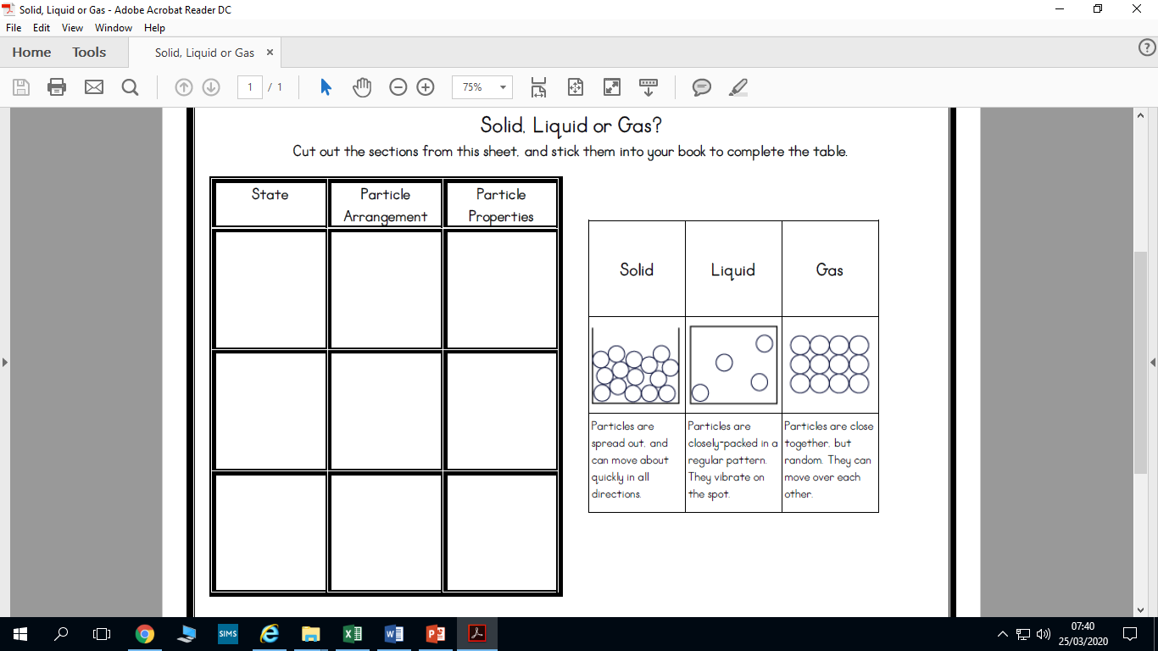
Place numbers in the grid to match diagram, particle arrangement and properties
1
2
3
4
5
6
7
8
9

Slide 5
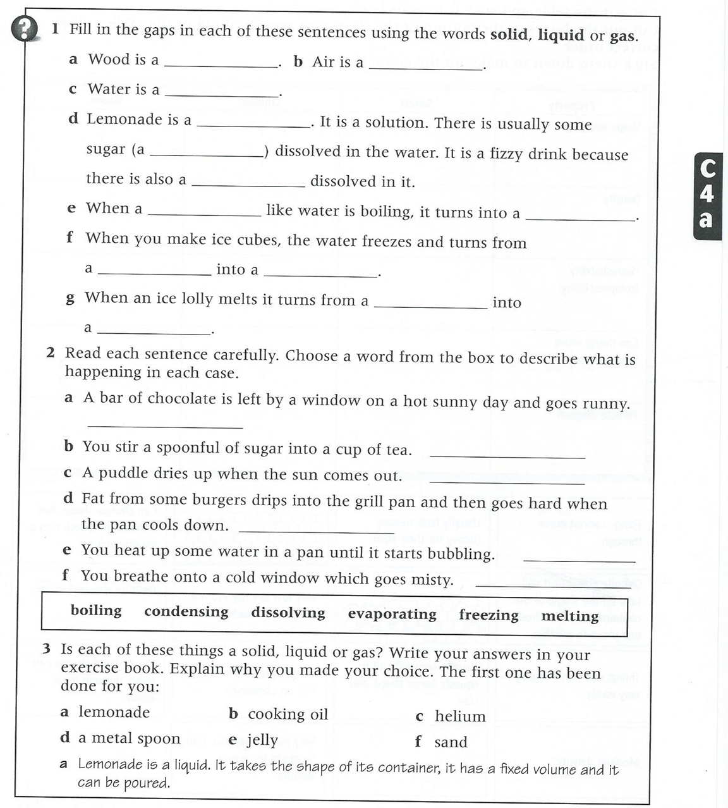
Use the words solid, liquid or gas to complete the sentences

Slide 6
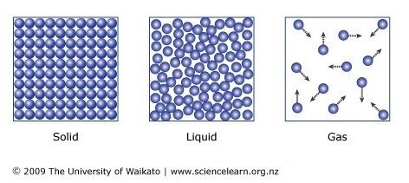
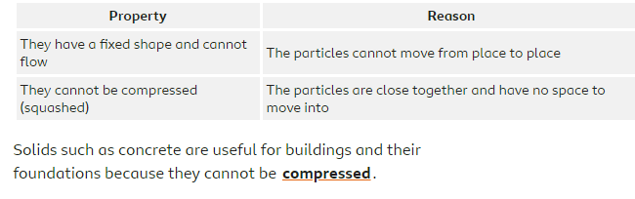
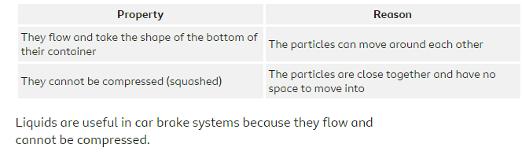
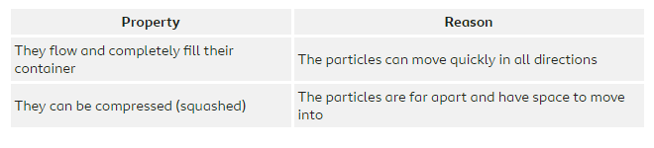
Properties of solids, liquids and gases
Solids
Liquids
Gases

Slide 7
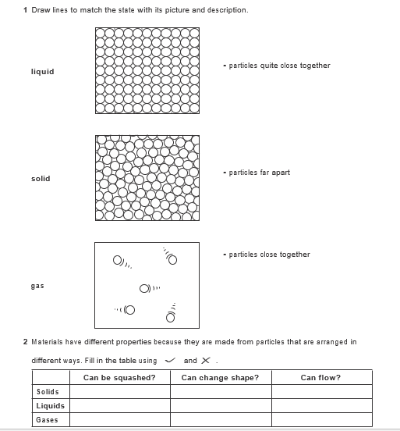

Slide 8
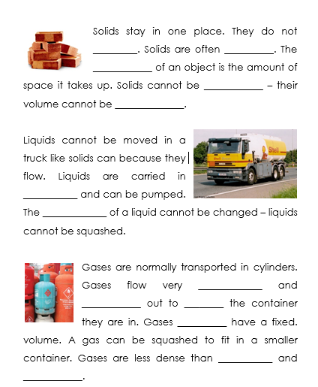
Use the words below to fill the gaps
changed dense don’t easily fill flow liquids solids spread squashed tankers volume volume

Slide 9
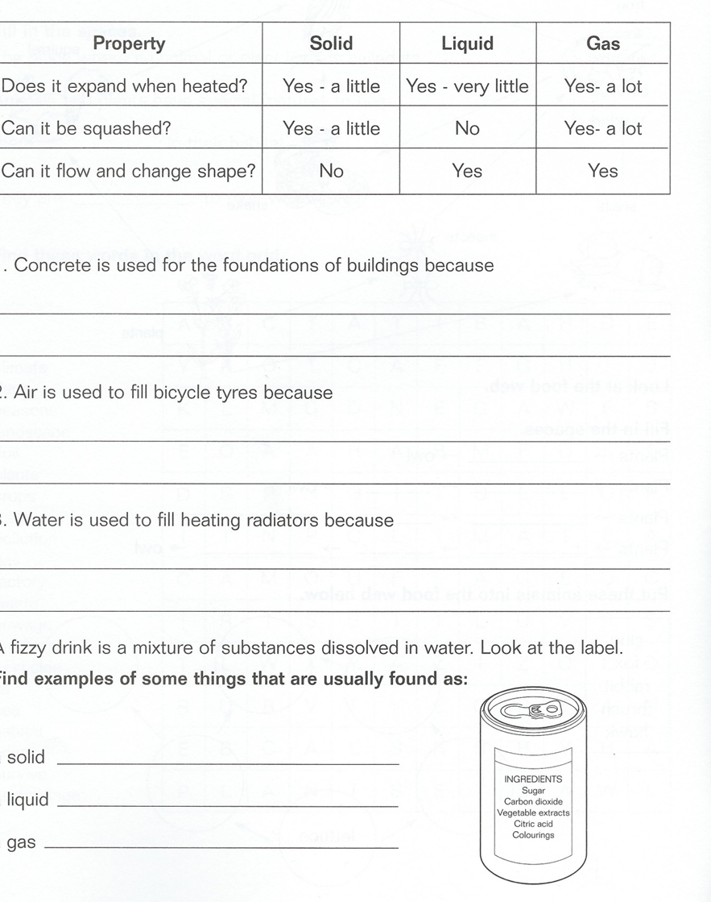

Slide 10
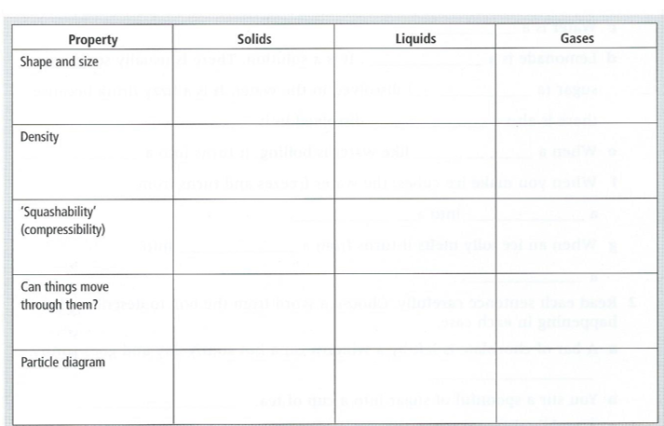
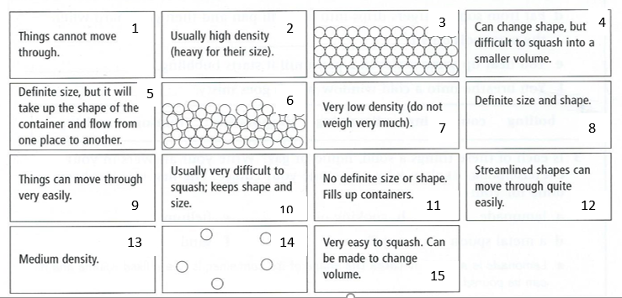
Summary

Slide 11
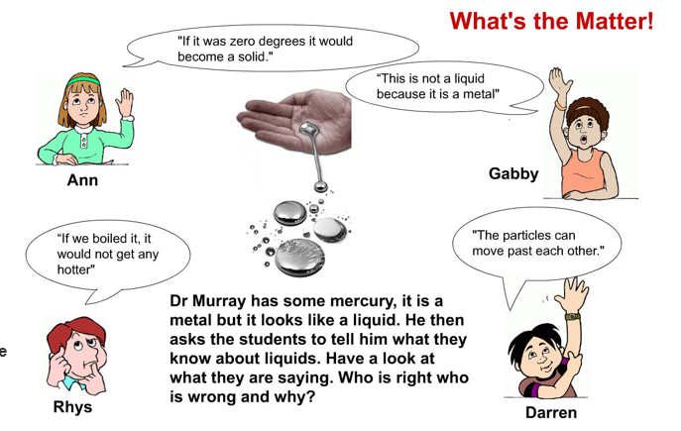

Slide 12
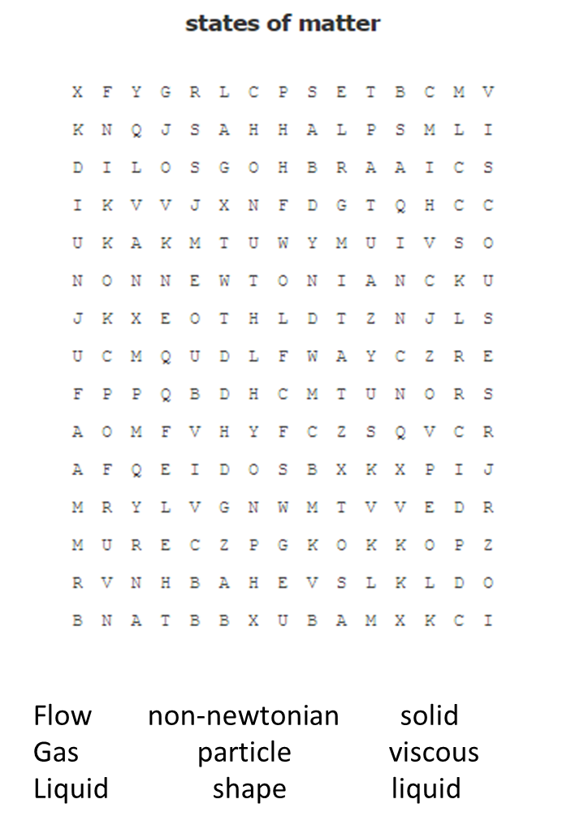
Keyword | Definition
State | A state of matter refers to if something is a solid liquid or gas
Solid | A state of matter where the particles are closely packed together. They cannot be compressed and particles cannot move but can vibrate
Liquid | A state of matter where the particles are quite close together but are able to move over each other. The particles cannot be compressed
Gas | A state of matter where the particles are not touching, the particles move around the space freely and can be compressed
Particle | A small piece of something that makes up matter
Compressed | The actions of squashing something into a smaller space
Density | A measure of mass per unit of volume. If something is dense the particles are close together and heavy
Find the words and look up the definitions of the words you don’t know

