Slide 1
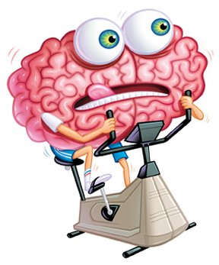
English Home Learning
Booklet
Name:…………………………………………………………………………..
Teacher:………………………………………………………………………

Slide 2
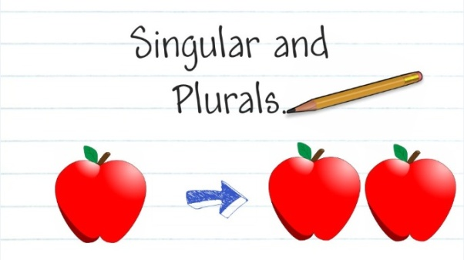
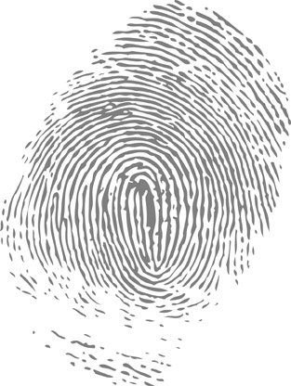
Section four: Singular and plural
What do I need to complete?
Spelling test 1
Read the singular to plural rules
Complete single to plural worksheet
Read page on irregular plurals
Complete sheet on irregular plurals
New vocabulary G and H
Reading comprehension: The Pickwick Papers
Self Assessment: What do I still need to practise from this section?

Slide 3
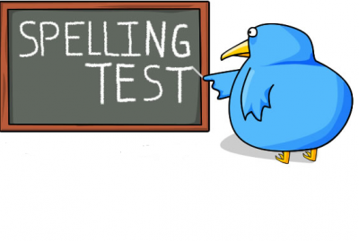
Spelling test 1
You will be tested on your spellings in every
literacy lesson.
You are expected to get at least 17/20 right each time. If you do not manage this you will need to re-take the test at another time.
 | Read | Write | Cover and write
Commonly misspelt words | Committed
 | Conscience
 | Conscientious
 | Conscious
 | Definite
 | Definitely
 | Disappear
 | Discipline
 | Embarrass
 | Equipment
 | Exhilarate
 | Exceed
 | Existence
 | Experience
 | Fiery
Topic specific words

Slide 4
When writing it is very important to make sure we are using singular and plural nouns or our work won’t make sense!
Unfortunately the rules for making a singular word into a plural word is not as easy us just adding an ‘S’ to the end, there are a few rules to look out for.
Some rules for you
Just add an S!
The general rule is just add an S (but)
Sometimes you need to add an es
Change the y to an i and add es
Words that end in ey add an s
Change an F to a V and add an es
Cat › cats
Boss › bosses
Lorry › lorries
Monkey › monkeys
Leaf › leaves
1 - 4 are called regular plurals
5 are called near-regular plurals
There are, of course, exceptions to all these rules.

Slide 5
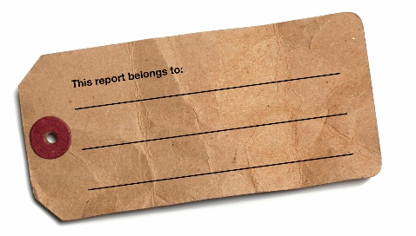
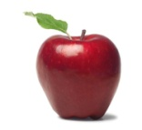
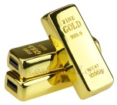
Task
Change these words from single to plural or plural to single.
Gold task: Use the word in an ambitious language technique, e.g. Simile, metaphor, personification.
Singular | Plural | Language technique
Planet
Puppy
Dwarf
 | Dominoes
 | Halves
Baby
Hero
Knife
Find an extra word for each rule and add it to the list below.

Slide 6
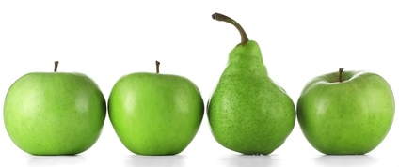
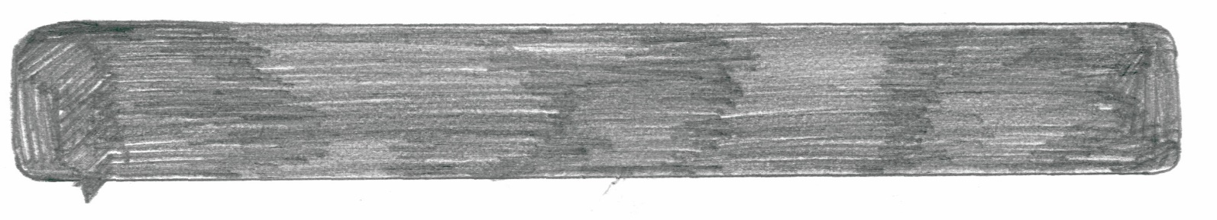
What are the exceptions to the rules?
What does that even mean?
For example, this pear is the exception to the rule, it is green and it is a fruit but it doesn’t come in the same shape – it abides by different rules to the apples.
Words are the same. Some just have different rules to our five basic ones when changing from singular to plural. These are called irregular plurals.
Task: change these commonly used words from single to plural form, or the other way round – we like to keep you on your toes!
Singular | Plural | Language technique
Child
Sheep
Mouse
 | People
 | Feet
Man
 | Women
Penny
 | Teeth

Slide 7
Letter
Word
G
Definition
Sentence (using your word):
Synonyms
Antonyms
Letter
Word
H
Definition
Sentence (using your word):
Synonyms
Antonyms

Slide 8
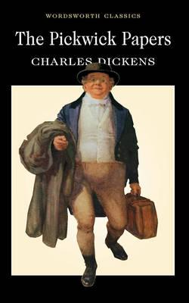
The Pickwick Papers by Charles Dickens
Reading comprehension : Read the extract and answer the questions in as much detail as possible.
Old Wardle led the way to a pretty large sheet of ice; and the fat boy and Mr. Weller, having shovelled and swept away the snow which had fallen on it during the night, Mr. Bob Sawyer adjusted his skates with a dexterity which to Mr. Winkle was perfectly marvellous, and described circles with his left leg, and cut figures of eight, and inscribed upon the ice, without once stopping for breath, a great many other pleasant and astonishing devices, to the excessive satisfaction of Mr. Pickwick, Mr. Tupman, and the ladies; which reached a pitch of positive enthusiasm, when old Wardle and Benjamin Allen, assisted by the aforesaid Bob Sawyer, performed some mystic evolutions, which they called a reel.
All this time, Mr. Winkle, with his face and hands blue with the cold, had been forcing a gimlet into the sole of his feet, and putting his skates on, with the points behind, and getting the straps into a very complicated and entangled state, with the assistance of Mr. Snodgrass, who knew rather less about skates than a Hindoo. At length, however, with the assistance of Mr. Weller, the unfortunate skates were firmly screwed and buckled on, and Mr. Winkle was raised to his feet.
'Now, then, Sir,' said Sam, in an encouraging tone; 'off with you, and show 'em how to do it.'
'Stop, Sam, stop!' said Mr. Winkle, trembling violently, and clutching hold of Sam's arms with the grasp of a drowning man. 'How slippery it is, Sam!'
'Not an uncommon thing upon ice, Sir,' replied Mr. Weller. 'Hold up, Sir!'
This last observation of Mr. Weller's bore reference to a demonstration Mr. Winkle made at the instant, of a frantic desire to throw his feet in the air, and dash the back of his head on the ice.
'These--these--are very awkward skates; ain't they, Sam?' inquired Mr. Winkle, staggering.
'I'm afeerd there's a orkard gen'l'm'n in 'em, Sir,' replied Sam.
'Now, Winkle,' cried Mr. Pickwick, quite unconscious that there was anything the matter. 'Come; the ladies are all anxiety.'

Slide 9
'Yes, yes,' replied Mr. Winkle, with a ghastly smile. 'I'm coming.'
'Just a-goin' to begin,' said Sam, endeavouring to disengage himself.
'Now, Sir, start off!'
'Stop an instant, Sam,' gasped Mr. Winkle, clinging most affectionately to Mr. Weller. 'I find I've got a couple of coats at home that I don't want, Sam. You may have them, Sam.‘
‘Thank'ee, Sir,' replied Mr. Weller.
'Never mind touching your hat, Sam,' said Mr. Winkle hastily. 'You needn't take your hand away to do that. I meant to have given you five shillings this morning for a Christmas box, Sam. I'll give it you this afternoon, Sam.'
'You're wery good, sir,' replied Mr. Weller.
'Just hold me at first, Sam; will you?' said Mr. Winkle. 'There--that's right. I shall soon get in the way of it, Sam. Not too fast, Sam; not too fast.'
Mr. Winkle, stooping forward, with his body half doubled up, was being assisted over the ice by Mr. Weller, in a very singular and un-swan-like manner, when Mr. Pickwick most innocently shouted from the opposite bank—
'Sam!'
'Sir?'
'Here. I want you.'
'Let go, Sir,' said Sam. 'Don't you hear the governor a-callin'? Let go, sir.'
With a violent effort, Mr. Weller disengaged himself from the grasp of the agonised Pickwickian, and, in so doing, administered a considerable impetus to the unhappy Mr. Winkle. With an accuracy which no degree of dexterity or practice could have insured, that unfortunate gentleman bore swiftly down into the centre of the reel, at the very moment when Mr. Bob Sawyer was performing a flourish of unparalleled beauty. Mr. Winkle struck wildly against him, and with a loud crash they both fell heavily down. Mr. Pickwick ran to the spot. Bob Sawyer had risen to his feet, but Mr. Winkle was far too wise to do anything of the kind, in skates. He was seated on the ice, making spasmodic efforts to smile; but anguish was depicted on every lineament of his countenance.
'Are you hurt?' inquired Mr. Benjamin Allen, with great anxiety.
'Not much,' said Mr. Winkle, rubbing his back very hard.

Slide 10
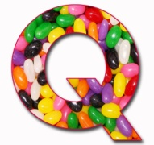
uestions
What shows that Mr Sawyer was an experienced skater?
2. Write down five sentences that show Mr Winkle was new to skating.
3. Why does Dickens use the phrase ‘knew rather less about skates than a Hindoo’ to show Mr Snodgrass’ unfamiliarity with skating?
4. Why did Mr Winkle offer Sam two coats and five shillings?
5. Why did Mr Winkle not want Sam to touch his hat?
6. Write out in correct modern English the four phrases underlined.
7. Write in your words an account of what happened in the paragraph
beginning: ‘With a violent effort’.
8. What is the meaning of these words?
9. Was Mr Winkle hurt by the fall? How do we know?
10.Describe Mr Winkle in your own words. What sort of a man do you think
he was?
a. Dexterity | b. inscribed | c. mystic | d. gimlet
e. singular | f. impetus | g. spasmodic

Slide 11
Answer your questions in detail here:

