Slide 1
Title: Good Sleep Habits |  |  |  | 23 April 2020
Learning Challenge: To learn about the importance of good sleep
Lesson Outcome
SPaG Focus Terminology | Numeracy Focus | SMSC Impact of significant life events on sleep | Terminology:
Emerging
Secure
Mastery
Developing
I can explain how significant life events can disrupt sleep patterns
I can explain why sleep is important for a healthy lifestyle
I can identify how our sleep patterns and needs might change as we grow up
I can describe bedtime routines that help improve sleep
CHALLENGE
Super CHALLENGE

Slide 2

Z
Z
Z
Z
Taking care of myself:
getting a good night’s sleep

Slide 3
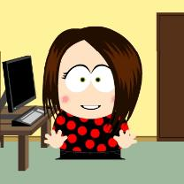


We are learning about the importance of good sleep
      We will be able to:
  Describe bedtime routines that help improve sleep
  Identify how our sleep patterns and needs might change as we grow up
  Explain why sleep is important for a healthy lifestyle
  Explain how significant life events can disrupt sleep patterns

Slide 4


Sleep: What’s our starting point?
Activity 1:
Draw a person getting ready for a good night’s sleep.
Think about — what might they be doing, thinking, feeling?
Answer the three questions

Slide 5
ACTIVITY 1: Draw Here
ACTIVITY 1: Answer the questions here
How this person will feel when they wake up?
What is helping them to sleep well?
What might make it hard for them to sleep well?

Slide 6
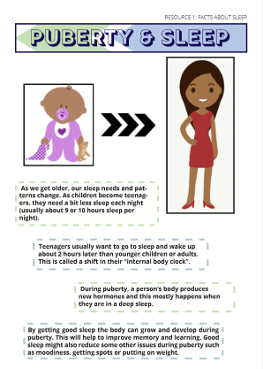
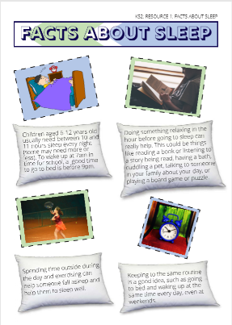
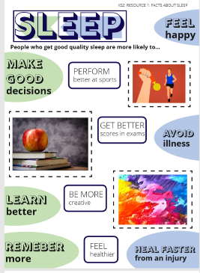
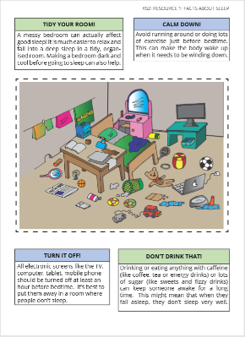
Activity 2: Why is sleep important?
?
?
Go on a fact hunt…
Look at the information on the posters in your worksheet pack (pages 1-4).
Use these posters to help you to answer the questions on the worksheet
(My Sleep Factfile – page 5)
?
?
Could you now tell someone at home the 3 facts you think are most important?
?
?

Slide 7
Activity 2: Answer Here
QUESTION | POSSIBLE ANSWERS
How much sleep do children need each night?
Find 3 things to start doing that help someone get good sleep:
Find 3 things to stop doing that would help someone sleep:
What happens during sleep when someone starts puberty?
Why is it important to get good sleep?

Slide 8
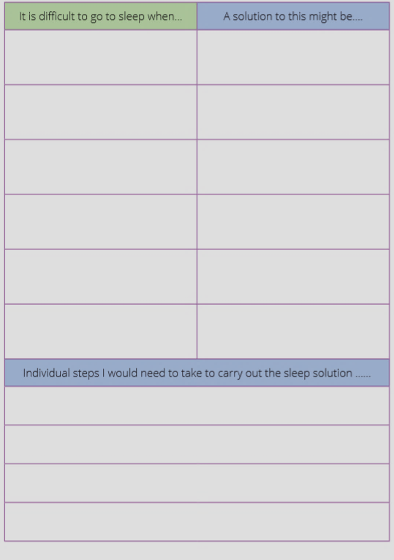

Activity 3: Sleepbusters
Complete the sleep buster solutions grid by coming up with some possible solutions to the problems people might have when trying to go to sleep.
Can you think of any additional problems and solutions?
Add them to the table.

Slide 9

Activity 3: Complete the table with your Solutions
It is difficult to go to sleep when… | A solution to this might be….
Someone has been watching TV, or playing games online before bed
Someone is nervous or worried about something, e.g. a test at school
Someone drinks a sugary or caffeinated drink, such as orange juice, coke or redbull, before bed
Individual steps I would need to take to carry out the sleep solution ……

Slide 10
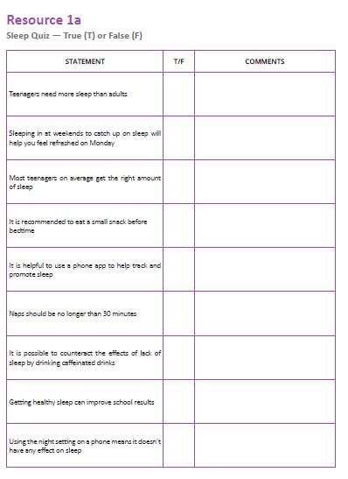
Activity 4: Sleep quiz
Look at each statement in the table (‘Activity 4: Sleep quiz’) and decide if it is true or false.
If you think it’s false, write what you think the truth might be in the comment box next to the statement.
Check your answers using the next slide…
Z
Z
Z

Slide 11
STATEMENT | T/F | COMMENTS
Teenagers need more sleep than adults
Sleeping in at weekends to catch up on sleep will help you feel refreshed on Monday
Most teenagers on average get the right amount of sleep
It is recommended to eat a small snack before bedtime
It is helpful to use a phone app to help track and promote sleep
Naps should be no longer than 45 minutes
It is possible to counteract the effects of lack of sleep by drinking caffeinated drinks
Getting healthy sleep can improve school results
Using the night setting on a phone means it doesn’t have any effect on sleep

Slide 12
STATEMENT | T/F | COMMENTS
Teenagers need more sleep than adults | T | Research shows the average teenager needs just over 9 hours sleep a night, whereas the average for adults is 7 hours. This can be particularly challenging to manage as teenagers often don’t feel tired until considerably later (e.g. 11pm) and have changing routines that require them to wake up in time for school.
Sleeping in at weekends to catch up on sleep will help you feel refreshed on Monday | F | This can actually make sleep worse. An erratic sleep schedule (for eample staying up later at weekends and sleeping in later) make it even harder to fall asleep on Sunday night and wake up on Monday morning. It is much better to maintain regular wake hours over the weekends to keep the body in routine.
Most teenagers on average get the right amount of sleep | F | Due to problems highlighted above, the majority of teenagers are sleep deprived, (often by more than 2 hours of required sleep per night) which accumulates over time.
It is recommended to eat a small snack before bedtime | T | It is a good idea not to go to sleep hungry. While a big meal right before sleep is not advisable, a small snack before bed can help with falling asleep and improve sleep quality.
It is helpful to use a phone app to help track and promote sleep | F | Lots of apps suggest they can help to promote or track sleep, however little research has been done into how effective these really are. Any benefits the app may provide are also likely to be outweighed by having the phone on the bedside table, as the lights on phones and constant notifications throughout the night can have a significant negative impact on sleep
Naps should be no longer than 45 minutes | T | Napping can help sleepiness, but should be no longer than 15-30 mins and in the early afternoon. Napping for longer than this or late in the afternoon can make it difficult to fall asleep at night. Naps should only be used as a technique if absolutely necessary; it is much better to try to improve the quality and length of night-time sleep
It is possible to counteract the effects of lack of sleep by drinking caffeinated drinks | F | Caffeine can give the body a temporary energy boost but it can have sig- nificant detrimental effects over time. Caffeine products are potentially addictive and can impact health; they also disrupt sleep even further.
Getting healthy sleep can improve school results | T | Research suggests that students who get the best results in tests sleep more than their peers. Sleep can improve brain functions such as memory, organisation, decision making and attention.
Using the night setting on a phone means it doesn’t have any effect on sleep | F | As blue light filter apps are relatively new, research studies have not yet been published. However, using your phone before sleep still has other impacts as people are engaging in conversations, games, processing information etc. at a time when the brain needs them to wind down

Slide 13

Sleep: Where are we now?
Go back to the ‘What’s our starting point?’ activity
  Use a different colour pen or pencil to change your draw and write…
  Is there anything you would like to change about your pictures?
  Is there anything you would like to add to your pictures?
Can you think of one thing that you could change about your bedtime routine to help you to get better sleep?

Slide 14
Sleep and Covid 19 (Corona Virus)
At the moment we are in the middle of a worldwide pandemic.
This has meant huge changes to our daily lives.
This can have a big effect on our sleep patterns and maintaining healthy sleep habits.
Have these changes affected your sleep?
Why do you think this has happened?
What can you do to help improve your sleep?
Write down your ideas in the thought bubbles…

Slide 15
Sleep and Covid 19 (Corona Virus)
Why do you think this has happened?
Have lockdown changes affected your sleep?
What can you do to help improve your sleep?
Me

Slide 16


More activities
Instagram
Create an Instagram post to promote good sleep habits during the current shut down.
What can people do to make sure they are sleeping well.
Give me 10
Create a poster of 10 top tips for a good night’s sleep that you can share with your family and friends.
10 TOP TIPS

Slide 17

Further support
If you’re worried about your sleep, you can always speak to your parent or carer, your tutor of other member of staff in school for more advice and support.
The ChildLine website has advice about sleep for young people:
www.childline.org.uk
Phone: 0800 1111
NHS Direct (Tel: 111) can be called for non-urgent medical issues or for further information.
© PSHE Association 2020

