Slide 1

Science work pack
*week 3
Helpful websites to support with the work or for interest:
https://www.bbc.co.uk/bitesize/guides/z2wmxnb/revision/1
https://mysteryscience.com/ https://thekidshouldseethis.com/
There is online learning available at:
app.senecalearning.com/dashboard/join-class/4ggjlziov1
You need to sign up using an email address. When asked to type in the school it is St Matthias academy. This should take you to straight to the learning page, if you are asked for a class code it is: 4ggjlziov1. There are tutorials and then questions.
Please work on the assignments and I can see what has been completed and how well you are doing.
Miss Grant

Slide 2
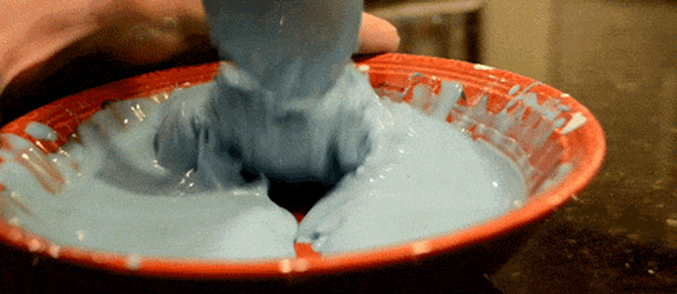
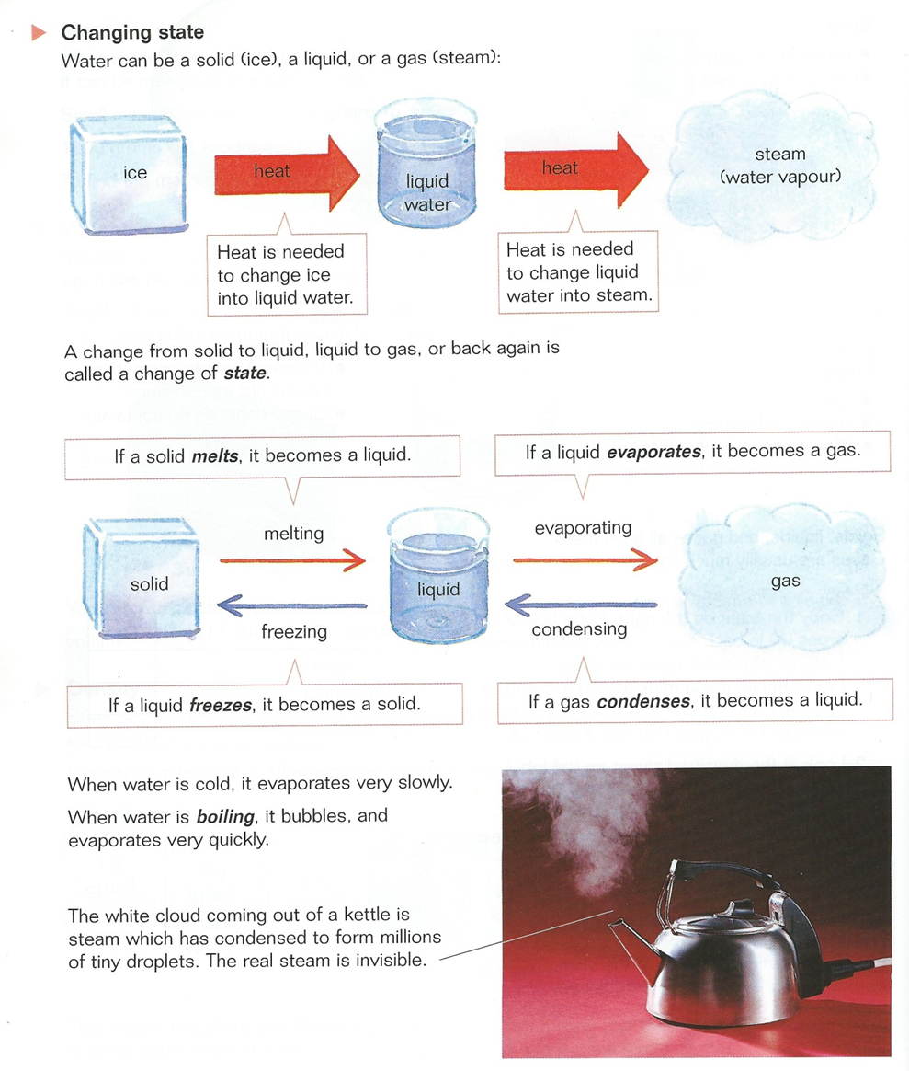
Try this at home pour some cornflour or custard powder into a bowl, add just enough water to make it into a stiff paste. If you move this quickly it is hard, if you pick it up and leave it, it will drizzle through your fingers.
This is known as a non-Newtonian fluid. Look online and you will see people running on custard because of this property

Slide 3
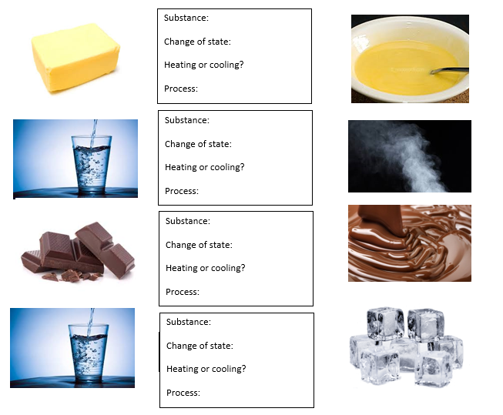
Use the tables to help you complete the boxes
Substance
Water to steam
water to ice
Solid butter to liquid butter
Chocolate bar to liquid chocolate
Process
Evaporating
Melting
freezing
Change of state
Water to steam
water to ice
Solid butter to liquid butter
Chocolate bar to liquid chocolate

Slide 4
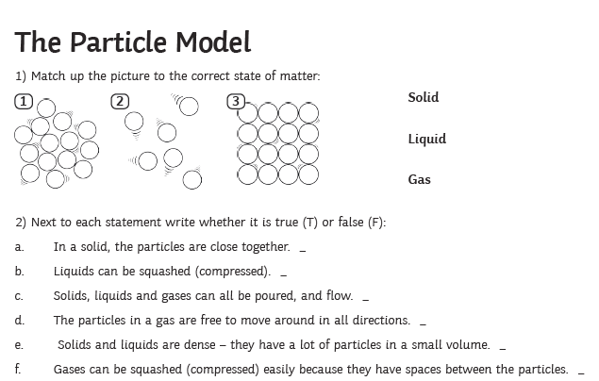
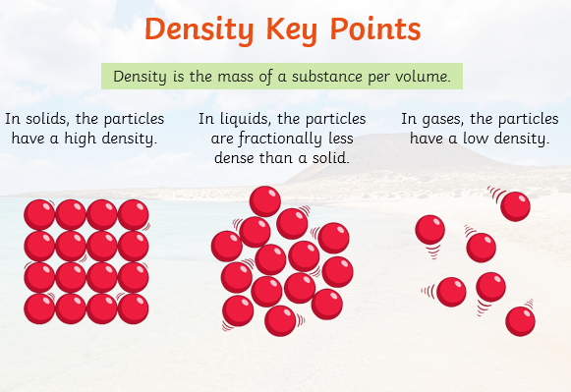

Slide 5
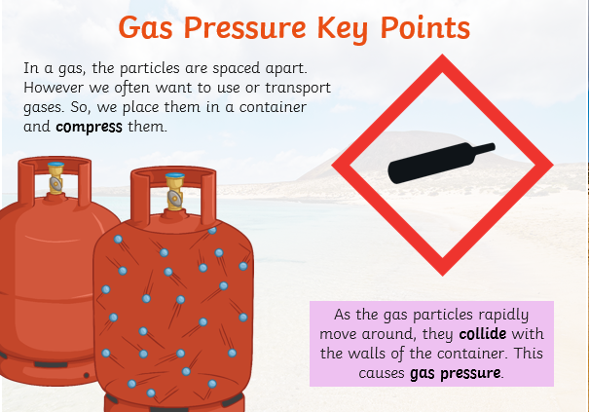
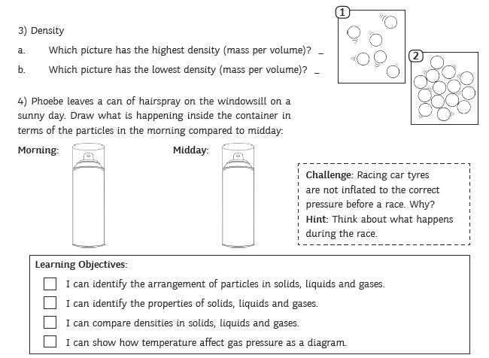

Slide 6
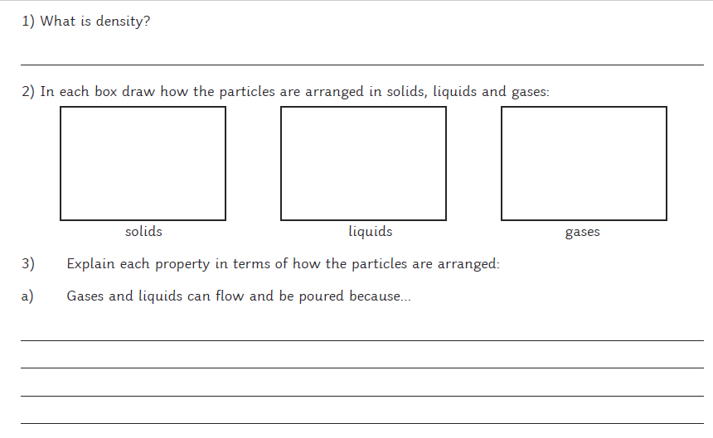
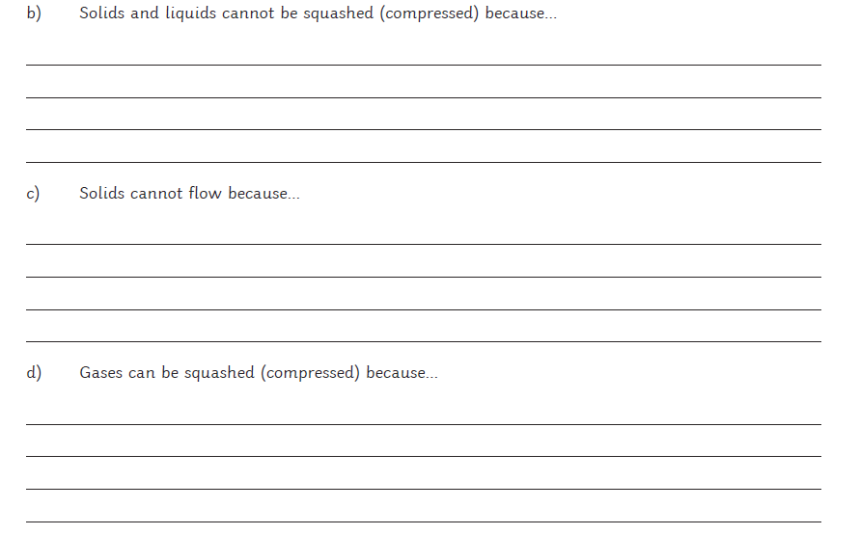

Slide 7
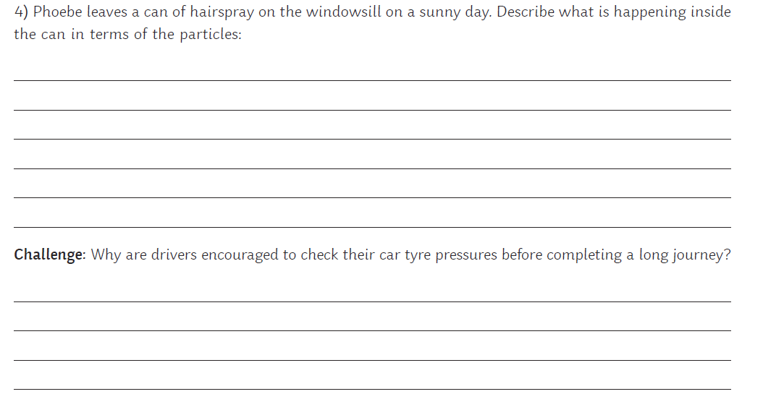

Slide 8
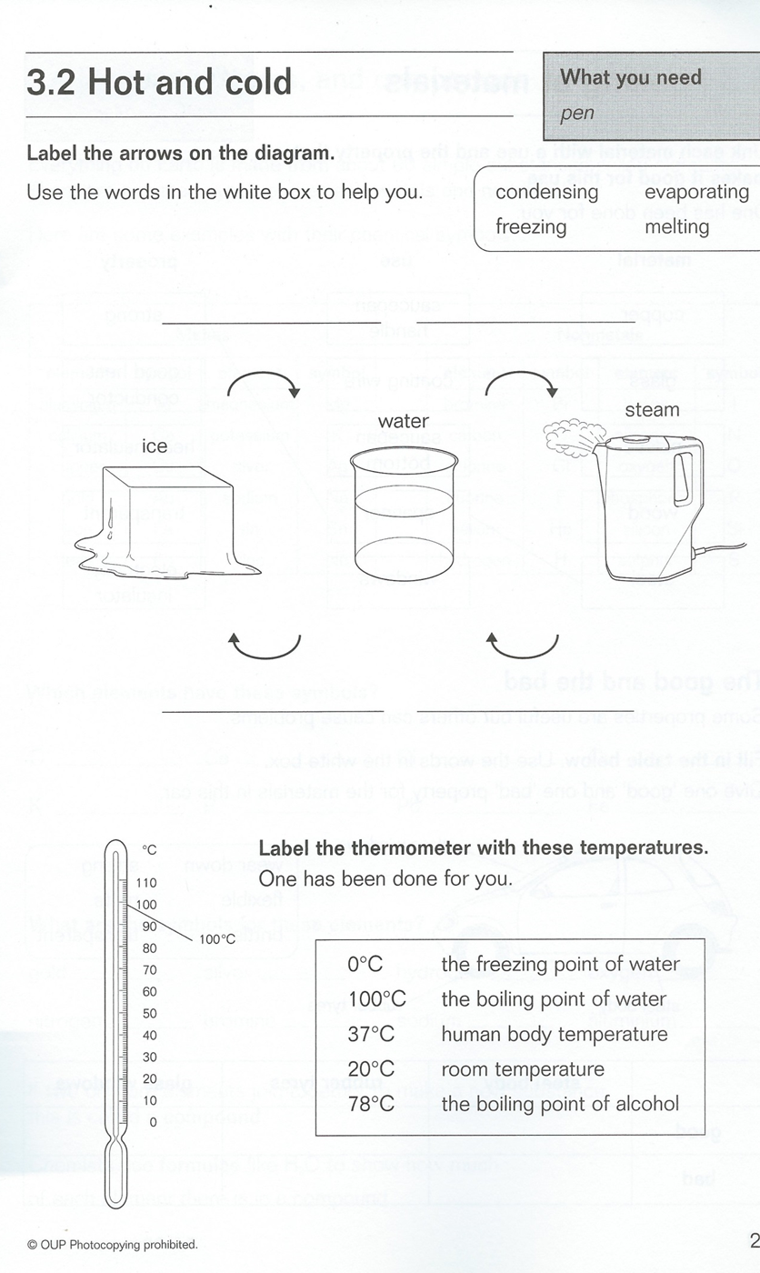

Slide 9
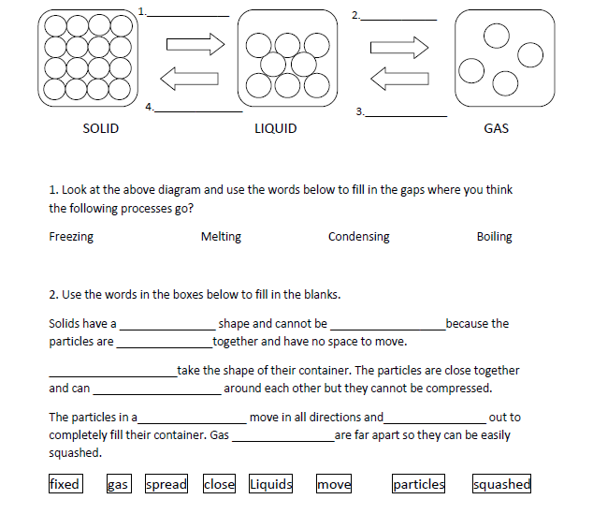
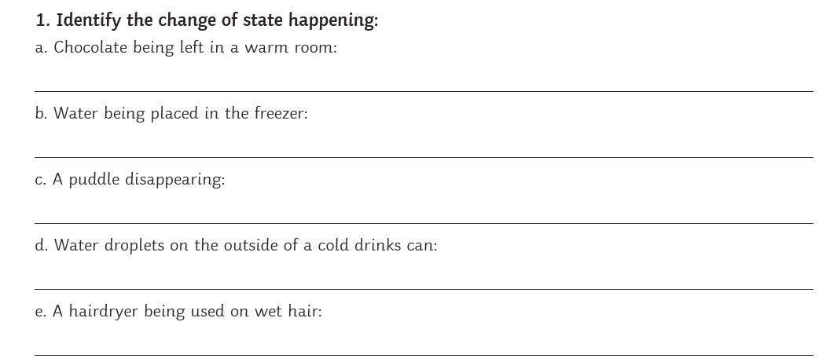

Slide 10
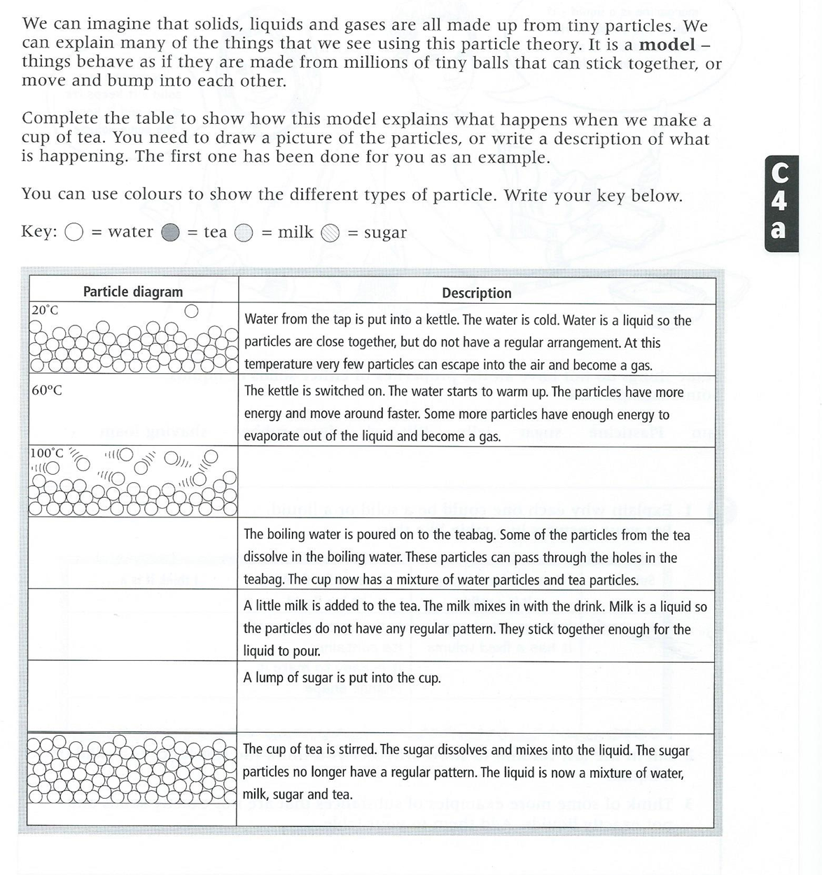

Slide 11
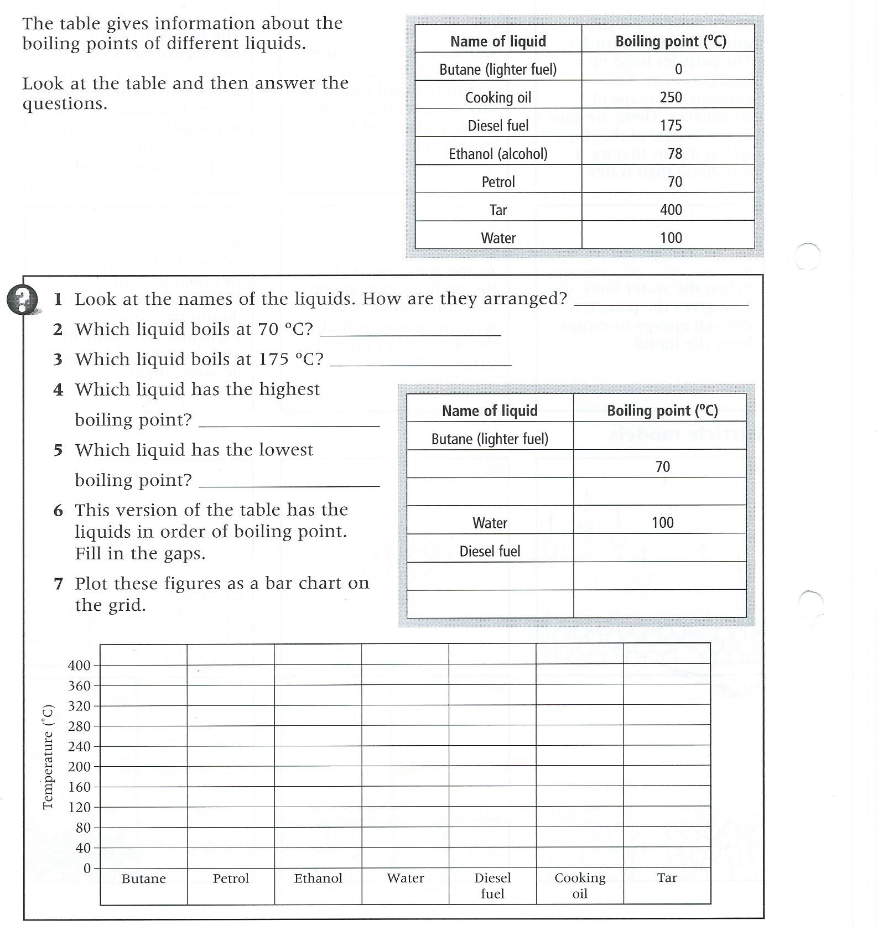

Slide 12
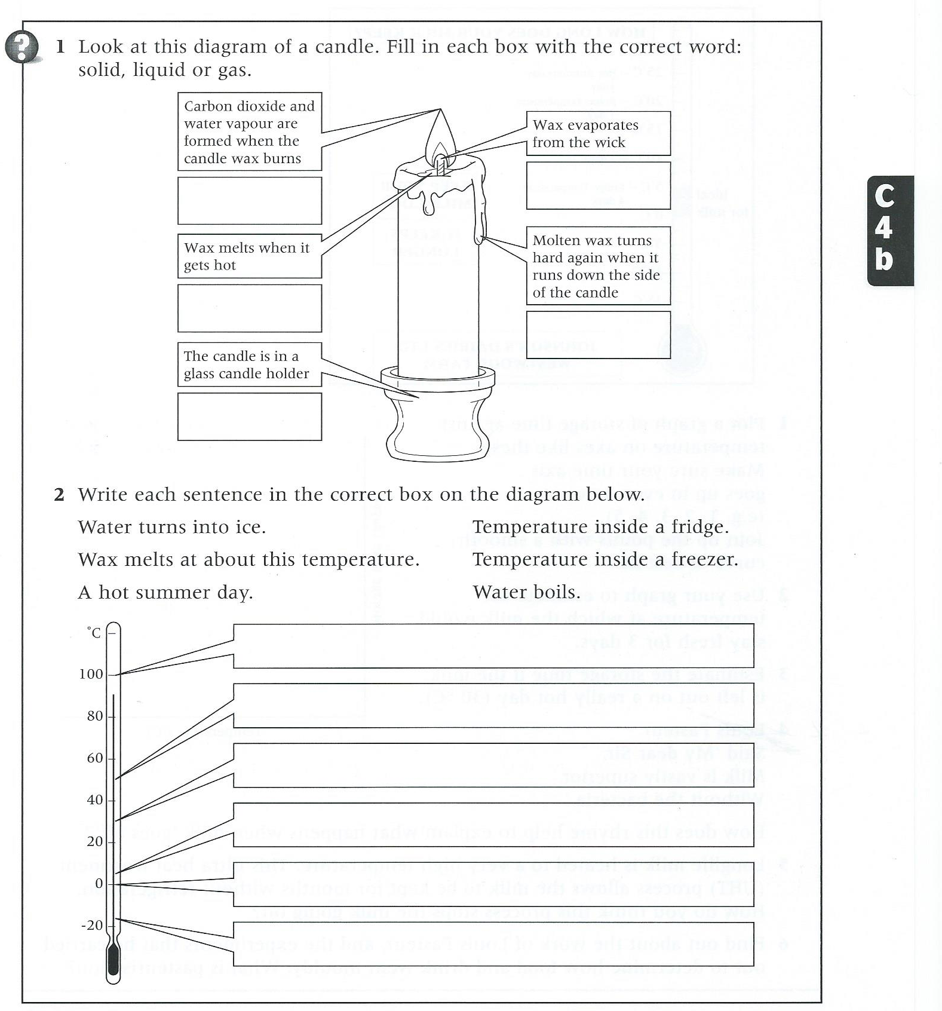

Slide 13
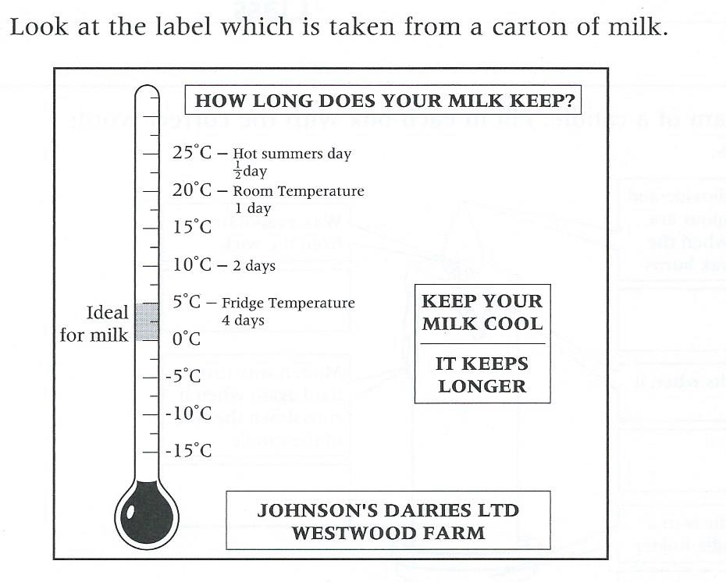

Plot on a graph how long milk lasts at different temperatures. The x-axis has been done for you. Make sure you label the y-axis.
Use your graph to estimate the temperature which would cause milk to last 3 days.
_______________
Estimate the storage time if the milk is at 30°C
_______________
Why do you think milk goes off quicker at higher temperatures?
________________________________________________________________________________________________________________________________________________________________________________________
0 1 2 3 4
Days

Slide 14
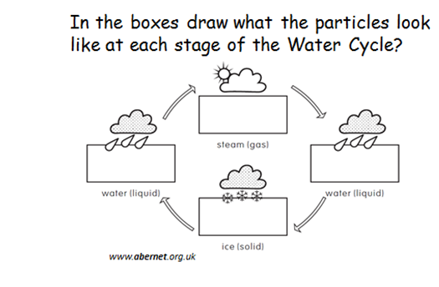
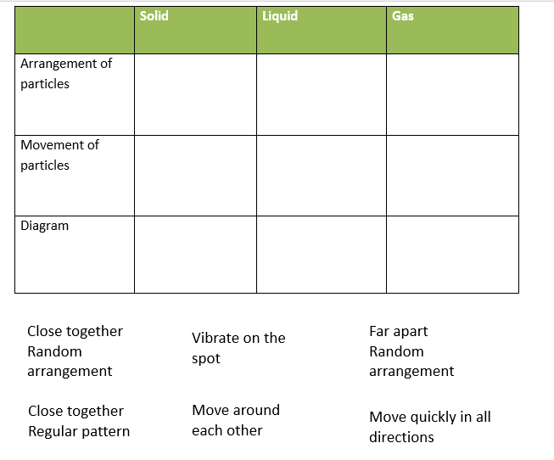

Slide 15
Assessment task
Draw particle diagrams and label the change of state in the boxes
Tick or cross to answer the questions
Key words: particles close far move random condense melt evaporate freeze

Slide 16


