Slide 1
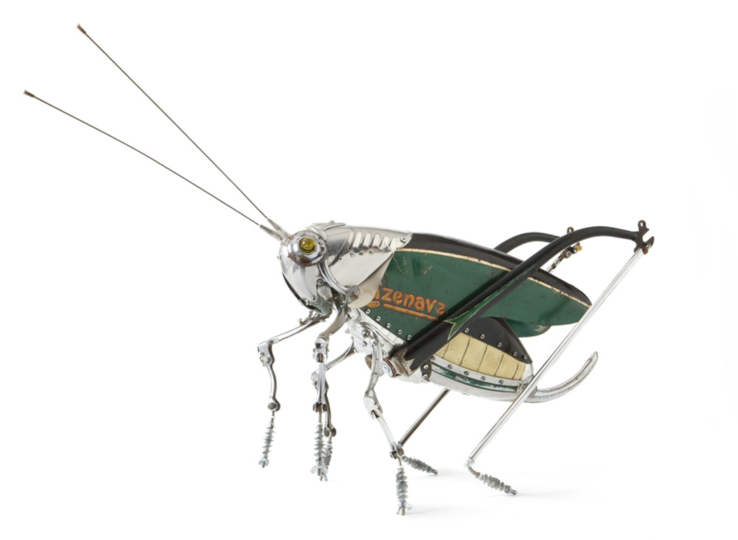
Insects
art@stmatthias
Grasshopper
by Edouard Martinet
Learning objective: developing observational drawing skills
Success criteria:
I can draw from observation .
I can draw some details showing that I have looked many times at the photograph.

Slide 2
Insect art
Look at the art.
What can you see?
Which colours are used?
When was it made?
What is it made of?
Why do you think the artist made it?
What kinds of insects can you see in the painting?
How does the image make you feel?
Which of the artworks would you have in your home? Why?

Slide 3
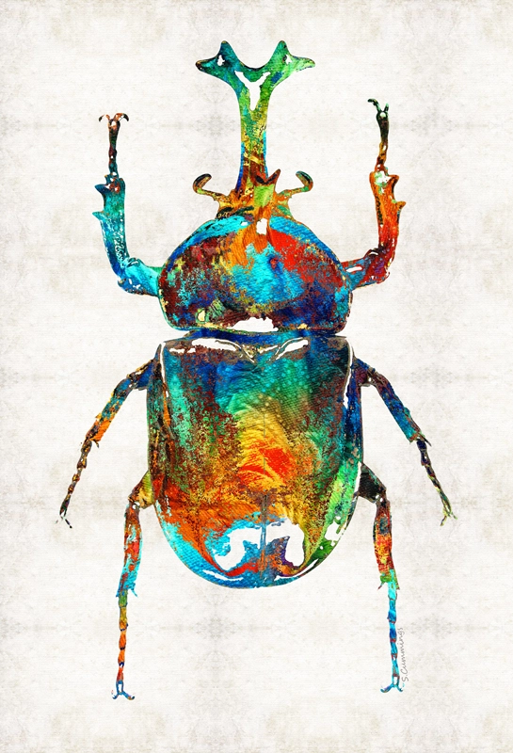
Insect art
Look at the art.
What can you see in the photograph?
Which colours are used?
When was it made?
What is it made of?
Why do you think the artist made it?
What kinds of insects can you see in the painting?
How does the image make you feel?
Which of the artworks would you have in your home? Why?
Sharon Cummings

Slide 4
Insect art
Grasshopper
by Edouard Martinet
Look at the art.
What can you see in the photograph?
Which colours are used?
When was it made?
What is it made of?
Why do you think the artist made it?
What kinds of insects can you see in the painting?
How does the image make you feel?
Which of the artworks would you have in your home? Why?

Slide 5
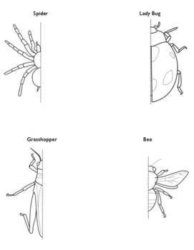
Drawing insects
Draw the missing half using LINE ONLY

Slide 6
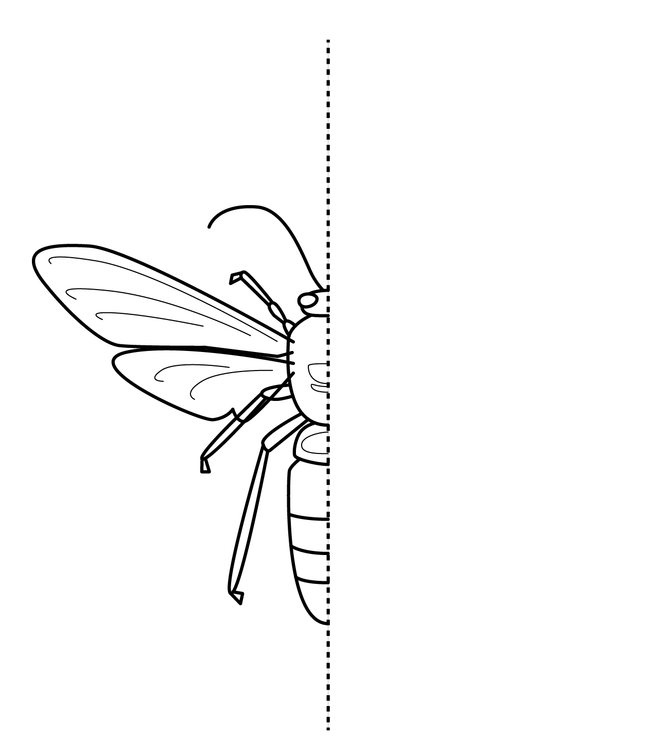
Draw the missing half using LINE ONLY
Can you use TONE to make it 3D?

Slide 7
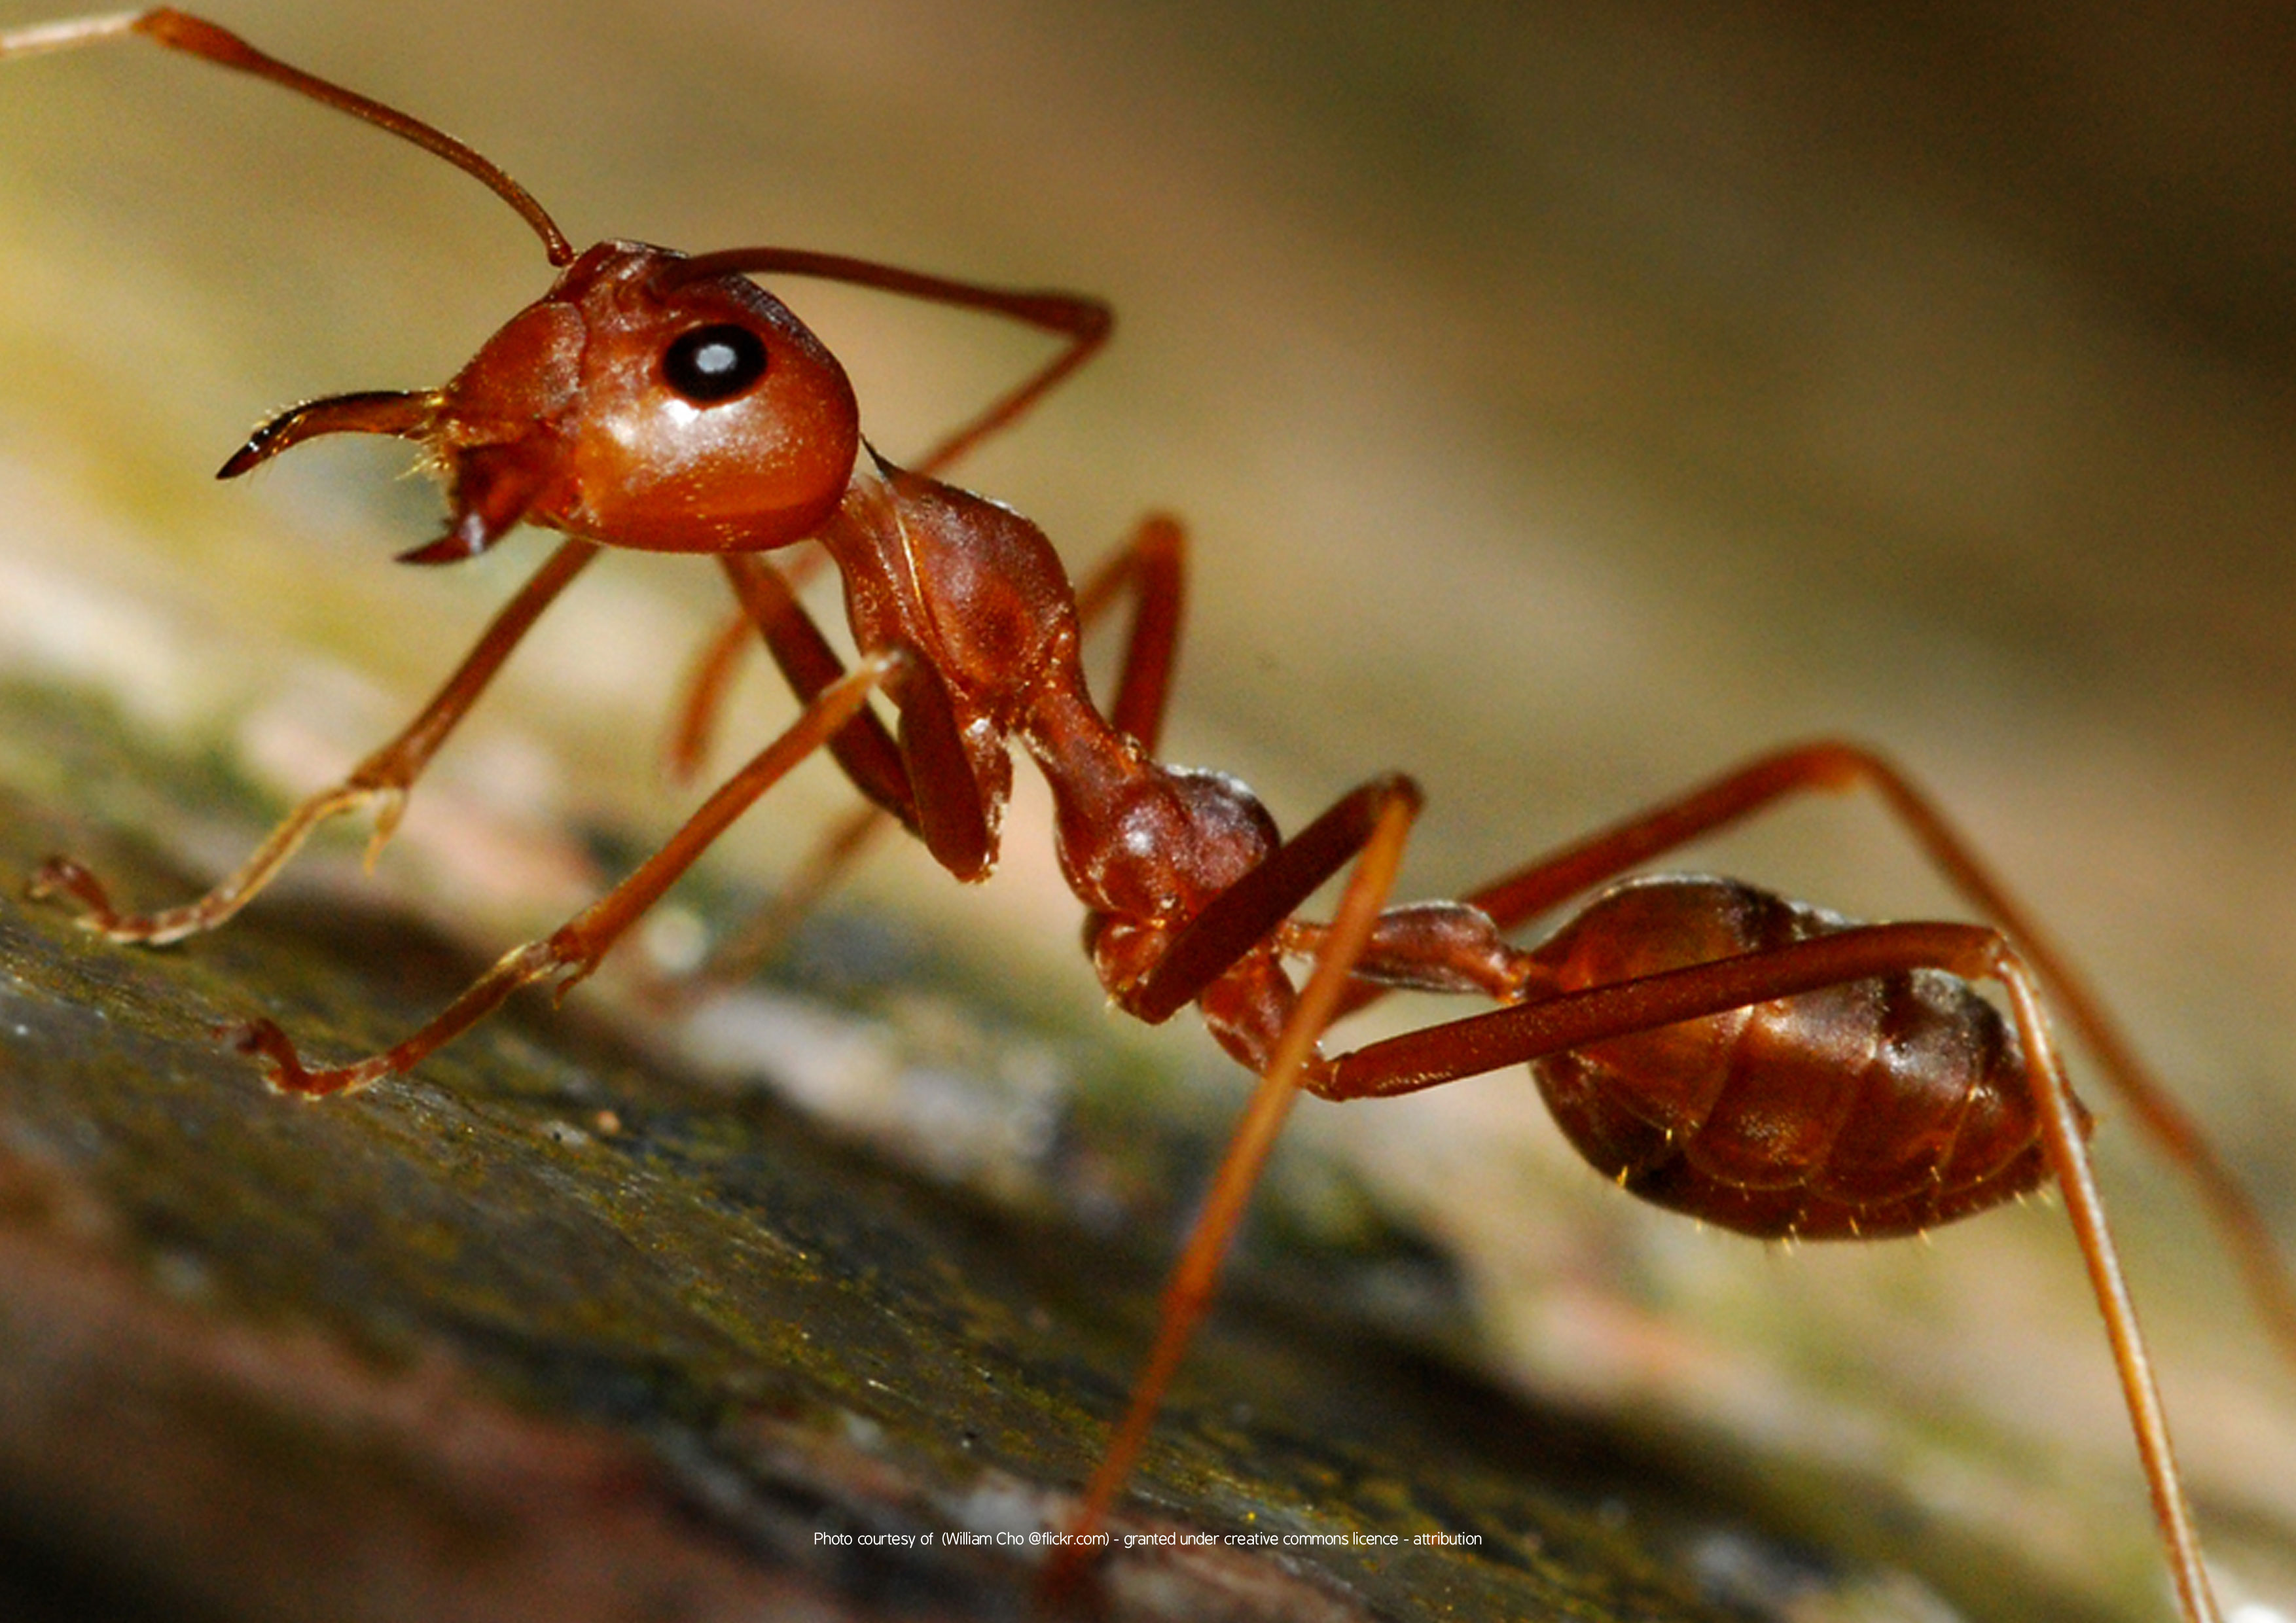
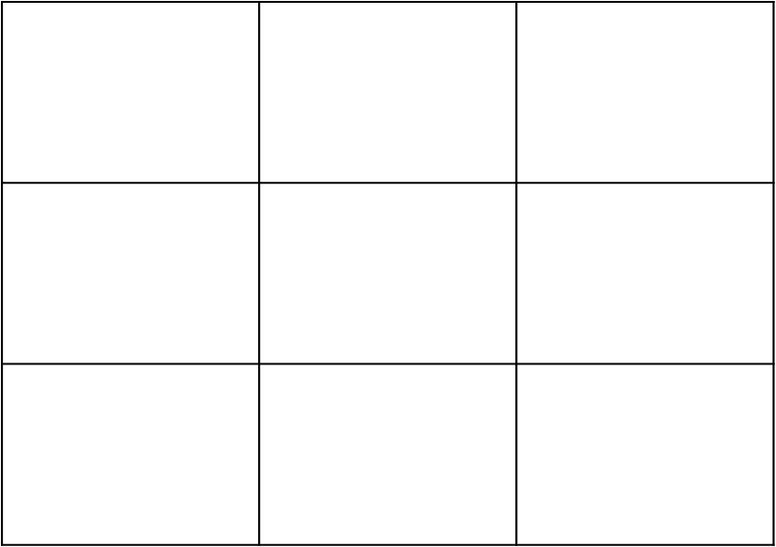
Drawing from observation
OBSERVE the basic SHAPES that make up the ant and draw.

