Slide 1
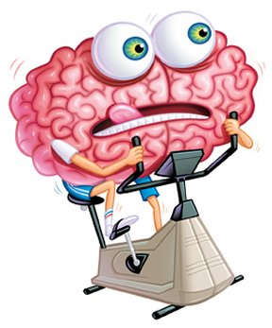
Exercise your brain!
English Home Learning
Week 5
Name:_____________________
Teacher:___________________

Slide 2
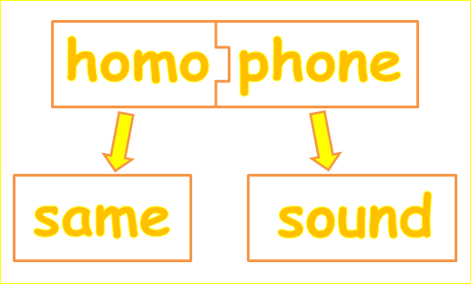

Section two: Homophones
What do I need to complete over the next two weeks?
Spelling test 2
What is a homophone? – read
Homophone tasks (x4)
Extended writing task
New vocabulary I and J
Reading comprehension: Frankenstein
Self Assessment: What do I still need to practise from this section?

Slide 3
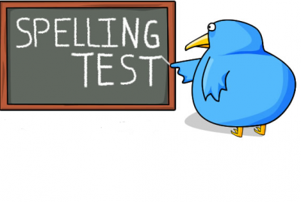
Spelling test 2
You will be tested on your spellings in every
literacy lesson.
You are expected to get at least 17/20 right each time. If you do not manage this you will need to re-take the test at another time.
 | Read | Write | Cover and write
Commonly misspelt words | Foreign
 | Fourth
 | Gauge
 | Generally
 | Grammar
 | Grateful
 | Guarantee
 | Harass
 | Height
 | Hierarchy
 | Ignorance
 | Immediate
 | Independent
 | Indispensible
 | Intelligence
Topic specific words

Slide 4

What is a homophone?
Homophones are words that sound the same but have different
meanings. If we get these words wrong it can create a
completely different meaning to our writing and understanding.
Why is it important? Moving forward there will be a larger emphasis on SPaG in your GCSE exams. Across literature and language it will now be worth 20% of the grade, so let’s start practising now!
The basics and most frequent
There | Use there when referring to a place, whether concrete ("over there by the building") or more abstract ("it must be difficult to live there"). Also use there with the verb BE (is, am, are, was, were) to indicate the existence of something, or to mention something for the first time. If you wrote there, will the sentence still make sense if you replace it with here? If so, you're using it correctly.
They’re | A contraction of they and are where you simply add an apostrophe to omit (add in the place of a letter) the letter a in the are. If you used they're, will the sentence still make sense if you replace it with they are? If so, you're on the right track!
Their | When you are talking bout something that someone owns. If you chose their, will the sentence still make sense if you replace it with our? If so, you've chosen the correct word.
Task
Fill in the blanks using the correct their / they’re / there.
____________ going to the funfair but _______ not sure what rides to go on yet.
___________ house was amazingly beautiful but _________ incredibly rude!
She couldn’t collect her boots from the cupboard as _________ was a gigantic spider in _________.
This is __________ ball of green string and __________ going to build a helicopter with it.
Please go over _______ and speak to Mr. Smith about the topic. When you have finished ask group two if you can borrow _______ pencils.

Slide 5
Here | Use here when referring to a place, whether concrete (“please come over here by the entrance") or more abstract ("it must be difficult to live here"). Also use here with the verb BE (is, am, are, was, were) to indicate the existence of something, or to mention something for the first time. If you wrote here, will the sentence still make sense if you replace it with there? If so, you're using it correctly. (Did you notice – this was very similar to there?)
Hear | One of your five senses. The noises that go into your ear. Is there reference to a sound or noise in the sentence, then you are using the right homophone!
You need to wait _________ patiently until the bus comes.
Can you _______ the bells in the distance?
“What is this over _________? Have you drawn on the wall?”
She rang the reception bell impatiently and eventually ended up yelling, “Hello, I am here!”
I feel ancient, I can barely _________ myself think of this racket they call music.
To | Use to as a preposition before a noun or as an infinitive before a verb.
Too | Use too as a synonym for also or to indicate excessiveness (a lot of something!) Can you replace too with also, you are probably using the right one!
Two | Simply the number after one.
I ate _______ much cake and now I think I am going ______ explode.
Annoyingly, when I opened my Skittles , I only had ______ red ones. I am going ______ complain.
This time he has gone ______ far.
Atticus talks _______ much. I need him to understand that I only have _______ minutes before my curfew runs out.
Meet me at ________ O’clock to catch the train to Upminster

Slide 6

Where | Where is one of our 5 Ws for asking questions. Like there and here, it is also a place.
Wear | Used when referring to an item that you, or somebody else, have on their body.
We’re | The same as you’re, a contraction for we and are. If you can replace it with we are then you have the right one!
Were | The past tense of was.
“________ are we going? Is it some_______ fun?” Lucy squealed.
_________ going to go crazy if we sit here any longer.
I thought I was going to ________ a woolly hat but by the time I was ready it was sunny outside.
They ________ going to the gym but then they passed the ice cream parlour, _______ they spent the next hour.
_________ going to have to resort to plan B _________ we use the dancing crocodile instead of the gymnastic elephant.
Imagine you are secret agent trying to stop the mastermind of the criminal world from stealing the crown jewels.
Describe your plan in detail using all the homophone words we have looked at today.
Extended writing task

Slide 8
Letter
Word
I
Definition
Sentence (using your word):
Synonyms
Antonyms
Letter
Word
J
Definition
Sentence (using your word):
Synonyms
Antonyms

Slide 9
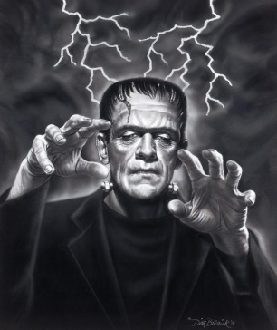
Frankenstein by Mary Shelley
Reading comprehension : Read the extract and answer the questions in as much detail as possible.
Chapter 5
It was on a dreary night of November that I beheld the accomplishment of my toils. With an anxiety that almost amounted to agony, collected the instruments of life around me, that I might infuse a spark of being into the lifeless thing that lay at my feet. It was already one in the morning; the rain pattered dismally against the panes, and my candle was nearly burnt out, when, by the glimmer of the half-extinguished light, I saw the dull yellow eye of the creature open; it breathed hard, and a convulsive motion agitated its limbs.
How can I describe my emotions at this catastrophe, or how delineate the wretch whom with such infinite pains and care I had endeavoured to form? His limbs were in proportion, and I had selected his features as beautiful. Beautiful! -- Great God! His yellow skin scarcely covered the work of muscles and arteries beneath; his hair was of a lustrous black, and flowing; his teeth of a pearly whiteness; but these luxuriances only formed a more horrid contrast with his watery eyes, that seemed almost of the same colour as the dun white sockets in which they were set, his shrivelled complexion and straight black lips.
The different accidents of life are not so changeable as the feelings of human nature. I had worked hard for nearly two years, for the sole purpose of infusing life into an inanimate body. For this I had deprived myself of rest and health. I had desired it with an ardour that far exceeded moderation; but now that I had finished, the beauty of the dream vanished, and breathless horror and disgust filled my heart. Unable to endure the aspect of the being I had created, I rushed out of the room, continued a long time traversing my bed chamber, unable to compose my mind to sleep. At length lassitude succeeded to the tumult I had before endured; and I threw myself on the bed in my clothes, endeavouring to seek a few moments of forgetfulness. But it was in vain: I slept, indeed, but I was disturbed by the wildest dreams. I thought I saw Elizabeth, in the bloom of health, walking in the streets of Ingolstadt. Delighted and surprised, I embraced her; but as I imprinted the first kiss on her lips, they became livid with the hue of death; her features appeared to change, and I thought that I held the corpse of my dead mother in my arms; a shroud enveloped her form, and I saw the grave-worms crawling in the folds of the flannel. I started from my sleep with horror; a cold dew covered my forehead, my teeth chattered, and every limb became convulsed: when, by the dim and yellow light of the moon, as it forced its way through the window shutters, I beheld the wretch -- the miserable monster whom I had created. He held up the curtain of the bed and his eyes, if eyes they may be called, were fixed on me.

Slide 10

His jaws opened, and he muttered some inarticulate sounds, while a grin wrinkled his cheeks. He might have spoken, but I did not hear; one hand was stretched out, seemingly to detain me, but I escaped, and rushed down stairs. I took refuge in the courtyard belonging to the house which I inhabited; where I remained during the rest of the night, walking up and down in the greatest agitation, listening attentively, catching and fearing each sound as if it were to announce the approach of the demoniacal corpse to which I had so miserably given life.
Oh! no mortal could support the horror of that countenance. A mummy again endued with animation could not be so hideous as that wretch. I had gazed on him while unfinished he was ugly then; but when those muscles and joints were rendered capable of motion, it became a thing such as even Dante could not have conceived.
I passed the night wretchedly. Sometimes my pulse beat so quickly and hardly that I felt the palpitation of every artery; at others, I nearly sank to the ground through languor and extreme weakness. Mingled with this horror, I felt the bitterness of disappointment; dreams that had been my food and pleasant rest for so long a space were now become a hell to me; and the change was so rapid, the overthrow so complete!
uestions
Summarise in 50 – 100 words what has happened in the passage you have read.
How does Dr Frankenstein feel about the monster he has created? How do you know this?
How does the author describe the monster? What effect does this create?
Find 3 quotes that tell you Dr Frankenstein is afraid.
Extended writing
Create a diary entry as if you are Dr Frankenstein and you have just created your monster. Include thoughts and feelings. Also, include lots of description so that the reader can imagine what you are seeing and doing.

Slide 11
Answer your questions in detail here:

