Slide 1
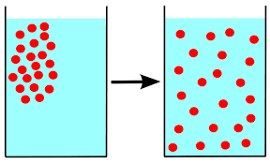
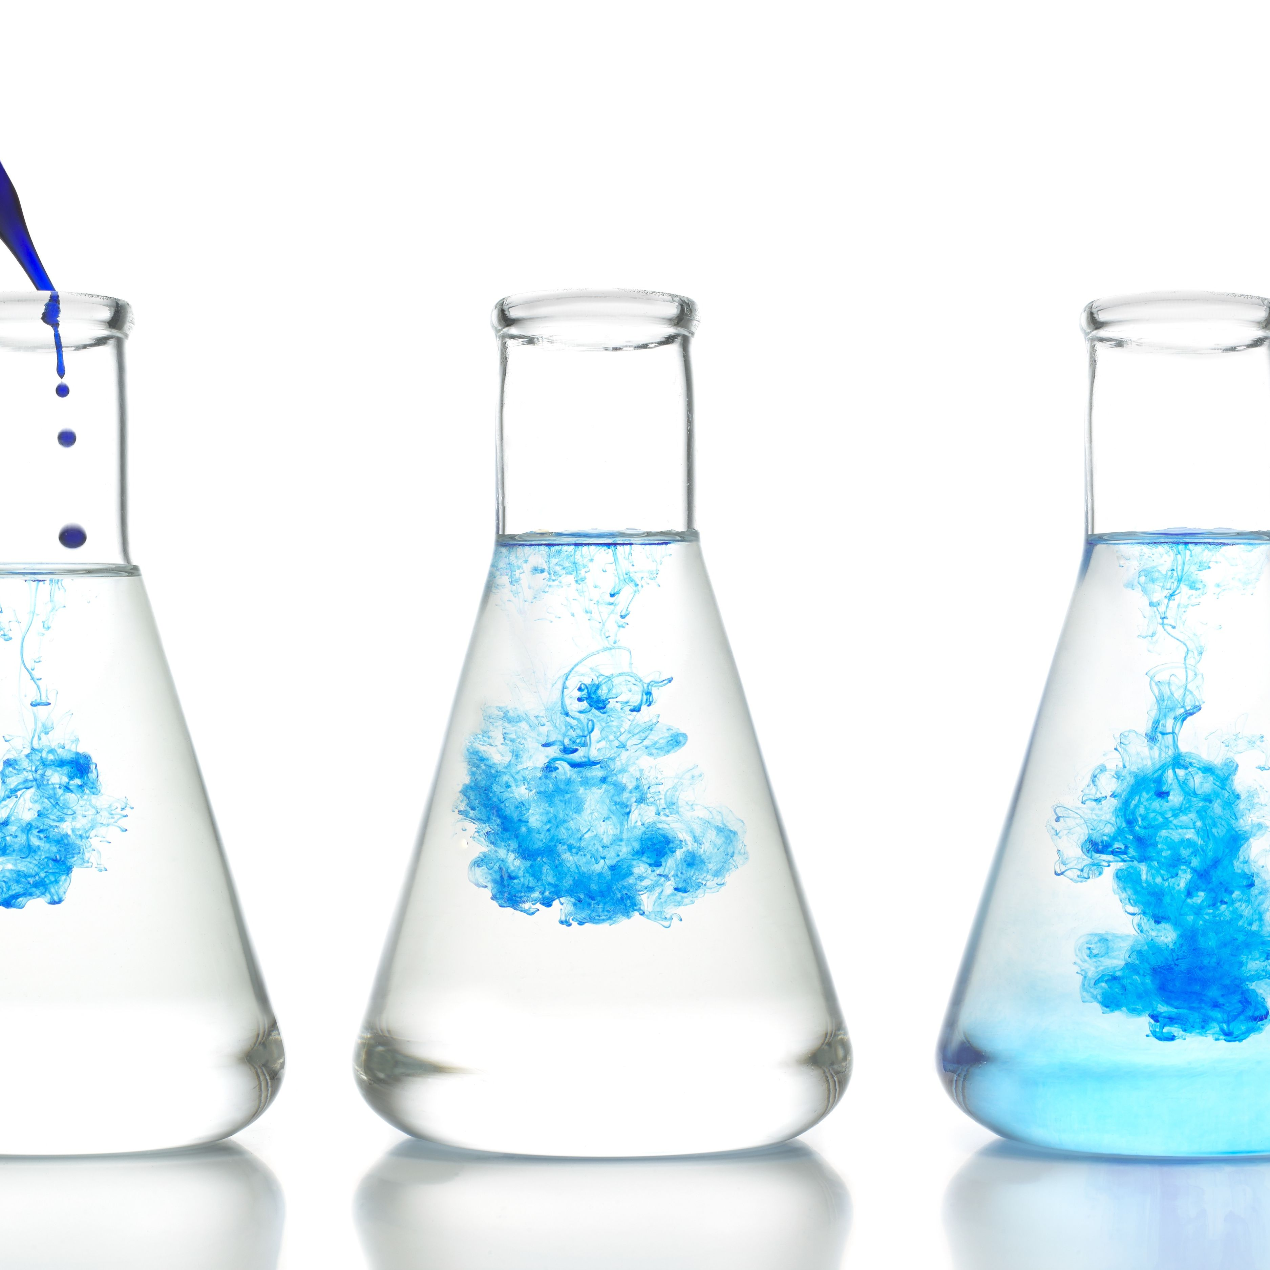
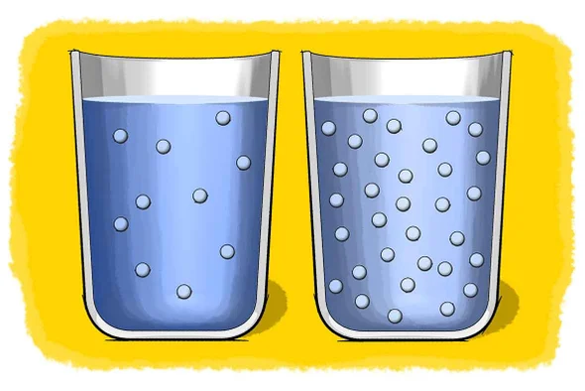
Science work pack
week 5
Helpful websites to support with the work or for interest:
https://www.bbc.co.uk/bitesize/guides/z2wmxnb/revision/1
https://mysteryscience.com/ https://thekidshouldseethis.com/
There is online learning available at:
app.senecalearning.com/dashboard/join-class/4ggjlziov1
You need to sign up using an email address. When asked to type in the school it is St Matthias academy. This should take you to straight to the learning page, if you are asked for a class code it is: 4ggjlziov1. There are tutorials and then questions.
Please work on the assignments and I can see what has been completed and how well you are doing.
Miss Grant

Slide 2
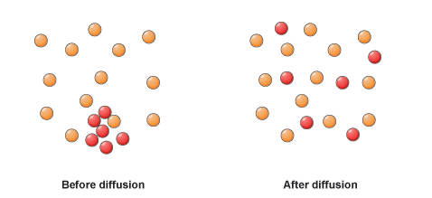
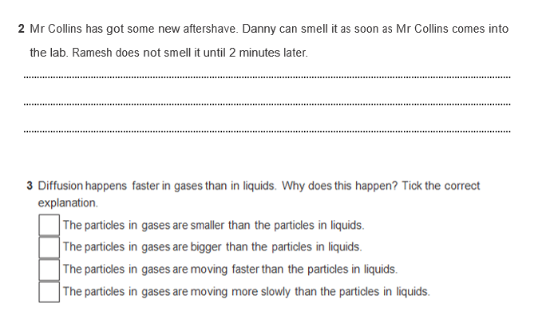
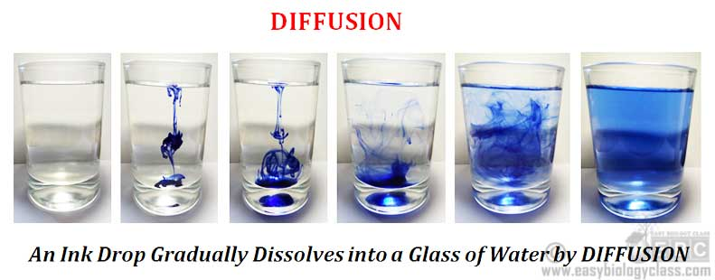
What is diffusion?
Diffusion is the spreading out of particles of a substance within a liquid or gas. It doesn’t require stirring!
Can you think of a reason why?

Slide 3
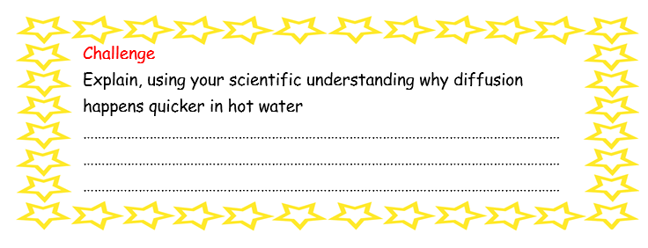
Diffusion
If you have food colouring at home. Fill a glass with water add a few drops of food colouring or squash and watch. Complete the sentences below:
When I first added the food colouring it was in one _ _ _ _
Then the food colouring _ _ _ _ _ _ out through the water until the whole beaker was _ _ _ _ _ _ _ _
This was because of _ _ _ _ _ _ _ _ _
Diffusion is the spreading out and mixing of particles in a _ _ _ _ _ _ or gas.
Diffusion does not happen in _ _ _ _ _ because the particles in a solid cannot move around.
diffusion solids coloured spread liquid area
Draw diagrams showing what happened to the particles as they diffused. Using a colour to show the food colouring particles

Slide 4

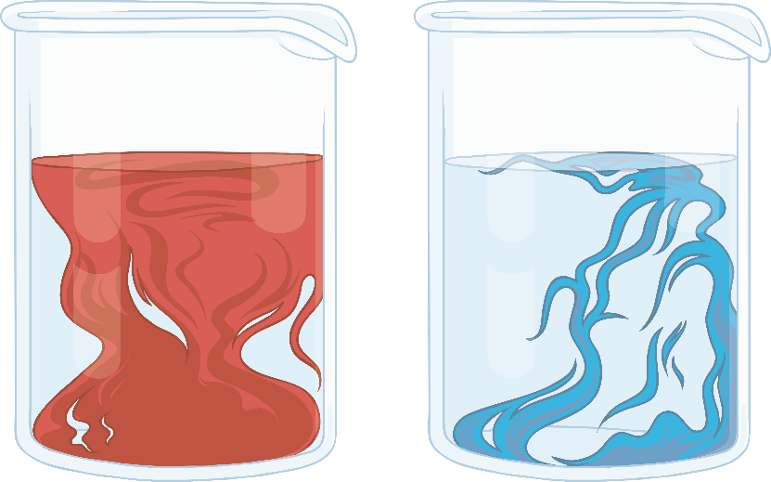
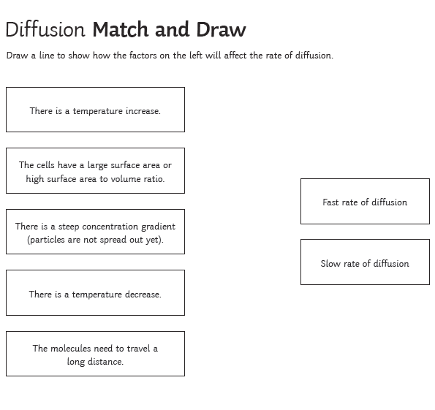
Temperature
If we tried making a cup of tea with cold water, we’d have to wait a very long time for the tea to diffuse – if it even diffused at all. We make it with hot water because the heated particles in the water move faster, speeding up the process of diffusion and therefore bringing the flavour out.
Not to mention that nobody likes cold tea!

Slide 5
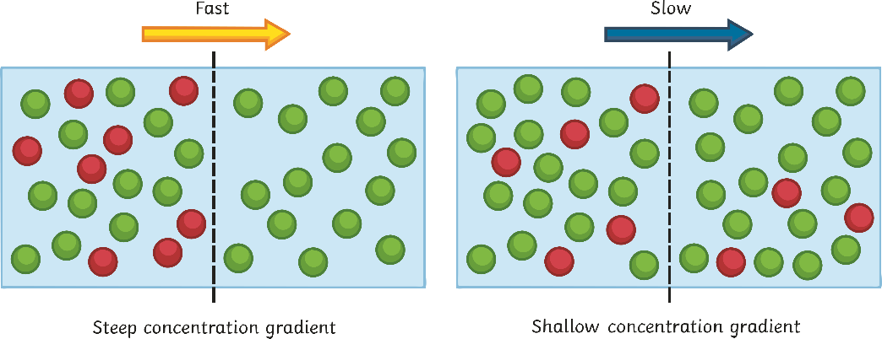
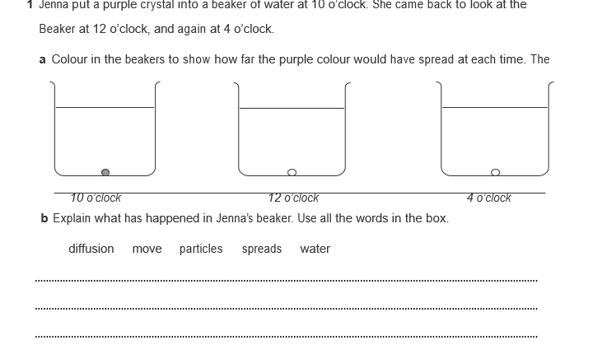
Concentration
Particles moves from an area of high concentration (lots of them) to an area of low concentration (fewer of them). Think about the cooking smells from the kitchen; slowly, they make their way into different rooms. If they didn’t do this, the smells would permanently be in the kitchen!

Slide 6
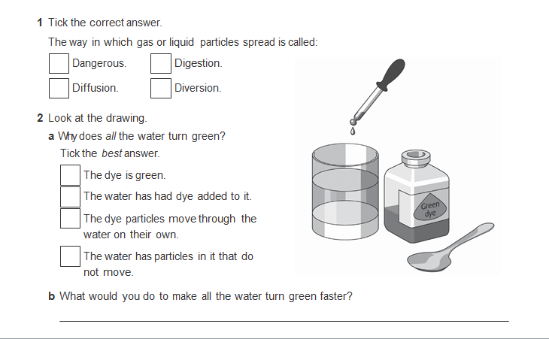
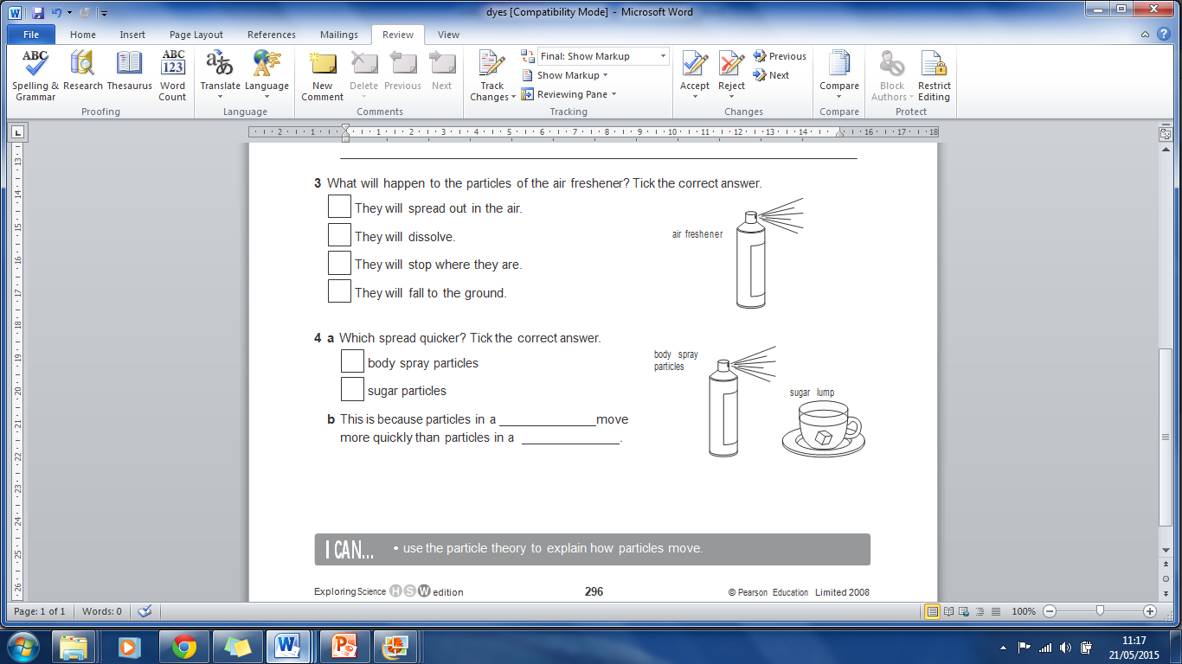
Randomly, energy, diffusion, air, faster, particles
When food cooks, you can smell it because some ……….. leave the food.
The particles move ………… and mix with the ….. ……
This is called ……. …….
Particles diffuse because ………… is transferred.
The higher the temperature, the …….….. the diffusion

Slide 7
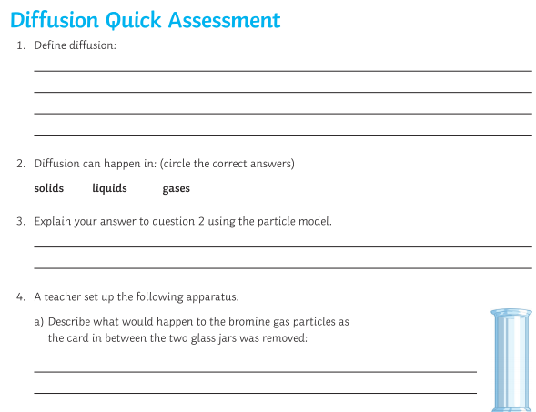
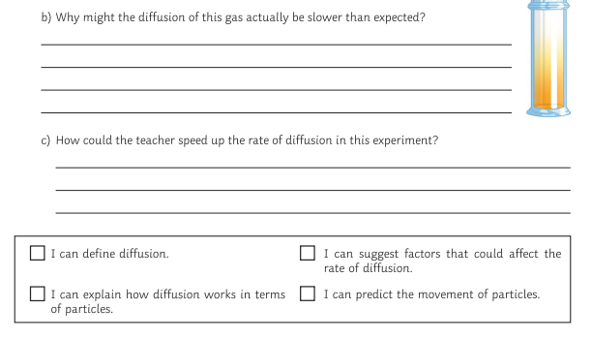

Slide 8
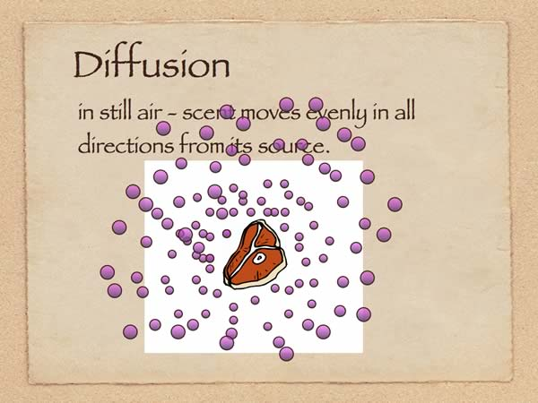
Creative task
Choose a time in your life when diffusion has happened (eg, spraying perfume, smelling doughnuts, adding squash to water)
Draw a picture to show the diffusion of the particles
Add labels to show what is happening to the particles

Slide 9
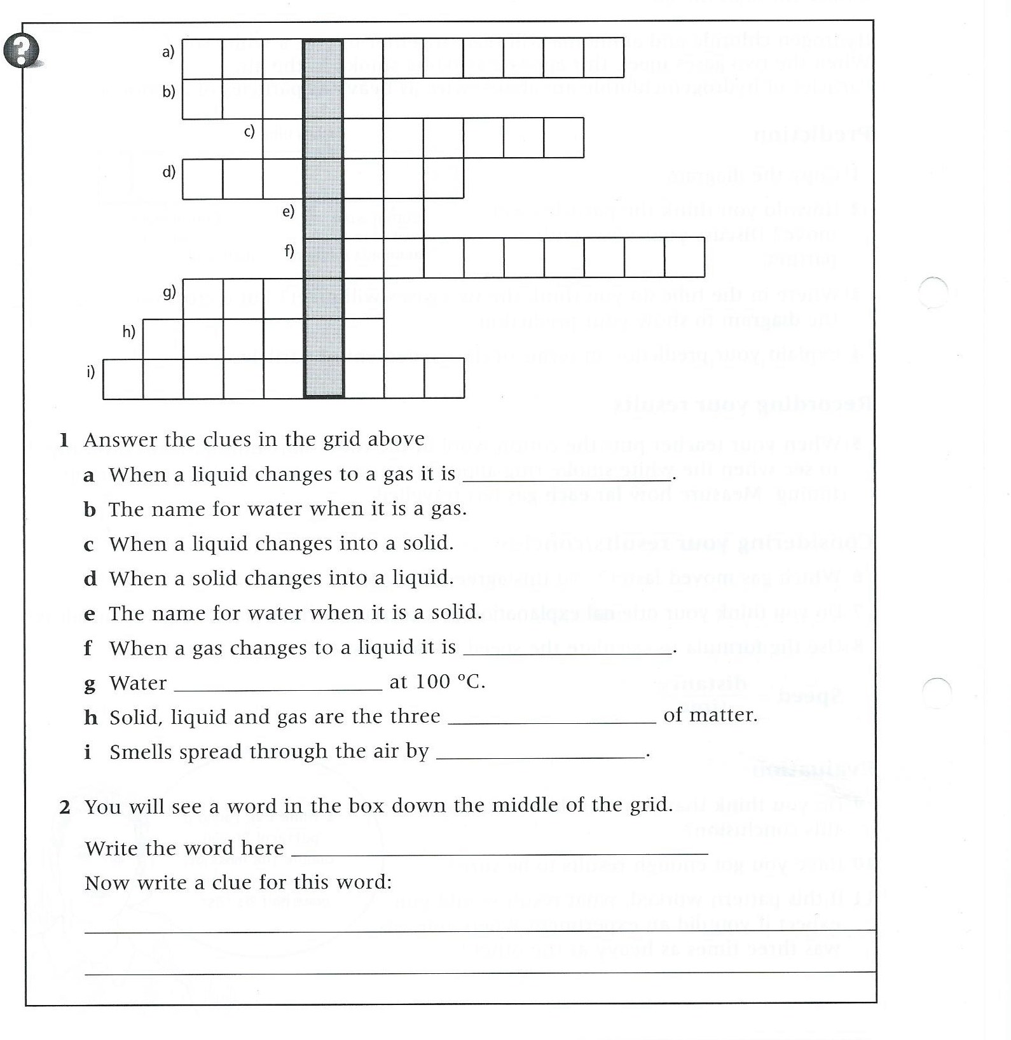

Slide 10
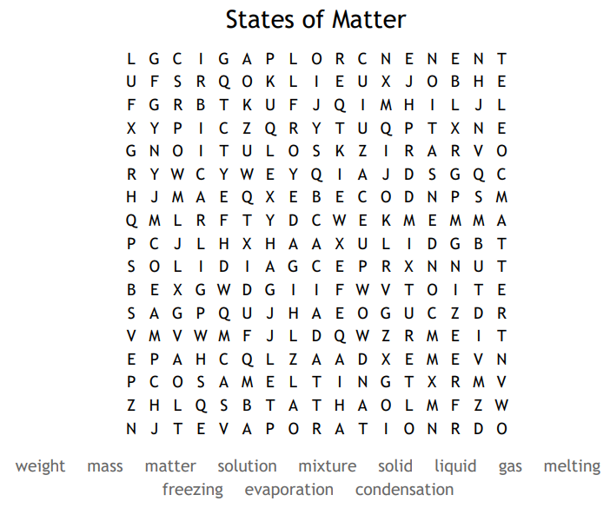
Glossary
Keyword | Definition
State | A state of matter refers to if something is a solid liquid or gas
Solid | A state of matter where the particles are closely packed together. They cannot be compressed and particles cannot move but can vibrate
Liquid | A state of matter where the particles are quite close together but are able to move over each other. The particles cannot be compressed
Gas | A state of matter where the particles are not touching, the particles move around the space freely and can be compressed
Particle | A small piece of something that makes up matter
Compressed | The actions of squashing something into a smaller space
Density | A measure of mass per unit of volume. If something is dense the particles are close together and heavy
Diffusion | Diffusion is the movement of a substance from an area of high concentration (lots of it) to an area of low concentration. Diffusion happens in liquids and gases because their particles move randomly from place to place.
Concentration | The concentration of a solution is a measure of how 'crowded' the solute particles are. The more concentrated the solution, the more particles it contains in a given volume.

