Slide 1
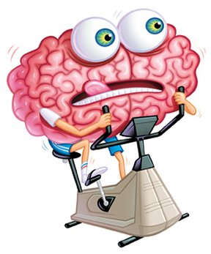
Exercise your brain!
English Home Learning
Week 6
Name:_____________________
Teacher:___________________

Slide 2


Past, present, future
What do I need to complete?
Spelling test 3
What are the rules?– read
Which present tense?
Recap verbs
Complete the tenses grid
Extended writing
New vocabulary K and L
Reading comprehension: Mo Farah
Self Assessment: What do I still need to practise from this section?

Slide 3

Spelling test 3
You will be tested on your spellings in every
literacy lesson.
You are expected to get at least 17/20 right each time. If you do not manage this you will need to re-take the test at another time.
 | Read | Write | Cover and write
Commonly misspelt words | Judgement
 | Knowledge
 | Leisure
 | Library
 | Lightning
 | Maintenance
 | Manoeuvre
 | Memento
 | Millennium
 | Miniature
 | Mischievous
 | Noticeable
 | Occasion
 | Occasionally
 | Occur
Topic specific words

Slide 4


Past tense
We use the past tense to talk about things that have already happened.
Present tense
We use the present tense to talk about things that are happening now.
Future tense
We use the future tense to talk about things that are going to happen.
What are the rules?
These are the basic ones, but like with all rules, there are exceptions.
Key: | Past tense | Present tense | Future tense
Present to past
When changing a verb (a doing word) into the past tense you need to add an –ed on the end.
Want + ed = wanted
Present with subjects
In the present tense verbs can also change with different subjects (the person or thing in the sentence).
We add an s to the word when the subject is he, she or it or a single noun (person, place or thing).
For example; I love chocolate. We love chocolate. They love chocolate but, Sara loves chocolate.
Exceptions, or more formally – irregular verbs
Is | Are
Eat | Ate
Do | Did
Go | Went
Have | had

Slide 5
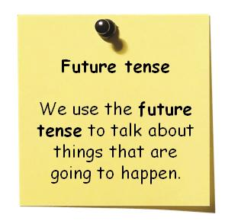

There are three different ways to write in the future tense.
Future tense = Will or shall + verb
Present continuous = where plans about the future are being discussed. (Verb + ing)
‘going to’ + verb = when you are talking about making a decision
Examples
I will go to the cinema tomorrow.
What time are you leaving tomorrow? I am leaving at 7am.
I’m going to watch a film on TV.
Task
Which version of the future am I?
Underline the key part of the sentence that tells me this.
Example, Tomorrow I shall eat a whole chicken at Nandos. | 1
I am going to have a bath and go to bed.
She will run a marathon next week.
She is getting married in 2 months time at 3pm.
They’re determined to eat carrots every day until they can see in the dark.
I shall dance at the ball until my feet can’t take anymore.

Slide 6
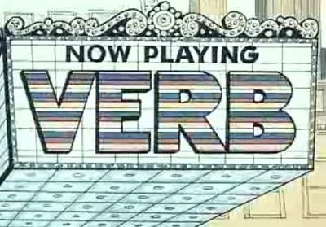
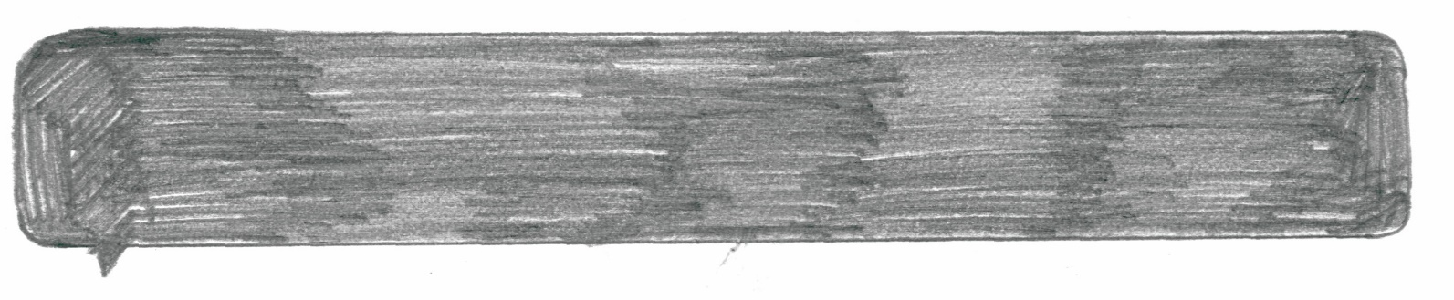
Recap: In term 1 we looked at what a verb is. Explain here what you can remember about them: ________________________________________________________________________________
________________________________________________________________________________
Task 1: highlight all the verbs in the sentences below.
Task 2: convert these sentences into past / present /future tense.
Past tense | Present tense | Future tense
 | 1. The gate creaks in the wind.
2. We went to the fish and chip shop and it was delicious.
 | 3. Jo is wearing jeans.
 |  | 4. James will be playing in a band. .
 |  | 5. Cassandra will be walking to school tomorrow .
6. Barbara went shopping.
 | 7. I am very hungry.
8. They ate lunch very quickly.

Slide 7


Let’s get these skills and ideas in writing.
(What tense? _____________________)
Task:
Write three paragraphs to show your understanding of tenses we have been studying.
1: What did you do last weekend? (Past)
2: What are you doing today? (Present)
3. What are you doing next weekend? (Future)
Remember: Try to use a variety of sentence structures and vocabulary choices – you need all your skills!

Slide 9
Letter
Word
K
Definition
Sentence (using your word):
Synonyms
Antonyms
Letter
Word
L
Definition
Sentence (using your word):
Synonyms
Antonyms

Slide 10
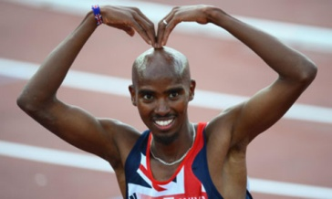
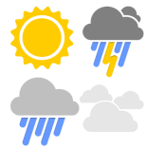
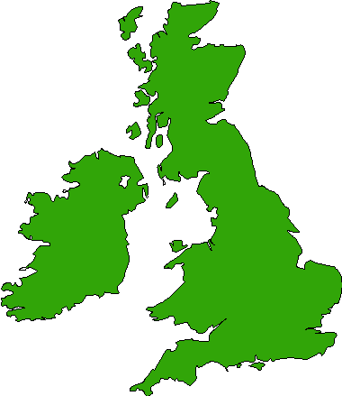
Mo Farah an interview
Reading comprehension : Read the extract and answer the questions in as much detail as possible.
The Weather
“There was still so much I had to get used to when it came to life in Britain. Like the weather, for example. I’d never seen snow before. That first winter it snowed so heavily I couldn’t believe what I was seeing. The whole town was blanketed in thick white. Then there was the cold. Djibouti stayed hot all year round. In December and January the temperature might drop to around 29˚C. That’s about as cold as it ever got. My first winter in England, I remember my fingers and toes turning numb from the freezing cold. I wore gloves but I could never warm up my hands. I’m fine with the rain , but I can’t be dealing with the cold. I’ll probably never get used to it.
1. What happened Mo’s first winter in England?
2. Had he ever seen snow before?
3. What was the weather like in his home town?
4. What does he think about the cold now?
5. What do you think about the weather in this country?
English
“My biggest struggle in those days was with my English. I could speak a few words but I couldn’t read or write, and sometimes I had to communicate with people using hand gestures because I didn’t know the word for certain things. To help improve my English, the school placed in an English as an Additional Language (EAL) group. I still struggled............ Instead, I found myself sitting in this EAL class and finding it difficult to concentrate. There was a Ukrainian kid in the group called Sergiy. We used to fight all the time. It was like Frazier-Ali between Sergiy and me. I learnt more about fighting than I did about English in that class.
1. What problems did Mo have with English?
2. How did he communicate when he didn’t know a word?
3. What did the school do to help him?
4. Why do you think he found it difficult to concentrate?
5. Why do you think he got involved in teaching?

Slide 11
Being Different
“I got into a fair few fights in my early days at Feltham. It was never anything serious, just the odd scrap here and there. Because I usually have a smile on my face and try to be nice to people my kindness often gets mistaken for weakness. I suppose I stood out at school. I was slightly different from the other kids. I came from another continent, I was a Muslim, I spoke another language. Some kids probably looked at me and thought, ‘Yeah, here’s someone we can push around.’ They didn’t know me. I’ve never been afraid to stick up for myself. I’d had a tough childhood- a lot tougher than a lot of kids. From a young age I had to learn to be a fighter. I never backed down from a fight”
1. Why did people think Mo was weak?
2. Was Mo afraid of other people?
3. What did he mean when he said “I’d had a tough childhood”?
4. What did he learn from a young age?
Extended writing task:
Compare your thoughts on British weather with Mo’s
How do people in this country/ class/ college treat you? Explain why you think that is so

Slide 12
Answer your questions in detail here:

