Slide 1
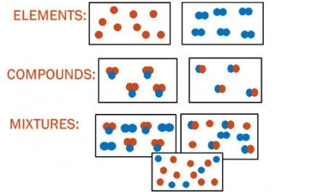
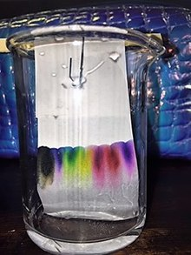
Science work pack
week 6
Helpful websites to support with the work or for interest:
https://www.bbc.co.uk/bitesize/guides/z2wmxnb/revision/1
https://mysteryscience.com/ https://thekidshouldseethis.com/
There is online learning available at:
app.senecalearning.com/dashboard/join-class/4ggjlziov1
You need to sign up using an email address. When asked to type in the school it is St Matthias academy. This should take you to straight to the learning page, if you are asked for a class code it is: 4ggjlziov1. There are tutorials and then questions.
Please work on the assignments and I can see what has been completed and how well you are doing.
Miss Grant

Slide 2
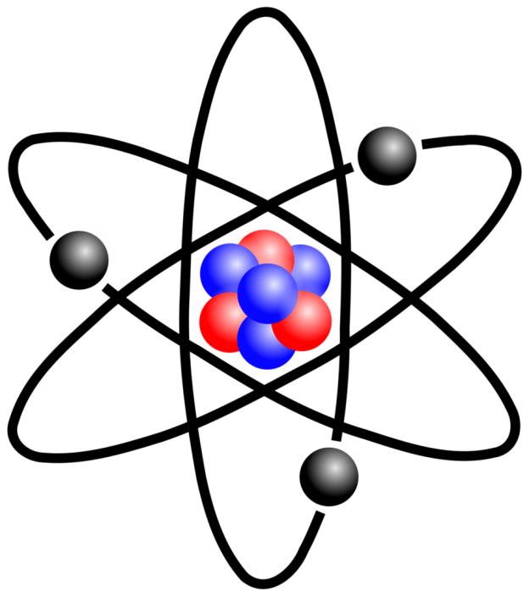

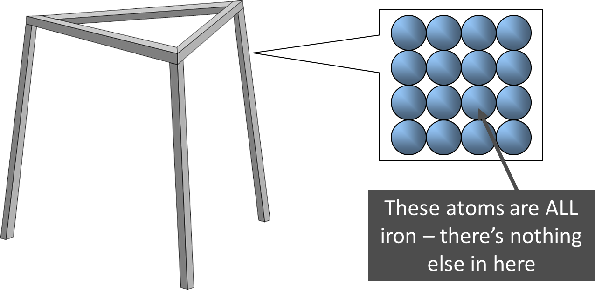
Atom
Tiny particles that make up everything!
One type of atom, on its own or joined to another atom of the same type.

Slide 3
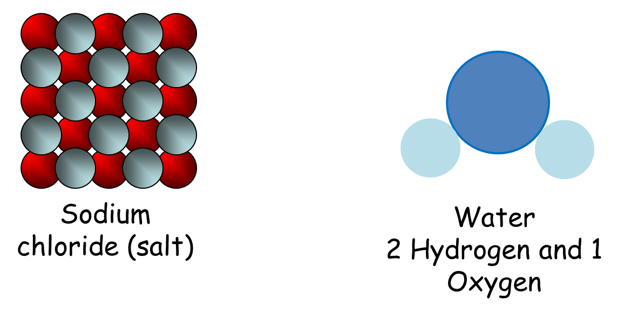
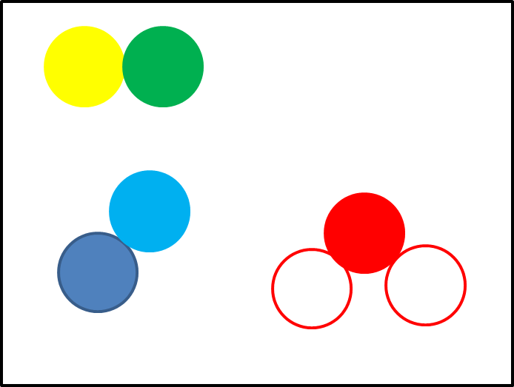
Compound
Different types of atom joined by a chemical bond.
Mixture
Different types of atoms or compounds that can be physically separated,
NO chemical bond.

Slide 4
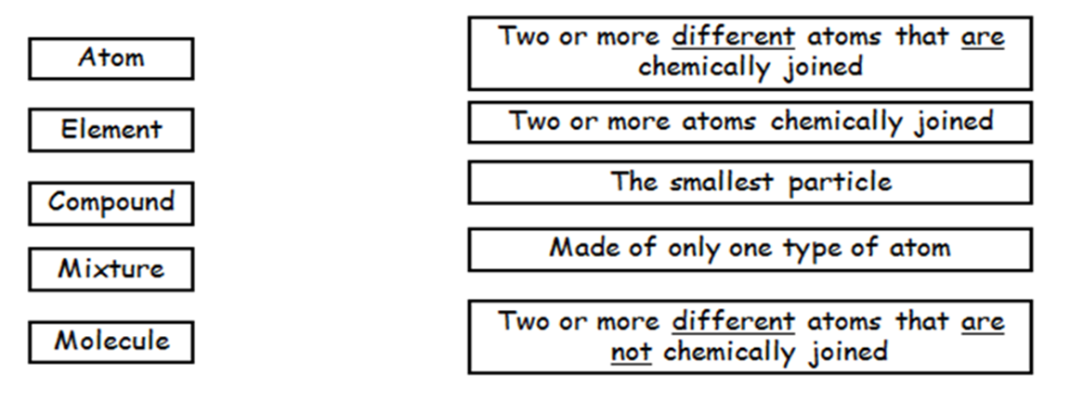
Fill in the gaps and then draw diagrams to show elements, compounds and mixtures
Same chemical bond atom two mixture elements atom smaller chemical
Elements are the __________ substances and are only made up from one type of ________. They cannot be broken down into anything _________. | Compounds are made up from ____ or more types of _____ joined together by _________ ­­­­_______. | In a _______ two or more substances (________ or compounds) are put together but there is NO _________ bonds. Mixtures can usually be separated easily.

Slide 5
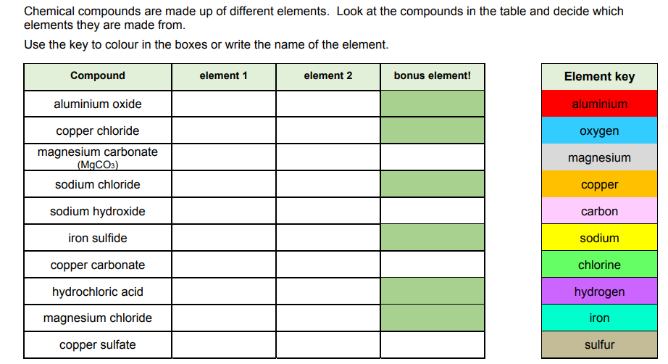
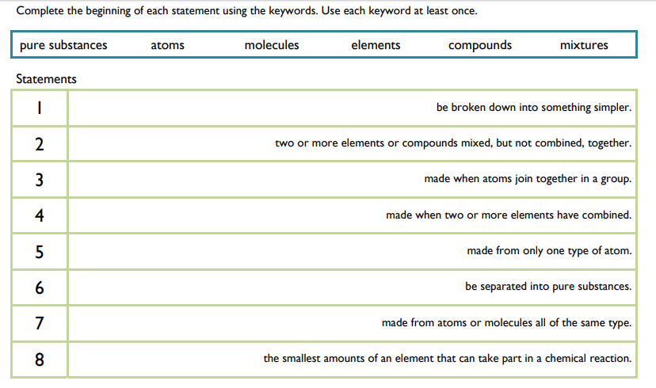

Slide 6
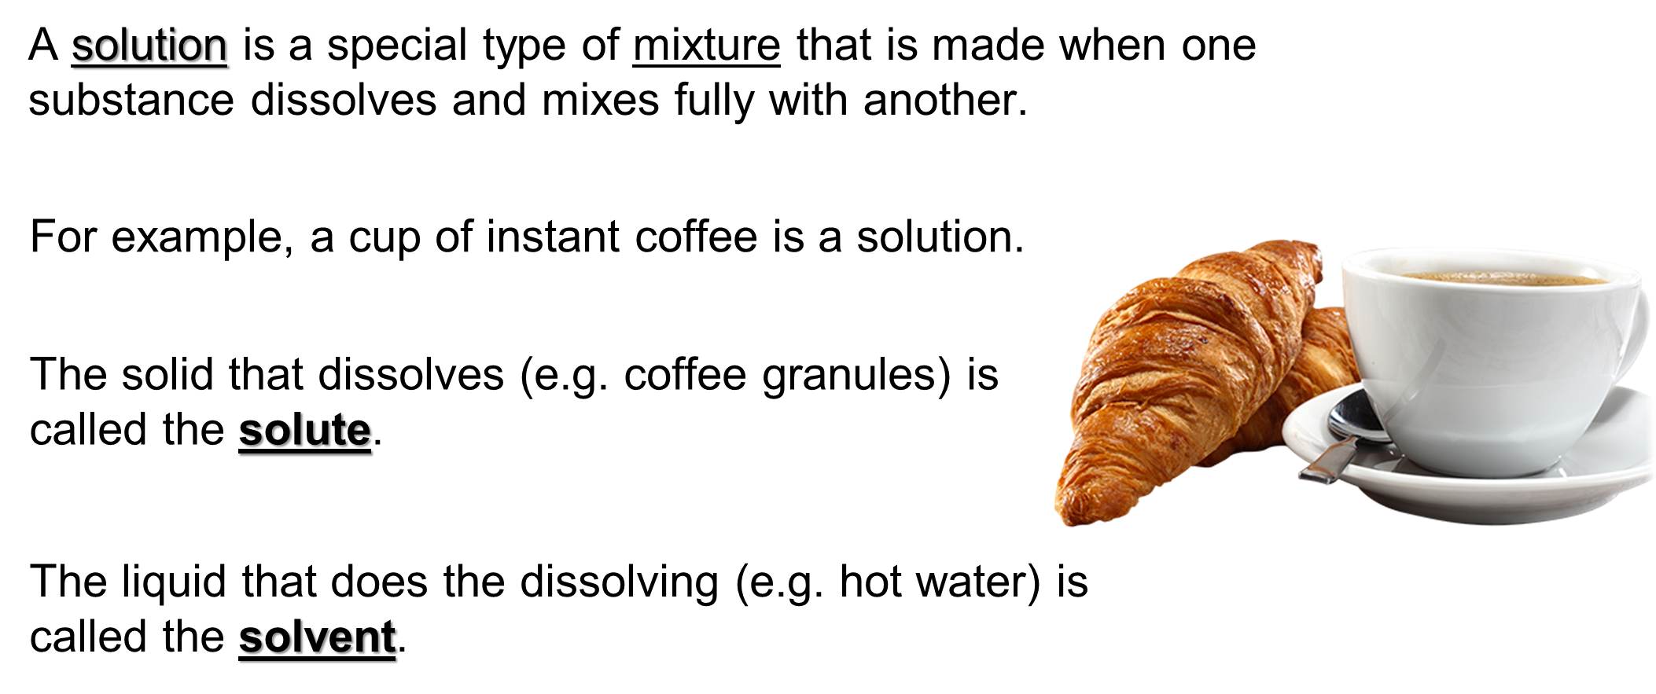
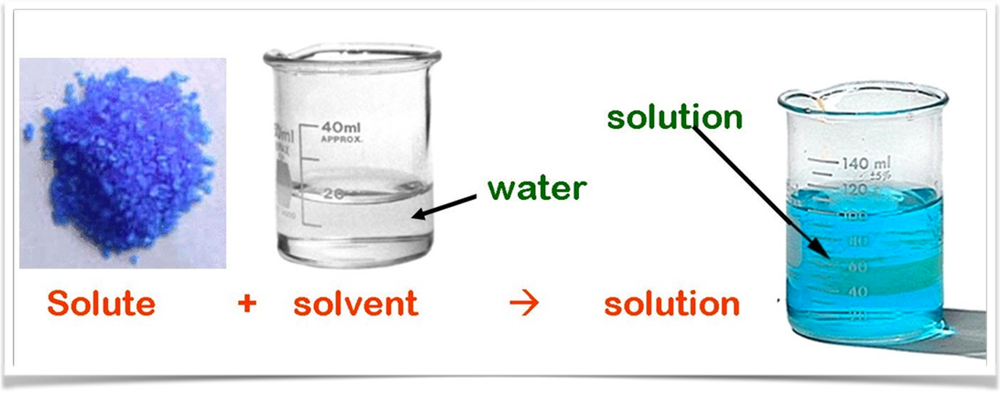
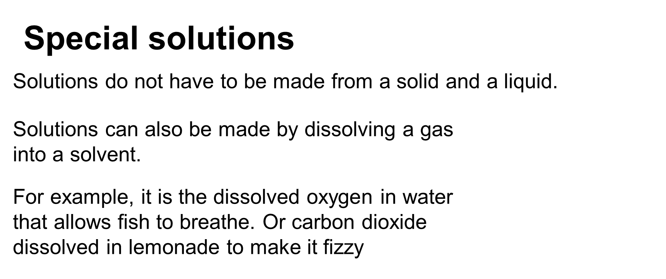
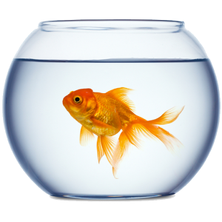
Solutions

Slide 7
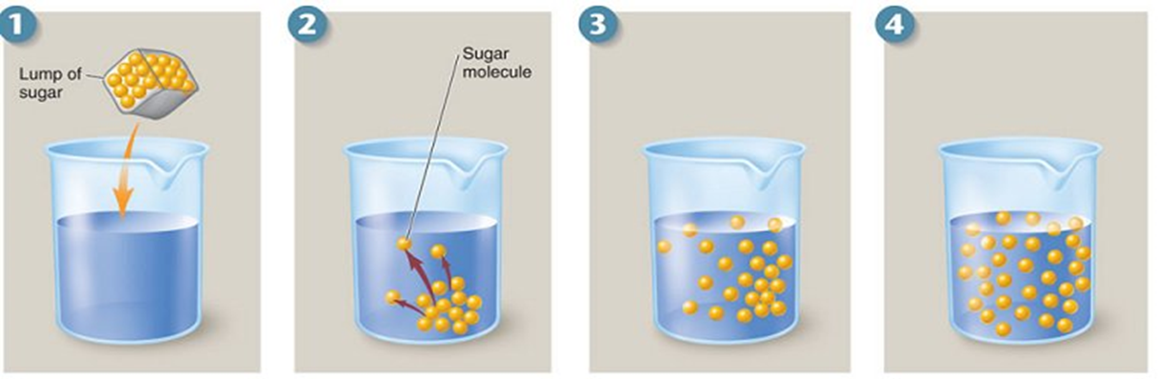
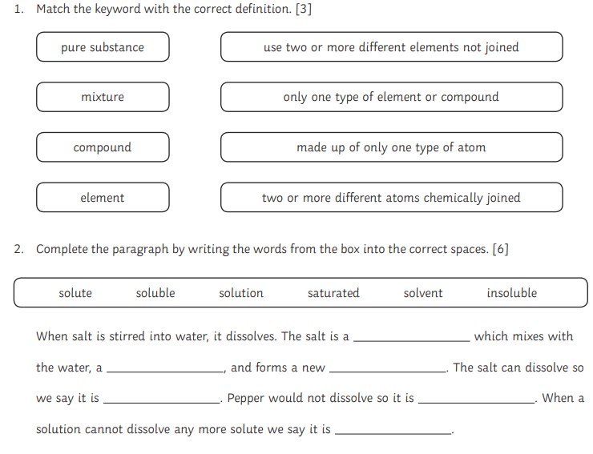
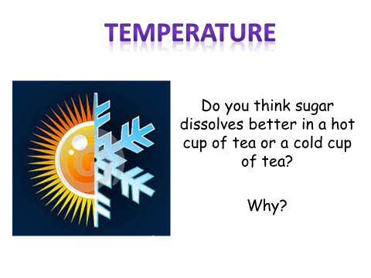
Try it at home
Into 100ml of cold water count how many spoons of sugar you can add before you can see grains of sugar
Repeat with hot water.
What was the difference?
Why?

Slide 8
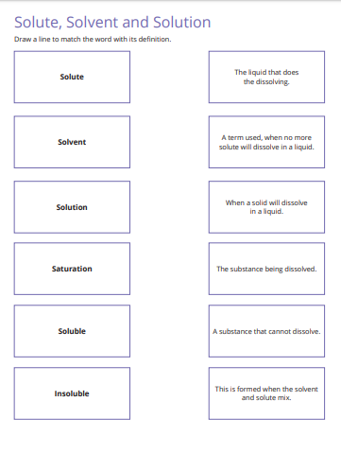
If you get stuck use the glossary at the end of the work pack to help you

Slide 9
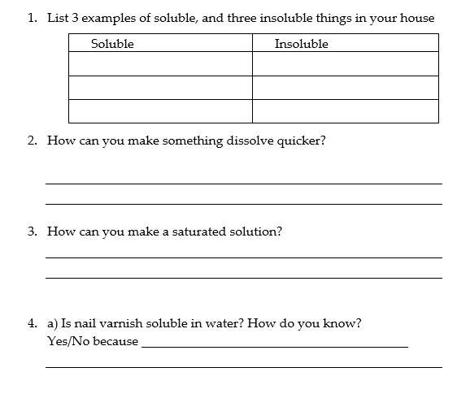
5. Put the words in the table to show if they are a solute, solvent or solution.
Salt / sugar / oil / hot chocolate powder / orange juice /water / coffee granules/ tea / milk / paint
Solute | Solvent | Solution

Slide 10
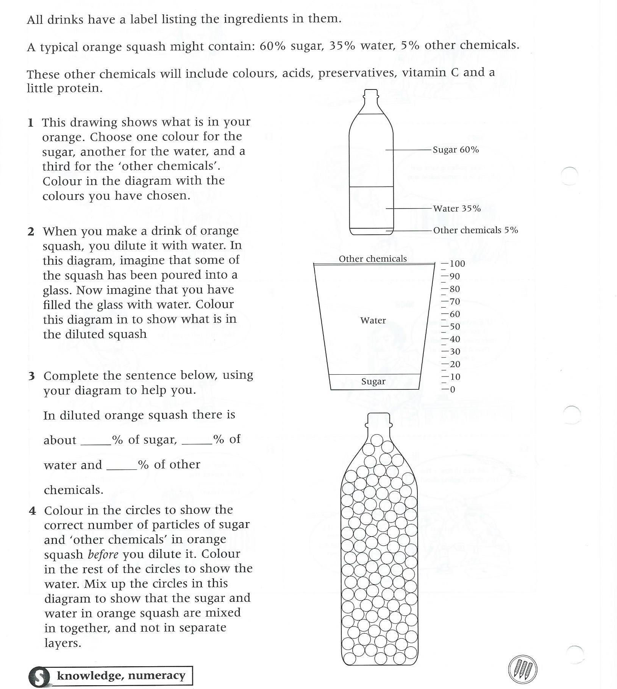

Slide 11
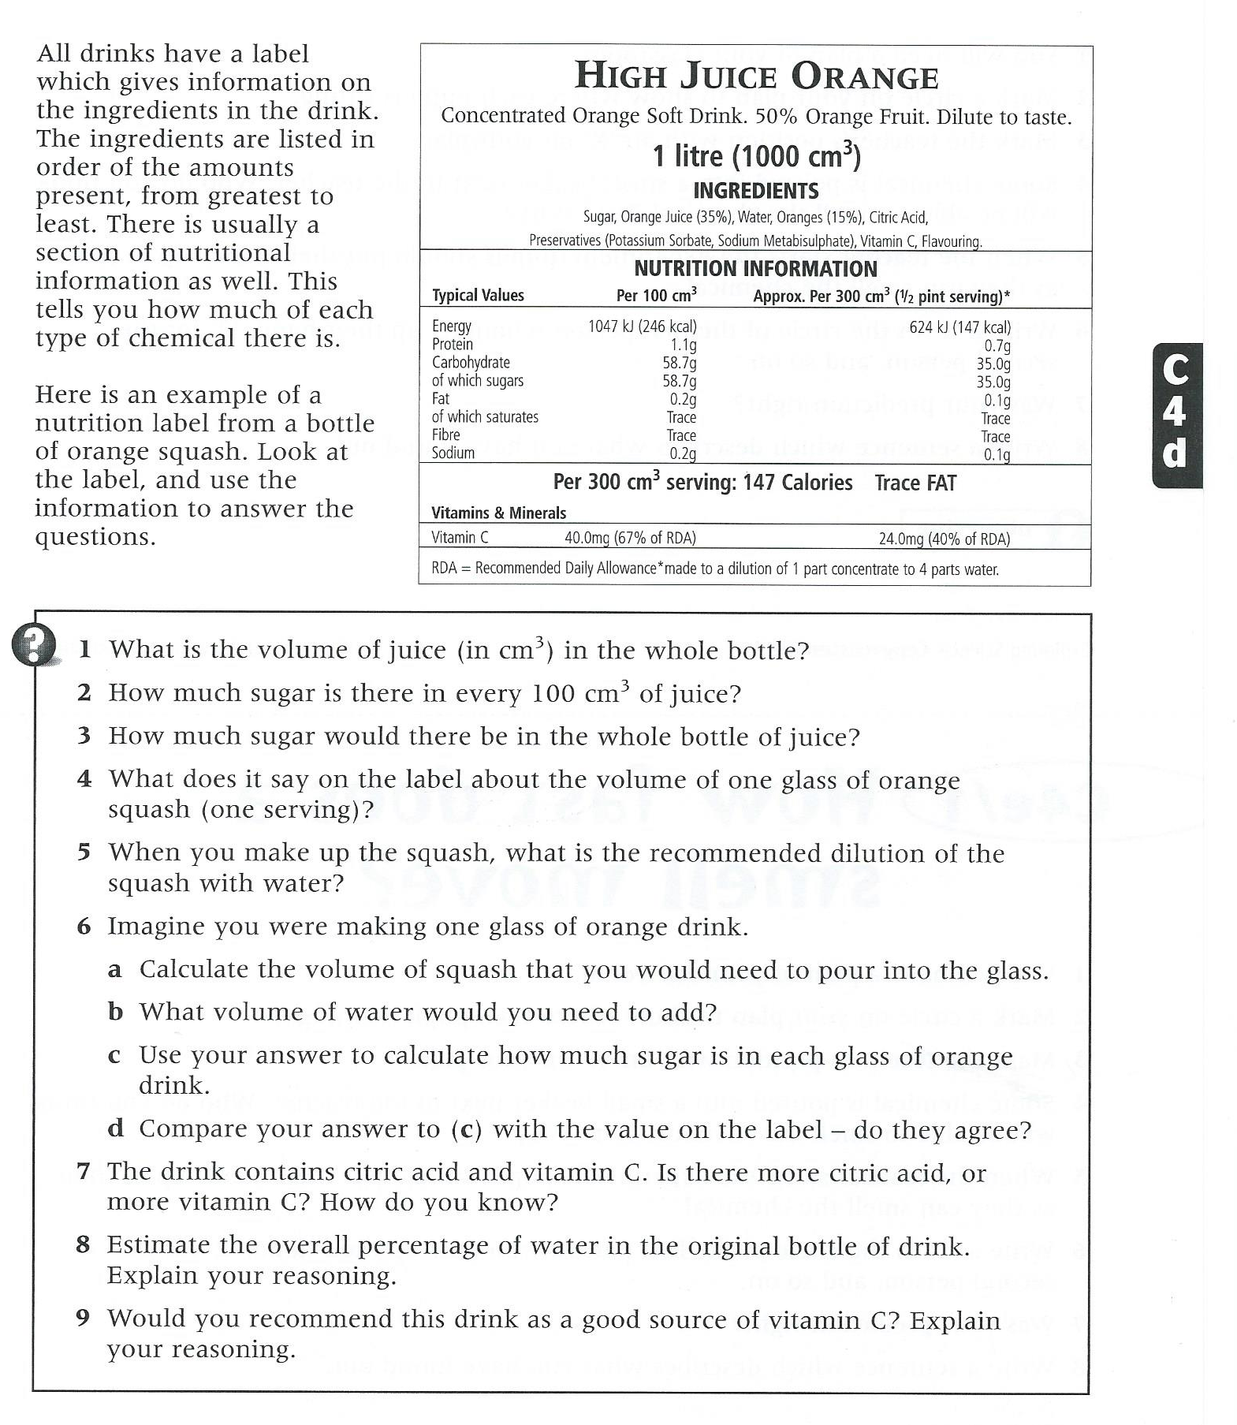

Slide 12
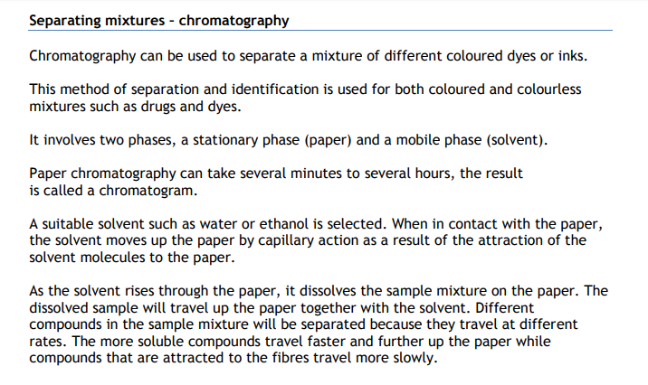
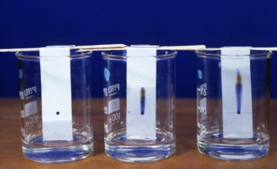
Try it at home
On a piece of kitchen roll put dots of different felt pens 5cm from the bottom. Fill a glass with so it comes up to 2cm from the bottom. Rest the kitchen roll in so that the ink does not touch the water and watch. Fill in the table below
Colour of felt tip | Colours it separated into

Slide 13
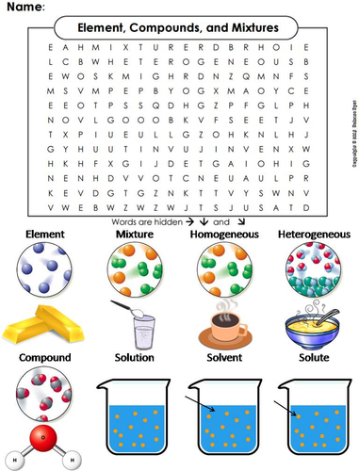
Glossary
Atom | Tiny particles that make up everything
Element | One type of atom, on its own or joined to another atom of the same type
Mixture | Different types of atoms or compounds that can be physically separated, NO chemical bond.
Compound | Different types of atom joined by a chemical bond.
Solution | This is formed when the solute and solvent mix (sugar mixed into water is a solution)
Solute | The substance being dissolved
Solvent | The liquid which does the dissolving
saturated | When no more solute will dissolve in a liquid (solvent)
Soluble | When a solid is able to dissolve
Insoluble | The a solid is not able to dissolve
chromatography | A way of separating dissolved substances such as ink

