Slide 1
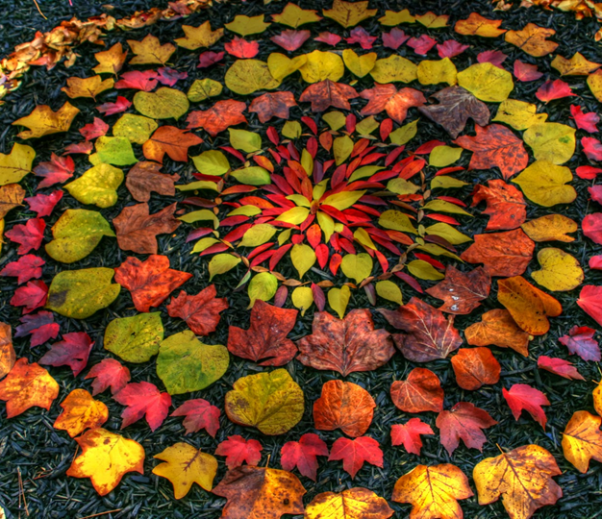

Land art
Andy Goldsworthy is a British artist, known for his sculptures and photography. He is an environmentalist, which is someone
who wants to protect the environment around them.
Here are some facts about him:
• born in 1956, in Cheshire;
• grew up in Leeds;
• studied art in Lancashire;
• now lives in Scotland.
Andy makes sculptures with natural materials on sites in the UK and around the world. He has made them in forests, fields, cities,
lakes and fields, takes photographs and lets the
art naturally decompose.
Goldsworthy is inspired by natural shapes and
creates many works using circles and spirals.
DISCUSS the shapes, colours and materials in this artwork.

Slide 2
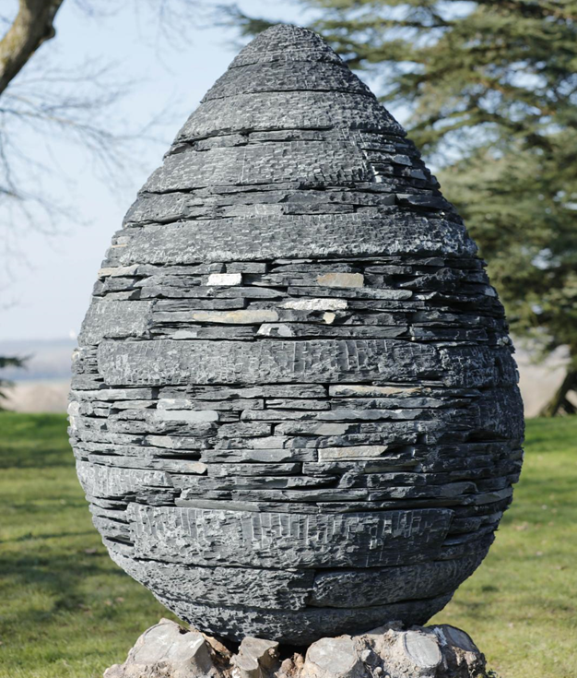
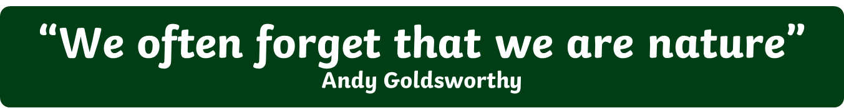
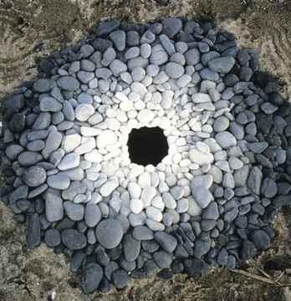
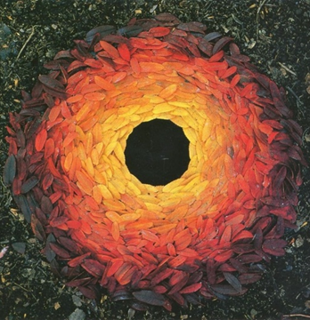
As well as making sculptures, Andy takes photographs of his work over time to show how they change.
Andy Goldsworthy
Talk About It
EXPLAIN the method and materials Goldsworthy used to make this sculpture?
Talk About It
DISCUSS the shape, texture and colour of this sculpture.
Andy Goldsworthy’s art makes us think about the world around us and how nature is art. What do you like/dislike about his art and why? Do you think this is art. Why?

Slide 3

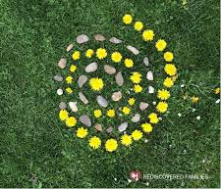
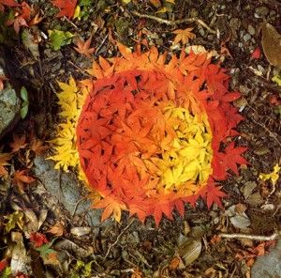
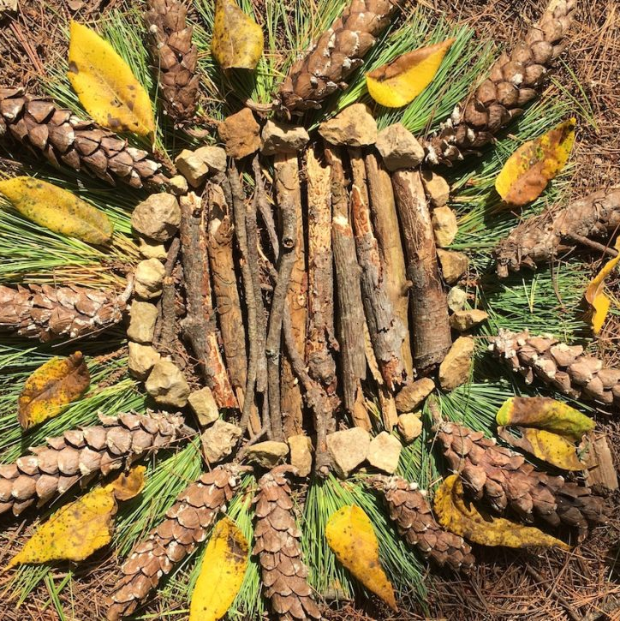
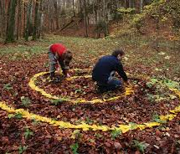
Task instructions
CREATE your own land art inspired by Goldsworthy. You could:
Take a walk and collect a range of natural materials, take them home a create a pattern, collage or sculpture.
Make art outside using natural materials (leaves, twigs, flowers, mud, stones).
Collect a range of leaves and flowers and create an observational study using your medium of choice.
Take a range of photos using your phone. Try to capture a range of colours, textures and shapes naturally found in nature.
Take a photo of your art and send to: julie.caswell@stmatthias.learnmat.uk
KEEP SAFE WHEN YOU ARE DOING THESE TASKS
it is important to get daily exercise and fresh air so Complete these tasks on you daily exercise and only go out with people from your household.
Keep at least 2 metres distance from others.
Try to wear gloves.
Wash hands regularly.

