Slide 1
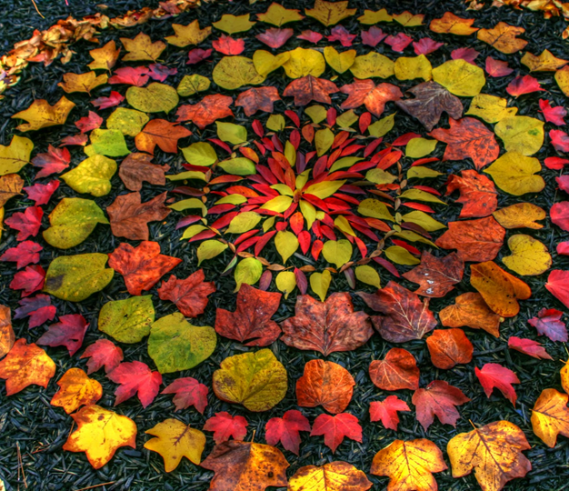

Land art
Andy Goldsworthy is a British artist, known for his sculptures and photography. He is an environmentalist, which is someone
who wants to protect the environment around them.
Here are some facts about him:
• born in 1956, in Cheshire;
• grew up in Leeds;
• studied art in Lancashire;
• now lives in Scotland.
Andy makes sculptures with natural materials
on sites in the UK and around the world. He
has made them in forests, fields, cities,
lakes and fields, takes photographs and lets the
art naturally decompose.
Goldsworthy is inspired by natural shapes and
creates many works using circles and spirals.
DISCUSS the shapes and colours in this artwork.

Slide 2
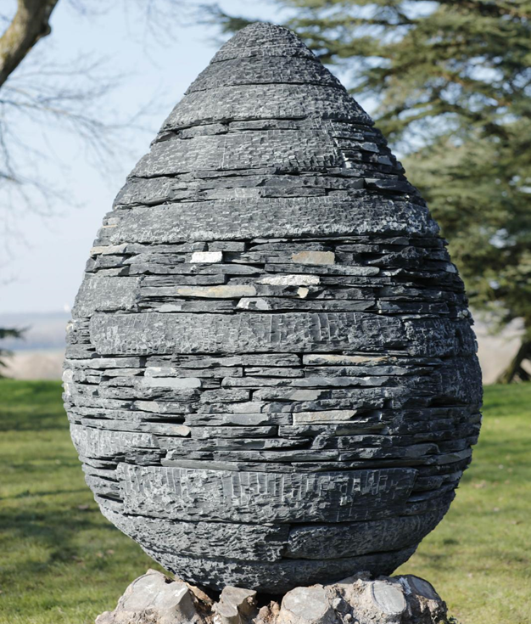

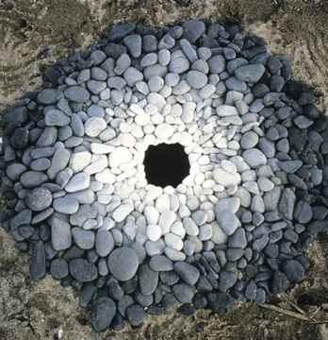
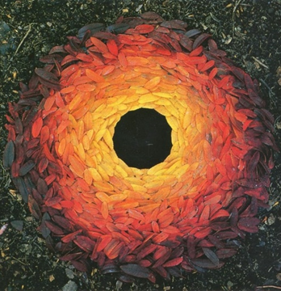
As well as making sculptures, Andy takes photographs of his work over time to show how they change.
Andy Goldsworthy
Talk About It
HOW do you think his sculptures
change?
Talk About It
Which natural materials are
used in this sculpture by Andy
Goldsworthy? How would you describe the shape?
Andy Goldsworthy’s art makes us think about the world around us and how nature is art. What do you like/dislike about his art and why?

Slide 3

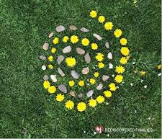
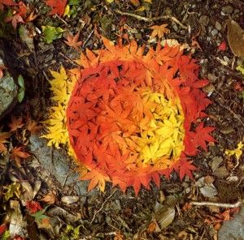
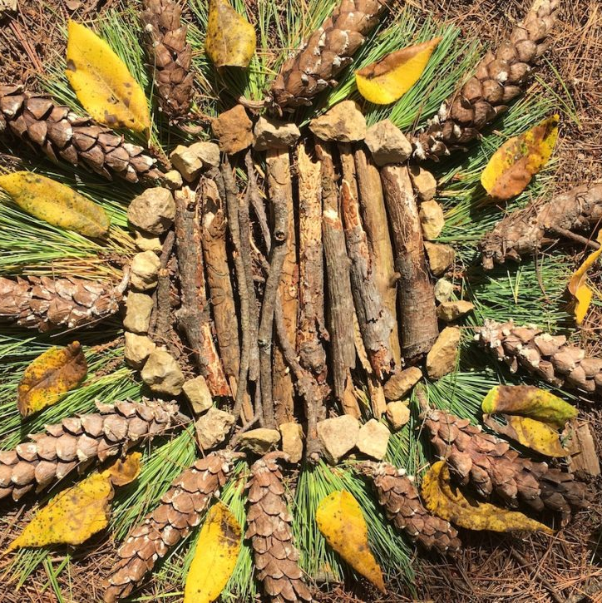
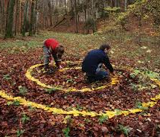
Task instructions
CREATE your own land art inspired by Goldsworthy. You could:
Take a walk and collect a range of natural materials, take them home a create a pattern, collage or sculpture.
Make art outside using natural materials (leaves, twigs, flowers, mud, stones).
Take a photo of your art and send to: julie.caswell@stmatthias.learnmat.uk
KEEP SAFE WHEN YOU ARE DOING THESE TASKS
it is important to get daily exercise and fresh air so Complete these tasks on you daily exercise and only go out with people from your household.
Keep at least 2 metres distance from others.
Try to wear gloves.
Wash hands regularly.

