Slide 1
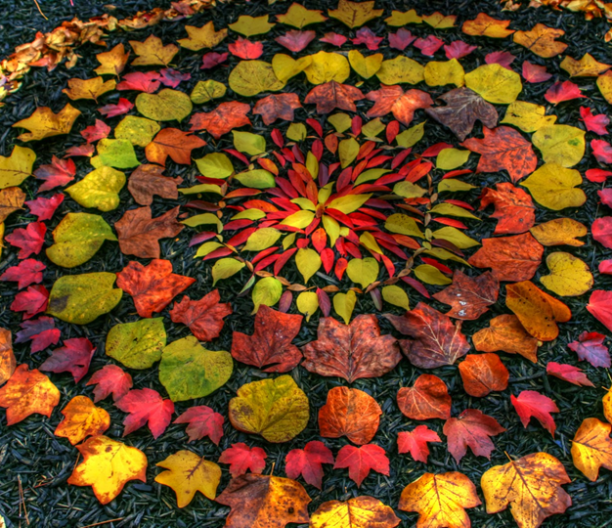

Land art
Andy Goldsworthy is a British artist, known for his sculptures
and photography. He is an environmentalist, which is someone
who wants to protect the environment around them.
Here are some facts about him:
• born in 1956, in Cheshire;
• grew up in Leeds;
• studied art in Lancashire;
• now lives in Scotland.
Andy makes sculptures with natural materials
on sites in the UK and around the world. He
has made them in forests, fields, cities,
lakes and fields.
They are known as land art.
Which natural materials can
you think of that he could use
to make sculptures?

Slide 2
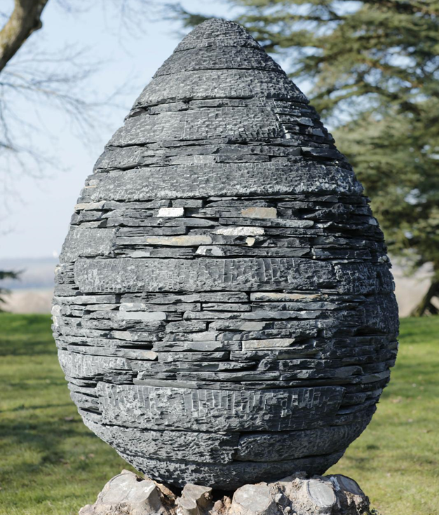
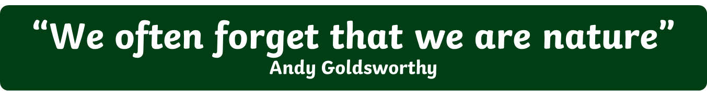
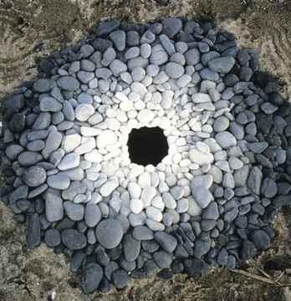
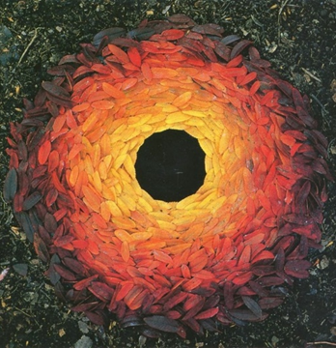
As well as making sculptures, Andy takes photographs of his work over time to show how they change.
Andy Goldsworthy
Talk About It
Why do you think his sculptures
change?
Talk About It
Which natural materials are
used in this sculpture by Andy
Goldsworthy?
Andy Goldsworthy’s art makes us think about the world around us and how nature is art. Do you think it is art? Why?

Slide 3

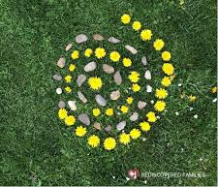
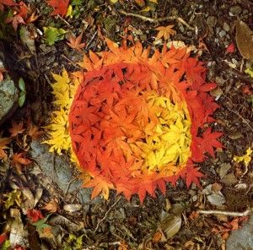
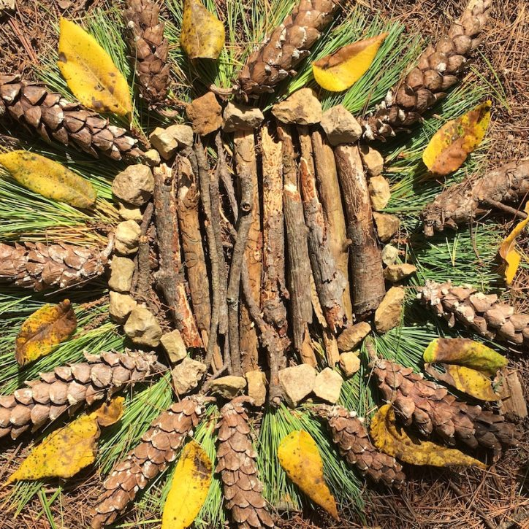
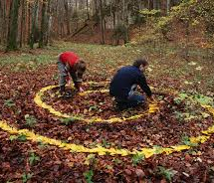
Task instructions
Look at the tasks on the cards and complete as many as you can. Photograph your land art and email to: julie.caswell@stmatthias.learnmat.co.uk
KEEP SAFE WHEN YOU ARE DOING THESE TASKS
it is important to get daily exercise and fresh air so Complete these tasks on you daily exercise and only go out with people from your household.
Keep at least 2 metres distance from others.
Try to wear gloves.
Wash hands regularly.

