Slide 1
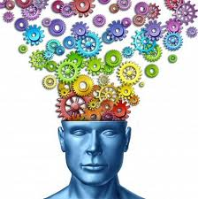
English Home Learning
Week 7
Name:_____________________
Teacher:___________________

Slide 2
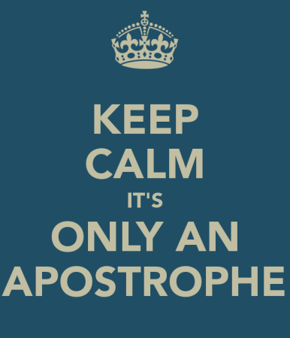

Section one: Apostrophe
What do I need to complete?
Spelling test 1
Read the information page on social networking
Complete the Re-tweet task
Read page on apostrophes
Complete the task on apostrophes
Complete the task on Don’t and Doesn’t
New vocabulary M and N
Reading comprehension: Wuthering Heights
Self Assessment: What do I still need to practise from this section?

Slide 3
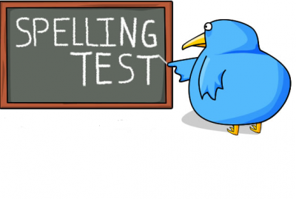
Spelling test 1
You will be tested on your spellings in every
literacy lesson.
You are expected to get at least 17/20 right each time. If you do not manage this you will need to re-take the test at another time.
 | Read | Write | Cover and write
Commonly misspelt words | Advise
 | Advice
 | Affect
 | Effect
 | Allowed
 | Aloud
 | Bought
 | Brought
 | Breaking
 | Braking
 | Chose
 | Choose
 | Cloth
 | Clothe
 | Analyse
Topic specific words

Slide 4


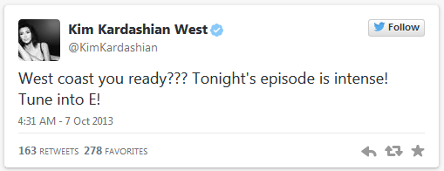



Social networking has unleashed a new trend: bad grammar.
We are now surrounded by social media, it is everywhere we look. Most of us like to follow our favourite celebrities but what kind of role model are they to us if they can’t get their spelling and grammar right? In every section of this book there will be a chance to tell these celebrities how to do it properly. You will need to do two things:
Explain to this celebrity what they need to do to make sure they don’t make the same error
Re-write their post ensuring that it is grammatically correct.
I have done this one for you.
Miss Killick
@MissKEnglish
@KimKardashian I noticed in your recent tweet that you have made a few grammatical errors. You have missed out the word ‘are’ in your first sentence and have added too many question marks, only one is required to show this is a question. You would also need a capital letter for ‘Coast’ as it is a proper noun. Well done for using an apostrophe correctly.
4.18 PM – 2 Jan 2015
212
101
Miss Killick
@MissKEnglish
@KimKardashian here is how you could re-write this text correctly – West Coast are you ready? Tonight’s episode is intense! Tune into E!
4.26 PM – 2 Jan 2015
189
78

Slide 5
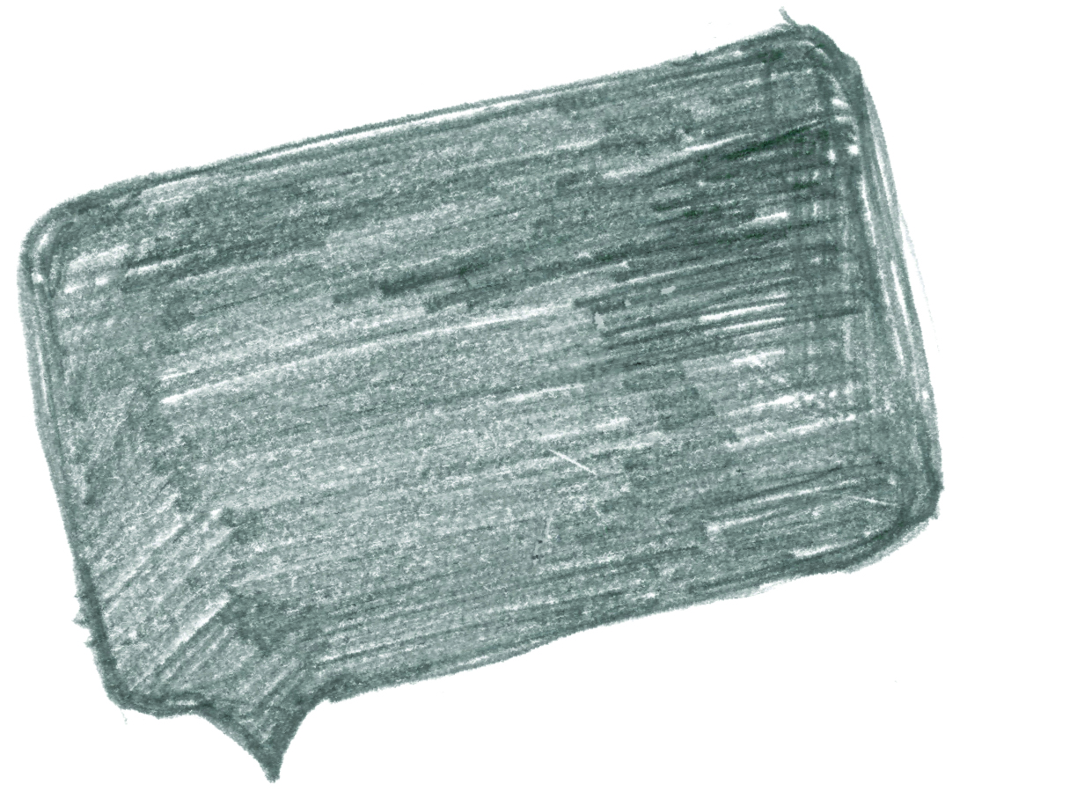
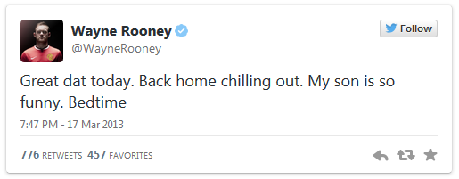
Social networking has unleashed a new trend: bad grammar.
Correct the following tweets
@
___________________________________________________________________________________________________________________________________________________________________________________________________________________________________________________________________________________________________________________________________________________________________
Reply
212
101
@
____________________________________________________________________________________________________________________________________________________________________________________________________________________________________________________________________________
Re-write
189
78
@
This space has been left blank for you to find your own celebrity who commits crimes against grammar.
____________________________________________________________________________________________________________________________________________________________________________________________________________________________________________________________________________________________________________
189
78

Slide 6
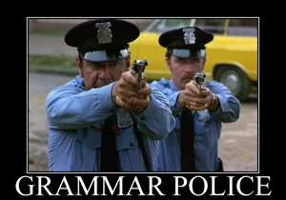




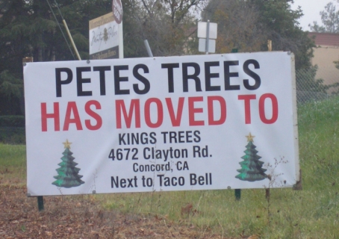
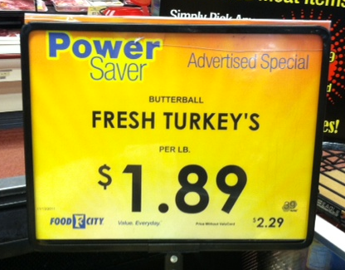
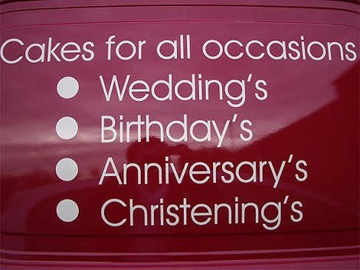
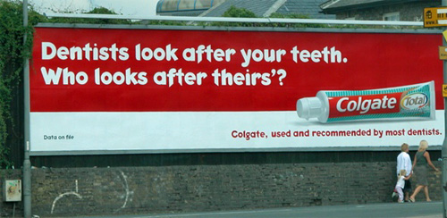
The rules about apostrophes
You will have seen in booklet one a little bit about how to use an apostrophe but now we are going to really practice and get those rules embedded into all our work.
You never use an apostrophe when you are talking about a plural, for example, you would have one shoe and two shoes – it would never be shoe’s.
You use an apostrophe in omission – to omit something is to take it away, this is your root word – in this case, when you omit one or more letters. For example, do not becomes don’t – you use the apostrophe in the place of the o here.
You can also use an apostrophe to show posession, before an s to say that one subject of a sentence owns the next subject in a sentence. For example, Katie’s pencil case – this tells us that Katie owns the pencil case.
Exception to the rule: If the person or subject already ends in an s then the apostrophe comes after the s and no extra s is added. For example, James’ pile of books.
Task:
Can you correct these errors?

Slide 7
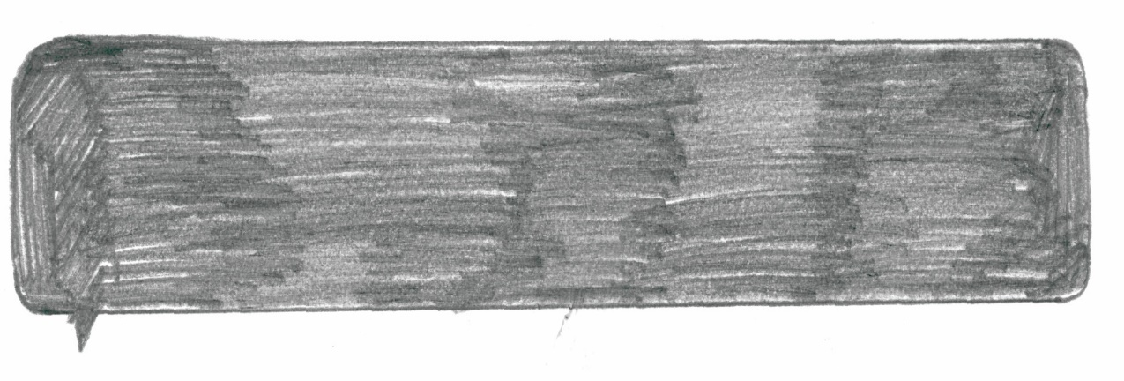
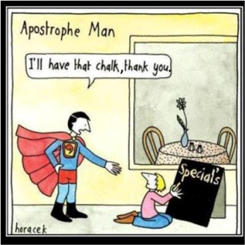


Task: With a green pen, go through the written work below and correct it using our marking scheme. Look out for the incorrect use of homophones and apostrophes. Don’t forget the rules you have learnt.
When my workdays over, and I have closed my notebook, hidden my pen, and sawed hole’s in my rented canoe so that it cant be found, I often like to spend the evening in conversation with my few surviving friend’s. Sometime’s we discuss literature. Sometime’s we discuss the people who are trying to destroy us, and if theres any hope of escaping from them. And sometime’s we discuss frightening and troublesome animal’s that might be nearby, and this topic always lead’s to much disagreement over which part of a frightening and troublesome beast is the most frightening and troublesome. Some say the teeth of the beast, because teeth are used for eating children, and often they’re parents, and nawing on there bones. Some say the claw’s of the beast, because claws are used for ripping things to shreds. And some say the hair of the beast, because the hair can make allergic people sneeze.
But I always’s insist that the most frightening part of any beast is it’s belly, for the simple reason that if you are seeing the belly of the beast it mean’s you have already seen the teeth and the claw’s of the beast and even the hair of the beast, and now you are trapped and there is probably no hope for you. For this reason, the phrase “in the belly of the best” has become an expression which means “inside some terrible place with little chance of escaping safely,” and its not an expression one should look forward to using.
Set this writer a target to move forward with their work.
What do they need to improve on specifically?
You are the teacher

Slide 8


Don’t
or
Doesn’t
This seems simple enough but we often put the wrong word into our writing which means it is grammatically incorrect.
When in doubt, use the words without an apostrophe, this way you will make sure it makes sense.
When we use don’t or doesn’t we use an apostrophe to omit the letter o. Without the apostrophe we have two separate words:
Do not
Does not
Task: Complete the sentences below using the correct word – don’t or doesn’t.
The cat _____________ want to go out in the rain.
__________ step in the mud and then come in the house with your trainers on.
It ____________ matter if you _________ get the right answer, as long as you try.
Life is short, ____________ let it pass you by.
I _________ want to get up early in the morning.
I don’t believe that Romeo is cruel as he ________ intentionally fall in love with Juliet.
Curley’s Wife ______ deserve to be called names because she is mistreated by Curley.
He __________ like me because I am better football player than he is.

Slide 9
Word (Adjective)
Letter
M
Definition
Sentence (using your word):
Synonyms
Antonyms
Word (Adjective)
Letter
N
Definition
Sentence (using your word):
Synonyms
Antonyms

Slide 10
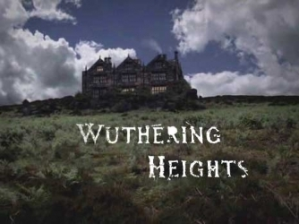
Wuthering Heights by Emily Bronte
Reading comprehension : Read the extract and answer the questions in as much detail as possible.
The narrator, Mr Lockwood, is here visiting Wuthering Heights. He was prevented by heavy snow from leaving for home but Heathcliff, the bad tempered owner of Wuthering Heights is unwilling to let Lockwood stay the night. A servant takes pity on him, and shows him upstairs, where he finds an unused room in which he decides to spend the night. He is unable to sleep because of noises outside the window and disturbing dreams.
This time, I remembered I was lying in the oak closet, and I heard distinctly the gusty wind, and the driving of the snow; I heard, also, the fir bough repeat its teasing sound, and ascribed it to the right cause: but it annoyed me so much, that I resolved to silence it, if possible; and, I thought, I rose and endeavoured to unhasp the casement.
The hook was soldered into the staple: a circumstance observed by me when awake, but forgotten. 'I must stop it, nevertheless!' I muttered, knocking my knuckles through the glass, and stretching an arm out to seize the importunate branch; instead of which, my fingers closed on the fingers of a little, ice-cold hand! The intense horror of nightmare came over me: I tried to draw back my arm, but the hand clung to it, and a most melancholy voice sobbed, 'Let me in--let me in!' 'Who are you?' I asked, struggling, meanwhile, to disengage myself. 'Catherine Linton,' it replied, shiveringly (why did I think of Linton? I had read Earnshaw twenty times for Linton). 'I'm come home: I'd lost my way on the moor!' As it spoke, I discerned, obscurely, a child's face looking through the window. Terror made me cruel; and, finding it useless to attempt shaking the creature off, I pulled its wrist on to the broken pane, and rubbed it to and fro till the blood ran down and soaked the bedclothes: still it wailed, 'Let me in!' and maintained its tenacious grip, almost maddening me with fear.
'How can I!' I said at length. 'Let me go, if you want me to let you in!' The fingers relaxed, I snatched mine through the hole, hurriedly piled the books up in a pyramid against it, and stopped my ears to exclude the lamentable prayer. I seemed to keep them closed above a quarter of an hour; yet, the instant I listened again, there was the doleful cry moaning on! 'Begone!' I shouted. 'I'll never let you in, not if you beg for twenty years.' 'It is twenty years,' mourned the voice: 'twenty years. I've been a waif for twenty years!' Thereat began a feeble scratching outside, and the pile of books moved as if thrust forward. I tried to jump up; but could not stir a limb; and so yelled aloud, in a frenzy of fright. To my confusion, I discovered the yell was not ideal: hasty footsteps approached my chamber door; somebody pushed it open, with a vigorous hand, and a light glimmered through the squares at the top of the bed. I sat shuddering yet, and wiping the perspiration from my forehead: the intruder appeared to hesitate, and muttered to himself. At last, he said, in a half-whisper, plainly not expecting an answer, 'Is anyone here?' I considered it best to confess my presence; for I knew Heathcliff's accents, and feared he might search further, if I kept quiet. With this intention, I turned and opened the panels. I shall not soon forget the effect my action produced.

Slide 11


uestions
How does Bronte build up fear in the passage?
How is this reflected in the way the narrator acts and talks?
Why did Lockwood have to break the glass?
What are the definitions of these words:
What is the narrator’s attitude towards Catherine Linton? How do we know this?
Extended writing task: Using the image write a paragraph describing East Riddlesden Hall. Think about your choice of adjectives.
Tenacious | Importunate | Casement | Ascribed
Unhasp | Discerned | Doleful | Obscurely

Slide 12
Answer your questions in detail here:

