Slide 1
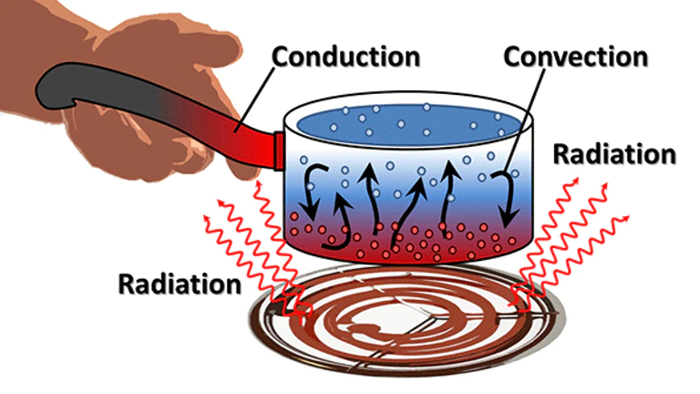
Science work pack
week 7
Helpful websites to support with the work or for interest:
https://www.bbc.co.uk/bitesize/guides/zttrd2p/revision/1
https://sciencebob.com/category/experiments/
https://mysteryscience.com/ https://thekidshouldseethis.com/
There is online learning available at:
app.senecalearning.com/dashboard/join-class/4ggjlziov1
You need to sign up using an email address. When asked to type in the school it is St Matthias academy. This should take you to straight to the learning page, if you are asked for a class code it is: 4ggjlziov1. There are tutorials and then questions.
Please work on the assignments and I can see what has been completed and how well you are doing.
Miss Grant

Slide 2
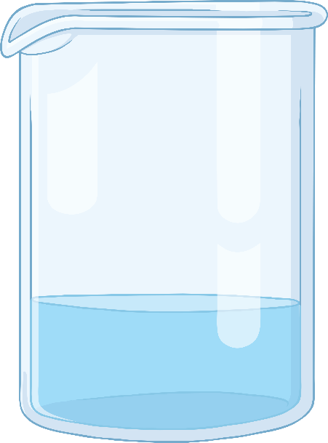
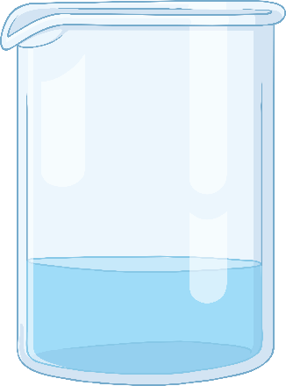
Temperature: What Do You Know?
Name the piece of equipment used to measure temperature.
_ _ _ _ _ _ _ _ _ _ _
What unit do we measure temperature in?
What is…
room temperature?
fridge temperature?
freezer temperature?
body temperature?
50 °C
30 °C
Which beaker is the hottest?
Which beaker contains the most heat energy? Consider the size of the beakers.

Slide 3
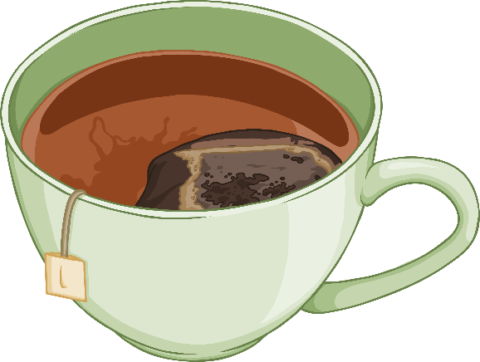
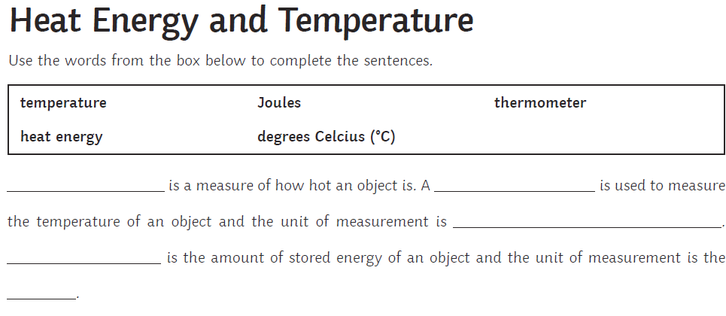
Equilibrium
When something is balanced.
Equilibrium means:
Hot objects cool down. Energy is always transferred from a hot object to a cold object, and not the other way round. Think of a cup of tea - as the temperature gradually cools, and it reaches the same temperature as the room, there are no more energy transfers and it has reached equilibrium.
equilibrium
50 °C
20 °C

Slide 4
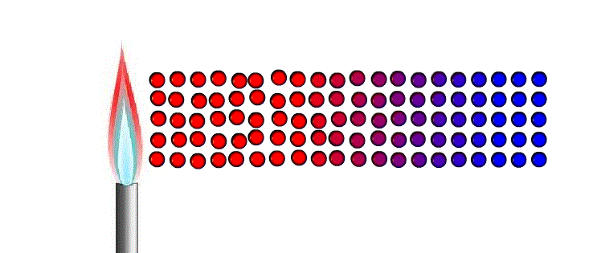
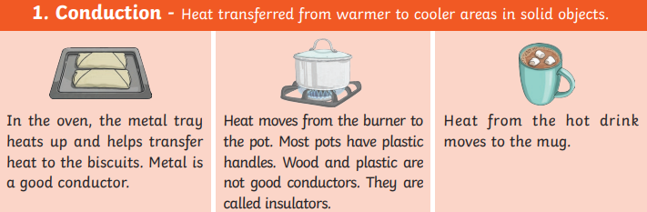
Conduction
Conduction happens in solids, it occurs by the particles heating up and this makes them vibrate (shake). The particles in solids are so close together this shaking causes the next particle to vibrate, the vibration transfers the heat energy.
C _ _ _ _ _ _ _ _ _ can only occur in s _ _ _ _ _
The heat travels by …………………………………………………
……………………………………………………………………………….
Try this at home.
Put hot water in a mug until it is ¼ full. Put a metal spoon into the mug, after few minutes the top of the spoon (not in the hot water) will feel hot. This is because the heat energy has travelled up the spoon by conduction.
Metals are good conductors of heat (they let heat travel easily)
Plastic and wood are insulators of heat (they do not let heat travel easily)

Slide 5
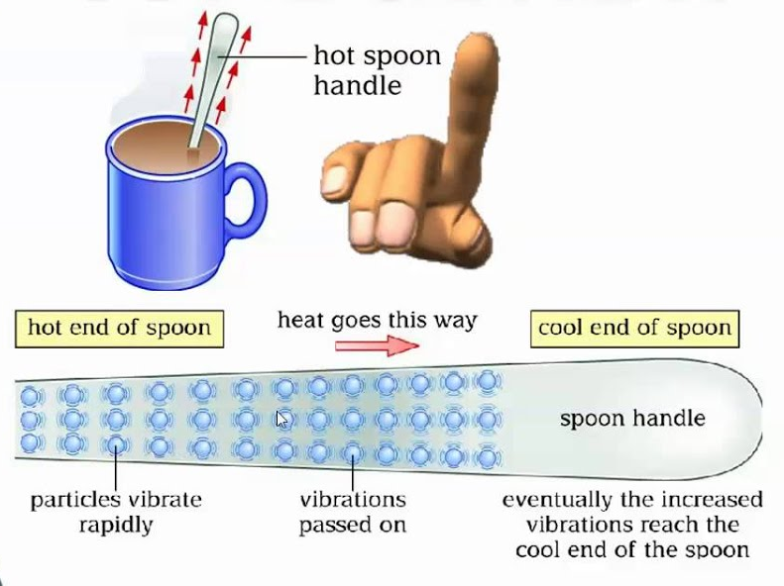
Conduction
When we heated the metal spoon in the hot water, the __________ received more energy. This meant they ________ more and bumped into each other.
As they bumped into each other, they passed on some of their energy. This meant the ______ (or thermal energy) moved through the spoon.
Eventually the whole spoon heated up. The movement of thermal energy like this is called ___________.
heat particles conduction vibrated
Draw and label diagrams showing what happened to the particles as the spoon was heated.
Substances that allow thermal energy to move easily through them are called conductors. Metals are good conductors of thermal energy.
Substances that do not allow thermal energy to move through them easily are called insulators. Air and plastics are insulators.
Explain why handles for pans are made from plastic and not metal?
Can you think of any other materials that are used as insulators or conductors of heat?

Slide 6
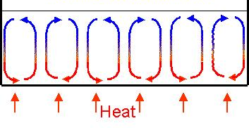
Convection
Convection occurs in liquids and gases. When a liquid/gas is heated the particles vibrate taking up more space, they expand and become less dense. This causes the particles to rise. When away from the heat, the particles cool and move down again.
The movement of gas or liquids as shown in the diagram is known as a convection current
C _ _ _ _ _ _ _ _ _ can occur in l _ _ _ _ _ _ and g _ _ _ _
The hot air rises and cools and then …………………………….
Fill in the gaps using the following words:
conduction convection convection conductors liquids gases solids
Heat flows through solids by _________________.
Liquids and gases are poor ______________ but transfer heat by _______________.
We make use of these _____________ currents in kettles, heaters and when cooking.
Convection takes place in ________________ and _______________.
Convection will not take place in ________________.

Slide 7
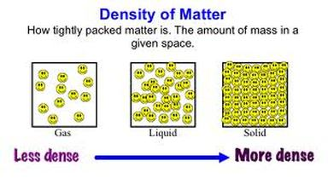
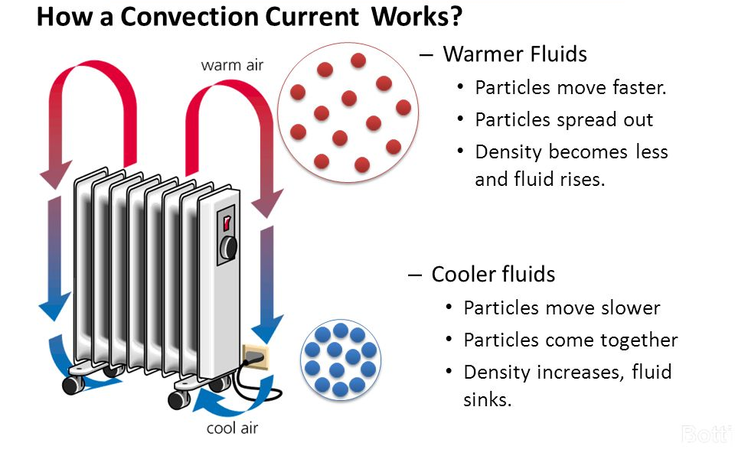
When particles heat up they vibrate more taking up more space and spreading out. This means the gas or liquid becomes less dense (lighter) so rises. As it cools it becomes more dense (heavier) so moves back down

Slide 8
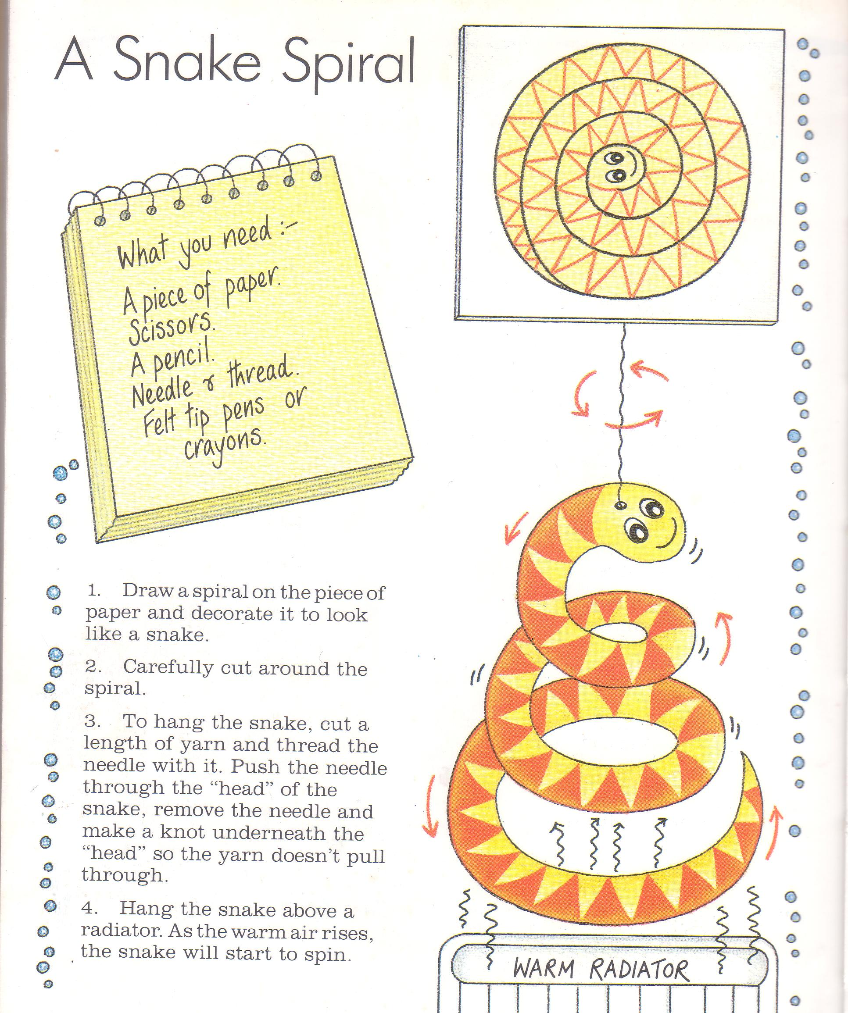
Read the instructions above and then
cut out the template on the next page and create your own snake, hold above a heater or some hot water in a mug and see what happens

Slide 9
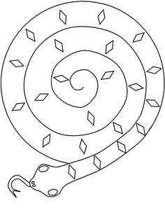

Slide 11
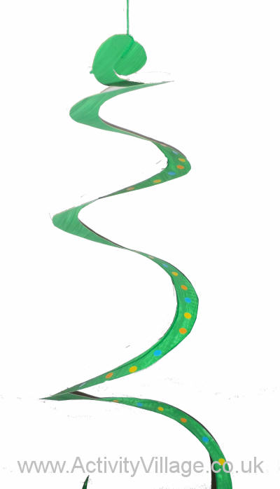
The hot air particles are less dense causing
……………………………………………………………………………………………………………………..
The mobile spins because…………………..
…………………………………
…………………………………
………………………………….
Hot air particles
Cold air particles
Air particles are heated this causes……
…………………………………………………………………..
………………………………..
Cold air replaces the warm air causing…………………………………
………………………………………………………………………………………..
Use the words below to form sentences explain what is happening:
Rise apart current vibrate heated convection

Slide 12
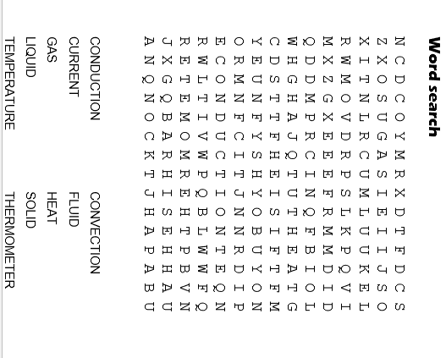
Glossary
Particle | A small piece of something that makes up matter
State | A state of matter refers to if something is a solid liquid or gas
Solid | A state of matter where the particles are closely packed together. They cannot be compressed and particles cannot move but can vibrate
Liquid | A state of matter where the particles are quite close together but are able to move over each other. The particles cannot be compressed
Conduction | heat transfer by particles vibrating against each other in a solid
Conductor | A substance that transfers energy easily from the hot part to the cold part is called a conductor .
Insulator | A substance that does not transfer energy easily from the hot part to the cold part is called an insulator
Convection | Convection happens when particles with a lot of thermal energy in a liquid or gas move, and take the place of particles with less thermal energy.
Density | A measure of mass per unit of volume. If something is dense the particles are close together and heavy

