Slide 1
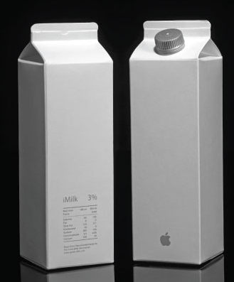
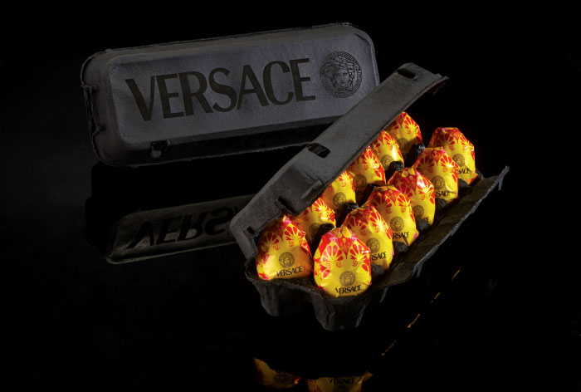
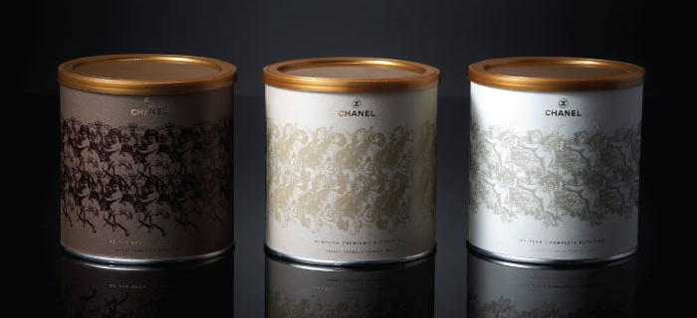
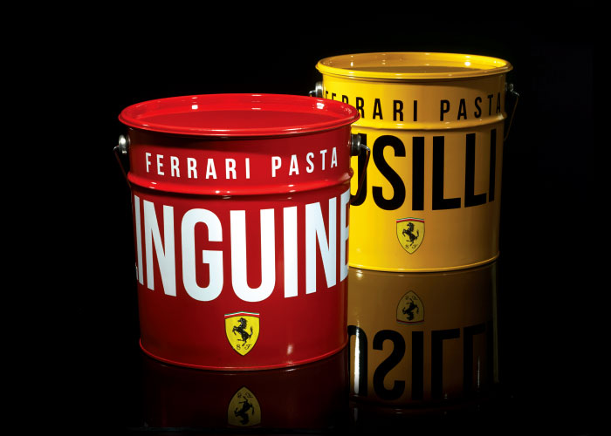
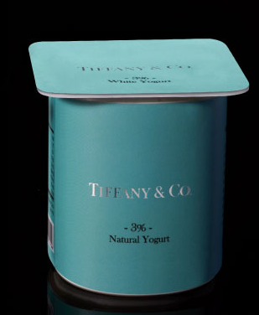
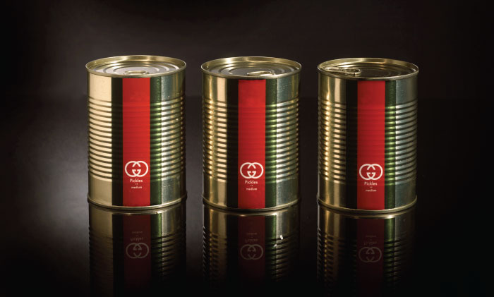
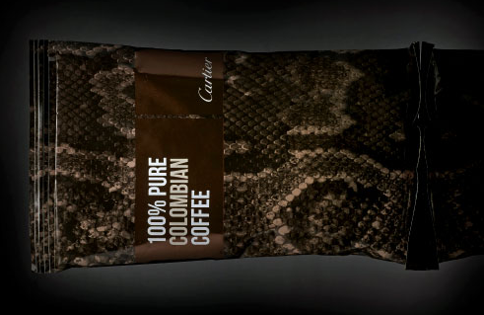
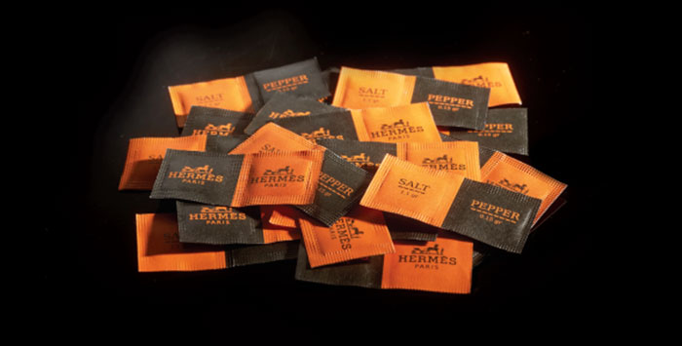
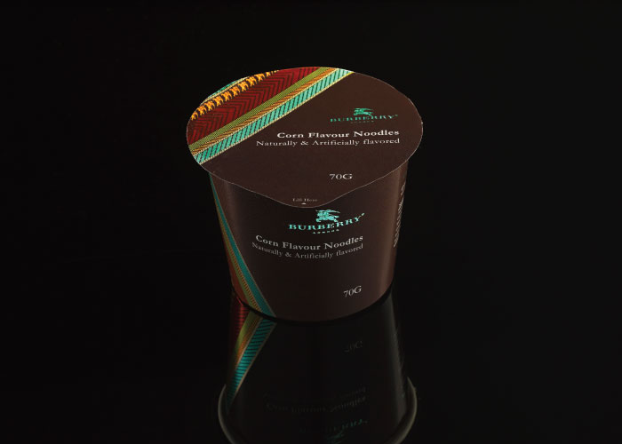
An artist made a series of packaging for everyday items, inspired by famous brands and designers
Look at the example images sheet and have a go at the worksheet of creating your own!

Slide 2
Name:
Date:
All drawings must be:
Neat
Done in pencil
Show 2 views (min)
Be well coloured (if possible)
Everyday designer items
Step 1) In the box below bullet point as many designer brands as you can think of
Step 2) In the box below draw a can of soup, pencil case, pencil holder, dustbin and water bottle that are all inspired by and use the branding of 5 different designer brands!
Notes:
Print A3 – 1 per pupil

