Slide 1
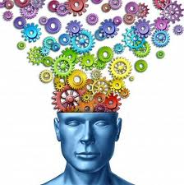
Time to get the cogs turning!
English Home Learning
Week 8
Name:_____________________
Teacher:___________________

Slide 2
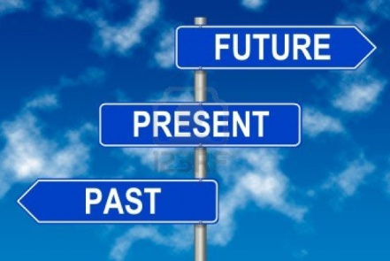
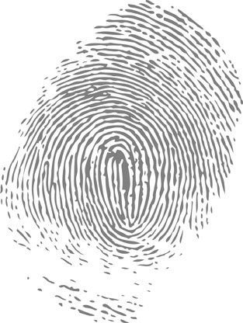
Section three: Past, present, future
What do I need to complete over the next two weeks?
Spelling test 3
Complete the re-tweet task
Revise past, present and future tenses; and singular and plural.
Complete task 1 on The Twits
Complete the extended writing task on The Twits
New vocabulary Q and R
Read and answer the questions on Pride and Prejudice
Self Assessment: What do I still need to practise from this section?

Slide 3
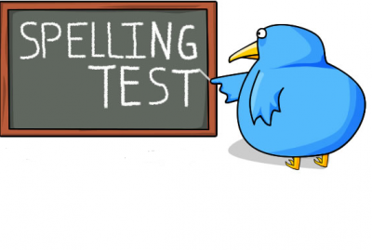
Spelling test 3
You will be tested on your spellings in every
literacy lesson.
You are expected to get at least 17/20 right each time. If you do not manage this you will need to re-take the test at another time.
 | Read | Write | Cover and write
Commonly misspelt words | Clause
 | Comparison
 | Conjunction
 | Consonant
 | Dialogue
 | Exclamation
 | Expression
 | Figurative
 | Imagery
 | Metaphor
 | Narrative
 | Paragraph
 | Plural
 | Preposition
 | Resolution
Topic specific words

Slide 4


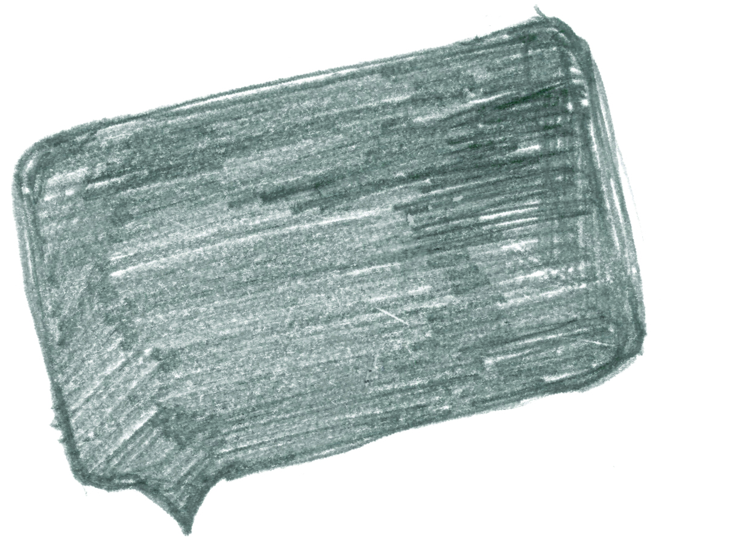
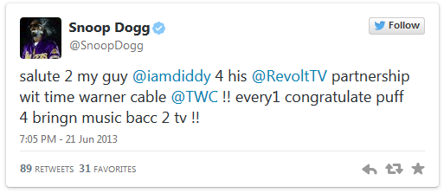
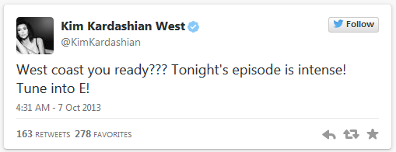

Social networking has unleashed a new trend: bad grammar.
Correct the following tweets
@
___________________________________________________________________________________________________________________________________________________________________________________________________________________________________________________________________________________________________________________________________________________________________
Reply
212
101
@
____________________________________________________________________________________________________________________________________________________________________________________________________________________________________________________________________________
Re-write
189
78
@
This space has been left blank for you to find your own celebrity who commits crimes against grammar.
____________________________________________________________________________________________________________________________________________________________________________________________________________________________________________________________________________________________________________
189
78

Slide 5


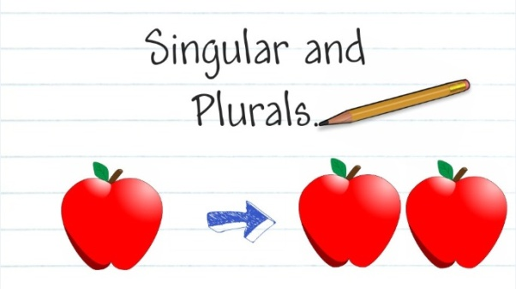
Past tense
We use the past tense to talk about things that have already happened.
Present tense
We use the present tense to talk about things that are happening now.
Future tense
We use the future tense to talk about things that are going to happen.
Last term we talked about different tenses and plural and singular words – this term we are going to combine these and talk about when and how to use the verb to be.
Key: | Past tense | Present tense | Future tense
Single (Talking about one person) |  | Plural (Talking about two or more people)
I am | I was | We are | We were
You are | You were | You are | You were
He is | He was | They are | They were
She is | She was
It is | It was
All of the present tense starters can be converted into future tense depending on the auxiliary verb (see your first booklet) that you choose to follow the main verb.
Example
I am having a great day at the funfair.
I am going to have a great day at the funfair.

Slide 6
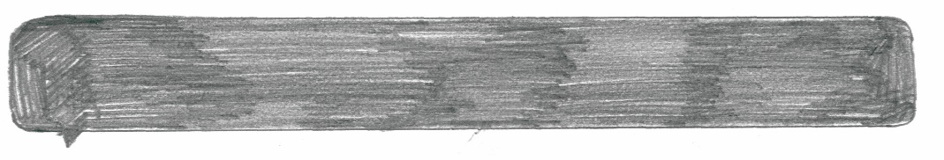
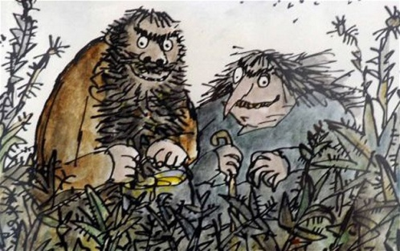
An extract from The Twits by Roald Dahl.
Task 1: Circle the correct single or plural.
The Twits is/are nasty. Mr Twit is/are hairy and Mrs Twit is/are ugly. They is/are the most horrible people you will ever read about. Mr Twit and Mrs Twit is/are always thinking of nasty tricks to play on each other. When Mrs Twit was/were angry, she gave Mr Twit worms to eat. He didn’t know that there was/were worms in his dinner. He thought that he was/were eating spaghetti. He wondered why his dinner was moving.
Task 2: Write the next part of the story about The Twits and their terrible, nasty tricks.
Be sure to include all of the sentence starters here. This will mean you have to use more than one paragraph to show a change in time.
Single |  | Plural
I am | I was | We are | We were
You are | You were | You are | You were
He is | He was | They are | They were
She is | She was
It is | It was
All of the present tense starters can be converted into future tense depending on the auxiliary verb (see your first booklet) that you choose to follow the main verb.

Slide 8
Letter
Word (Adjective)
Q
Definition
Sentence (using your word):
Synonyms
Antonyms
Letter
Word (Adjective)
R
Definition
Sentence (using your word):
Synonyms
Antonyms

Slide 9
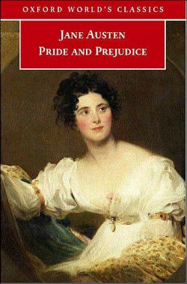
Pride and Prejudice by Jane Austen
Reading comprehension : Read the extract and answer the questions in as much detail as possible.
It is a truth universally acknowledged that a single man in possession of a good fortune must be in want of a wife.
However little known the feelings or views of such a man may be on his first entering a neighbourhood, this truth is so well fixed in the minds of the surrounding families, that he is considered the rightful property of someone or other of their daughters.
"My dear Mr. Bennet," said his lady to him one day, "have you heard that Netherfield Park is let at last?"
Mr. Bennet replied that he had not.
"But it is," returned she; "for Mrs. Long has just been here, and she told me all about it."
Mr. Bennet made no answer.
"Do you not want to know who has taken it?" cried his wife impatiently.
"You want to tell me, and I have no objection to hearing it."
This was invitation enough.
"Why, my dear, you must know, Mrs. Long says that Netherfield is taken by a young man of large fortune from the north of England; that he came down on Monday in a chaise and four to see the place, and was so much delighted with it, that he agreed with Mr. Morris immediately; that he is to take possession before Michaelmas, and some of his servants are to be in the house by the end of next week."
"What is his name?"
"Bingley."
"Is he married or single?”
"Oh! Single, my dear, to be sure! A single man of large fortune; four or five thousand a year. What a fine thing for our girls!"
"How so? How can it affect them?"
"My dear Mr. Bennet," replied his wife, "how can you be so tiresome! You must know that I am thinking of his marrying one of them."
"Is that his design in settling here?"
"Design! Nonsense, how can you talk so! But it is very likely that he may fall in love with one of them, and therefore you must visit him as soon as he comes."
"I see no occasion for that. You and the girls may go, or you may send them by themselves, which perhaps will be still better, for as you are as handsome as any of them, Mr. Bingley may like you the best of the party.“

Slide 10


"My dear, you flatter me. I certainly have had my share of beauty, but I do not pretend to be anything extraordinary now. When a woman has five grown-up daughters, she ought to give over thinking of her own beauty."
"In such cases, a woman has not often much beauty to think of."
"But, my dear, you must indeed go and see Mr. Bingley when he comes into the neighbourhood."
"It is more than I engage for, I assure you."
"But consider your daughters. Only think what an establishment it would be for one of them. Sir William and Lady Lucas are determined to go, merely on that account, for in general, you know, they visit no newcomers. Indeed you must go, for it will be impossible for us to visit him if you do not."
"You are over-scrupulous, surely. I dare say Mr. Bingley will be very glad to see you; and I will send a few lines by you to assure him of my hearty consent to his marrying whichever he chooses of the girls; though I must throw in a good word for my little Lizzy."
"I desire you will do no such thing. Lizzy is not a bit better than the others; and I am sure she is not half as handsome as Jane, nor half as good-humoured as Lydia. But you are always giving her the preference."
uestions:
How is Mrs Bennett portrayed when we first meet her in Pride and Prejudice?
How is Mr Bennett portrayed at the beginning of the novel?
What does the opening tell us about life in 19th Century England?
Even though we do not meet Lizzie, what relationship does she have with her parents?
What is the role of a single man in 19th century England? How do we know this?
Discuss the following point and explain why you agree or disagree:
Men and women have vastly different roles in today’s society in comparison to the men and women in Pride and Prejudice.

Slide 11
Answer your questions in detail here:

