Slide 1

English Home Learning
Term 6 Week 2
Name:____________________

Slide 2

Comprehension
Learning Objective:
Demonstrate understanding of a range of texts.
Key Words
A biography is a description of a person’s life written by
………………………………………………… else.
An autobiography is a …………………………………… of a person’s life
………………………………………..by them.
written description someone

Slide 3
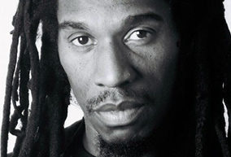
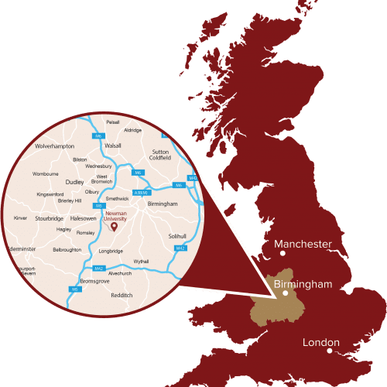
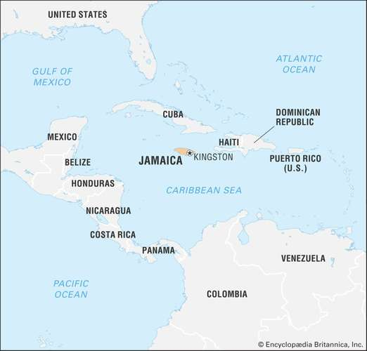
Benjamin Zephaniah
Dr Benjamin Obadiah Iqbal Zephaniah was born and raised in Birmingham, England. He cannot remember a time when he was not creating poetry but this had nothing to do with school where poetry meant very little to him, in fact he had finished full time education at the age of 13.
His poetry is strongly influenced by the music and poetry of Jamaica and what he calls ‘street politics’.
His first real public performance was in church when he was 10 years old. By the time he was 15, he had developed a strong following in his home town of Handsworth.

Slide 4
True or False
Choose four true statements from the following list.
Tick the ones you think are true.
Benjamin Zephaniah was born in Birmingham
School inspired him to write poetry
He finished school at 15
His poetry was influenced by Jamaica
His first performance was in church
He had a following by the time he was 10
His hometown was Handsworth
He did not have a strong following

Slide 5
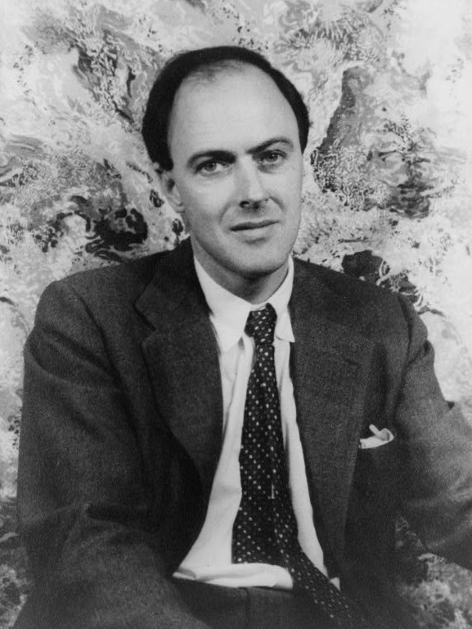
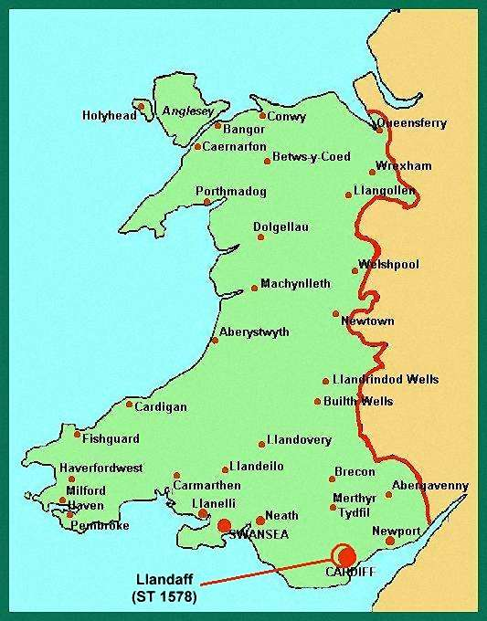
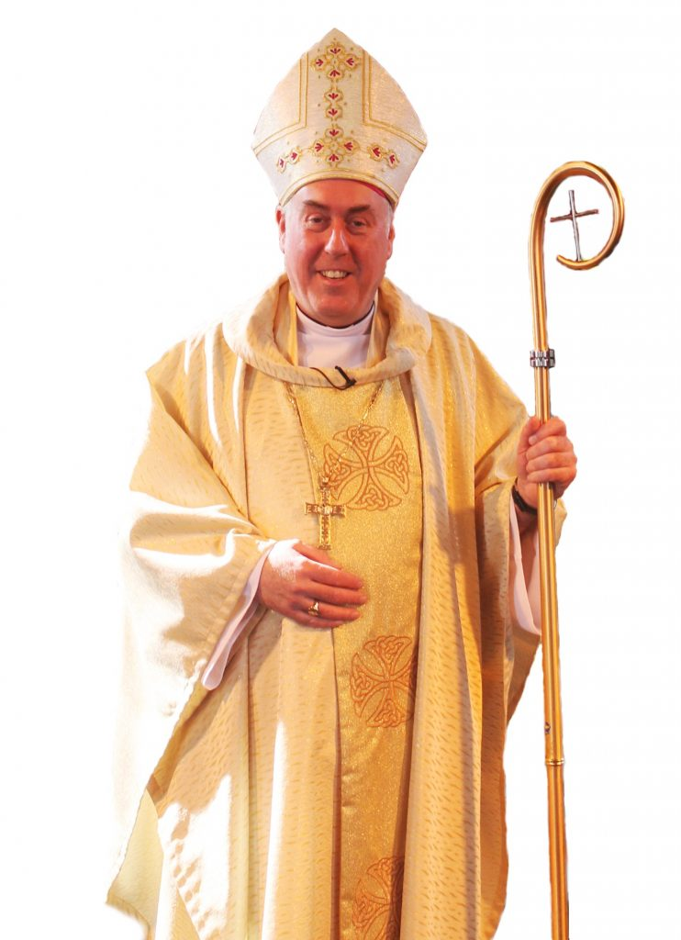
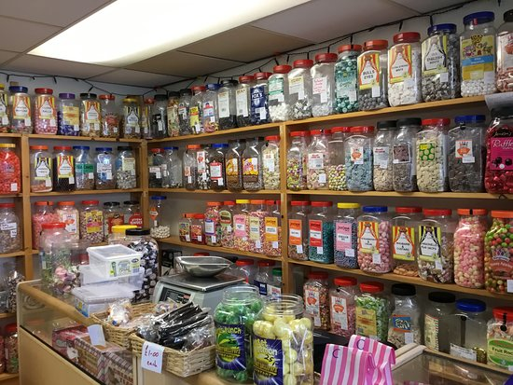
Boy by Roald Dahl
Roald Dahl is a famous author. In his autobiography ‘Boy’ he talks about his childhood.
The sweet-shop in Llandaff in the year 1923 was the very centre of our lives. To us, it was what a bar is to a drunk, or a church is to a Bishop. Without it, there would have been little to live for. But it had one terrible drawback, this sweet-shop. The woman who owned it was a horror. We hated her and we had good reason for doing so.
Find four things about the sweet shop.
_________________________________________
2. _________________________________________
3. _________________________________________
4. _________________________________________

Slide 6

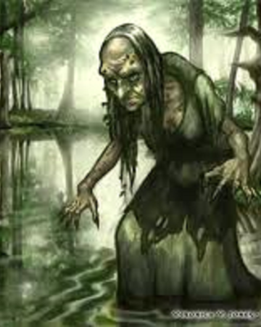

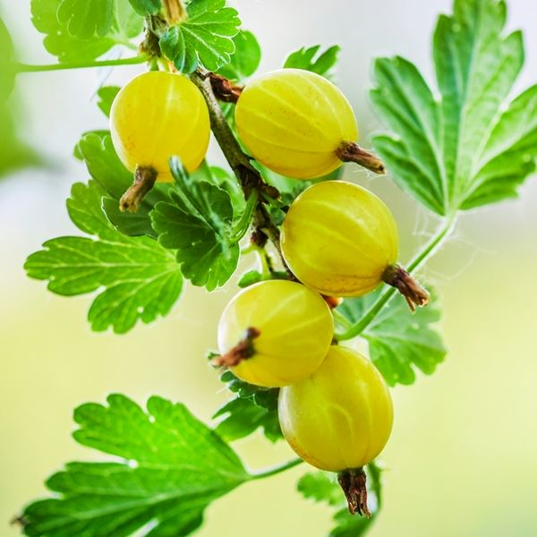
Boy by Roald Dahl
Roald Dahl is a famous author. In his autobiography ‘Boy’ he talks about his childhood.
Her name was Mrs. Pratchett. She was a small skinny old hag with a moustache on her upper lip and a mouth as sour as a green gooseberry. She never smiled. She never welcomed us when we went in, and the only times she spoke were when she said things like, ‘I’m watchin’ you so keep yer thievin’ fingers off them chocolates!’ Or ‘I don’t want you in ‘ere just to look around! Either you forks out or you gets out’.
Find four things about Mrs Pratchett
_________________________________________
2. _________________________________________
3. _________________________________________
4. _________________________________________

Slide 7
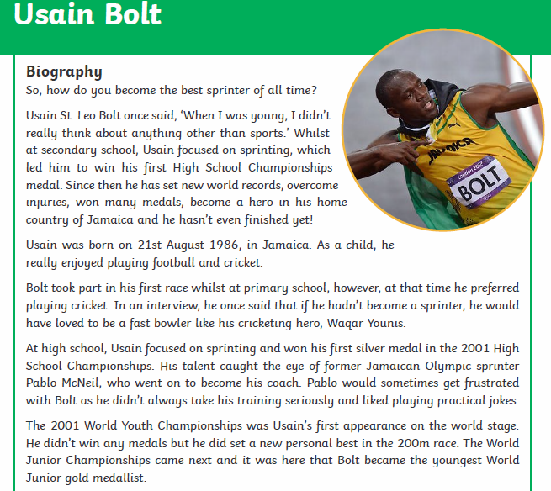
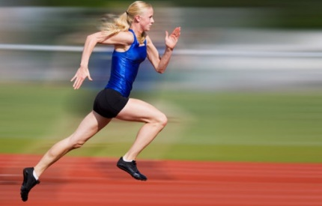
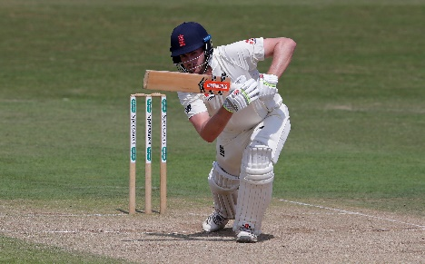
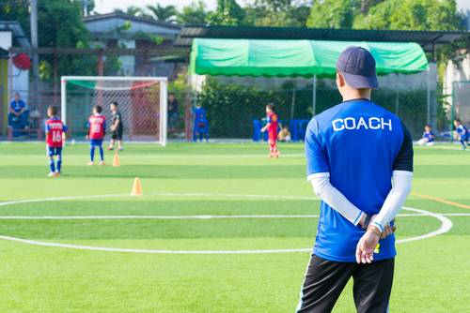
Usain Bolt
Key Words:
Sprinting: Running quickly over a short distance
Cricket: A bat and ball game
Coach: Teaches how to do a sport well.

Slide 8
Usain Bolt
Put in the following words:
sprinter medal World sports first
Jamaica cricket football coach seriously gold
Usain Bolt is famous for being the best ____________ of all time.
From a young age, he loved _______________ .. During Secondary school he won his __________ High School Championships __________. He has set __________ records and he is a hero in _____________ the country he lives in.
When he was a child, Usain liked playing ______________ and cricket.
His favourite sport in Primary school was ____________.
Usain got into sprinting in High School and got a __________ called Pablo McNeil. Sometimes he would get annoyed with him for not taking it ________________ and playing jokes.
Usain became the youngest World Junior __________ medallist.

Slide 9
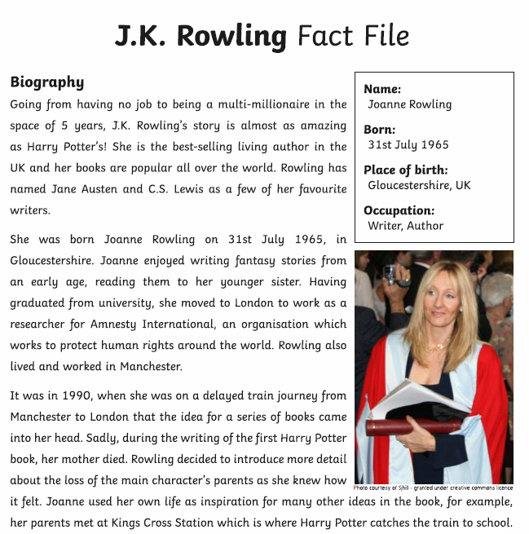
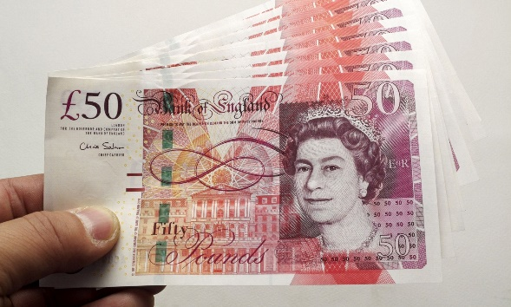
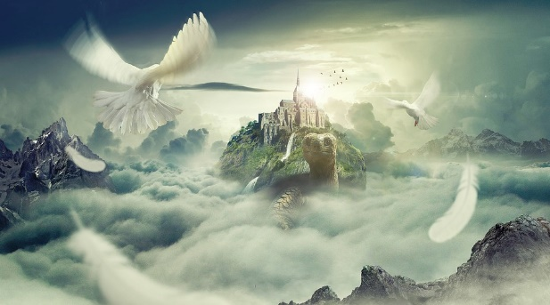
Key Words:
Multi-millionaire: Earning more than 1 million pounds
Fantasy: Stories set in a fictional universe

Slide 10

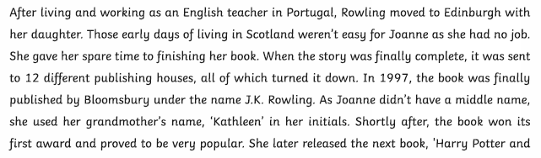
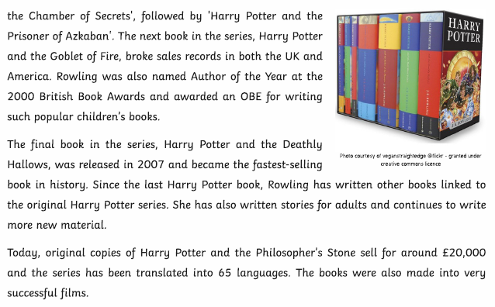

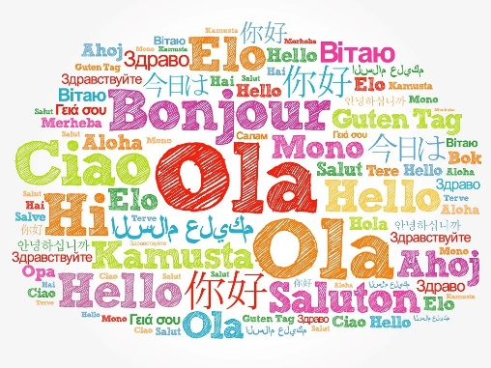
Key Words:
Publishing: Selling books for authors
Translated: Changed the language to another language

Slide 11
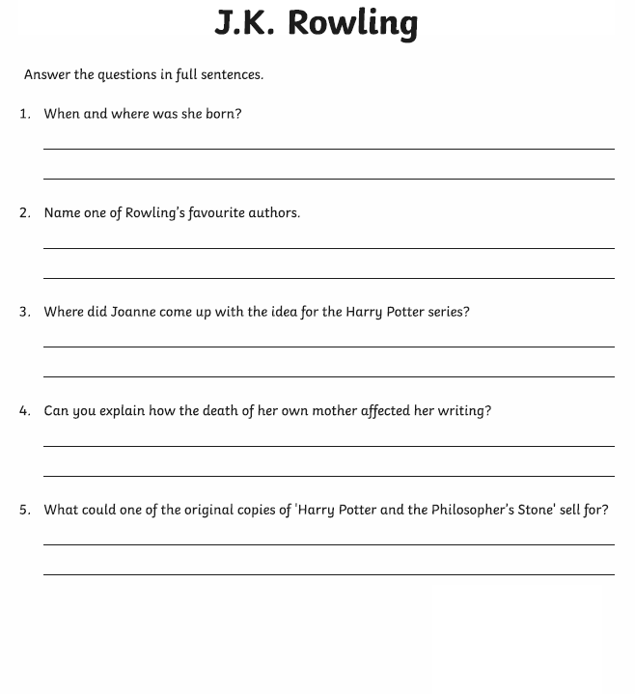

Slide 12

Self Assessment
Well done! You completed the comprehension week on biographies and autobiographies.
Can you remember any facts about the different people you have read about without looking?
Name: _________________________________
Fact: ___________________________________
Name:______________________________
Fact: _____________________________________
What went well this week?
My best piece of work is…
_________________________
because…
_________________________
_________________________

