Slide 1

English Home Learning
Term 6 Week 2
Name:____________________

Slide 2

Comprehension
Learning Objective:
Demonstrate understanding of a range of texts.
Key Words
Write out the definitions
A biography is __________________________________
______________________________________________
An autobiography _________________________________
_______________________________________________

Slide 3
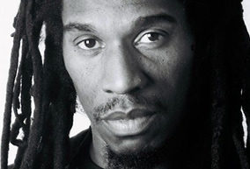
Benjamin Zephaniah
Dr Benjamin Obadiah Iqbal Zephaniah was born and raised in Birmingham, England. He cannot remember a time when he was not creating poetry but this had nothing to do with school where poetry meant very little to him, in fact he had finished full time education at the age of 13. His poetry is strongly influenced by the music and poetry of Jamaica and what he calls ‘street politics’. His first real public performance was in church when he was 10 years old, by the time he was 15 he had developed a strong following in his home town of Handsworth where he had gained a reputation as a young poet who was capable of speaking on local and international issues.

Slide 4
True or False
Choose four true statements from the following list.
Tick the ones you think are true.
Benjamin Zephaniah was born in Birmingham
School inspired him to write poetry
He finished school at 15
His poetry was influenced by Jamaica
His first performance was in church
He had a following by the time he was 10
His hometown was Handsworth
He did not have a strong following
Can you find out any more facts about Benjamin Zephaniah?

Slide 5
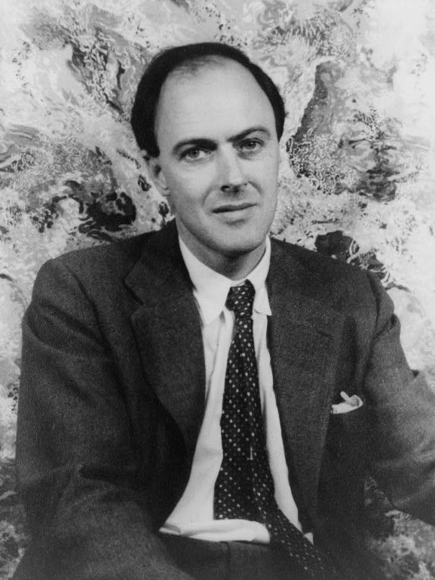
Boy by Roald Dahl
Roald Dahl is a famous author. In his autobiography ‘Boy’ he talks about his childhood.
The sweet-shop in Llandaff in the year 1923 was the very centre of our lives. To us, it was what a bar is to a drunk, or a church is to a Bishop. Without it, there would have been little to live for. But it had one terrible drawback, this sweet-shop. The woman who owned it was a horror. We hated her and we had good reason for doing so.
Her name was Mrs. Pratchett. She was a small skinny old hag with a moustache on her upper lip and a mouth as sour as a green gooseberry. She never smiled. She never welcomed us when we went in, and the only times she spoke were when she said things like, ‘I’m watchin’ you so keep yer thievin’ fingers off them chocolates!’ Or ‘I don’t want you in ‘ere just to look around! Either you forks out or you gets out’.

Slide 6
Boy by Roald Dahl
Find four things about the sweet shop.
_________________________________________
2. _________________________________________
3. _________________________________________
4. _________________________________________
Find four things about Mrs Pratchett
_________________________________________
2. _________________________________________
3. _________________________________________
4. _________________________________________

Slide 7
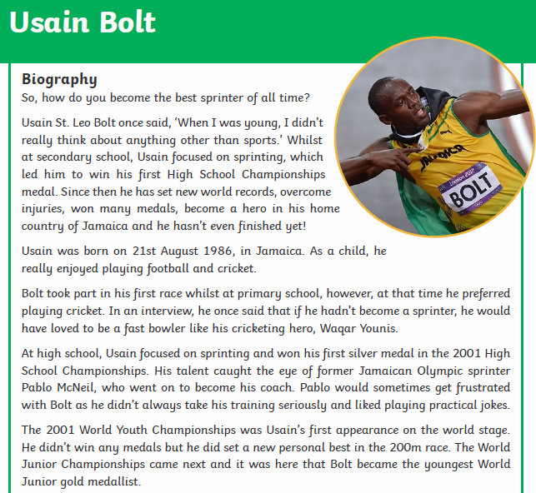
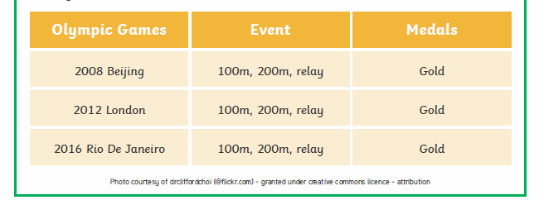

Slide 8
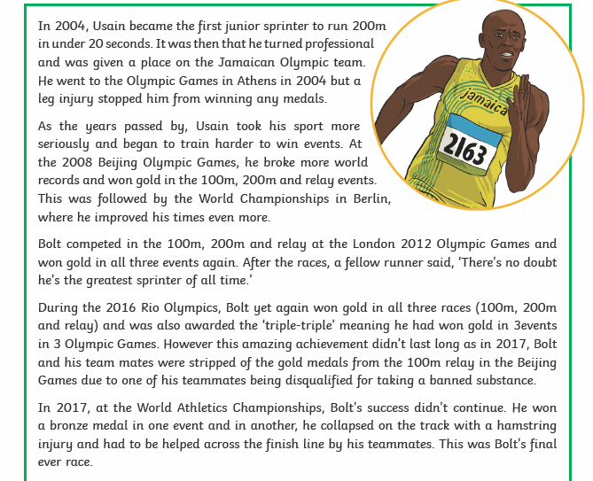


Slide 9
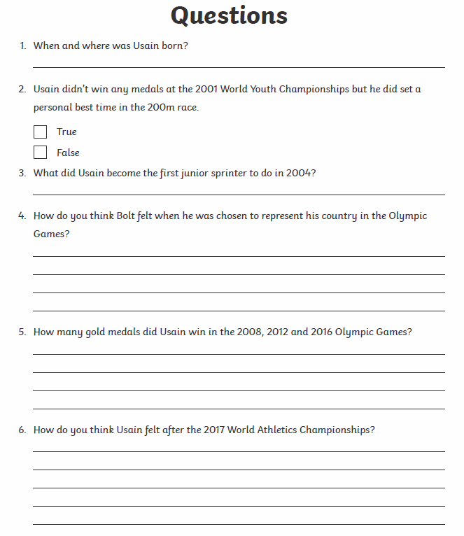

Slide 10
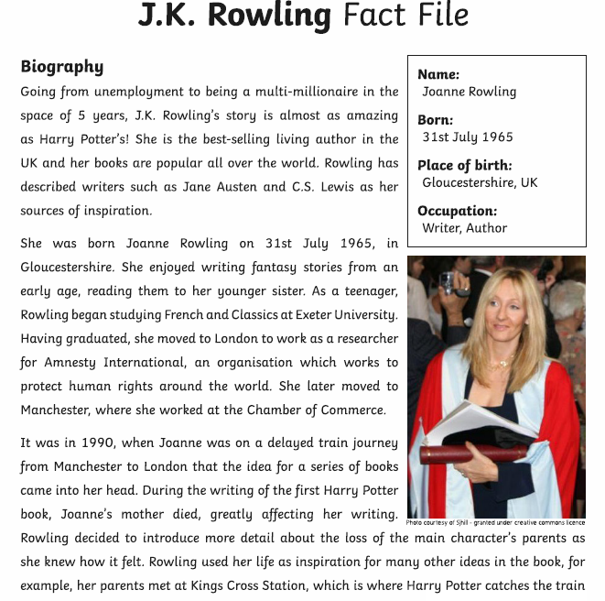
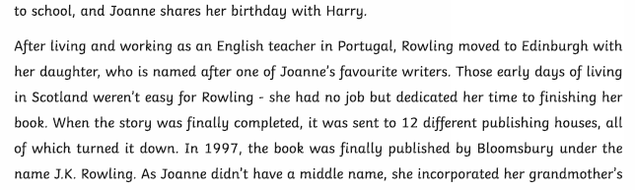

Slide 11
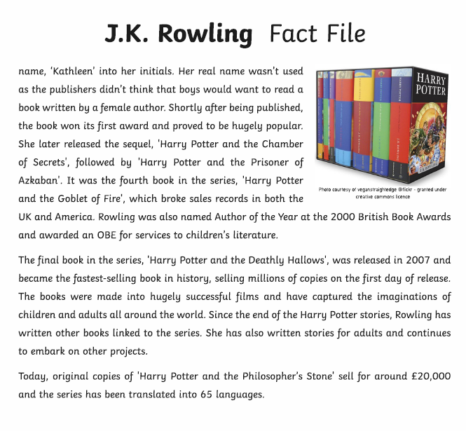

Slide 12
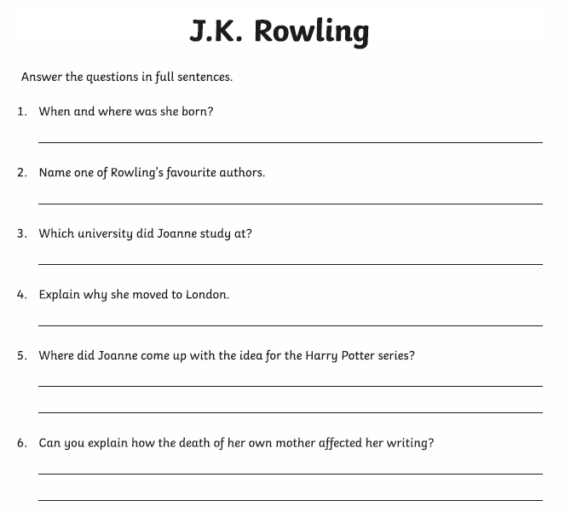
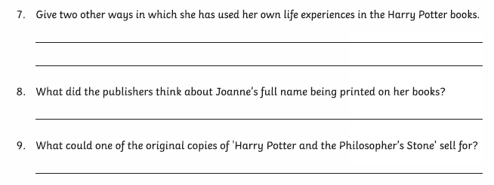

Slide 13

Extension Research Task
Choose a famous person of your choice.
Find some information about them and write your own questions.
These could be:
True or False
Questions to answer
Get someone in your family to answer them or include it in your work for you teacher to answer.

Slide 14

Self Assessment
Well done! You completed the comprehension week on biographies and autobiographies.
Can you remember any facts about the different people you have read about without looking?
Name: _________________________________
Fact: ___________________________________
Name:______________________________
Fact: _____________________________________
What went well this week?
My best piece of work is…
_________________________
because…
_________________________
_________________________

