Slide 1
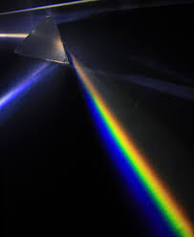
Science work pack
week 9
Helpful websites to support with the work or for interest:
https://www.bbc.co.uk/bitesize/guides/zq7thyc/revision/1
https://sciencebob.com/category/experiments/
https://mysteryscience.com/ https://thekidshouldseethis.com/
There is online learning available at:
app.senecalearning.com/dashboard/join-class/4ggjlziov1
You need to sign up using an email address. When asked to type in the school it is St Matthias academy. This should take you to straight to the learning page, if you are asked for a class code it is: 4ggjlziov1. There are tutorials and then questions.
Please work on the assignments and I can see what has been completed and how well you are doing.
Miss Grant

Slide 2
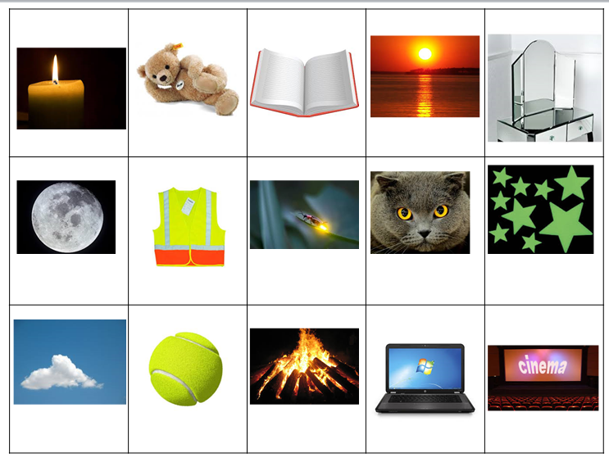
Luminous or non-luminous
If something is luminous it gives out light. It is a light source. An example would be a lamp, this gives out light
If something is non-luminous, it is not a light source, it is using light from something else.
Decide if the pictures below are luminous or non-luminous, I have started you off…
luminous
Non-luminous
Non-luminous

Slide 3

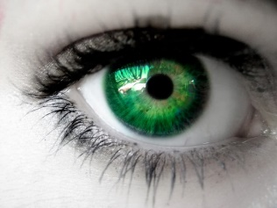

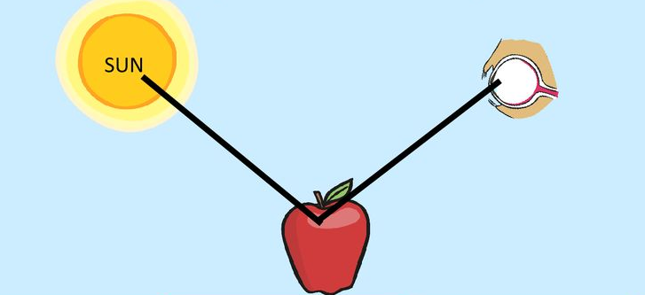
Light travels in straight lines
Light source is what is making the light
Medium is what the light is travelling through
Detector is what is where the light is received
Light detector= eye
Light source= light bulb
Medium =air
Draw arrows to show the direction the light is travelling
Add labels to show the light detector, medium and detector
_ _ _ _ _
_ _ _ _ _ _
=
_ _ _ _ _
_ _ _ _ _ _ _
=
_ _ _ _ _ _
=

Slide 4
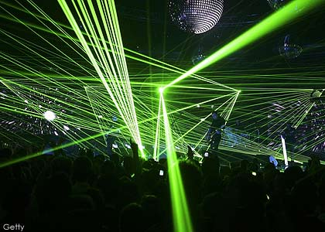
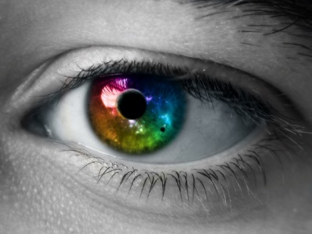
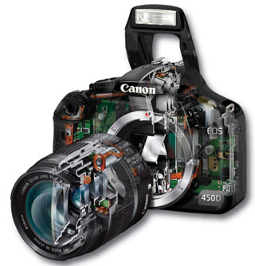
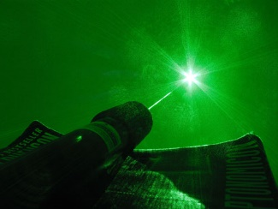
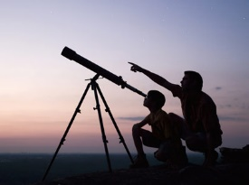
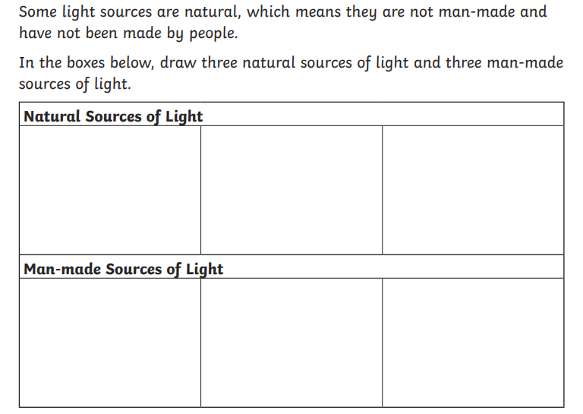


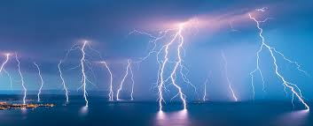

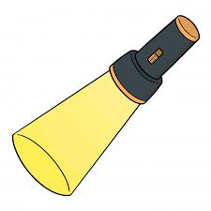
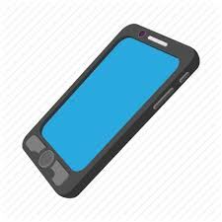
Name some uses of light
(the pictures may help with this)
light is needed to take a picture

Slide 5
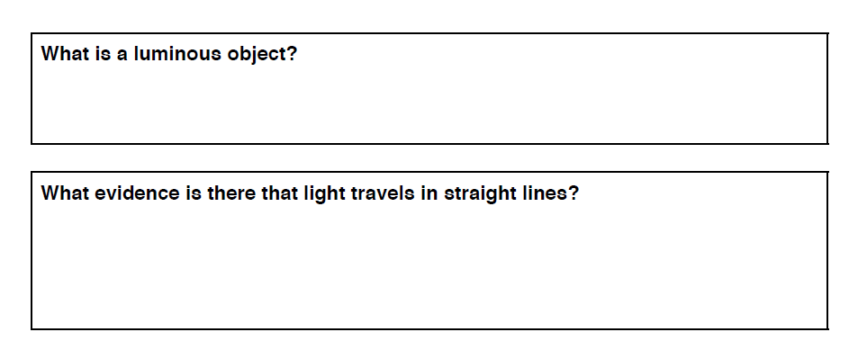
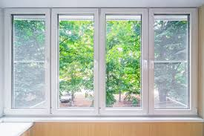
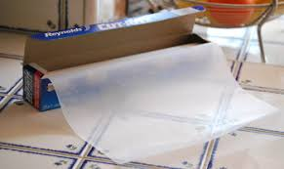
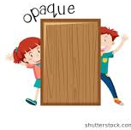
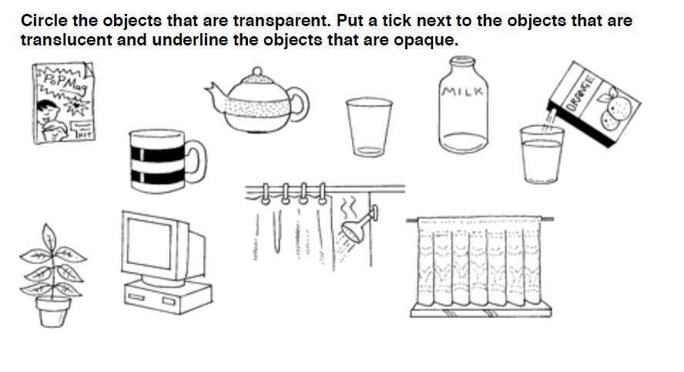
A luminous object is something that…………………………………..
Transparent | Something that you can see through eg glass
Translucent | Something that lets light through but you can’t see detailed shapes eg. Greaseproof paper
opaque | Is not able to be seen through, does not let light through eg. A door

Slide 6
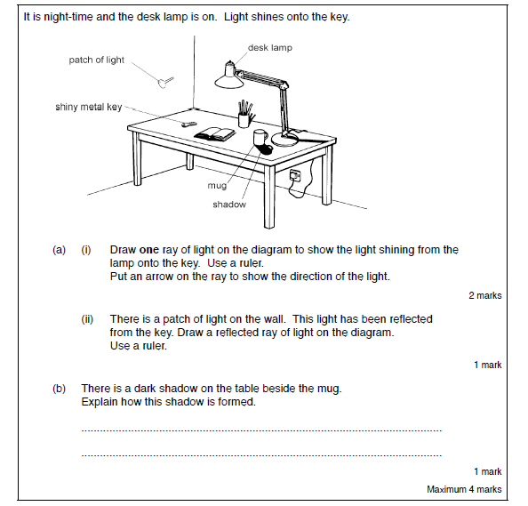
Name 3 things in your house which are, I have started you off with some examples:
Transparent | Translucent | opaque
glass | tissue paper | mug

Slide 7
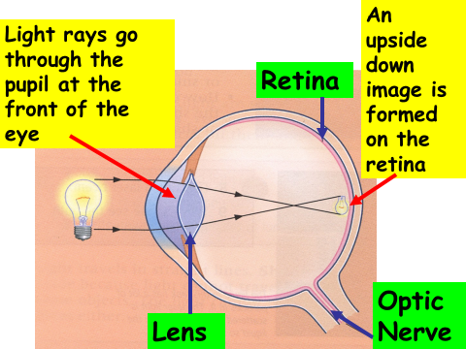
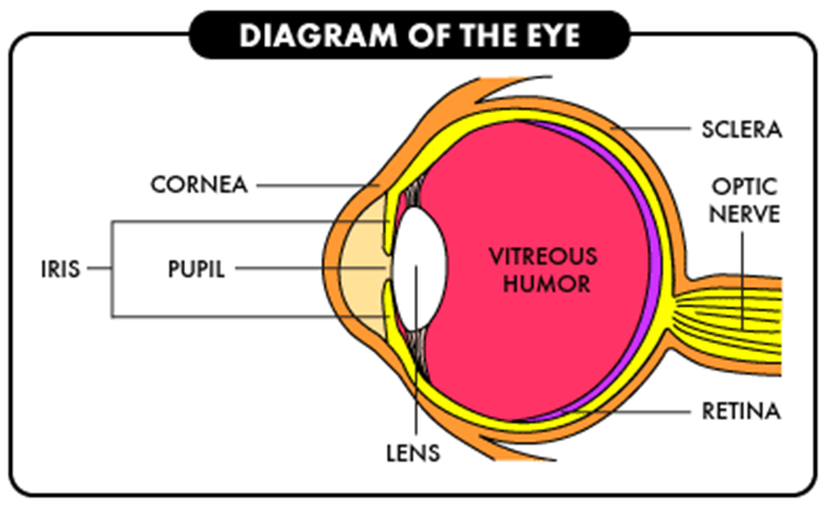
Contains nerve cells
Changes shape to focus the light
Carries the information to the brain
Coloured part of the eye
Allows light into the eye

Slide 8
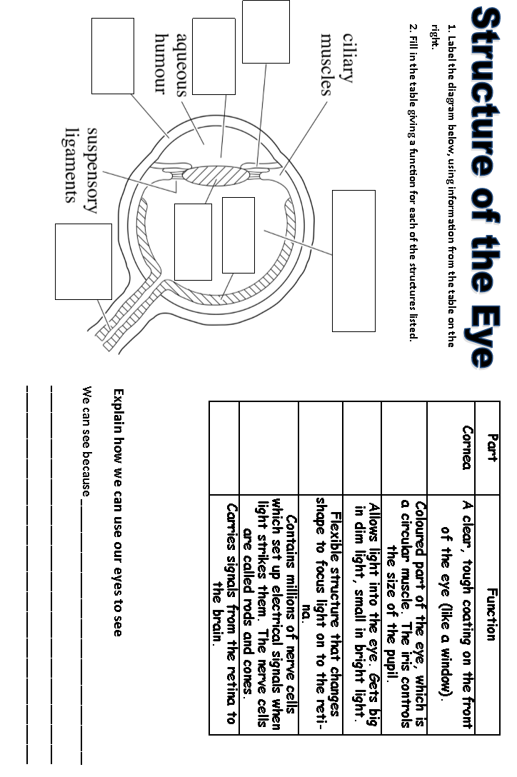
Use the diagrams on the previous page to complete the worksheet
I _ _ _
C _ _ _ _ _
P _ _ _ _ _
L _ _ _
R _ _ _ _ _
O _ _ _ _ N_ _ _ _
Vitreous Humor
O…………….
R…………….
L…………….
I…………….
P…………….

Slide 9
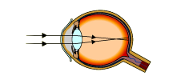
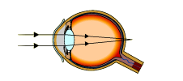
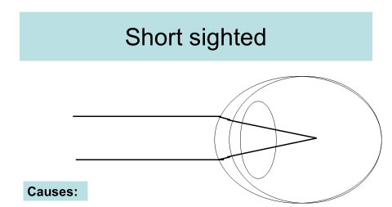
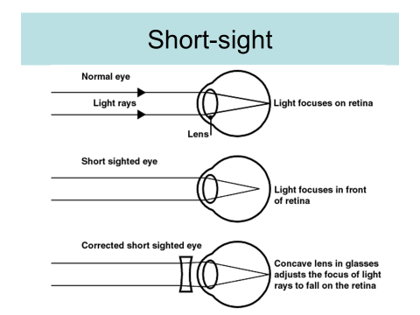
To see clearly, light has to be focussed on the retina (back of the eye) if this does not happen you may need glasses to focus the light.
Short sighted – eyeball too long or wrong shaped lens
Image is focused in front of the retina, not on it
Long sighted – eyeball too
short or wrong shaped lens
Image is focused behind
the retina, not on it
What causes someone to be short sighted?
…………………………………….
……………………………………
……………………………………
How can this be corrected?
…………………………………….
……………………………………
……………………………………

Slide 10
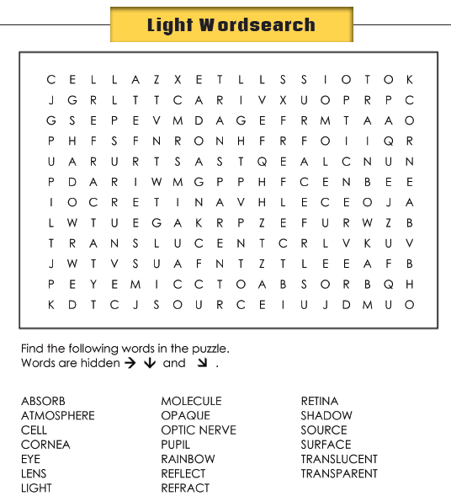
Glossary
Light source | is what is making the light
Light detector | is what the light is travelling through
Medium | is what is where the light is received
Transparent | Something that you can see through eg glass
Translucent | Something that lets light through but you can’t see detailed shapes eg. Greaseproof paper
opaque | Is not able to be seen through, does not let light through eg. A shoe
Luminous | Something that gives out light
retina | Receptors at the back of the eye which detect light and transfer it into an electrical signal
pupil | Hole in the middle of the eye to let light through
cornea | Transparent (clear) tough coating on the front of the eye

