Slide 1

English Home Learning
Term 6 Week 3
Name:____________________

Slide 2

Language and Structure
Learning Objective:
Comment on writer’s choice of words and layout.
Key Words
Language is the ………………………………………………… a writer uses in
their text.
Structure is the way a ……………………………………….. is
…………………………………………………………... .
text words organised

Slide 3
Key Words
Match up your definitions with the key words.
Use Google or a dictionary to check your answers
Key Word
Noun
Verb
Adjective
Definitions
An object, person, place or thing. E.G table, London, James ................
A word which describes a noun. E.G. purple, tall, kind, …………………
A word which describes an action. E.G. sit, jump, smile, ………………………..
Can you add your own examples in the gaps?

Slide 4
Key Words
A noun is an object, person, place or thing.
An adjective is a word which describes a noun.
A verb is a word which describes an action.
Sort these words into the right columns.
table orange tea jump sleep
tall soft computer waving beach
yellow growing sunshine warm happy
Noun | Adjective | Verb

Slide 5
Key Words
Find the key words in the word search
N | S | R | W | K | Z | Q | V | V | C
Q | O | V | V | N | A | Q | U | E | E
Y | G | U | Z | W | R | S | C | R | V
L | D | R | N | I | T | U | K | B | I
E | B | I | I | X | W | J | I | Z | T
R | Z | P | C | O | V | Q | G | P | C
E | R | U | T | C | U | R | T | S | E
O | H | D | S | B | I | U | X | K | J
L | A | N | G | U | A | G | E | A | D
N | G | W | I | Z | X | A | W | Q | A
ADJECTIVE | LANGUAGE | NOUN
STRUCTURE | VERB

Slide 6
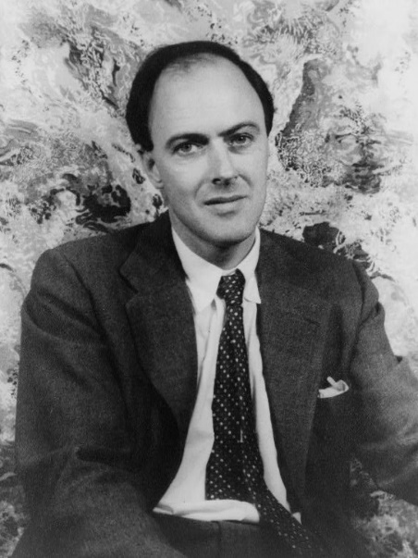
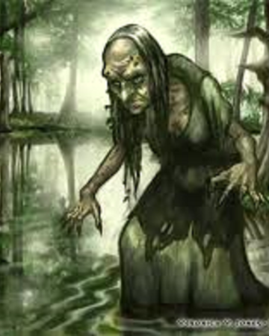

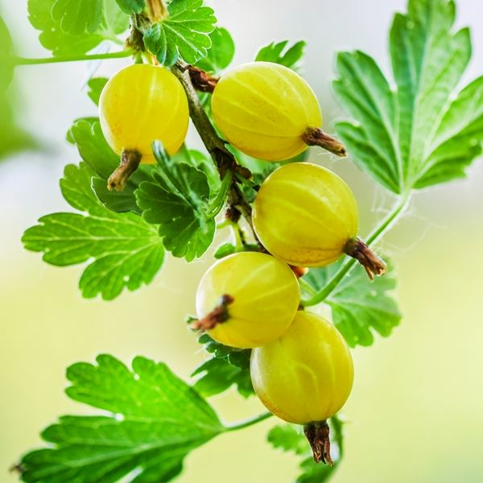

Roald Dahl – Boy
Extract from his autobiography
Her name was Mrs. Pratchett. She was a small skinny old hag with a moustache on her upper lip and a mouth as sour as a green gooseberry. She never smiled. She never welcomed us when we went in, and the only times she spoke were when she said things like, ‘I’m watchin’ you so keep yer thievin’ fingers off them chocolates!’ Or ‘I don’t want you in ‘ere just to look around! Either you forks out or you gets out’.

Slide 7
Roald Dahl – Boy
Extract from his autobiography
Language Questions
Find two adjectives in the first sentence.
______________________________________
2. Look at the picture. Why does he compare her to a hag?
______________________________________
3. Roald Dahl says she has a moustache on her upper lip. What kind of word is this?
______________________________________
4. Which one do you think he thought she was? Tick
pretty ugly
5. He describes her as sour. What kind of person does he think she is?
______________________________________

Slide 8
Key Words
Match up your definitions with the key words.
Use Google or a dictionary to check your answers
Key Word
Bullet Points
Title
Sub-headings
Images
Definitions
Smaller headings that tell you what a section is about.
A list of points:
Pictures used to illustrate.
At the top of the page, it tells you what the text is about

Slide 9
Key Words
Find the key words in the word search
J | O | N | H | E | F | X | Z | J | B
T | I | C | E | Z | G | Y | Q | U | M
G | I | L | A | W | C | A | L | C | P
C | I | U | D | L | Z | L | M | W | T
E | U | M | I | D | E | Y | P | I | T
L | F | P | N | T | Z | U | D | S | Q
T | N | C | G | S | T | N | I | O | P
I | M | Y | X | M | Z | L | O | V | P
T | I | U | N | M | W | Y | D | R | M
O | C | N | Y | S | G | L | G | T | R
BULLET | HEADING | IMAGE
LIST | POINTS | TITLE

Slide 10
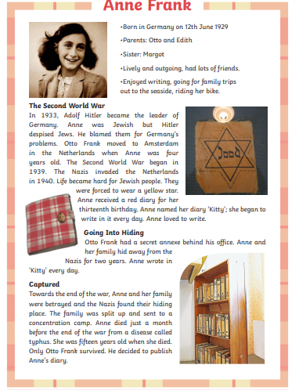
Anne Frank
Label the structure features on the this example

Slide 11
Anne Frank
Choose two features and explain why the writer has used them
Feature: ____________________
This is used to ___________
_______________________
_______________________
Key Words
Bullet Points
Title
Sub-headings
Images
Clear
Stand out
Reader
Colourful
Feature: ____________________
This is used to ___________
_______________________
_______________________

Slide 12

Self Assessment
Well done! You completed the comprehension week on biographies and autobiographies.
Can you remember the difference between language and structure without looking?
Language: _________________________________
_________________________________________
Structure:_________________________________
_________________________________________
What went well this week?
My best piece of work is…
_________________________
because…
_________________________
_________________________

