Slide 1

English Home Learning
Term 6 Week 3
Name:____________________

Slide 2

Language and Structure
Learning Objective:
Explain writer’s choices of language and structure.
Key Words
Write out the definitions for what these words when mean talking about a text.
Language is __________________________________
______________________________________________
Structure is _________________________________
_______________________________________________

Slide 3
Key Words
Look up the definitions of the following key words and write down.
Key Word | Definition
Noun
Verb
Adjective
Adverb

Slide 4
Key Words
Look up the definitions of the following key words and write down.
Key Word | Definition
Simile
Metaphor
Personification
Hyperbole

Slide 5
Key Words
Find the key words in the word search
H | A | S | G | N | C | F | E | L | W | U | W | G | U | N
Y | W | D | U | K | S | N | A | J | A | X | Y | I | O | U
P | V | O | J | X | R | N | J | J | K | Z | J | I | B | U
E | N | T | K | E | G | T | G | Y | E | T | T | S | N | Y
R | B | E | P | U | C | O | X | M | K | A | H | N | H | Y
B | S | R | A | F | P | T | I | F | C | D | V | U | N | L
O | S | G | E | D | W | O | I | I | V | E | R | B | E | X
L | E | B | Q | V | Y | F | F | V | D | T | W | U | L | Q
E | X | Q | U | W | D | I | R | Z | E | E | U | X | I | P
V | Q | L | E | U | N | A | X | E | K | Z | W | D | M | N
X | S | A | R | O | H | P | A | T | E | M | T | T | I | R
V | K | T | S | W | W | X | U | M | X | D | E | N | S | T
E | Q | R | I | F | X | U | W | N | A | M | Y | B | I | F
B | E | X | L | X | E | J | S | I | H | Y | R | K | T | Y
P | C | S | T | R | U | C | T | U | R | E | E | G | G | Y
ADJECTIVE | ADVERB | HYPERBOLE
LANGUAGE | METAPHOR | NOUN
PERSONIFICATION | SIMILE | STRUCTURE
VERB

Slide 6
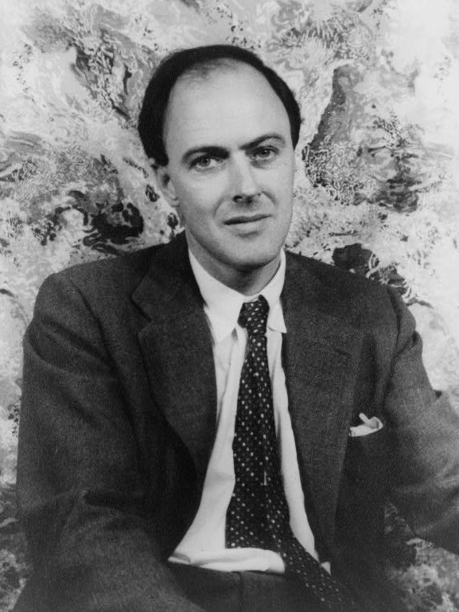
Boy by Roald Dahl
Roald Dahl is a famous author. In his autobiography ‘Boy’ he talks about his childhood.
The sweet-shop in Llandaff in the year 1923 was the very centre of our lives. To us, it was what a bar is to a drunk, or a church is to a Bishop. Without it, there would have been little to live for. But it had one terrible drawback, this sweet-shop. The woman who owned it was a horror. We hated her and we had good reason for doing so.
Her name was Mrs. Pratchett. She was a small skinny old hag with a moustache on her upper lip and a mouth as sour as a green gooseberry. She never smiled. She never welcomed us when we went in, and the only times she spoke were when she said things like, ‘I’m watchin’ you so keep yer thievin’ fingers off them chocolates!’ Or ‘I don’t want you in ‘ere just to look around! Either you forks out or you gets out’.

Slide 7
Boy by Roald Dahl
Roald Dahl is a famous author. In his autobiography ‘Boy’ he talks about his childhood.
How does Roald Dahl use language to describe the sweet shop and Mrs Pratchett?
Read through the extract.
Emerging: Highlight quotes which you think are interesting.
Developing: Label with techniques used.
Noun Adjective Metaphor
Adverb Verb Simile
Personification Hyperbole

Slide 8
Boy by Roald Dahl
How does Roald Dahl use language to describe the sweet shop and Mrs Pratchett?
Use your annotations to complete the PEE planning table on the next page.
See the example below.
Emerging: Make a point about the sweet shop or Mrs Pratchett
Developing: Get a quote
Secure: Comment on effect and name technique
Mastered: Explain in detail
Point | Evidence | Explain
The boys love the sweet shop | “it was the very centre of our lives” | Noun – “centre” show how important it was to them because the centre is usually the most important thing

Slide 9
Boy by Roald Dahl
How does Roald Dahl use language to describe the sweet shop and Mrs Pratchett?
Point | Evidence | Explain

Slide 10
Boy by Roald Dahl
How does Roald Dahl use language to describe the sweet shop and Mrs Pratchett?
Now use your plan to write out your paragraphs.
Emerging: Make a point and use quote to prove your ideas
Developing: Name the techniques use and comment on effect
Secure: Explain the effect using because
Mastered: Talk about the effect of a word from your quote
Use the sentence starters if you need a hand.
Roald Dahl tells us… He says “…”
This … suggests that… because…
The reader might think….
The word “….” is effective because…

Slide 11
Boy by Roald Dahl
How does Roald Dahl use language to describe the sweet shop and Mrs Pratchett?
………………………………………………………………………………………………………………………………………………………………………………………………………………………………………………………………………………………………………………………………………………………………………………………………………………………………………………………………………………………………………………………………………………………………………………………………………………………………………………………………………………………………………………………………………………………………………………………………………………………………………………………………………………………………………………………………………………………………………………………………………………………………………………………………………………………………………………………………………………………………………………………………

Slide 12
Boy by Roald Dahl
How does Roald Dahl use language to describe the sweet shop and Mrs Pratchett?
………………………………………………………………………………………………………………………………………………………………………………………………………………………………………………………………………………………………………………………………………………………………………………………………………………………………………………………………………………………………………………………………………………………………………………………………………………………………………………………………………………………………………………………………………………………………………………………………………………………………………………………………………………………………………………………………………………………………………………………………………………………………………………………………………………………………………………………………………………………………………………………………

Slide 13
Key Words
Look up the definitions of the following key words and write down.
Key Word | Definition
Bullet Points
Title
Image
Sub-headings

Slide 14
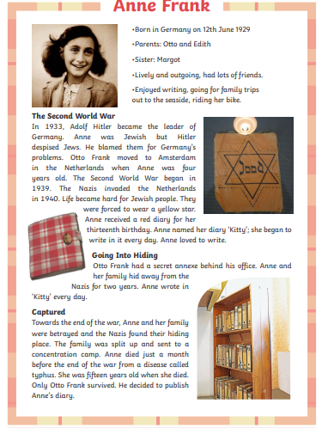
Anne Frank
Label the structure features on the this example

Slide 15
Key Words
Why does the writer use the following structural techniques?
Key Word | Why are they used?
Bullet Points
Title
Image
Sub-headings

Slide 16

Self Assessment
Well done! You completed the comprehension week on biographies and autobiographies.
Can you remember the difference between language and structure without looking?
Language: _________________________________
_________________________________________
Structure:_________________________________
_________________________________________
What went well this week?
My best piece of work is…
_________________________
because…
_________________________
_________________________

