Slide 1

English Home Learning
Week 10
Name:_____________________
Teacher:___________________

Slide 2


Section one: How to construct your writing
What do I need to complete?
Spelling test 1
Read the information on metalanguage
Complete the task on metalanguage
Read the page on revising sentence structure and complete the task
Read the page on sentence effect and complete the task
Complete the extended writing task
New vocabulary S and T
Reading comprehension: Harry Potter
Self Assessment: What do I still need to practise from this section?

Slide 3
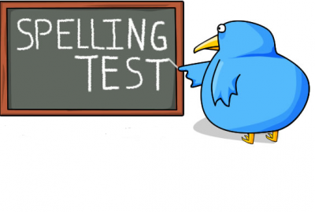
Spelling test 1
You will be tested on your spellings in every
literacy lesson.
You are expected to get at least 17/20 right each time. If you do not manage this you will need to re-take the test at another time.
 | Read | Write | Cover and write
Commonly misspelt words | Conscious
 | Ambitious
 | Suspicious
 | Cautious
 | Vicious
 | Pretentious
 | Gracious
 | Fictitious
 | Precious
 | Fractious
 | Delicious
 | Vexatious
 | Spacious
 | Anxious
 | Tenacious
Topic specific words
Notes:
http://www.saveteacherssundays.com/spelling/

Slide 4



Metalanguage
Don’t panic! Look at the root word (language) – we already know what this means. Now look at the prefix – Meta – this means ‘to make aware’. By putting these together it means that we are looking at the language (vocabulary) that describes the way we write and how we construct it.
Why is it important to understand metalanguage?
By understanding the metalanguage you can understand more clearly how to construct your writing.
For example, if your teacher tells you “You need to add a noun into your sentence to make sure it makes sense” or “you need to add a complex sentence to add more description” then it becomes much easier to begin to tackle the task you have been set.
Find the definition of the word and write it in your own words.
Write a sentence using the type of metalanguage you have defined. Circle or underline the metalanguage.
Word: Noun
Definition: A person, place or thing – if it is a proper noun then you need to use a capital letter. These are always the subject of the sentence.
Sentence: The princess was exceptionally beautiful.
Word: Prefix
Definition:
Sentence:

Slide 5
Word: Hyperbole
Definition:
Sentence:
Word: Verb
Definition:
Sentence:
Word: Pronoun
Definition:
Sentence:
Word: Adverb
Definition:
Sentence:
Word: Superlative
Definition:
Sentence:

Slide 6
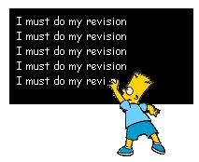



Revising sentence structure
It is important to revise and practice the skills you have already learned or you will forget how to use them and your success will go in a straight line rather than upwards!
We are going to look at our sentence structure again this term.
Read the following information carefully, this is also an important skill moving towards GCSE.
A simple sentence (or main clause) includes four elements: a capital letter, a noun (the subject), a verb (doing word) and a full stop.
It will make sense on its own.
Simple sentence
A complex sentence contains two parts – a main clause and a subordinate clause. The subordinate clause does not make sense on its own and needs a comma to separate it from the main clause. Both parts of the sentence should be about the same noun (subject).
Complex sentence
A compound sentence consists of two parts: two main clauses and a connective. If you remove the connective both will still make sense on their own.
Compound sentence
These are your three basic sentence structures to go even further you can start to experiment with how to put two different types of sentence together to make your writing even more intricate (detailed).

Slide 7
Task: Extend all these sentences – make sure you read the instructions for each section properly.
Add a subordinate clause to these sentences to create a complex sentence
1. The rain was pouring
2. The unicorn was jubilant
3. The night was a catastrophe
4. The house was bleak
5. The nail varnish was sparkly
Add another main clause and connective to these sentences to create a compound sentence – Remember, connective doesn’t only mean and or because.
1. The anchor dropped into the sea
2. The locket opened
3. The squirrel was sprinting
4. The shiny boots were fabulous
5. The campfire was scorching
Add a main clause to these subordinate clauses to create a complex sentence.
1. Shrieking as it went
2. Revolving around and around,
3. Believing the lies
4. Sizzling against my skin
5. Indifferently

Slide 8

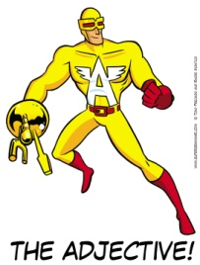
What is the ?
Using a variety of sentences is not just about showing off your literacy skills, it is also used to create an atmosphere or feeling in your writing.
Simple sentences can be used for a variety of reasons. They are most often used to create tension and fear so you will see them quite frequently in horror or thriller type stories. It can help the reader to feel immersed in the story.
Simple sentence
Example: We ran quickly. Fear filled the air. Thud. Darkness.
Complex sentences are used to add information to sentence to give the reader a more detailed description of what is happening in the text. It helps the text flow more easily and can symbolise a calmer point in a story.
Complex sentences are often used to show a character’s inner thoughts or when describing the scene.
Complex sentence
Example: Beautifully transcendent, the sun rose up above the rolling green hills.
A compound sentence is also used to give more information but usually in a less descriptive way.
It can be used to add more information to the original subject rather than add to the description.
Compound sentence
Example: The boy was very tall and he had short brown hair.
Remember – it is not enough to just use these structures properly, you can show your skill by including many ambitious adjectives.

Slide 9

Extended writing
Using all your knowledge of sentence structure so far
you are going to create a short, descriptive story.
Choose one idea from each column – all of these must be included in your piece.
Write a minimum of three paragraphs using the sentence structure we have looked at. Where do you need to build tension? Where is your in depth description?
Swap your work with your partner and get them to highlight the most effective paragraph and to explain why. Avoid phrases like “It makes the reader want to read on.” and focus on using your metalanguage.
Character 1 | Place | Item | Character 2 | Feeling
A policeman | Train | Binoculars | Babysitter | Ill
A school girl | Asda | An invitation | A stranger | Fear
A detective | The woods | A watch | A teacher | Anxious
A homeless man | A library | Smelly trainers | A lion | Delirious
A polar bear | The Sahara | Fortune cookie | A clown | Ecstatic
Adjectives bank
Character 1 | Place | Item | Character 2 | Feeling

Slide 12
Word (Adjective)
Letter
S
Definition
Sentence (using your word):
Synonyms
Antonyms
Word (Adjective)
Letter
T
Definition
Sentence (using your word):
Synonyms
Antonyms

Slide 13

Harry Potter by J. K. Rowling
Reading comprehension : Read the extract and answer the questions in as much detail as possible.
Harry had never been to London before. Although Hagrid seemed to know where he was going, he was obviously not used to getting there in an ordinary way. He got stuck in the ticket barrier on the Underground, and complained loudly that the seats were too small and the trains too slow. "I don't know how the Muggles manage without magic," he said as they climbed a broken-down escalator that led up to a bustling road lined with shops.
Hagrid was so huge that he parted the crowd easily; all Harry had to do was keep close behind him. They passed book shops and music stores, hamburger restaurants and cinemas, but nowhere that looked as if it could sell you a magic wand. This was just an ordinary street full of ordinary people. Could there really be piles of wizard gold buried miles beneath them? Were there really shops that sold spell books and broomsticks? Might this not all be some huge joke that the Dursleys had cooked up?
If Harry hadn't known that the Dursleys had no sense of humour, he might have thought so; yet somehow, even though everything Hagrid had told him so far was unbelievable, Harry couldn't help trusting him. "This is it," said Hagrid, coming to a halt, "the Leaky Cauldron. It's a famous place."
For a famous place, it was very dark and shabby. A few old women were sitting in a corner, drinking tiny glasses of sherry. One of them was smoking a long pipe. A little man in a top hat was talking to the old bartender, who was quite bald and looked like a toothless walnut. The low buzz of chatter stopped when they walked in. Everyone seemed to know Hagrid; they waved and smiled at him, and the bartender reached for a glass, saying, "The usual, Hagrid?" "Can't, Tom, I'm on Hogwarts business," said Hagrid, clapping his great hand on Harry's shoulder and making Harry's knees buckle.
"Good Lord," said the bartender, peering at Harry, "is this? Can this be?" The Leaky Cauldron had suddenly gone completely still and silent. "Bless my soul," whispered the old bartender, "Harry Potter... what an honor." He hurried out from behind the bar, rushed toward Harry and seized his hand, tears in his eyes. "Welcome back, Mr. Potter, welcome back!" Harry didn't know what to say. Everyone was looking at him. The old woman with the pipe was puffing on it without realizing it had gone out.
Hagrid was beaming. Then there was a great scraping of chairs and the next moment, Harry found himself shaking hands with everyone in the Leaky Cauldron. "Doris Crockford, Mr. Potter, can't believe I'm meeting you at last." "So proud, Mr. Potter, I'm just so proud." "Always wanted to shake your hand, I'm all of a flutter." "Delighted, Mr. Potter; just can't tell you, Diggle's the name, Dedalus Diggle." "I've seen you before!" said Harry, as Dedalus Diggle's top hat fell off in his excitement. "You bowed to me once in a shop." "He remembers!" cried Dedalus Diggle, looking around at everyone. "Did you hear that? He remembers me!" Harry shook hands again and again; Doris Crockford kept coming back for more.
A pale young man made his way forward, very nervously. One of his eyes was twitching. "Professor Quirrell!" said Hagrid. "Harry, Professor Quirrell will be one of your teachers at Hogwarts." "P-P-Potter," stammered Professor Quirrell, grasping Harry's hand, "c-can't t-tell you how p- pleased I am to meet you." "What sort of magic do you teach, Professor Quirrell." "D-Defense Against the D-D-Dark Arts," muttered Professor Quirrell, as though he'd rather not think about it. "N-not that you n-need it, eh, P-P-Potter?" He laughed nervously. "You'll be g-getting all your equipment, I suppose. I've g-got to p-pick up a new b-book on vampires, m-myself." He looked terrified at the very thought.
But the others wouldn't let Professor Quirrell keep Harry to himself. It took almost ten minutes to get away from them all. At last, Hagrid managed to make himself heard over the babble. "Must get on -- lots ter buy. Come on, Harry." Doris Crockford shook Harry's hand one last time, and Hagrid led them through the bar and out into a small, walled courtyard, where there was nothing but a trash can and a few weeds.
Hagrid grinned at Harry. "Told yeh, didn't I? Told yeh you was famous.

Slide 14
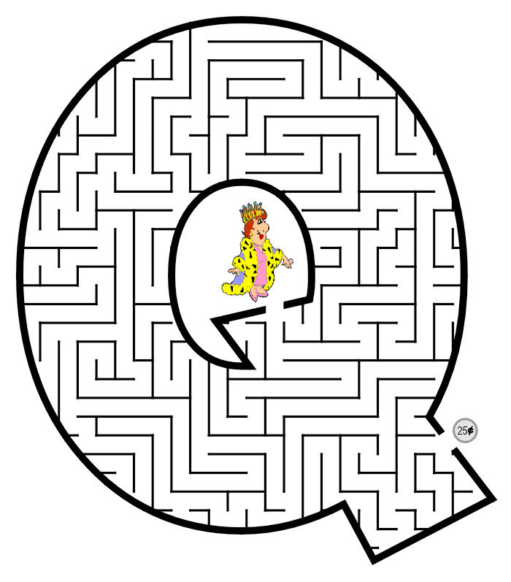
A pale young man made his way forward, very nervously. One of his eyes was twitching. "Professor Quirrell!" said Hagrid. "Harry, Professor Quirrell will be one of your teachers at Hogwarts." "P-P-Potter," stammered Professor Quirrell, grasping Harry's hand, "c-can't t-tell you how p- pleased I am to meet you." "What sort of magic do you teach, Professor Quirrell." "D-Defense Against the D-D-Dark Arts," muttered Professor Quirrell, as though he'd rather not think about it. "N-not that you n-need it, eh, P-P-Potter?" He laughed nervously. "You'll be g-getting all your equipment, I suppose. I've g-got to p-pick up a new b-book on vampires, m-myself." He looked terrified at the very thought.
But the others wouldn't let Professor Quirrell keep Harry to himself. It took almost ten minutes to get away from them all. At last, Hagrid managed to make himself heard over the babble. "Must get on -- lots ter buy. Come on, Harry." Doris Crockford shook Harry's hand one last time, and Hagrid led them through the bar and out into a small, walled courtyard, where there was nothing but a trash can and a few weeds.
Hagrid grinned at Harry. "Told yeh, didn't I? Told yeh you was famous.”
uestions
What did Hagrid complain about on the way to London?
Which types of shop did Harry and Hagrid pass on their way through London?
What is the name of the pub they enter before going to Diagon Alley?
How does J. K. Rowling describe the bartender?
Who did he meet in the pub?
Who has Harry met before? Can you explain why Harry remembers him?
What do we learn about Professor Quirrell in this extract?
How is Hagrid portrayed in this extract?
How is Harry portrayed in this extract?

Slide 15
Answer your questions in detail here:

