Slide 1
Keeping Safe: Tattoos and Piercing
There are 3 levels of task in this workpack:
Challenge: Venus, Atlas, Phobos and Europa have a go at completing all of these tasks
More challenging: Neptune and Titan, aim to complete these tasks. If you are finding them too challenging work through the Challenge tasks
Mega challenge: Saturn and Mercury these are for you! Again if these are too challenging work your way through the Challenge and More Challenging tasks!

Slide 2
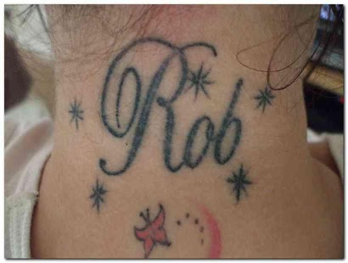
Do we need to worry about body piercings and tattoos?
STARTER:
Molly’s older sisters all have tattoos. Molly’s mum says she’s too young and besides, it’s illegal at 15. Molly has found a tattoo studio that has booked her in and never asked her age. She has chosen a large tattoo of her boyfriend’s name. She wants it on her neck.
Answer here:
Challenge: Is Molly’s plan a good idea? What could go wrong?
More challenging: Why is there an age restriction for getting tattoos? Explain using Molly as an example.
Mega challenge: Analyse why Molly wants a tattoo. Is this a good reason? Explain the long and short term consequences of Molly’s plan.

Slide 3

Key terms:
Self Expression – A way of showing the world your true self, or showing how you would like people to think of you.
Septicaemia / Sepsis – Blood infection conditions, which can be fatal. This can happen very quickly too if not treated immediately.
Learning Outcomes:
Correctly identify the potential problems getting tattoos and body piercings at a young age can cause.
Describe the possible long term and short term consequences of body piercings and tattoos.
Explain how small decisions made in youth can have far reaching consequences in many areas of our adult lives.

Slide 4
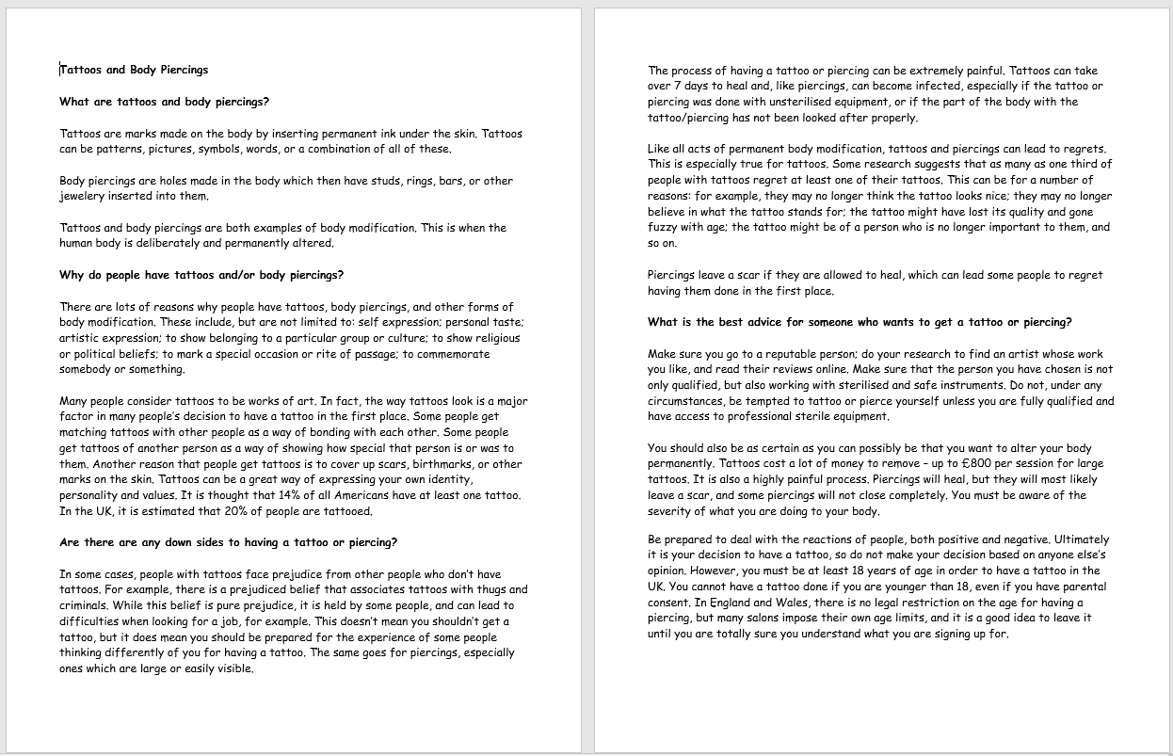

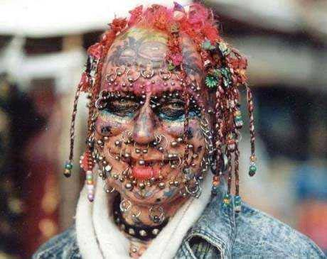
Task One:
We will now find out more
about tattoos and body
piercings and their
potential short and long
term consequences.
POPCORN READING!
Read through the information
sheets that follow
You will then complete the
next task at your challenge level.

Slide 5
Tattoos and Body Piercings
What are tattoos and body piercings?
Tattoos are marks made on the body by inserting permanent ink under the skin. Tattoos can be patterns, pictures, symbols, words, or a combination of all of these.
Body piercings are holes made in the body which then have studs, rings, bars, or other jewelery inserted into them.
Tattoos and body piercings are both examples of body modification. This is when the human body is deliberately and permanently altered.
Why do people have tattoos and/or body piercings?
There are lots of reasons why people have tattoos, body piercings, and other forms of body modification. These include, but are not limited to: self expression; personal taste; artistic expression; to show belonging to a particular group or culture; to show religious or political beliefs; to mark a special occasion or rite of passage; to commemorate somebody or something.
Many people consider tattoos to be works of art. In fact, the way tattoos look is a major factor in many people’s decision to have a tattoo in the first place.
Some people get matching tattoos with other people as a way of bonding with each other. Some people get tattoos of another person as a way of showing how special that person is or was to them.
Another reason that people get tattoos is to cover up scars, birthmarks, or other marks on the skin.
Tattoos can be a great way of expressing your own identity, personality and values. It is thought that 14% of all Americans have at least one tattoo. In the UK, it is estimated that 20% of people are tattooed.

Slide 6
Tattoos and Body Piercings
Are there are any down sides to having a tattoo or piercing?
In some cases, people with tattoos face prejudice from other people who don’t have tattoos. For example, there is a prejudiced belief that associates tattoos with thugs and criminals.
While this belief is pure prejudice, it is held by some people, and can lead to difficulties when looking for a job, for example. This doesn’t mean you shouldn’t get a tattoo, but it does mean you should be prepared for the experience of some people thinking differently of you for having a tattoo. The same goes for piercings, especially ones which are large or easily visible.
The process of having a tattoo or piercing can be extremely painful. Tattoos can take over 7 days to heal and, like piercings, can become infected, especially if the tattoo or piercing was done with unsterilised equipment, or if the part of the body with the tattoo/piercing has not been looked after properly.
Like all acts of permanent body modification, tattoos and piercings can lead to regrets. This is especially true for tattoos.
Some research suggests that as many as one third of people with tattoos regret at least one of their tattoos.
This can be for a number of reasons: for example, they may no longer think the tattoo looks nice; they may no longer believe in what the tattoo stands for; the tattoo might have lost its quality and gone fuzzy with age; the tattoo might be of a person who is no longer important to them, and so on.
Piercings leave a scar if they are allowed to heal, which can lead some people to regret having them done in the first place.

Slide 7
Tattoos and Body Piercings
What is the best advice for someone who wants to get a tattoo or piercing?
The most serious consequence of having a tattoo or piercing is infection. This is rare,but does happen.
There are ways of minimizing risk, however. Sepsis.com tells us to;
‘Visit the studio or shop. Look for signs of proper cleaning and maintenance.
Ask questions about what type of equipment the artists use. You are looking for artists who use single, “throw away” kits. For tattoos, these contain disposable needles and tubes, and for piercings they contain needles.
Does the staff use an autoclave to sterilize non-disposable equipment?
Check to see where they place their used needles. The shop or studio must have a separate, clearly marked red container marked “sharps disposal.” Razors must also be disposable.
The artist should also wash his or her hands and use a new pair of sterile disposable gloves before touching a new client or if he or she steps away and returns to continue the procedure.
If these basic steps of infection control are not present, go to another establishment.’

Slide 8
Tattoos and Body Piercings
What is the best advice for someone who wants to get a tattoo or piercing?
Make sure you go to a reputable person; do your research to find an artist whose work you like, and read their rMollyws online. Make sure that the person you have chosen is not only qualified, but also working with sterilised and safe instruments.
Do not, under any circumstances, be tempted to tattoo or pierce yourself unless you are fully qualified and have access to professional sterile equipment. Always follow the aftercare instructions.
You should also be as certain as you can possibly be that you want to alter your body permanently. Tattoos cost a lot of money to remove – up to £800 per session for large tattoos. It is also a highly painful process.
Piercings will heal, but they will most likely leave a scar, and some piercings will not close completely. You must be aware of the severity of what you are doing to your body.
Be prepared to deal with the reactions of people, both positive and negative. Ultimately it is your decision to have a tattoo, so do not make your decision based on anyone else’s opinion.
However, you must be at least 18 years of age in order to have a tattoo in the UK. You cannot have a tattoo done if you are younger than 18, even if you have parental consent.
In England and Wales, there is no legal restriction on the age for having a piercing, but many salons impose their own age limits, and it is a good idea to leave it until you are totally sure you understand what you are signing up for.

Slide 9
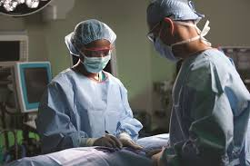
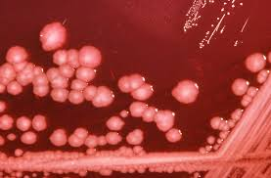
Task Two: Tattoos and Sepsis – watch and complete your choice of challenges on your worksheet.
https://www.youtube.com/watch?v=ysD4ywaOHuo
https://www.youtube.com/watch?v=6NdLnHbLZMU
Challenging:
What happened to the girl’s foot?
What happened when she went to hospital?
What causes sepsis?
What can happen if you develop sepsis?
More Challenging:
How could this situation have been avoided?
Explain what the girl believes should happen in the tattoo industry.
What are the symptoms of sepsis?
Mega Challenging:
What happens to the immune system when these infections occur?
Why does this make it hard for the blood to carry oxygen?
‘Tattooing needs to be recognized as an art-form.’ Why does this girl think that would help the situation?

Slide 10
Task Two: Tattoos and Sepsis – watch and complete your choice of challenges on your worksheet.
https://www.youtube.com/watch?v=ysD4ywaOHuo
https://www.youtube.com/watch?v=6NdLnHbLZMU
Answers here:

Slide 11
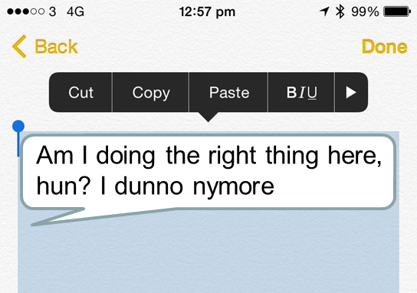


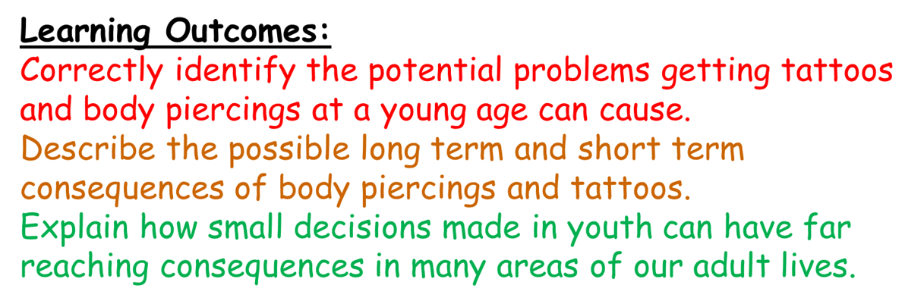
Plenary:
Let’s return to Molly.
Her appointment’s tomorrow.
She’s just sent you a message;
Challenge: Using what you’ve learned today, construct a two paragraph reply to Molly.
More challenging: Reply in detail, describing two long and two short term consequences.
Mega challenge: Using all today’s key terminology, evaluate the level of risk associated with Molly’s tattoo, focusing both the long and short term.
Answer here:

