Slide 1
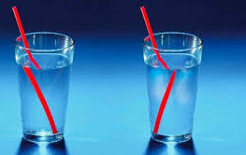
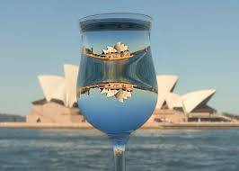
Science work pack
*week 10
Helpful websites to support with the work or for interest:
https://www.bbc.co.uk/bitesize/guides/zq7thyc/revision/1
https://sciencebob.com/category/experiments/
https://mysteryscience.com/ https://thekidshouldseethis.com/
There is online learning available at:
app.senecalearning.com/dashboard/join-class/4ggjlziov1
You need to sign up using an email address. When asked to type in the school it is St Matthias academy. This should take you to straight to the learning page, if you are asked for a class code it is: 4ggjlziov1. There are tutorials and then questions.
Please work on the assignments and I can see what has been completed and how well you are doing.
Miss Grant

Slide 2
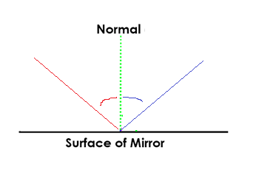
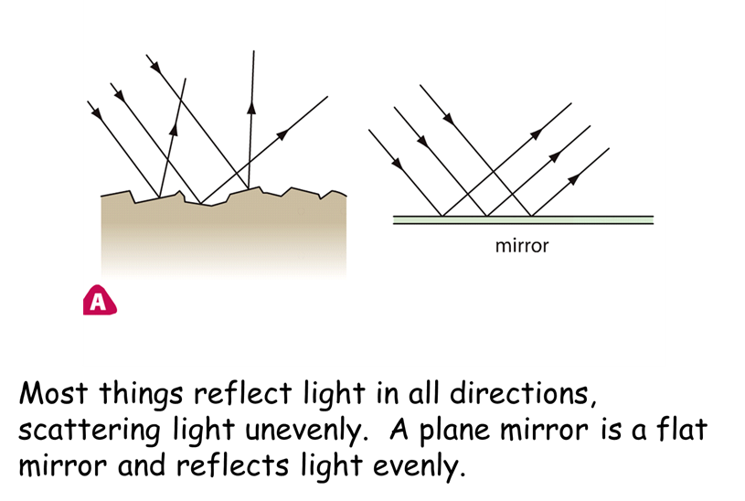
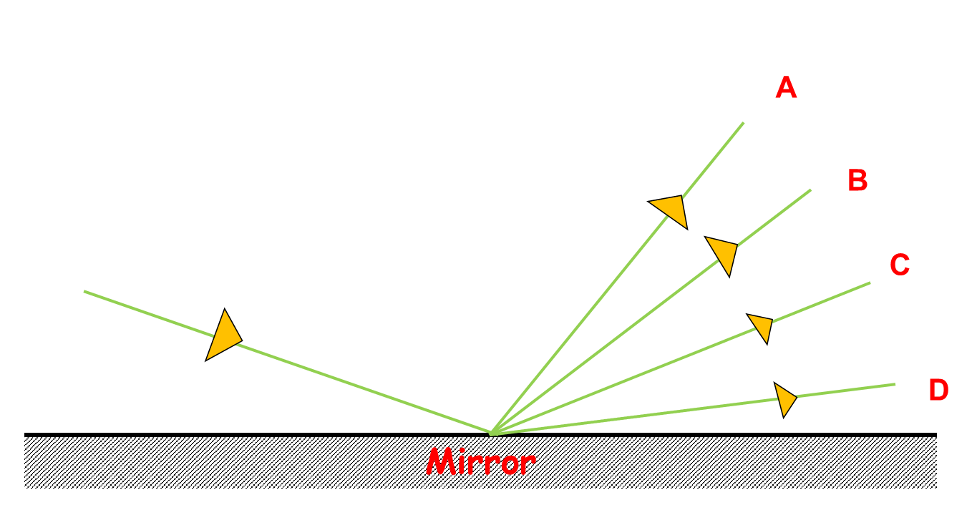
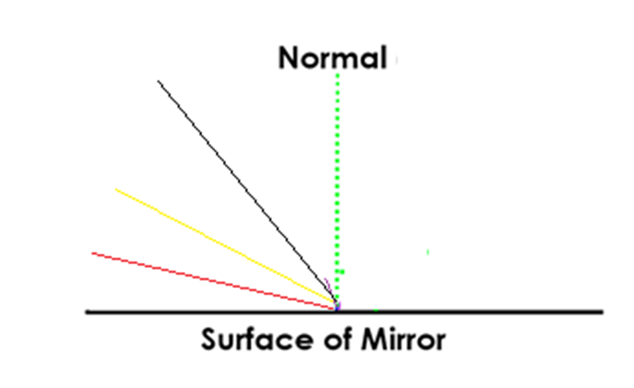
A normal line is 90°
From the surface
Light going into the mirror bounces off a mirror at the same angle from the normal line in the other direction.
Angle going into the mirror (incidence) =angle reflected from mirror
Angle of incidence
Angle of
reflection
Incident ray
45°
45°
Reflected ray
Which way will this ray of light go?
Why?
On the diagram:
Draw on the reflected rays in the correct colour. See yellow example
Label incident ray.
Measure the angles and label the angles on (if you have a protractor)
Reflected ray
More information here
https://www.bbc.co.uk/bitesize/guides/zq7thyc/revision/2

Slide 3
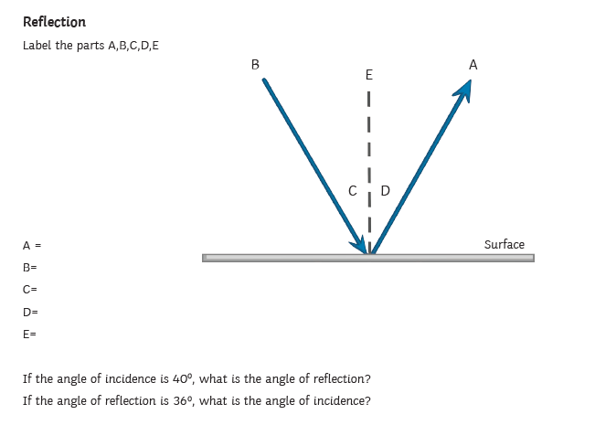
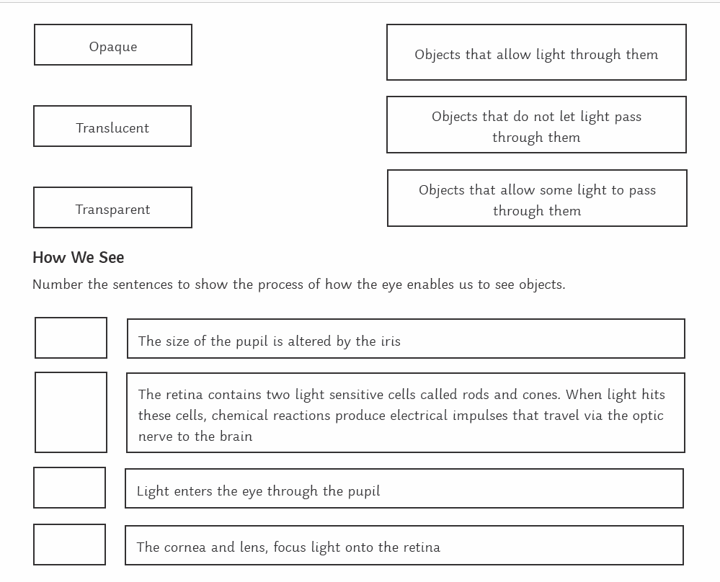
Use these to label the parts A, B, C, D, E
Incident ray
Reflected ray
Angle of incidence
Angle of reflection
Normal line
The first one has been done for you
1

Slide 4
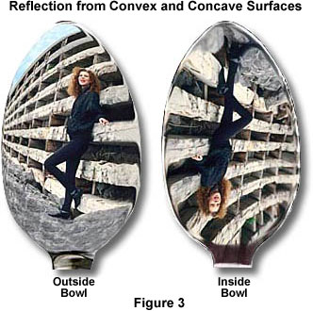
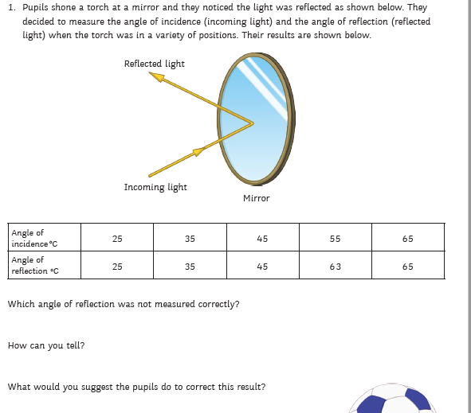
Try this at home!
Look at yourself in the front and the back of a spoon. How is the image different?
R _ _ _ _ _ _ _ _
r _ _
Label on:
Incidence ray
Reflected ray
I _ _ _ _ _ _ _ _
R _ _
I can tell because……………………………………………………………………………………………………………………………..
To correct this I would …………………………………………………………………………………………………………………..

Slide 5
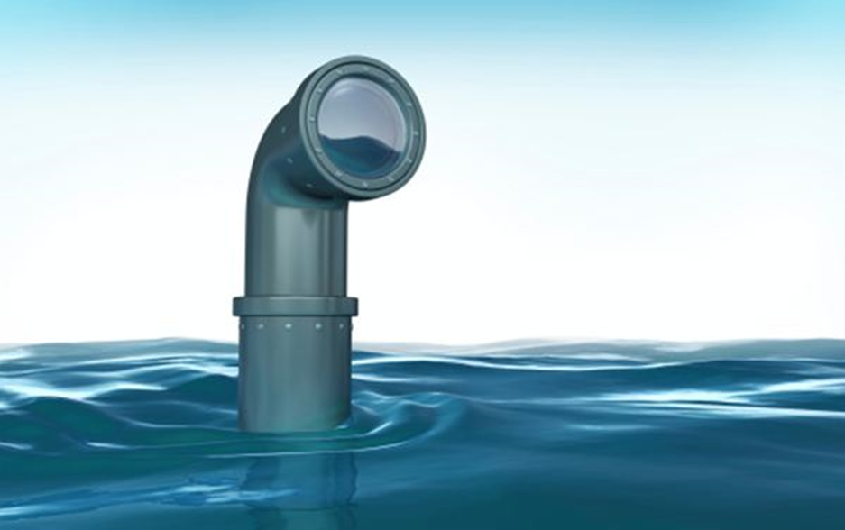
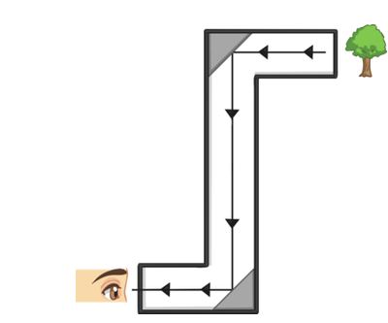
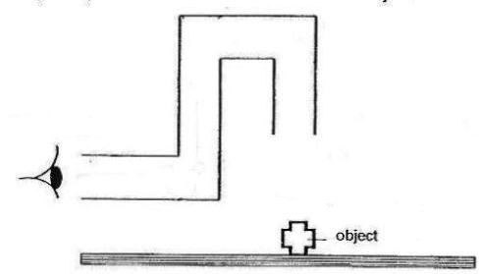
Research task
Use the internet to find out what a periscope is.
Draw a diagram to show how a periscope works
What angles do the angles need to be for it to work?
Why is a periscope useful?
Think of as many uses as you can for a periscope
On the diagram add 3 mirrors and then draw lines to show how light travels from the object to our eye.

Slide 6
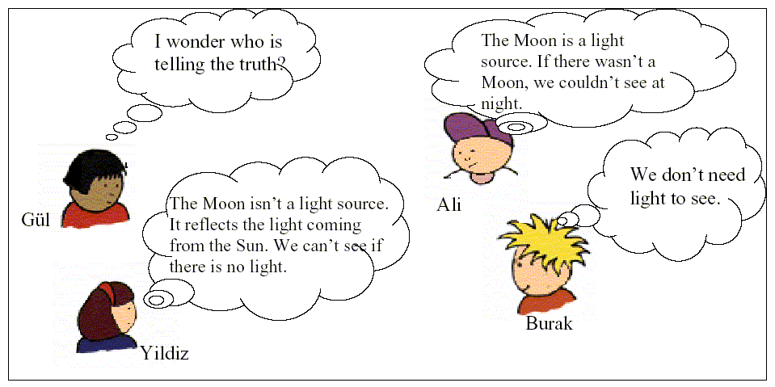
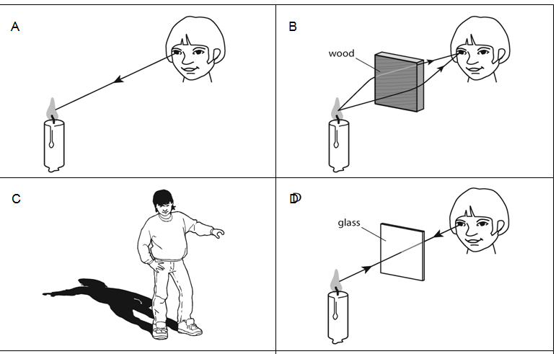
Who is telling the truth?
………….
How do you know?
………………………………………………………………………………
There is a mistake in each of the pictures.
Spot the mistake and label it on the diagram with a reason. The first one has been done for you.
The arrow is in the wrong directions light goes into the eye

Slide 7
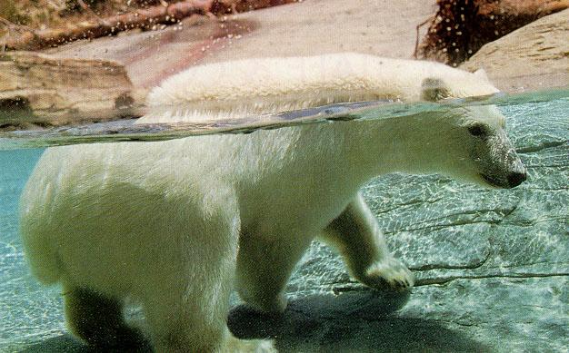
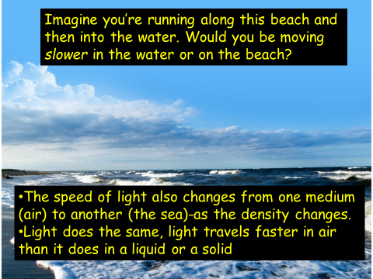
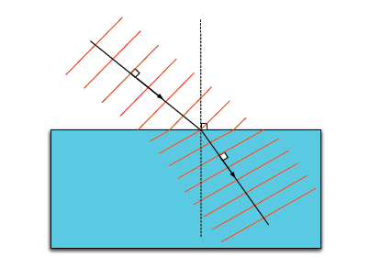
Look at the part of the polar bear out of the water and compare with the part in the water, what do you notice?
I can see that…………………………
……………………………………………
……………………………………………
More information here
https://www.bbc.co.uk/bitesize/guides/zq7thyc/revision/4
Refraction
Light slows down as it travels through water, as it gets slowed down the light bends towards the normal
normal

Slide 8
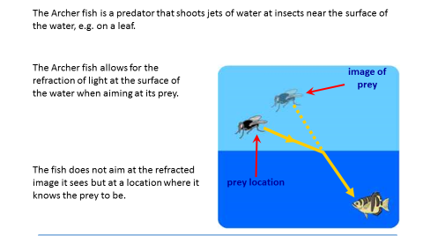
When light bends this is called r₋₋₋₋₋₋₋₋₋
R _ _ _ _ _ _ _ _ _ happens because the light changes speed.
When light enters a m₋₋₋ dense medium [e.g. glass], it bends t_ _ _ _ _ _ the normal.
When light enters a l _ _ _ dense medium [e.g. air], it bends a_ _ _ f_ _ _ the normal.
more refraction towards less
away from refraction

Slide 9
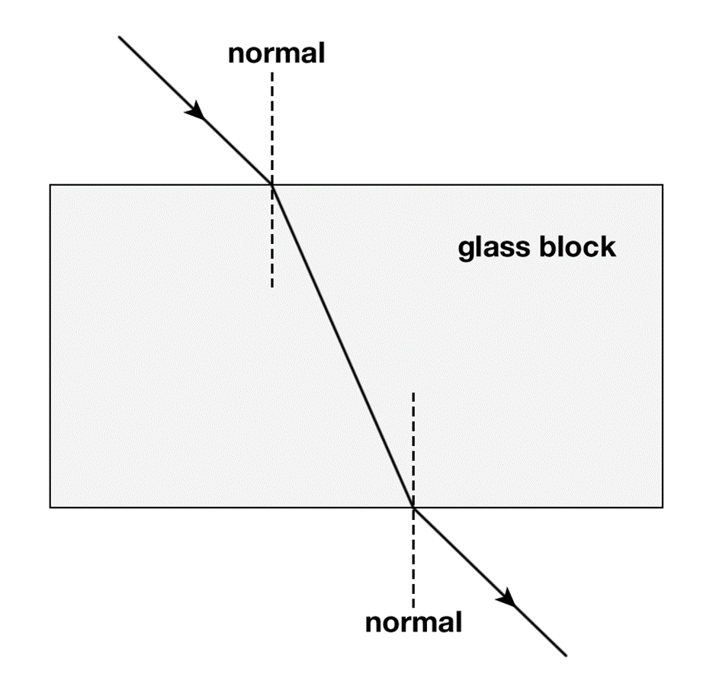
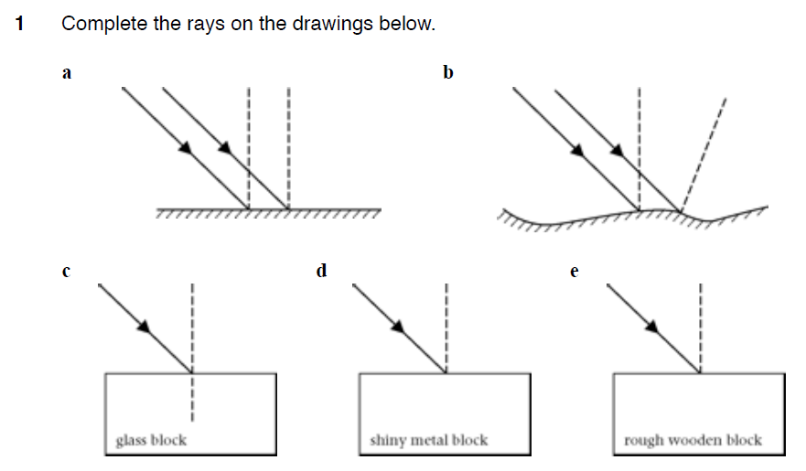
As l _ _ _ _ travels through the air, as it enters the glass block it causes the light to s _ _ _ down and this causes the light to b _ _ _ . When light exits the block the light speeds up and bends again. The bending of light is called
r _ _ _ _ _ _ _ _ _
slow light refraction glass bend

Slide 10
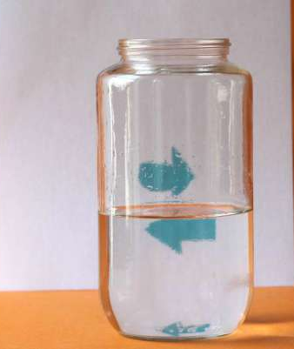
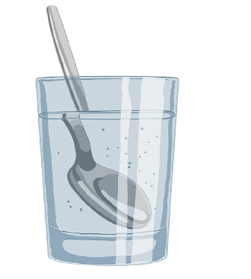
WATER REFRACTION SCIENCE EXPERIMENT
What you need::
Water
Jar or glass
A piece of paper with an arrow drawn on it
Fill the jar half full of water
Place arrows behind the water and slowly move it away from the jar
Note down what you notice
………………………………………
……………………………………...
Try other designs and shapes
Does it make a difference how close the water is to the paper?
Does it make a difference if the jar is square or round? What about the size of the jar or glass?
Put a spoon in the water. Describe what you see.
………………………………………………………………..
…………………………………………………………………
The science behind the water refraction experiment:
Refraction ( bending of light ) happens when light travels between two mediums. In the refraction experiment above light travels from the arrow through the air, through the glass, the water, the glass again and air again before reaching your eyes.
The light reaching your eye (or in this case our camera) coming from the arrow is refracted through the glass of water. In fact the glass of water acts like a convex lens (like you might have in a magnifying glass). Convex lenses bend light to a focal point. This is the point at which the light from an object crosses.
The light that was at the tip of the arrow is now on the right side and the light on the right side is now on the left as far as your eye is concerned (assuming you are further away from the glass than the focal point.

Slide 11
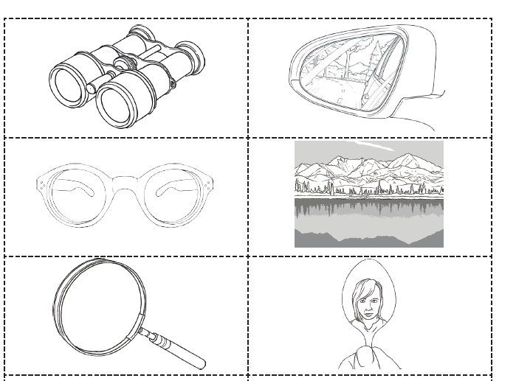
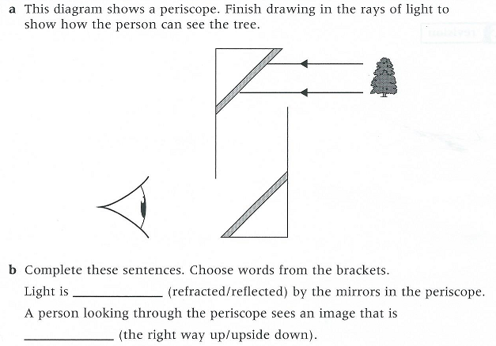
Reflection or refraction?
Decide if the pictures are reflection or refraction and put your answers in the table, the first has been done for you
Reflection | Refraction
 | Binoculars

Slide 12
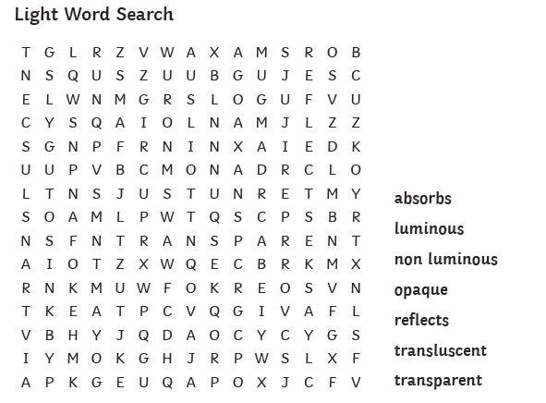
Glossary
Light source | is what is making the light
Light detector | is what the light is travelling through
Medium | is what is where the light is received
Transparent | Something that you can see through eg glass
Translucent | Something that lets light through but you can’t see detailed shapes eg. Greaseproof paper
opaque | Is not able to be seen through, does not let light through eg. A shoe
Luminous | Something that gives out light
reflection | Light bouncing off a surface
refraction | Light bending due to changing medium (eg going through air and then water
Normal line | A line at 90° to the surface

