Slide 1

English Skills
Home Learning Booklet
Name: ___________

Slide 2
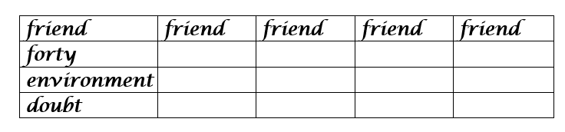

Slide 3
For words ending in ‘e’, drop the ‘e’ before adding an ending beginning with a vowel.
Complete the table below; some have already been done; ones with ----- on are not words so don’t use them.
--------------------------------------------------------------------------------------------
 | + ing | + ed | + er
take - ‘e’ = | taking | ----------- | taking
hope - ‘e’ = | hoping | hoped | -----------
dive - ‘e’ =
joke - ‘e’ = |  |  | joker
care - ‘e’ =
live - ‘e’ = |  | lived | -----------
dance - ‘e’ =
write - ‘e’ = |  | -----------
make - ‘e’ = |  | -----------
rule - ‘e’ =
fame - ‘e’ = |  | ----------- | -----------
noise - ‘e’ = |  | ----------- | -----------
Doubling consonants:
For words ending in a single vowel (a, e, i, o, u) , followed by a single consonant, always double the last consonant before adding an ending.
Complete the grid. (Some have been done for you)
 | Double the consonant | + ing | + ed | + er
man |  | ----------- | manned | manner
set |  | setting | ----------- | -----------
pip |  | ----------- |  | -----------
hop |  | hopping |  | -----------
hug |  |  | hugged | -----------

Slide 4

Possessive Apostrophes
This type of apostrophe shows that something or someone belongs to a person or thing:
When there is one noun with one or lots of things belonging to it, the apostrophe goes before the ‘s’.
the pen belonging to the boy | = | the boy’s pen
the car belonging to the woman | = | the woman’s car
the book belonging to Sam | =
the ball belonging to my brother | =
the ship belonging to the captain | =
the glasses belonging to Jay | =
the shoes belonging to Ben | =
the windscreen belonging to the car | =
interests that belong to Tom | =

Slide 5
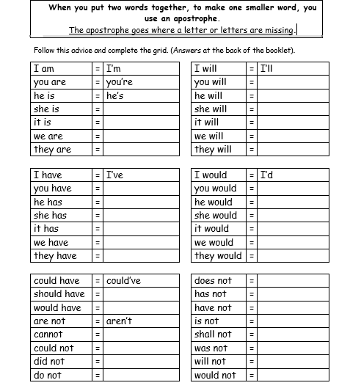
Apostrophes of Contraction

Slide 6
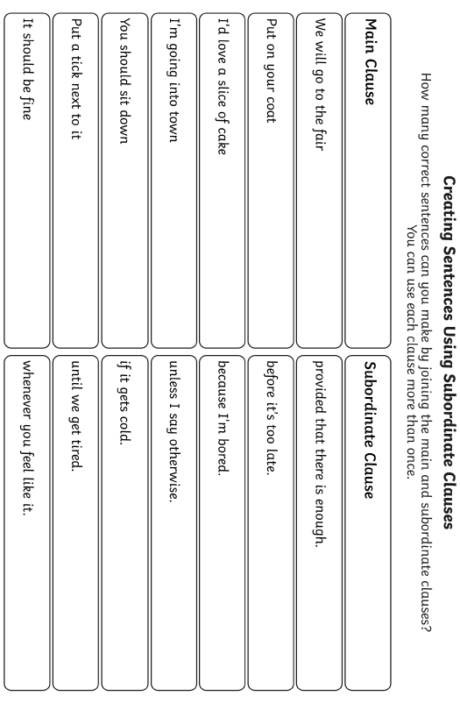
Complex Sentences

Slide 7
Complex Sentences
When you use a complex sentence, you need to include a comma to mark the clause.
When I finish my work, I will check it.
I will walk the dog later, provided it doesn’t rain.
Add the commas to these sentences:
If the sun came out we decided to go to the park.
Thunder and lightening slashed through the sky as the rain pelted down.
Before leaving the house I checked I had my keys.
Although pizza is my favourite I choose to have a double cheeseburger today.
The jungle covered miles of the surrounding land despite the government selling so much of it.
Can you write two of your on?
____________________________________________________________________________________________________________________________________________________________________________

Slide 8
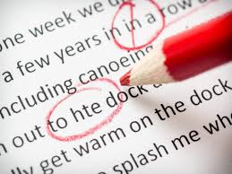
Proof Reading
Proof reading is when you check work for mistakes.
It’s really important that after you finish a piece of work, you check it through.
Read the following passage and circle all the mistakes you can spot.
The sun shone down as they maid their way towards river. Mark and samira hopped over the steping stones despite the rushing water. They needed to get home quickly. They had promised Marks mum said they had to be back by 6pm before dinner. Samiras Dad said that if they didnt get back in time they couldnt hang out any more. Samira started runing. Mark wheezed as he tried to catch up The clock in the town centre started ringing six times just as they reached door.

Slide 9
Proof Reading
Proof reading is when you check work for mistakes.
It’s really important that after you finish a piece of work, you check it through.
Now re-write the passage so it is correct.
____________________________________________________________________________________________________________________________________________________________________________________________________________________________________________________________________________________________________________________________________________________________________________________________________________________________________________________________________________

Slide 10


Self-Assessment
I completed the tasks on:
Spelling
Apostrophes - Possession
Apostrophes - Contraction
Subordinate Clauses
Commas
Proof Reading
How did you do?
I did well at…
____________________
I still need help with…
____________________

