Slide 1

English Skills
Home Learning Booklet
Assessment Objective 6: Candidates must use a range of vocabulary and sentence structures for clarity, purpose and effect, with accurate spelling and punctuation.
Name: ___________

Slide 2

Possessive Apostrophes - Singular
This type of apostrophe shows that something or someone belongs to a person or thing:
When there is one noun with one or lots of things belonging to it, the apostrophe goes before the ‘s’.
the pen belonging to the boy | = | the boy’s pen
the car belonging to the woman | = | the woman’s car
the book belonging to Sam | =
the ball belonging to my brother | =
the ship belonging to the captain | =
the glasses belonging to Jay | =
the shoes belonging to Ben | =
the windscreen belonging to the car | =
interests that belong to Tom | =

Slide 3
Possessive Apostrophes - Plural
This type of apostrophe shows that something or someone belongs to more than one person or thing:
When there is more than one noun with one or lots of things belonging to them, the apostrophe goes after the ‘s’.
the ball belonging to all of the girls | = | the girls’ ball
the ties belonging to all of the boys | = | the boys’ ties
the clothes belonging to all of the models | =
the horns belonging to all of the cars | =
the gardens belonging to all of the houses | =
the shouts belonging to all of the boys | =
all of the mugs belonging to the teachers | =

Slide 4
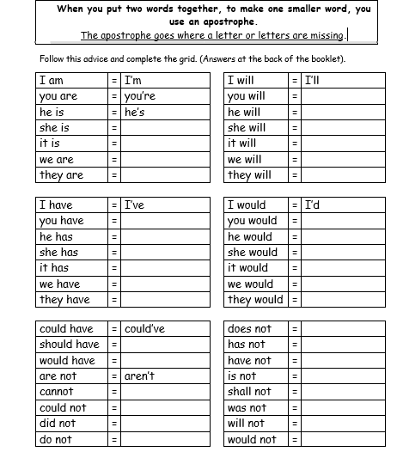
Apostrophes of Contraction

Slide 5
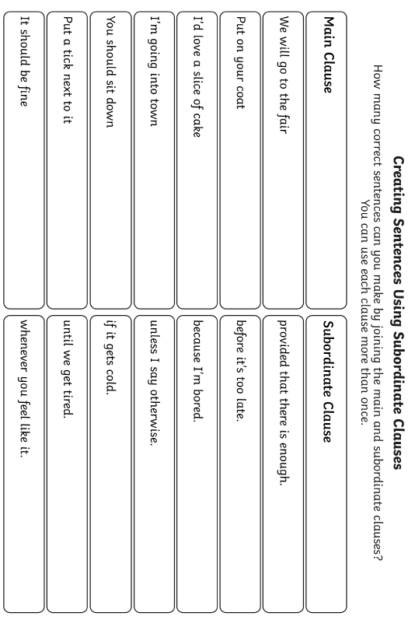
Complex Sentences

Slide 6
Complex Sentences
When you use a complex sentence, you need to include a comma to mark the clause.
When I finish my work, I will check it.
I will walk the dog later, provided it doesn’t rain.
Add the commas to these sentences:
If the sun came out we decided to go to the park.
Thunder and lightening slashed through the sky as the rain pelted down.
Before leaving the house I checked I had my keys.
Although pizza is my favourite I choose to have a double cheeseburger today.
The jungle covered miles of the surrounding land despite the government selling so much of it.
Can you write two of your on?
____________________________________________________________________________________________________________________________________________________________________________

Slide 7
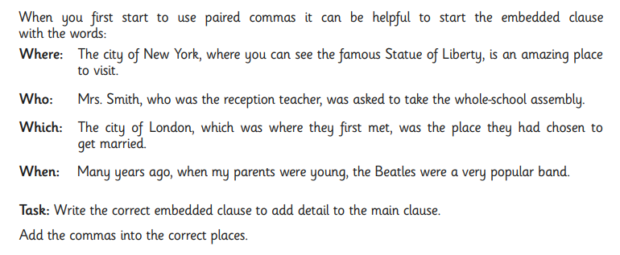
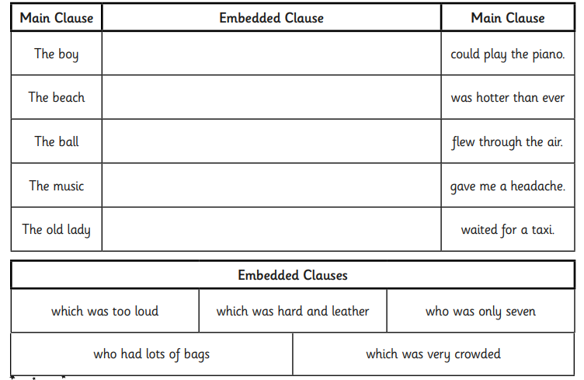
Complex Sentences
Can you write one of your own?
____________________________________________
____________________________________________

Slide 8
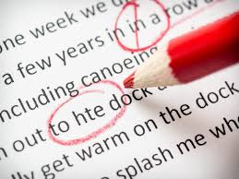
Proof Reading
Proof reading is when you check work for mistakes.
It’s really important that after you finish a piece of work, you check it through.
Read the following passage and circle all the mistakes you can spot.
As the rain lashed the windows she turned the windscreen wipers on higher She was starting to panic. Visibility was really bad. She had borrowed her Mums car – well ‘borrowed’ she hadnt actually asked. Despite her anxiety samira tried to breathe deeply. Trey her best friend had seen her Mum was still in town. She wouldn’t be home for at least 45 minutes. She would make it if she just kept going. As she turned the corner she was blinded by a police cars blue and red lights. She groaned to herself. What would she do now

Slide 9
Proof Reading
Proof reading is when you check work for mistakes.
It’s really important that after you finish a piece of work, you check it through.
Now re-write the passage so it is correct.
____________________________________________________________________________________________________________________________________________________________________________________________________________________________________________________________________________________________________________________________________________________________________________________________________________________________________________________________________________

Slide 10


Self-Assessment
I completed the tasks on:
Apostrophes - Possession
Apostrophes - Contraction
Subordinate Clauses
Commas
Embedded Clauses
Proof Reading
How did you do?
I am confident with…
_____________________________________
_____________________________________
I still need help with…
_____________________________________
_____________________________________

