Slide 1

English Skills
Home Learning Booklet
Name: ___________

Slide 2
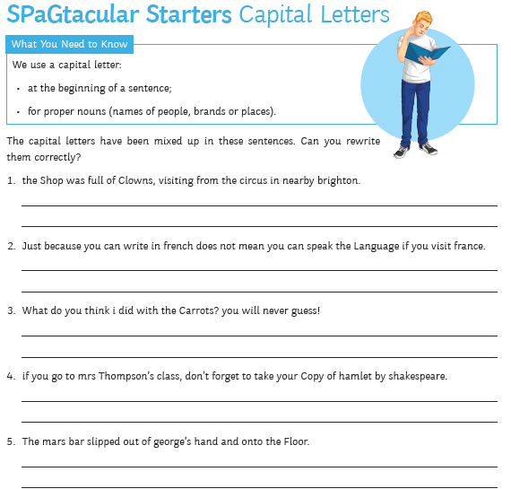

Slide 3
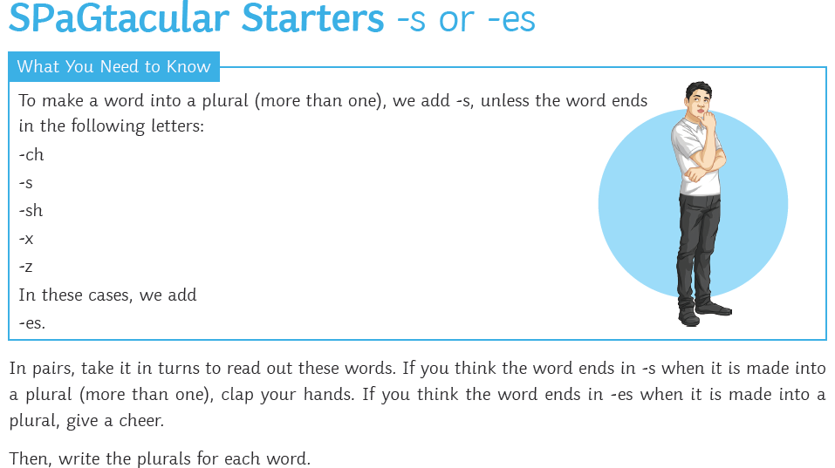
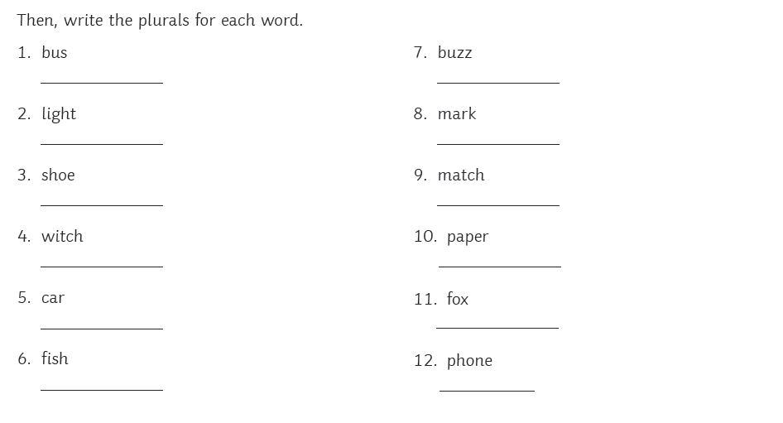
Can you think of some more examples that end in –es?
1.
2.
3.
4.
What about in –s?
1.
2.
3.
4.

Slide 4


