Slide 1
*Science: energy
If you prefer to work online please visit SENECA learning and sign up using the class code: 4ggjlziov

Slide 3
H
L
C
E
S
K
G
E

Slide 4
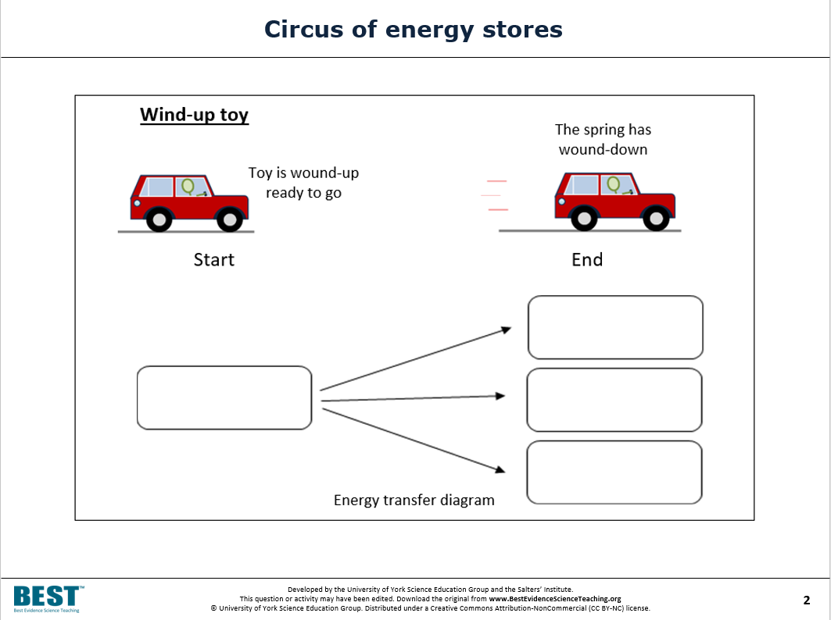
Energy cannot be lost it just gets transferred from one form to another. For example a light bulb uses electrical energy and it transfers it into light and heat.
Please complete the rest of the table to show the energy transfers
Appliance | Energy form changed from | Energy form changed to …. | and …….
light bulb | electrical | light | heat
electric kettle
toaster
battery powered torch
Words can be used more than once:
Light sound electrical kinetic heat chemical
Sound elastic kinetic heat

Slide 5
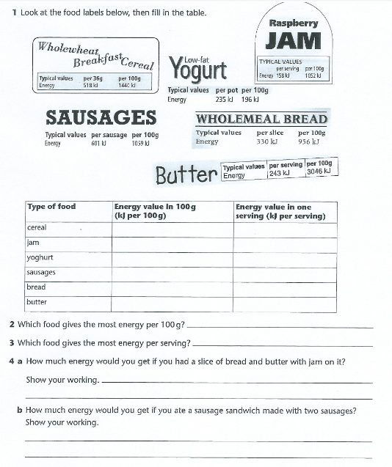

Slide 6
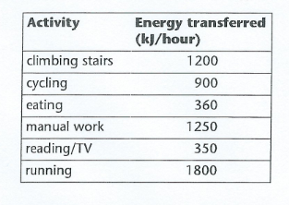
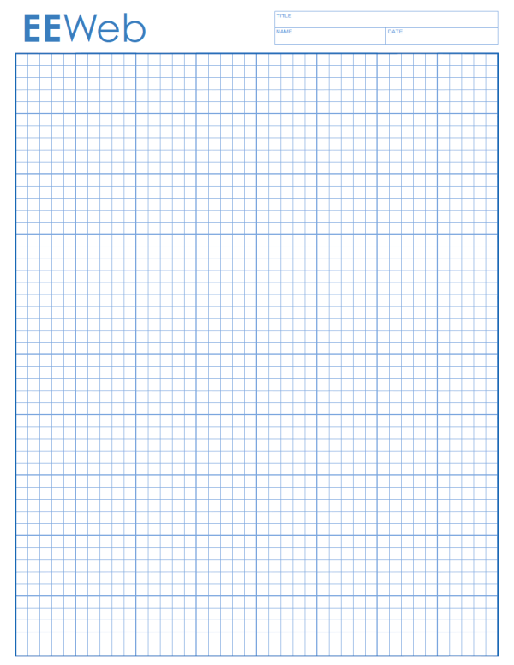
Draw a bar chart to show the energy transferred from each of the activities
Don’t forget to label your axes
The first one has been done for you
1800
1600
1400
1200
1000
800
600
400
200
Climbing cycling eating manual work reading/tv running
stairs

Slide 7
Which activity transfers the most energy?
………………………….
Which activity transfers the least energy?
…………………………..
Which two activities transfer the same amount of energy in one hour?
……………………….and…………………..
Bob cycles for 15 minutes to a café; he then spends 30 minutes eating before cycling home. How much energy does he transfer?
………………………………………………………………………………………………………………………………………………………………
Fill in the table to work out how much energy you use in a day
Activity | Time spent | Energy used (kJ)
Total=

Slide 8


