Slide 1


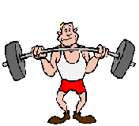
Science: forces
If you prefer to work online please visit SENECA learning and sign up using the class code: ow0q7tt10a
Friction – The force between two moving things.
Air Resistance – the push upwards of the air as something falls through it. This is a type of friction
Weight – the effect of gravity on an object. It is calculated using Gravity x mass (kg)

Slide 2
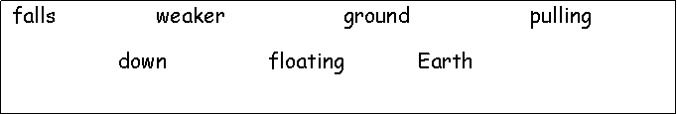
Gravity
Gravity is a p _ _ _ _ _ _ force. It pulls everything towards the centre of the E _ _ _ _ .
If you drop a ball it f_ _ _ _ to the g_ _ _ _ _ because of gravity.
The strength of gravity is different depending on size. That is why the gravity on the moon is w_ _ _ _ _ than the Earth because its smaller.
Gravity holds everything d_ _ _ and stops us from f_ _ _ _ _ _ _ away!
Is it easier to jump up or down steps?
Why do you think this is? (what’s helping you?)

Slide 3
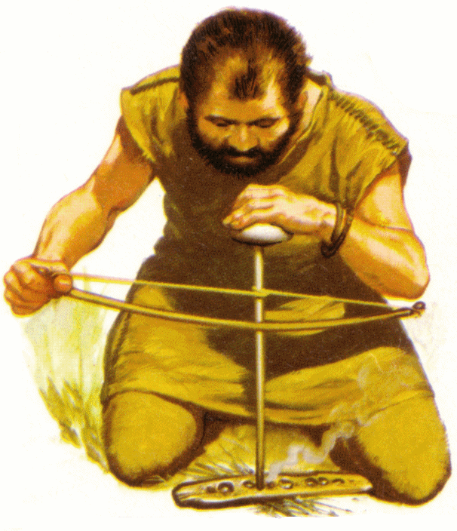
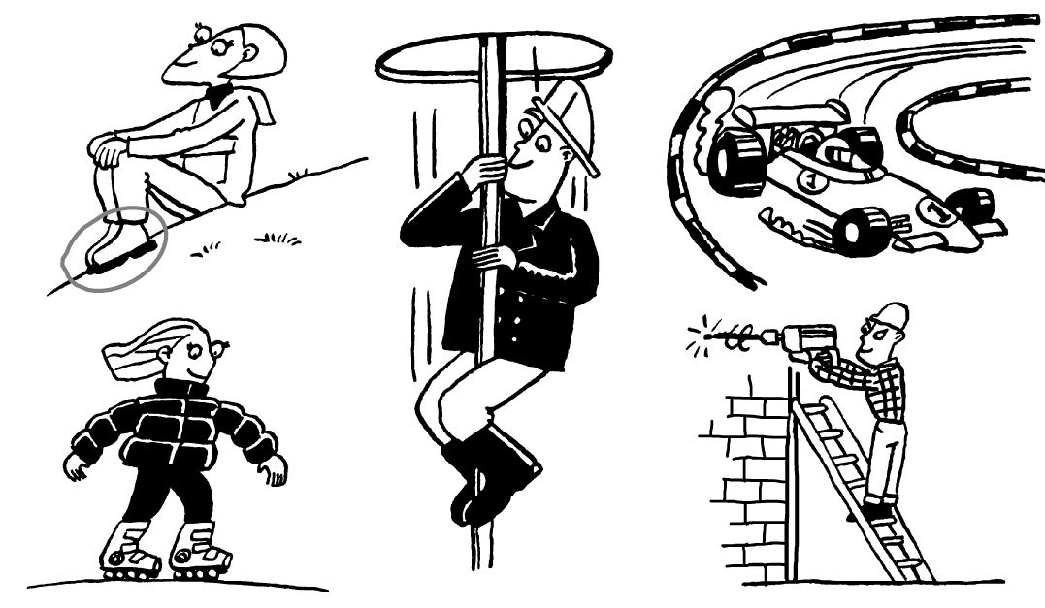
Friction
Friction is a force that s _ _ _ _ things down. It happens when two things rub together.
Friction makes things h _ _ .
We need friction to stop things s_ _ _ _ _ _ around.
But sometimes we need to stop friction so things can m _ _ _.
slows move sliding hot
Task: Put a circle around the all the places where there is friction. One has been done for you.

Slide 4
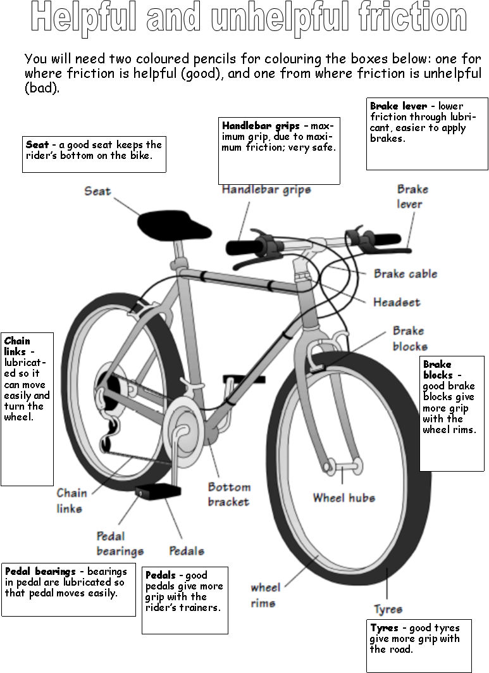

Slide 5
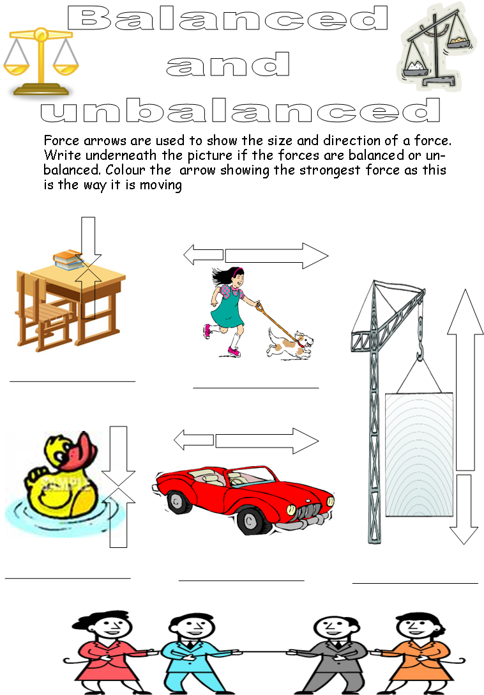

Slide 6
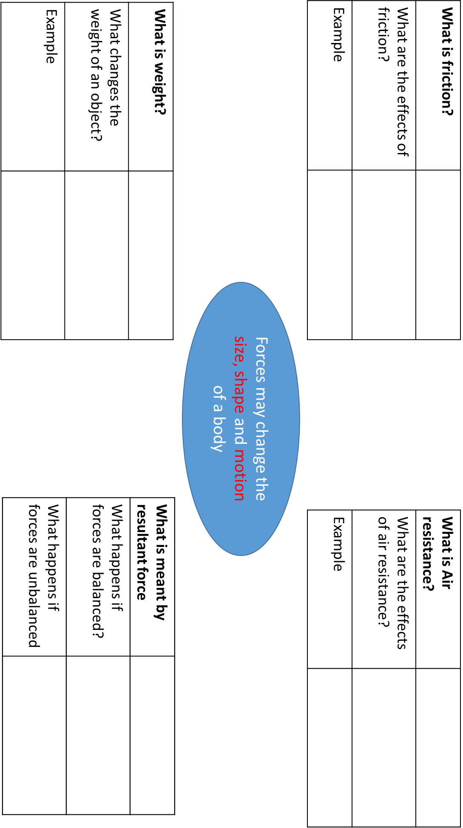

Slide 7
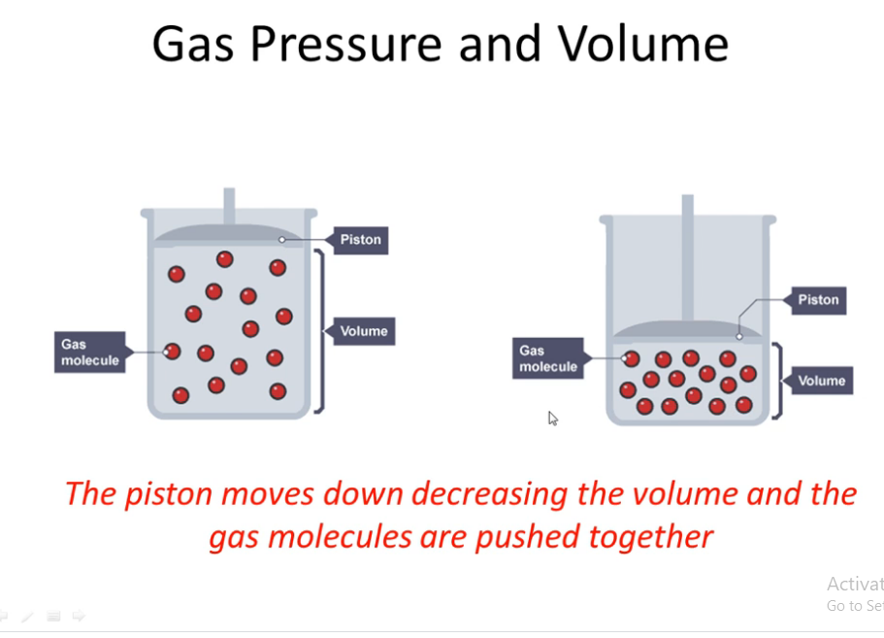
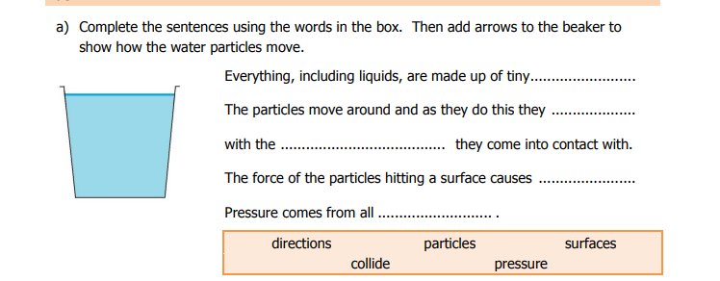
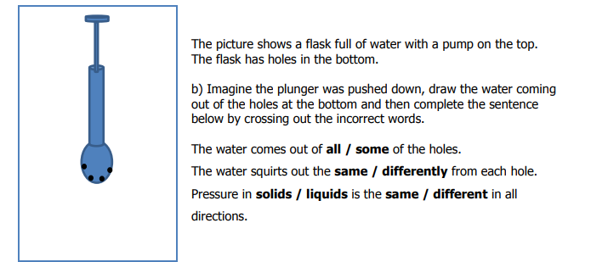

Slide 8
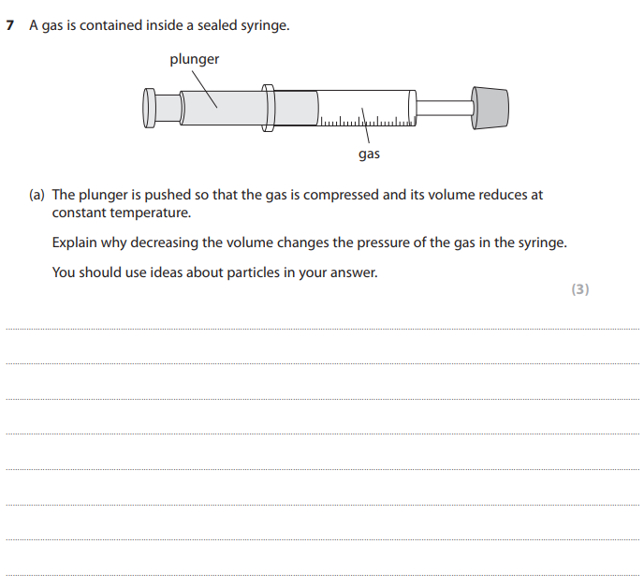
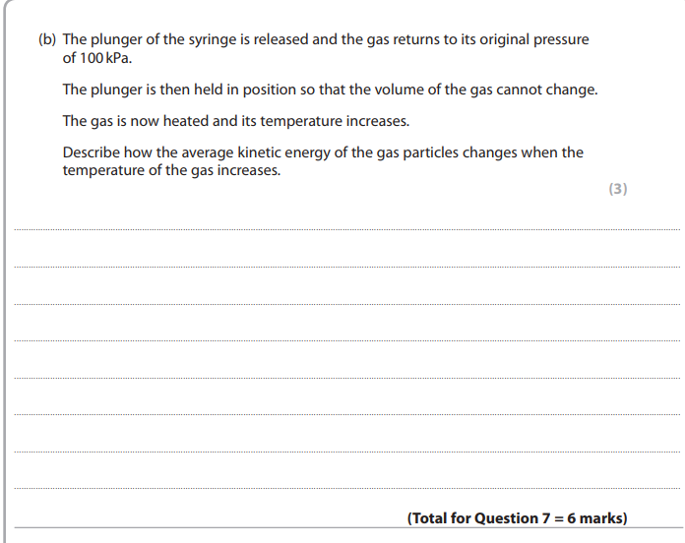

Slide 9
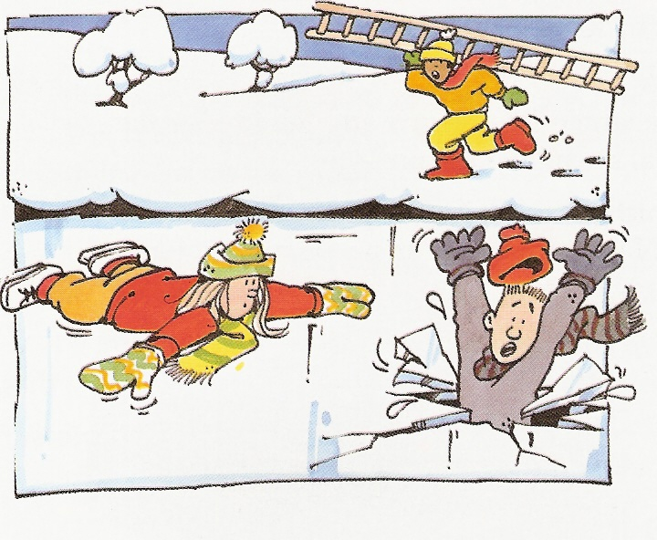
Jack is running over the snow to try to help Fred who has fallen through the ice. Susan is lying on the ice.
Why has Fred fallen through the ice and Susan has not?
Use some of the key words and phrases to help you complete the following question. You will need to write some words yourself.
weight is spread over small area large area
small pressure large pressure
___________________________________________________________________________________________________________________________________________________________________________________________________
_________________________________________________________________
_________________________________________________________________
_________________________________________________________________

Slide 10


