Slide 1
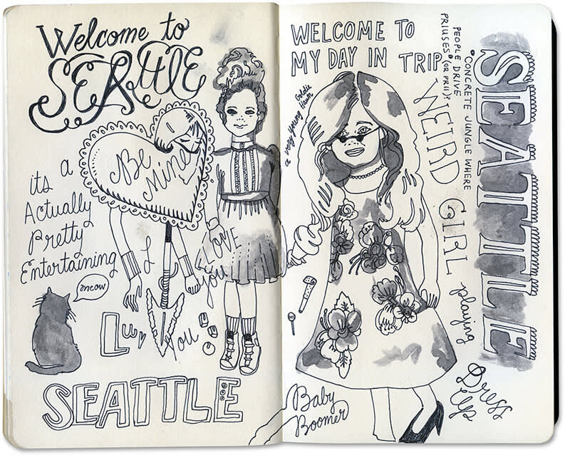
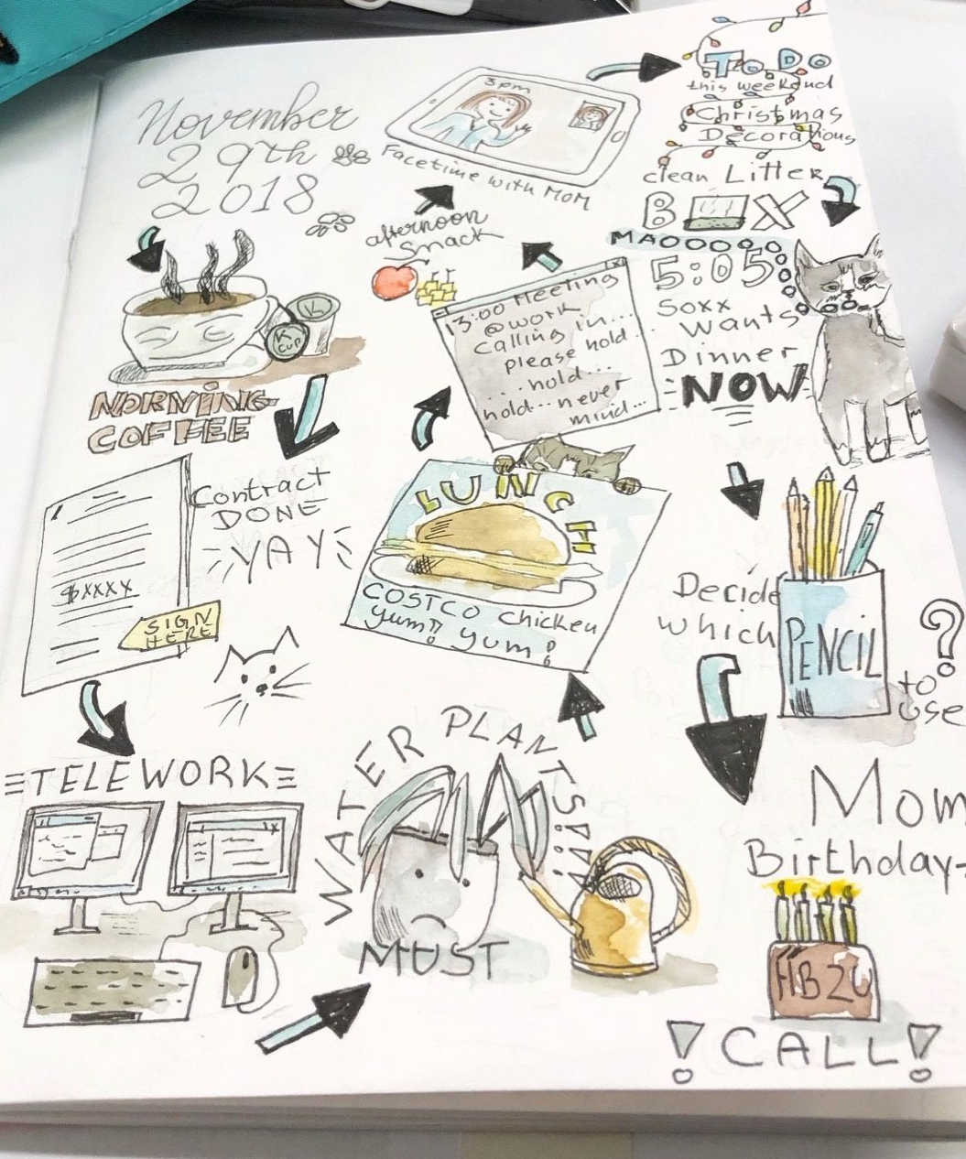
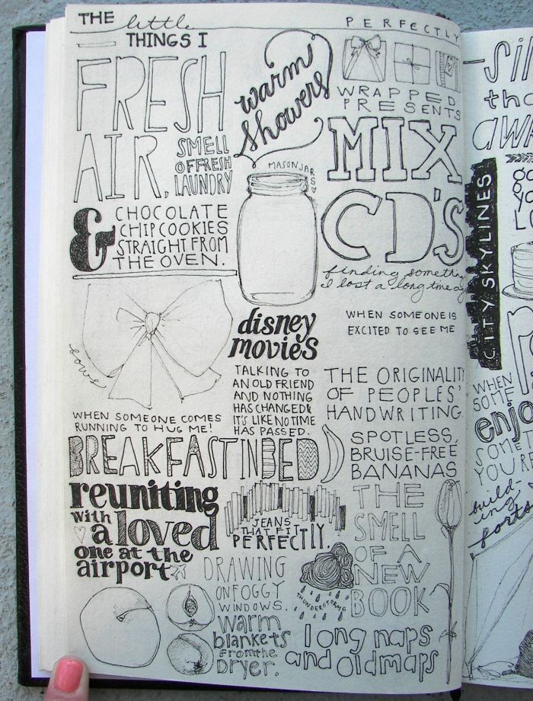
Life and Death
art@stmatthias
Throughout this term, you will fill in your sketchbook on your experiences and your life. The sketchbook can contain words, song lyrics, poems, cut out images from magazines and newspapers, doodles, sketches, photographs, paintings and drawings. The aim is for the sketchbook to be filled with anything relevant about YOU and YOUR LIFE. It could be a visual diary of your time this year/during lockdown, a reflection on your life or your hopes for the future.

Slide 2
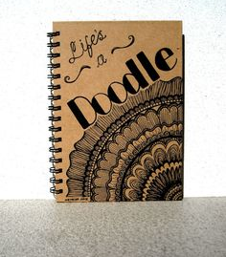
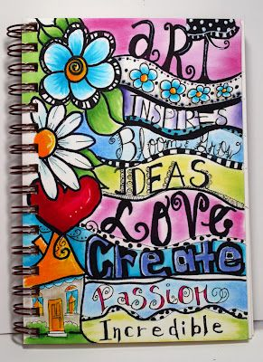
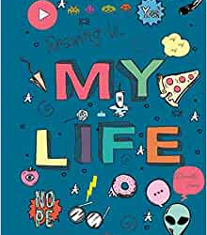
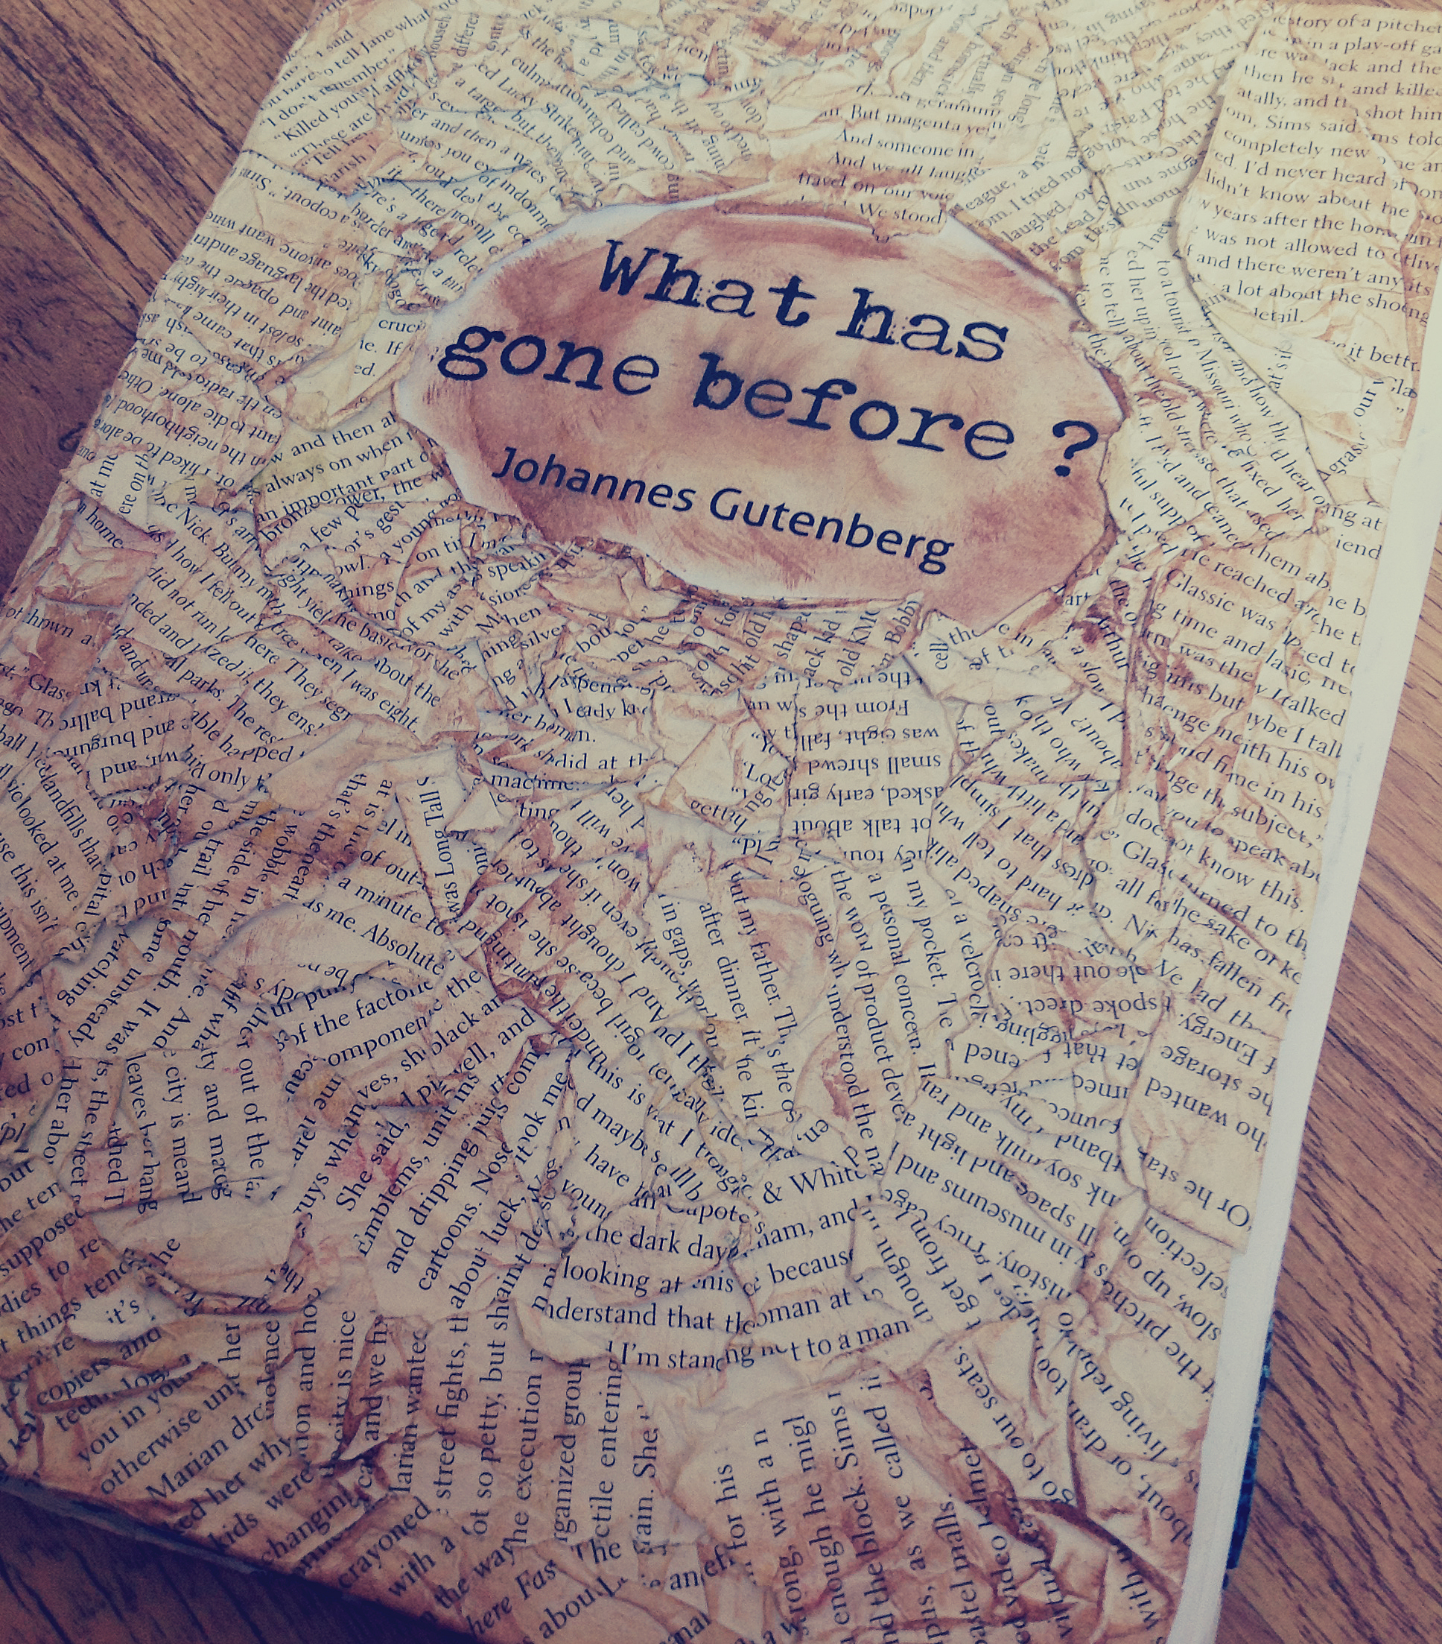
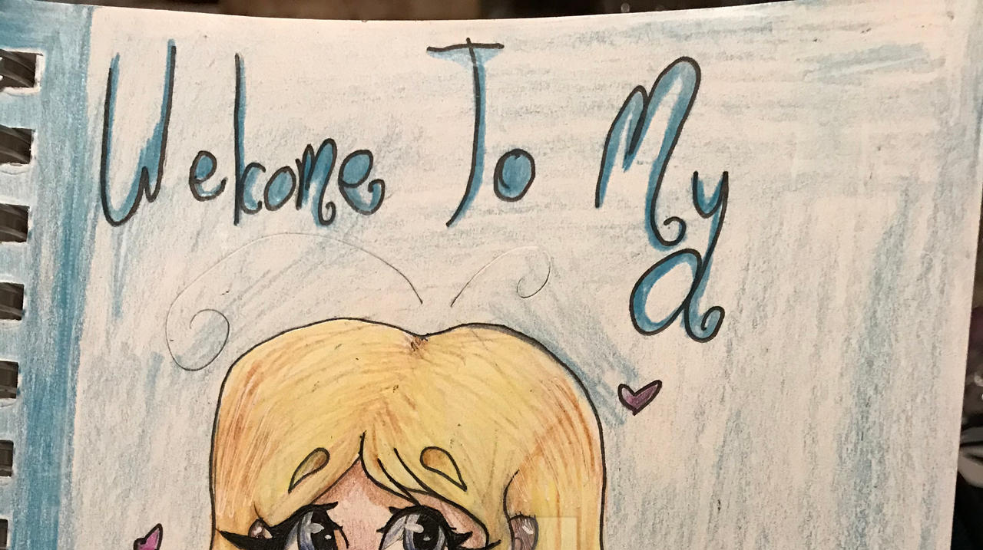
Your task for this week
Design a front page for your sketchbook.
Decide on the title-is it a diary, is it your hoped for the future or it could be something simples such as ‘ME’.
Make the front page creative.

Slide 3

Grade boundaries
KEYWORDS
Record ideas front page design life medium
GCSE assessment objective A03:Record ideas. Observations and insights relevant to intentions
Grade 2-Record & use simple observations . Basic use of materials.
Grade 3-Record & use observations which are linked to the topic. Competent use of appropriate materials.
Grade 4-Record & use observations which are linked to the topic with creativity. Control of appropriate materials.
Grade 5-Record & use observations which are clearly linked to the topic. Creative use of appropriate materials.
Objectives
To develop ability to record focused observations.
To develop creative ability.
Success Criteria
PRESENT a creative front page with your title.

Slide 4
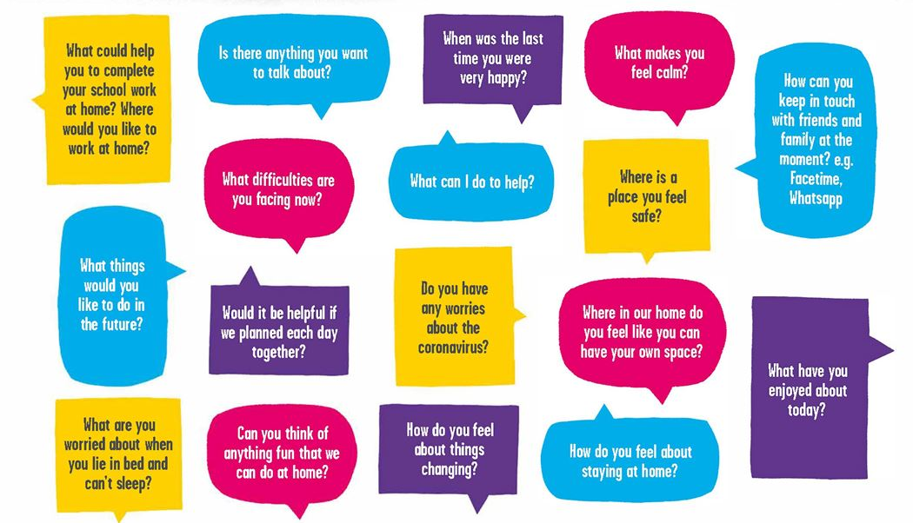
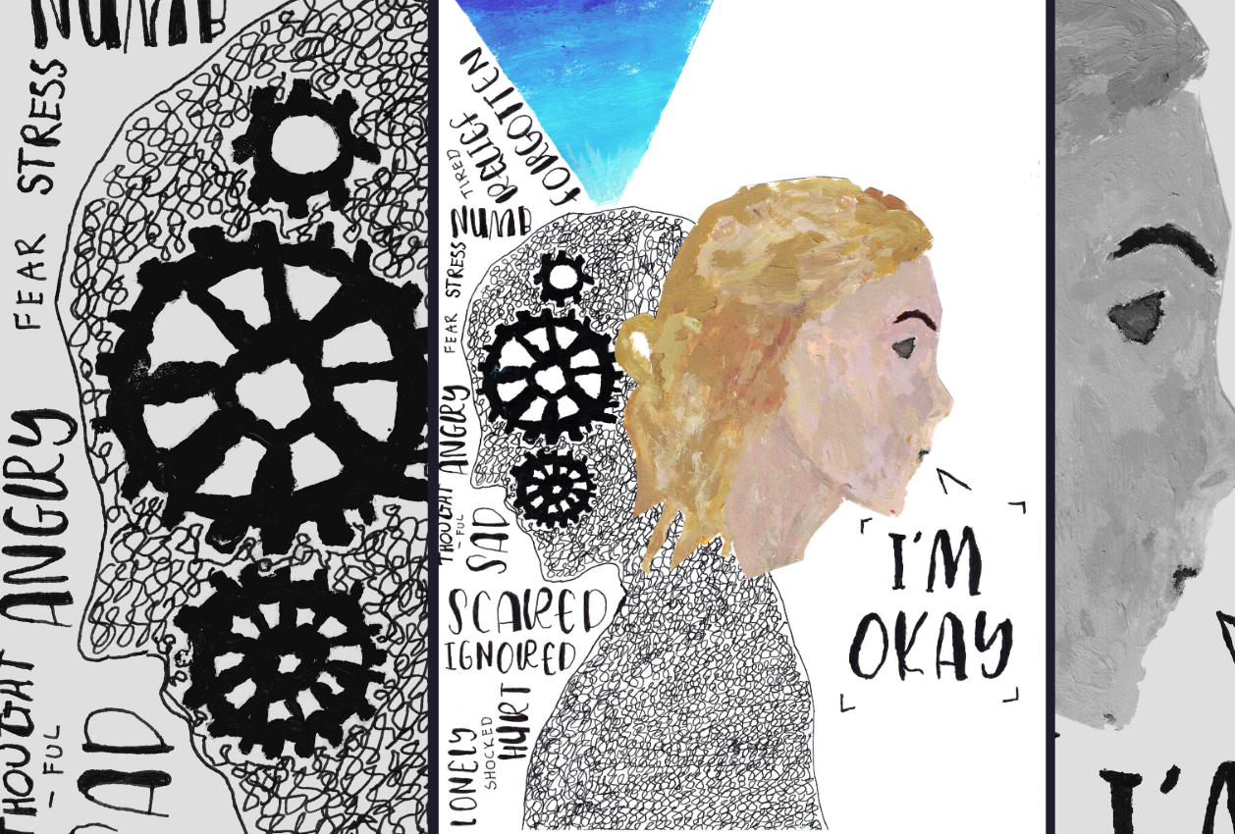
Extension task
Fill in your first page of your sketchbook with a response to the lockdown. How does it make you feel? What are your worries and fears? Answer the following questions using images of words. Be creative!

