Slide 1

English Skills
Home Learning Booklet
Name: ___________

Slide 2
Key Words
Match up your definitions with the key words.
Use Google or a dictionary to check your answers
Key Words
Author
Poem
Ingredients
Recipe
Definitions
A group of words which are used to show thoughts or feelings, often arranged in a specific way.
Instructions on how to cook something.
A writer.
Any of the food or substances required for a dish.

Slide 3
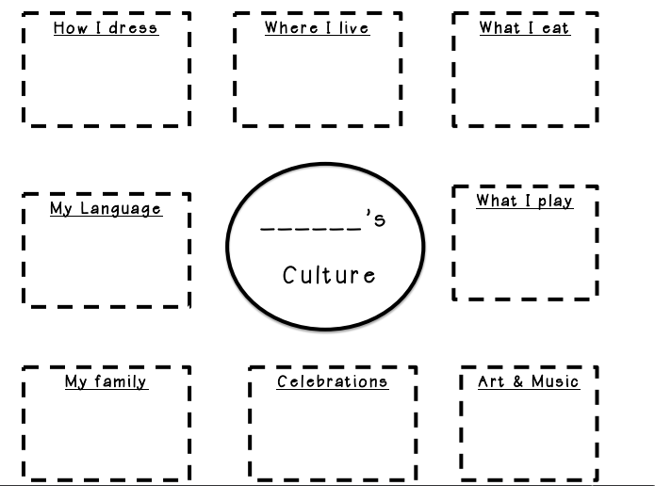
Culture
What is your Culture?
Culture is all the different things that make you, you. Things like the food you eat, the things you celebrate, the music you listen to.
Complete the below mind-map on different aspects of your own culture.

Slide 4
Culture
How is your culture different to someone you know?
Think about someone else you know and explain how and why your culture is different.
E.g. My best friend in Bristol is from London and I am from Cornwall. My culture is very different because I grew up in the countryside and they grow up in the city. This means that I like being in quiet open spaces and they like being in a busy city. We speak differently because we are from different areas of the country.
Emerging: Say where you are both from
Developing: Say one way your culture is different
Secure: Say multiple ways your culture is different
Mastered: Explain why your cultures are different
I am from _____________________________________________
Another person I know is from ______________________________
One way our cultures are different is _________________________
_____________________________________________________
because _______________________________________________
______________________________________________________
Another way our cultures are different is ______________________
_____________________________________________________
because _______________________________________________
______________________________________________________

Slide 5
Can you find the key words?
I | K | I | L | F | K | C | S | K | Y | A | I
C | I | X | Y | M | U | C | M | T | R | B | N
K | W | K | Q | L | K | E | T | E | T | D | G
L | C | X | T | T | O | I | N | Q | E | A | R
S | R | U | E | P | I | C | E | R | O | F | E
M | R | O | W | C | O | F | T | K | P | X | D
E | N | E | H | N | R | V | H | F | V | K | I
A | D | D | M | T | A | M | G | Y | J | J | E
T | Y | E | Z | J | U | Z | K | K | T | E | N
J | I | A | S | W | K | A | B | U | E | K | T
W | J | S | C | Y | R | M | Y | G | P | K | S
K | I | K | C | A | M | Z | T | Q | M | T | H
AUTHOR | CULTURE | INGREDIENTS
POEM | POETRY | RECIPE

Slide 6
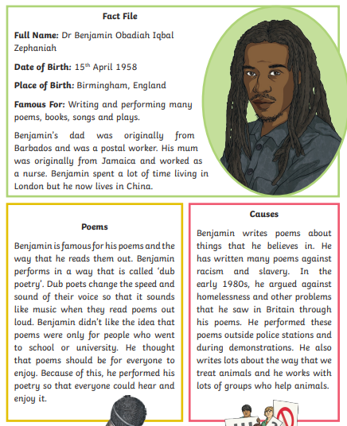
Benjamin Zephaniah

Slide 7
Benjamin Zephaniah
Complete the Cloze Summary about the author
Benjamin ____________ was born in Birmingham in 1958. His dad was originally from _____________ and his mum was originally from ______________.
Zephaniah is famous for writing _____________. He performs a type of poetry called __________ poetry. This is performed and written in a way that it sounds like __________________. Zephaniah wants poems to be for ___________________. He write poems about things he believes in and issues in the world. He has written poems about slavery and ___________________. He has also written about homelessness and _____________.
music racism dub Jamaica
poems animals Zephaniah
everyone Barbados

Slide 8
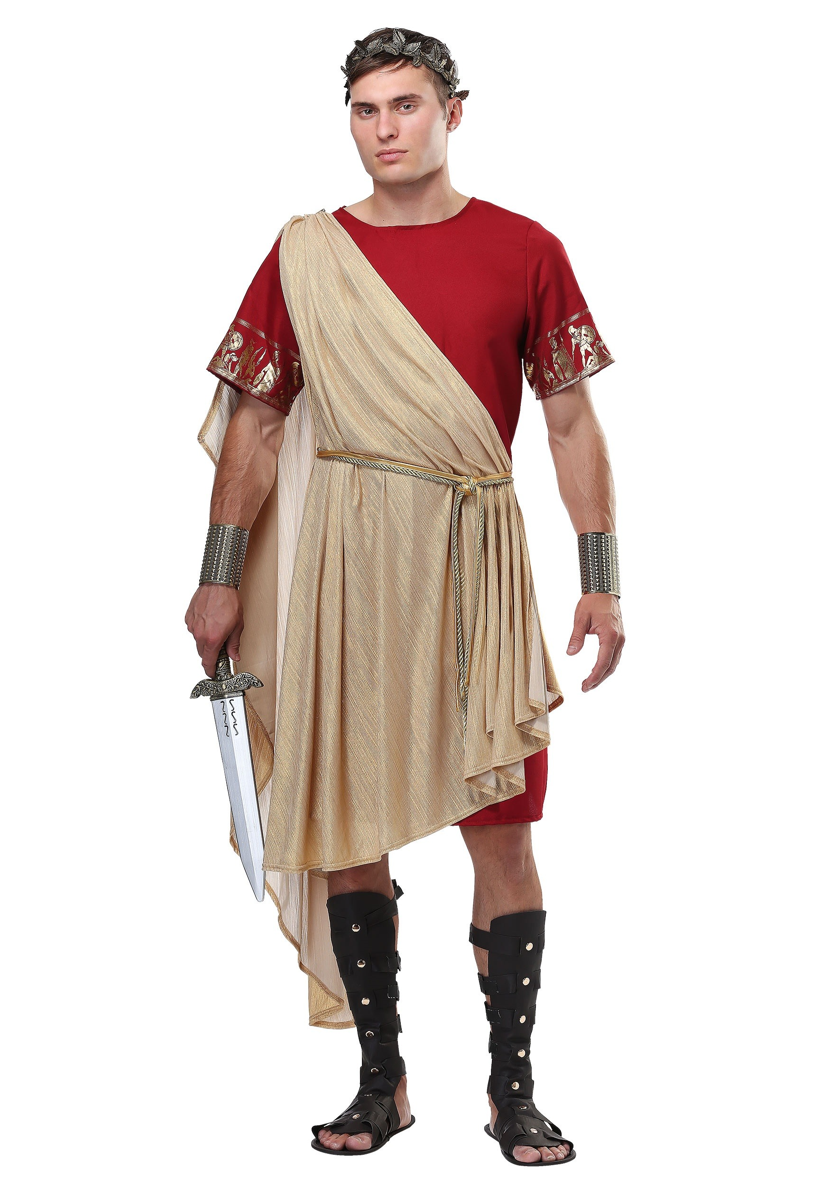
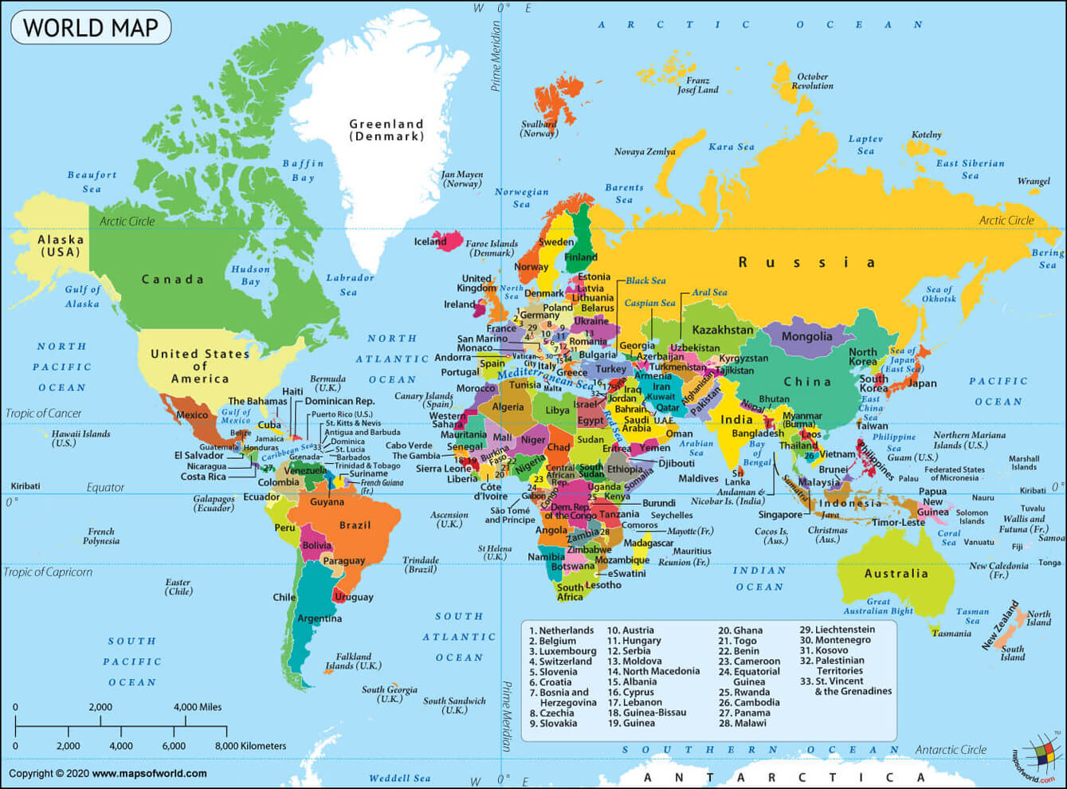
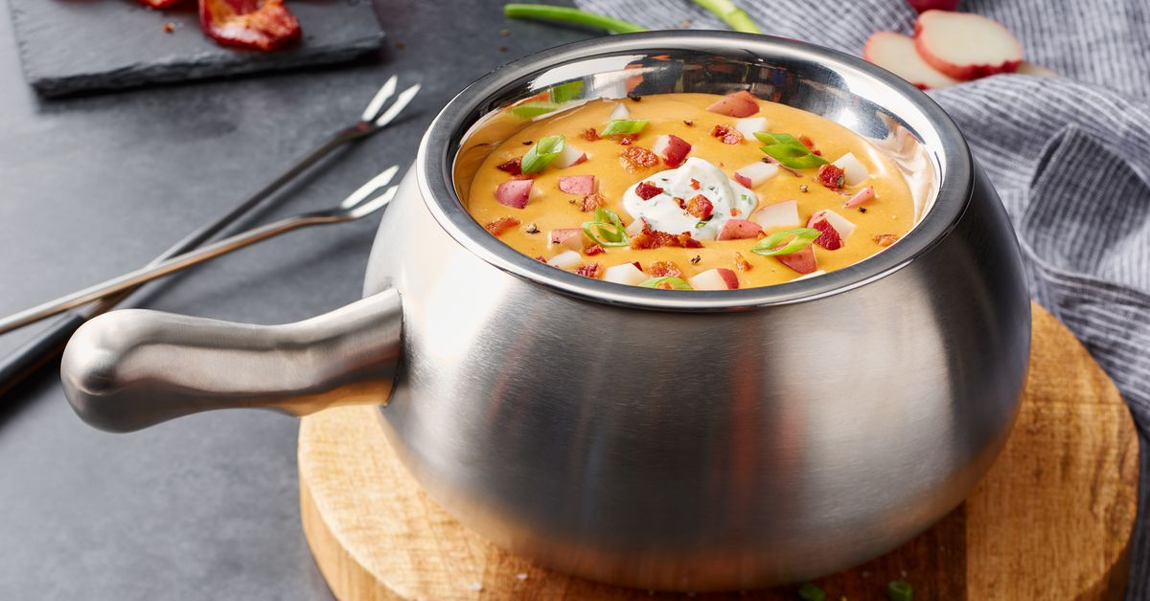

The British by Benjamin Zephaniah
Take some Picts, Celts and Silures
And let them settle,
Then overrun them with Roman conquerors.
Remove the Romans after approximately 400 years
Add lots of Norman French to some
Angles, Saxons, Jutes and Vikings, then stir vigorously.
Mix some hot Chileans, cool Jamaicans, Dominicans,
Trinidadians and Bajans with some Ethiopians, Chinese,
Vietnamese and Sudanese.
Then take a blend of Somalians, Sri Lankans, Nigerians
And Pakistanis,
Combine with some Guyanese
And turn up the heat.
Sprinkle some fresh Indians, Malaysians, Bosnians,
Iraqis and Bangladeshis together with some
Afghans, Spanish, Turkish, Kurdish, Japanese
And Palestinians
Then add to the melting pot.
Leave the ingredients to simmer.
As they mix and blend allow their languages to flourish
Binding them together with English.
Allow time to be cool.
Add some unity, understanding, and respect for the future,
Serve with justice
And enjoy.
Note: All the ingredients are equally important. Treating one ingredient better than another will leave a bitter unpleasant taste.
Warning: An unequal spread of justice will damage the people and cause pain. Give justice and equality to all.
https://www.youtube.com/watch?v=Aq13dvtZjP4&list=PLTlsTmGCVD6vt9oGc_3jr1fUBwqf9GiFr&index=62&t=0s

Slide 9
The British by Benjamin Zephaniah
Complete the Cloze Summary about the poem
Benjamin Zephaniah starts talking about historic groups who took over ___________. He then mentions the _____________ conquerors. After that he talks about lots of different countries from around the world. He mentions the _______ Chileans and ___________ Jamaicans. After listing all the countries he mentions putting them all together in a ‘______________ pot’. He wants them to mix and _________. He says it is important to serve with ____________. He also says that all ingredients are ____________ important.
cool justice blend equally
Roman Britain melting
hot

Slide 10
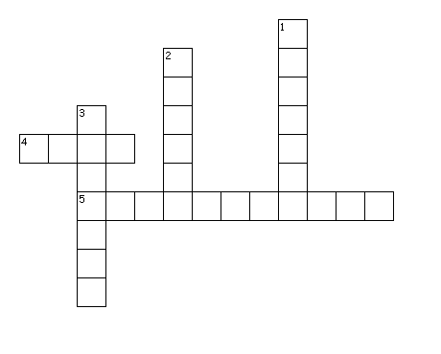
Can you put the key words in the right places?
Across
4. A group of words chosen to show a writer's thoughts and feelings, arranged in a specific way.
5. Any of the food or substances required for a dish.
Down
The different things which make you, you.
2. The person who writes the poem.
3. Instructions on how to cook something.

Slide 11
Annotation
You are now going to create a key and annotate the poem. There is a blank copy over the page.
Highlight or underline each item in a different colour (or if you only have one pen, with a different pattern!)
Colour or Pattern | Technique
 | Ingredients
 | Recipe words

Slide 12
The British by Benjamin Zephaniah
Take some Picts, Celts and Silures
And let them settle,
Then overrun them with Roman conquerors.
Remove the Romans after approximately 400 years
Add lots of Norman French to some
Angles, Saxons, Jutes and Vikings, then stir vigorously.
Mix some hot Chileans, cool Jamaicans, Dominicans,
Trinidadians and Bajans with some Ethiopians, Chinese,
Vietnamese and Sudanese.
Then take a blend of Somalians, Sri Lankans, Nigerians
And Pakistanis,
Combine with some Guyanese
And turn up the heat.
Sprinkle some fresh Indians, Malaysians, Bosnians,
Iraqis and Bangladeshis together with some
Afghans, Spanish, Turkish, Kurdish, Japanese
And Palestinians
Then add to the melting pot.
Leave the ingredients to simmer.
As they mix and blend allow their languages to flourish
Binding them together with English.
Allow time to be cool.
Add some unity, understanding, and respect for the future,
Serve with justice
And enjoy.
Note: All the ingredients are equally important. Treating one ingredient better than another will leave a bitter unpleasant taste.
Warning: An unequal spread of justice will damage the people and cause pain. Give justice and equality to all.

Slide 13
Response to Poem
Match the statement about the poem to the quotes which proves it.
Zephaniah mentions different groups who have taken over Britain.
Zephaniah talks about lots of different cultures.
Zephaniah writes a recipe about Britain.
Zephaniah wants us all to mix with each other.
The poem says is it important be kind to each other.
The poem says we should all treat each other equally.
“Somalians, Sri Lankans, Nigerians and Pakistanis”
“Angles, Saxons, Jutes and Vikings.”
“as they mix and blend”
“leave the ingredients to simmer”
“All ingredients are equally important”
“Unity, understanding and respect”

Slide 14
What does it mean to be British?
What does being British mean to you?
What do you think of when you think of Britain?
Complete the mind map
Being British

Slide 15
Being British
Look at this example poem called ‘Being British’.
Take a cup of tea and mix it with a curry.
Add a dash of football and a serving of tennis.
Stir in a bunch of daffodils and a Haggis,
A dragon and a four leaf clover.
Mix in the words of Bronte,
The rhymes of Coleridge and Wordsworth
And the wisdom of Shakespeare.
Simmer for two hours
Allowing tolerance and diversity to flavour and sweeten
You are going to write your own poem about your ideas of ‘Being British’ You can choose another culture if you wish.
Emerging: Include at least 5 ingredients you would need
Developing: Include instructions like a recipe
Secure: Use the same style as the poem
Mastered: Include poetic techniques like alliteration etc (Google these if you need a recap)

Slide 16
Being British
Sentence Stems
Take a…
Add…
Sprinkle…
Mix in…
Stir…
Lend in…
Leave to simmer…
Leave to cool…
______________________________________________________
______________________________________________________
______________________________________________________
______________________________________________________
______________________________________________________
______________________________________________________
______________________________________________________
______________________________________________________
______________________________________________________
______________________________________________________
______________________________________________________

Slide 17

Self Assessment
Well done! You completed the first week on poetry.
What do you think Benjamin Zephaniah wanted you to think about Britain?
_________________________________________
_________________________________________
_________________________________________
What went well this week?
My best piece of work is…
_________________________
because…
_________________________
_________________________

