Slide 1

English Skills
Home Learning Booklet
Name: ___________

Slide 2
Key Words
Look up the definitions of the following key words and write down.
Key Word | Definition
Culture
Poem
Author
Recipe
Ingredients
Metaphor

Slide 3
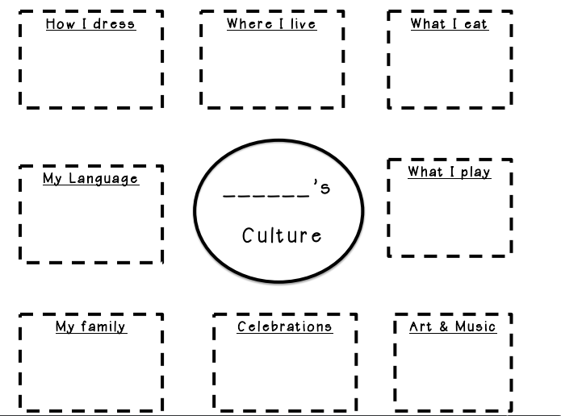
Culture
What is your Culture?
Culture is all the different things that make you, you. Things like the food you eat, the things you celebrate, the music you listen to.
Complete the below mind-map on different aspects of your own culture.

Slide 4
Culture
How is your culture different to one of your friends?
Think about someone else you know and explain how and why your culture is different.
E.g. My best friend in Bristol is from London and I am from Cornwall. My culture is very different because I grew up in the countryside and they grow up in the city. This means that I like being in quiet open spaces and they like being in a busy city. We speak differently because we are from different areas of the country.
Emerging: Say one way your culture is different
Developing: Say multiple ways your culture is different
Secure: Explain why your culture is different
Mastered: Compare yourself to more than one person
______________________________________________________
______________________________________________________
______________________________________________________
______________________________________________________
______________________________________________________
______________________________________________________
______________________________________________________
______________________________________________________
______________________________________________________
______________________________________________________

Slide 5
Can you find the key words in the word search?
K | P | F | F | K | K | S | Z | U | F | L | M | P | K | N
N | W | Q | Y | I | W | T | M | S | Q | Y | D | Q | R | R
G | X | I | X | Z | X | N | C | E | R | Y | L | O | O | E
S | P | E | S | K | S | E | C | G | O | J | W | H | G | A
Y | R | T | E | O | P | I | X | U | V | P | P | V | K | Y
O | H | E | H | U | L | D | Q | N | L | A | P | R | B | B
Y | C | U | D | B | A | E | R | K | T | T | J | L | W | F
C | U | G | Y | U | Q | R | L | E | R | O | U | D | Y | M
S | E | S | T | Z | A | G | M | E | I | H | R | R | T | N
W | E | H | I | D | E | N | T | I | T | Y | E | X | E | P
F | O | Q | I | E | E | I | C | F | A | K | C | I | T | V
R | V | N | C | L | E | I | Q | C | R | R | I | J | D | J
G | O | X | J | T | V | V | H | Z | J | Y | P | H | L | D
J | X | C | X | I | R | I | Y | E | K | I | E | J | X | I
L | P | S | W | D | W | Y | D | V | N | C | N | G | X | L
AUTHOR | CULTURE | IDENTITY
INGREDIENTS | METAPHOR | POEM
POETRY | RECIPE

Slide 6
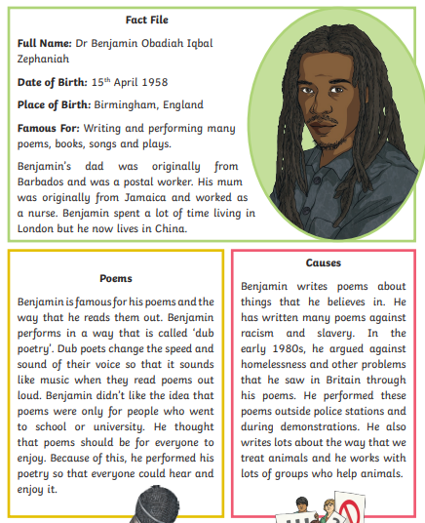
Benjamin Zephaniah

Slide 7
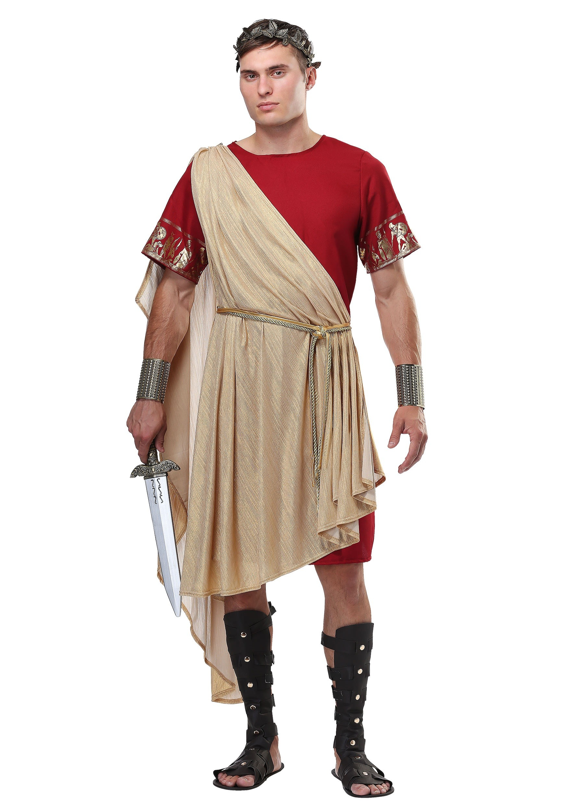
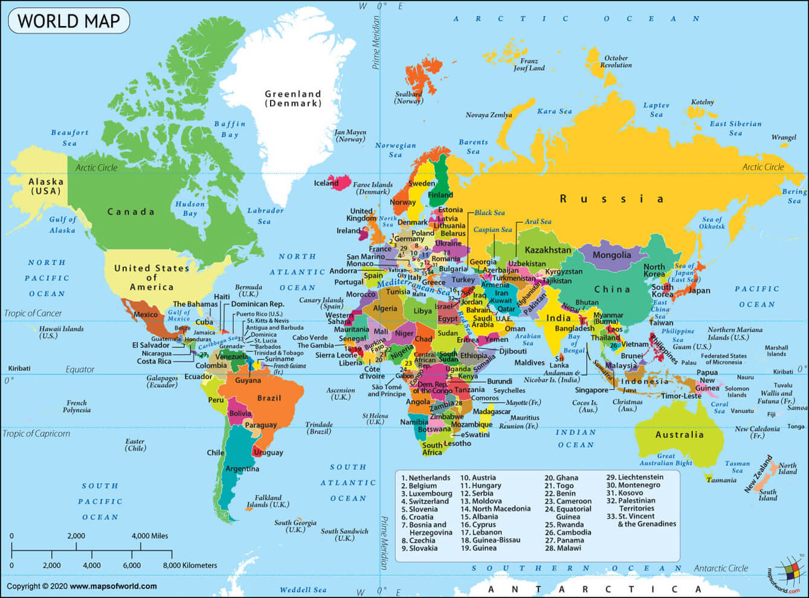
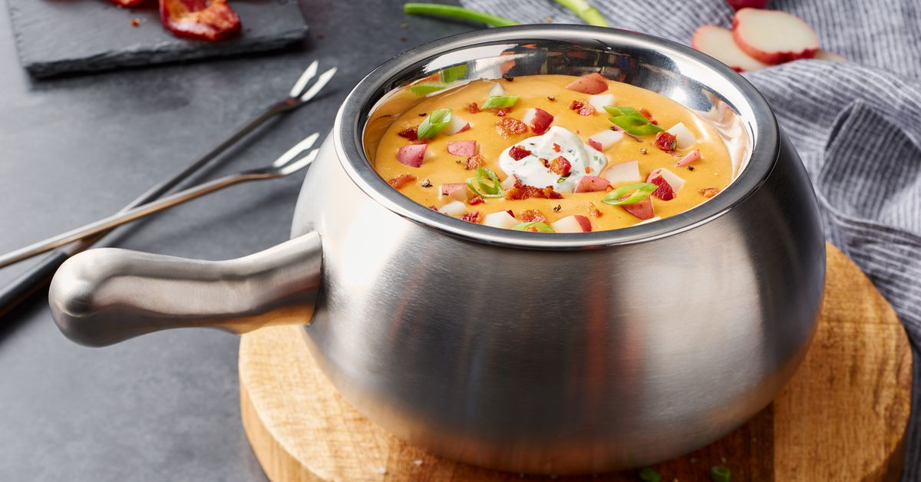

The British by Benjamin Zephaniah
Take some Picts, Celts and Silures
And let them settle,
Then overrun them with Roman conquerors.
Remove the Romans after approximately 400 years
Add lots of Norman French to some
Angles, Saxons, Jutes and Vikings, then stir vigorously.
Mix some hot Chileans, cool Jamaicans, Dominicans,
Trinidadians and Bajans with some Ethiopians, Chinese,
Vietnamese and Sudanese.
Then take a blend of Somalians, Sri Lankans, Nigerians
And Pakistanis,
Combine with some Guyanese
And turn up the heat.
Sprinkle some fresh Indians, Malaysians, Bosnians,
Iraqis and Bangladeshis together with some
Afghans, Spanish, Turkish, Kurdish, Japanese
And Palestinians
Then add to the melting pot.
Leave the ingredients to simmer.
As they mix and blend allow their languages to flourish
Binding them together with English.
Allow time to be cool.
Add some unity, understanding, and respect for the future,
Serve with justice
And enjoy.
Note: All the ingredients are equally important. Treating one ingredient better than another will leave a bitter unpleasant taste.
Warning: An unequal spread of justice will damage the people and cause pain. Give justice and equality to all.
https://www.youtube.com/watch?v=Aq13dvtZjP4&list=PLTlsTmGCVD6vt9oGc_3jr1fUBwqf9GiFr&index=62&t=0s

Slide 8
The British by Benjamin Zephaniah
1. Where were Zephaniah’s Mum and Dad from?
______________________________________________________
2. Where did Zephaniah grow up?
______________________________________________________
3. The poem starts off by listing groups of people who have taken over England in the past. Can you list three?
______________________________________________________
______________________________________________________
4. Why does he include these groups? What does he want the reader to think about?
_____________________________________________________
______________________________________________________
5. The poem then lists different races who are part of English culture. Can you list three?
______________________________________________________
______________________________________________________
6. Why does he include so many different cultures? What does he want the reader to think about?
_____________________________________________________
_____________________________________________________

Slide 9
The British by Benjamin Zephaniah
7. What three things does he say you need to add?
______________________________________________________
______________________________________________________
8. What word is repeated three times?
______________________________________________________
9. Why does Zephaniah want you to focus on this word?
______________________________________________________
10. Why does Zephaniah include the note?
______________________________________________________
______________________________________________________
11. Why does Zephaniah include the warning?
______________________________________________________
______________________________________________________
12. The poem uses an extended metaphor of a recipe. Why do you think it does this?
______________________________________________________
______________________________________________________
______________________________________________________

Slide 10
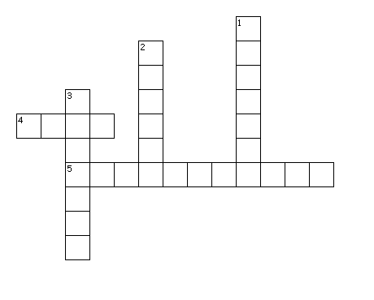
Can you put the key words in the right places?
Across
4. A group of words chosen to show a writer's thoughts and feelings, arranged in a specific way.
5. Any of the food or substances required for a dish.
Down
The different things which make you, you.
2. The person who writes the poem.
3. Instructions on how to cook something.

Slide 11
Annotation
You are now going to create a key and annotate the poem. There is a blank copy over the page.
Highlight or underline each item in a different colour (or if you only have one pen, with a different pattern!)
Colour or Pattern | Technique
 | Nouns This is all the ingredients included.
 | Extended Metaphor This is all words which link to the idea of the recipe
 | Imperative Verbs This are verbs which are at the beginning of a sentence. Frequently used in instructions.

Slide 12
The British by Benjamin Zephaniah
Take some Picts, Celts and Silures
And let them settle,
Then overrun them with Roman conquerors.
Remove the Romans after approximately 400 years
Add lots of Norman French to some
Angles, Saxons, Jutes and Vikings, then stir vigorously.
Mix some hot Chileans, cool Jamaicans, Dominicans,
Trinidadians and Bajans with some Ethiopians, Chinese,
Vietnamese and Sudanese.
Then take a blend of Somalians, Sri Lankans, Nigerians
And Pakistanis,
Combine with some Guyanese
And turn up the heat.
Sprinkle some fresh Indians, Malaysians, Bosnians,
Iraqis and Bangladeshis together with some
Afghans, Spanish, Turkish, Kurdish, Japanese
And Palestinians
Then add to the melting pot.
Leave the ingredients to simmer.
As they mix and blend allow their languages to flourish
Binding them together with English.
Allow time to be cool.
Add some unity, understanding, and respect for the future,
Serve with justice
And enjoy.
Note: All the ingredients are equally important. Treating one ingredient better than another will leave a bitter unpleasant taste.
Warning: An unequal spread of justice will damage the people and cause pain. Give justice and equality to all.

Slide 13
The British by Benjamin Zephaniah
What is the message of this poem?
Choose 2-3 of the following statements and write about how the poem
Zephaniah tells us that historically many different groups have taken over Britain
Zephaniah tells us that Britain is made up of many different cultures
Zephaniah wants us to respect each other’s cultures
Zephaniah believes that to be British is to be multi-cultural
Zephaniah believes the key to mixing well is justice and equality
Emerging: Use quote to prove the point
Developing: Comment on why it proves this
Secure: Explain why it proves your point
Mastered: Include a summary of the overall message of the poem
______________________________________________________
______________________________________________________
______________________________________________________
______________________________________________________
______________________________________________________
______________________________________________________
______________________________________________________
______________________________________________________
______________________________________________________
______________________________________________________
______________________________________________________

Slide 14
What does it mean to be British?
What does being British mean to you?
What do you think of when you think of Britain?
Complete the mind map
Being British

Slide 15
Being British
Look at this example poem called ‘Being British’.
Take a cup of tea and mix it with a curry.
Add a dash of football and a serving of tennis.
Stir in a bunch of daffodils and a Haggis,
A dragon and a four leaf clover.
Mix in the words of Bronte,
The rhymes of Coleridge and Wordsworth
And the wisdom of Shakespeare.
Simmer for two hours
Allowing tolerance and diversity to flavour and sweeten
You are going to write your own poem about your ideas of ‘Being British’ You can choose another culture if you wish.
Emerging: Include nouns of a range of different ingredients.
Developing: Use an extended metaphor of a recipe.
Secure: Include imperative verbs.
Mastered: Include poetic techniques like alliteration etc (Google these if you need a recap).

Slide 16
Being British
Sentence Stems
Take a…
Add…
Sprinkle…
Mix in…
Stir…
Lend in…
Leave to simmer…
Leave to cool…
______________________________________________________
______________________________________________________
______________________________________________________
______________________________________________________
______________________________________________________
______________________________________________________
______________________________________________________
______________________________________________________
______________________________________________________
______________________________________________________
______________________________________________________

Slide 17

Self Assessment
Well done! You completed the first week on poetry.
What do you think Benjamin Zephaniah wanted you to think about Britain?
_________________________________________
_________________________________________
_________________________________________
What went well this week?
My best piece of work is…
_________________________
because…
_________________________
_________________________

