Slide 1
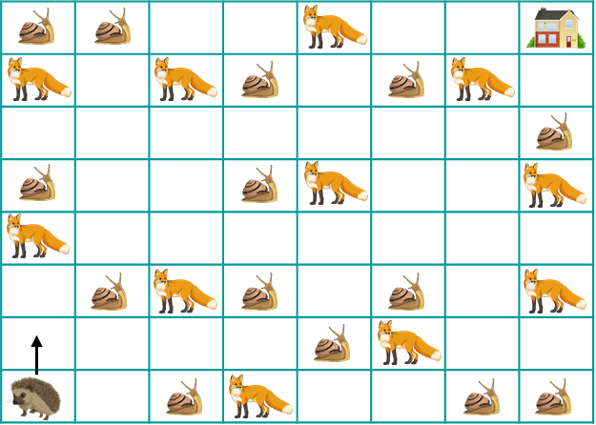
Name: | Date:
Flowcharts & Pseudocode Lesson One
Flowchart Challenge 1
Help Flo to get from her starting position to home. Try to help her find as many yummy snails as possible, but avoid Sly the fox and his friends at all cost! Here are your instructions:
Look a the map below
Flow can only move up, down, left or right, but not diagonally
Flowchart Task 1: On the map, starting from Flo’s starting position, draw a route that takes Flo home and passes as many snails as possible while avoiding the foxes.
This is home
Flo stars facing upwards
Top tip: use any of the PowerPoint line or arrow tools to draw your route

Slide 2
Flowchart Task 2: Help Flo to get from her starting position to her home. Try to help her find as many yummy snails as possible. Avoid Sly the fox and his friends at all costs! You must draw a flowchart to plan her route…
You can use any combination of the following flowchart instructions:
Start
Turn left
Forward 2 steps
Turn right
Top tip: You can change the number of steps
Stop
Top tip: copy and paste the instructions so that you don’t have to draw them out loads of times
Draw out your flowchart here:

Slide 3
Flowchart Task 3: How many instructions were in your flowchart?
My flowchart had instructions and I collected snails
Flowchart Extension 1: Can you find a way to make your flowchart shorter while still collecting as many (or more) snails?
Start
Turn left
Forward 2 steps
Turn right
Stop
Draw out your flowchart here:

