Slide 1

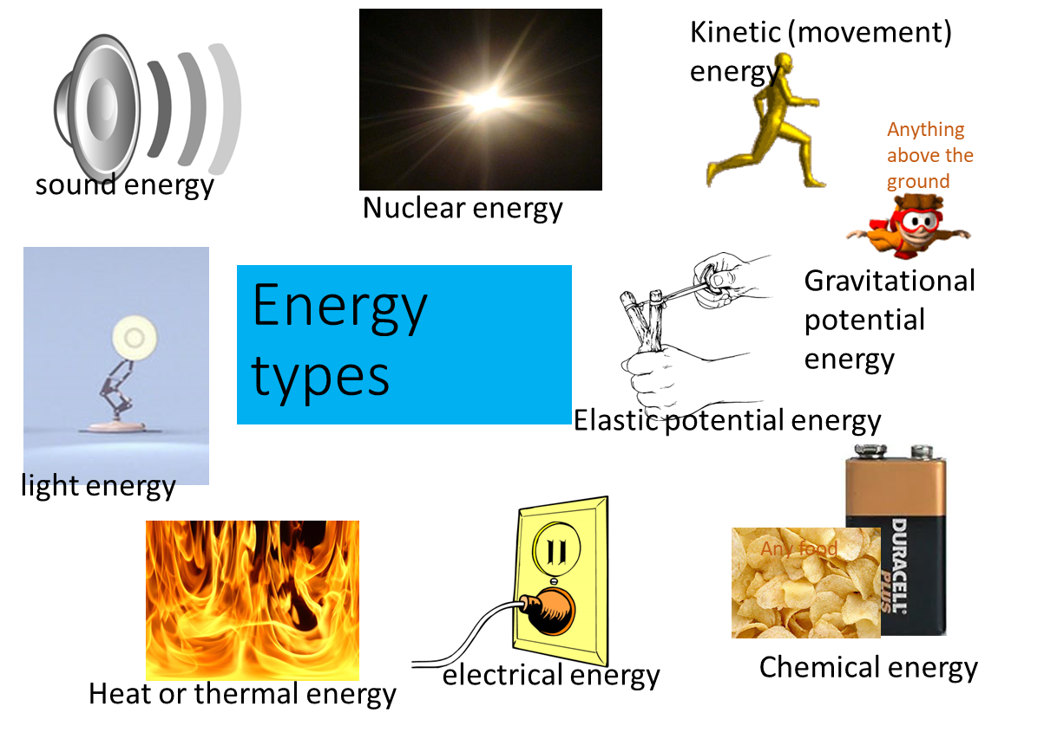
*Science: energy transfer and fossil fuel
If you prefer to work online please visit SENECA learning and sign up using the class code: 4ggjlziov
Recap
What type of energy is stored in food?
What 3 type of energy does a tv give out?
Describe what gravitational potential energy is

Slide 2
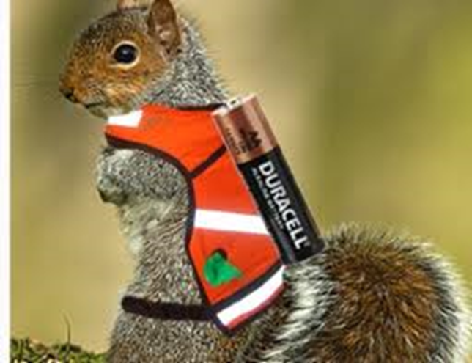
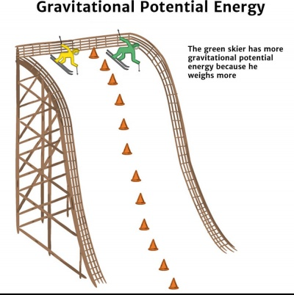

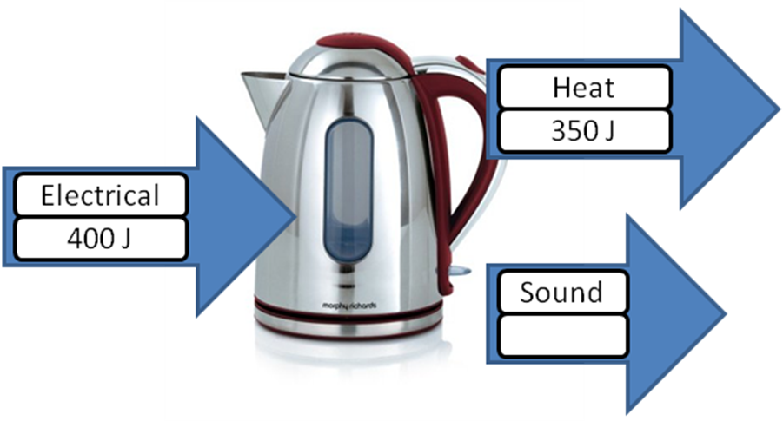
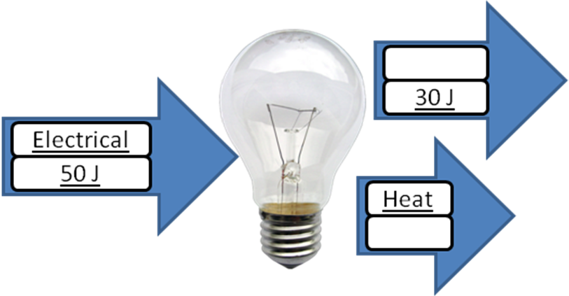
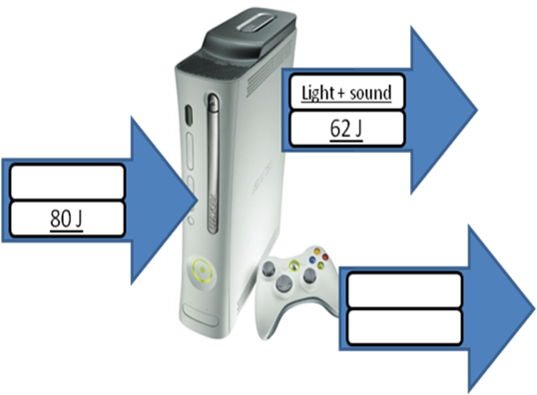
Energy can be transferred or stored
Energy cannot be lost
A catapult which has been pulled back has stored elastic energy, when you let go this is turned into kinetic energy
A battery has stored chemical energy. This can then be transferred into electrical energy
A skier at the top of a hill has stored gravitational potential energy. When they go down the hill this transfers to kinetic energy
As energy cannot be destroyed the amount of energy which we start with is the same as the energy which is transferred to.
Complete the diagrams with the numbers and the energy types
L _ _ _ _
e _ _ _ _ _ _ _ _ _
H _ _ _
Light heat electrical 50J 18J 20J

Slide 3
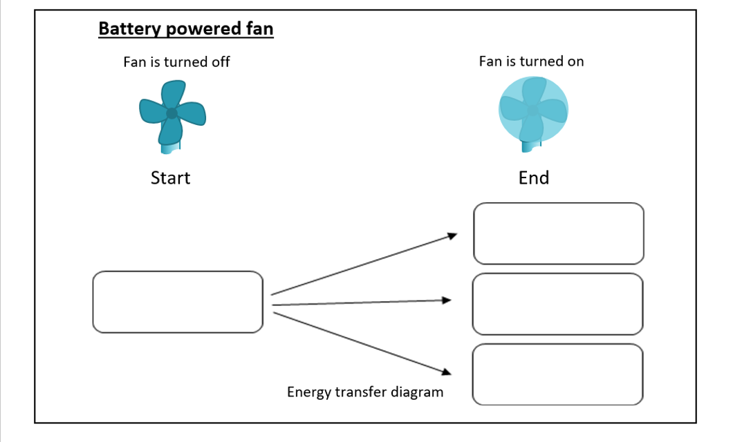
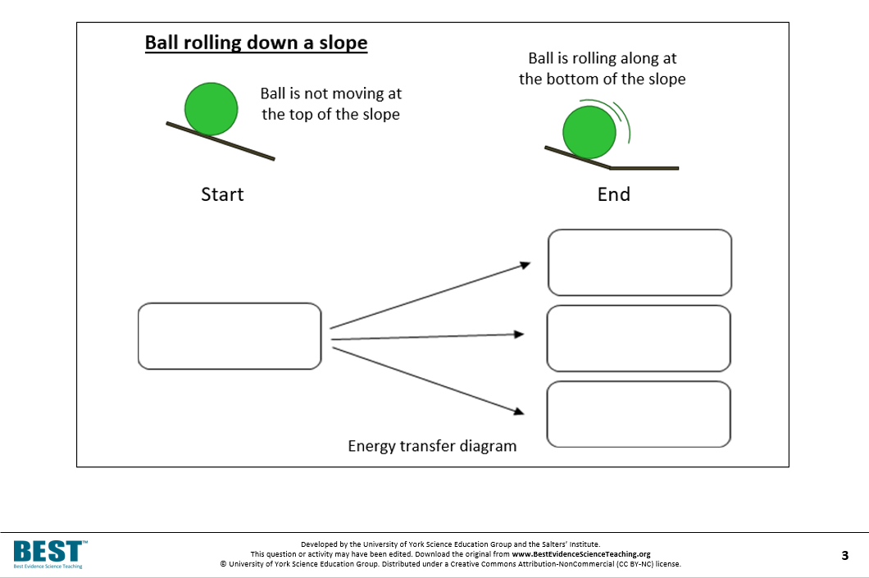
Kinetic sound chemical heat
Kinetic sound gravitational potential heat

Slide 4
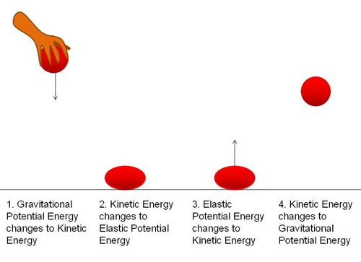
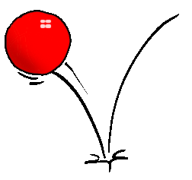
Bouncy ball investigation
When you hold a ball up it has stored gravitational potential energy because it is high up. When you drop the ball the energy is transferred to kinetic (movement energy). When it hits the floor some energy is transferred to sound and some into squashing the ball (elastic potential energy). This elastic energy transfers into kinetic energy to bounce the ball back up
Add labels to the diagram below to show the energy transfers
_ _ _ _ _ _ _ _ _ _ _ _ _
Potential energy
_ _ _ _ _ _ _ _ _ _ _ _ _
Potential energy
_ _ _ _ _ _ _
energy
_ _ _ _ _ _ _
energy
_ _ _ _ _ _ _
Potential energy
_ _ _ _ .
energy
Gravitational elastic sound kinetic gravitational kinetic

Slide 5
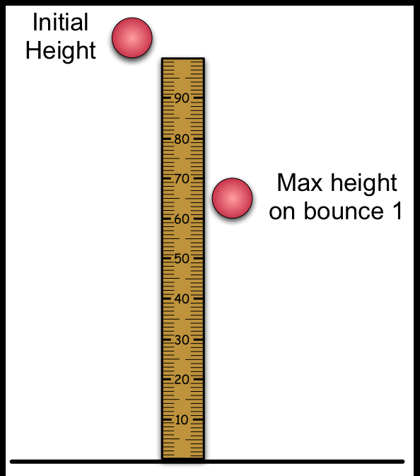
You are going to be testing the height the ball bounces after dropping the ball from different heights.
Prediction: Do you think dropping a ball from different heights will change how high the ball bounces up? Use the keywords below in your prediction if you can
I predict that the higher you drop a ball the _________ it will bounce.
This is because there is more __________ to _____________
________________________________________________
Energy kinetic higher lower force squash elastic
Practical task:
Find a ball.
Drop the ball from different heights and watch to see if it makes a difference to the height it bounces back up to.
Conclusion
I found out that as I dropped the ball from higher up it bounced
__________
To improve this experiment I could ………………………………………………………………………………………………………………………………………………………………………………………………………………………………………………………………………………………………………………
camera ruler higher lower measure repeat

Slide 6
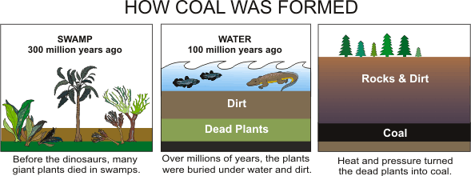
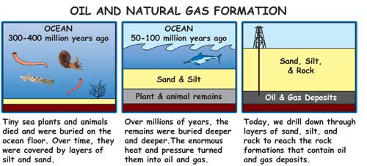
Fossil fuels
Fossil fuels are a chemical store of energy.
We can burn fossil fuels to give off heat energy.
Carbon is stored in fossil fuels, when we burn them that carbon goes into the air as carbon dioxide

Slide 7
Draw diagrams and fill in the gaps using the words below.
Burn sand oil heat years die sea deeper oil
 | Small sea creature _ _ _ and get buried at the bottom of the _ _ _ They then get covered by _ _ _ _
 | Over millions of _ _ _ _ _ they get buried deeper and _ _ _ _ _ _ The _ _ _ _ and pressure turns them into _ _ _
 | Humans drill down to get the _ _ _ so that they can _ _ _ _ it to make heat.

Slide 8
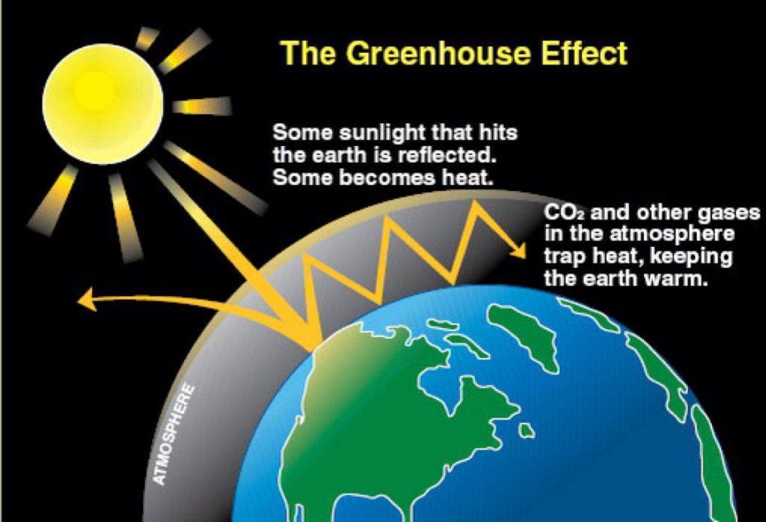
Much of the world’s energy is produced by burning fossil fuels such as oil, coal and gas. These natural resources are formed from the remains of plants and animals that died millions of years ago. They are used to power everything from planes to gas cookers.
Burning fossil fuels creates carbon dioxide gas, which is damaging to the environment and is making the Earth warmer than it should be. Once fossil fuels are gone they cannot be replaced, so people are now using renewable sources of energy.
Fossil fuels are called non-renewable because they will _ _ _ _ _ _
A problem with burning fossil fuels is that is causes the _ _ _ _ _ to get _ _ _ _ _ _
Why are we trying to reduce use of fossil fuels?
__________________________________________________________
_________________________________________________________
Earth run hotter out

Slide 9
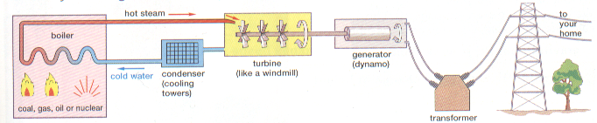
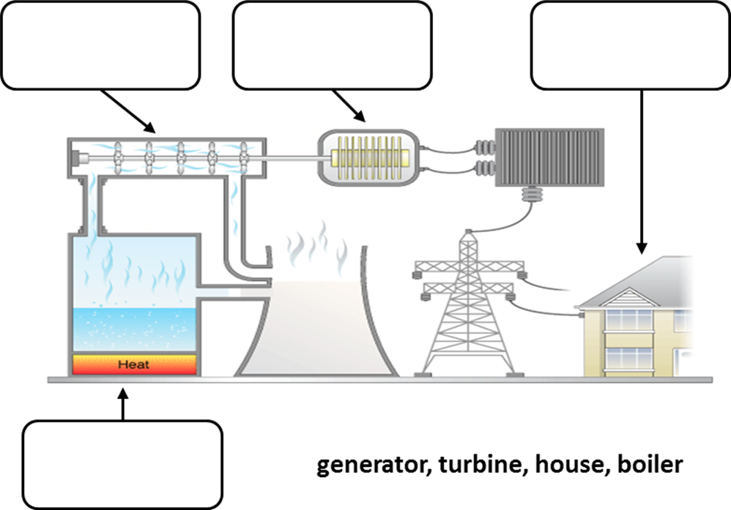
Fossil fuels can be burnt to generate electricity. This happens in power stations
Turbine
Cooling tower
Boiler
Generator
The fossil fuel (coal, oil or gas) is burnt in a boiler, this transfers the chemical energy into heat energy. The heat energy heats water turning it into a gas, this gas moves making a turbine spin (kinetic energy), this turns a generator which makes electricity.
Use the labels below to label the diagram
Label the

Slide 10

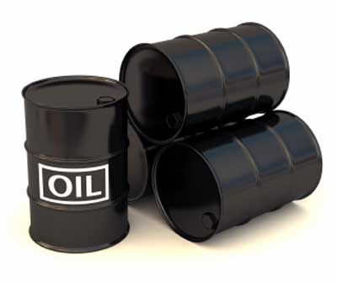
FOSSIL BURIED LIGHT CHEMICAL SAND COAL PLANTS GAS ANIMALS OIL SEA
Q1. Fill in the gaps in the following paragraph. Use the words that are given.
The Sun produces a great deal of _ _ _ _ _ energy and heat energy. Some of this reaches the Earth.
_ _ _ _ _ _ can trap this energy. Some of the energy becomes locked in them, in the form of
_ _ _ _ _ _ _ _ energy. Some were _ _ _ _ _ _ underground. Their energy became trapped as they were turned into
_ _ _ _.
_ _ _ _ _ _ _ that fed on the plants fell to the bottom of the _ _ _. They were buried under _ _ _ _ over time turned into _ _ _ and _ _ _
We call fuels formed from living things in this way
_ _ _ _ _ _ fuels.

Slide 11
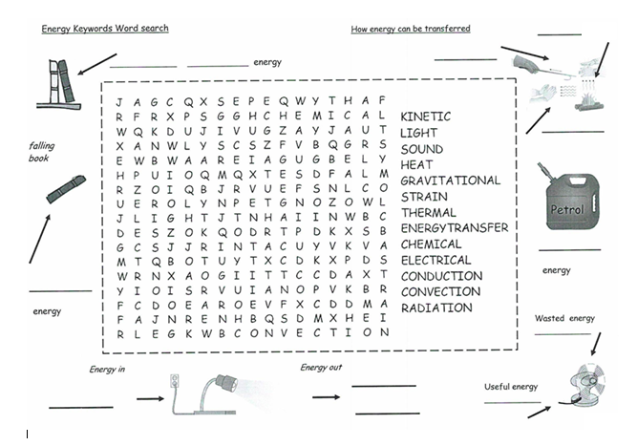
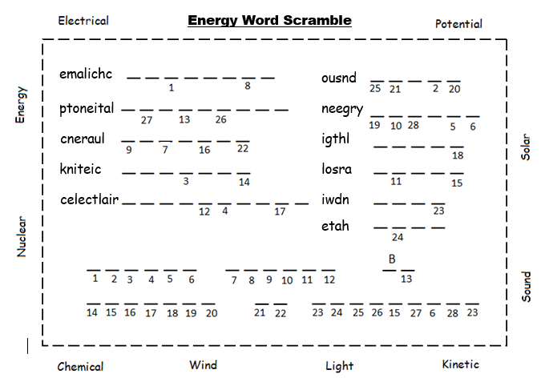
Unscramble the words, then use the numbers to fill in the phrase at the bottom

