Slide 1
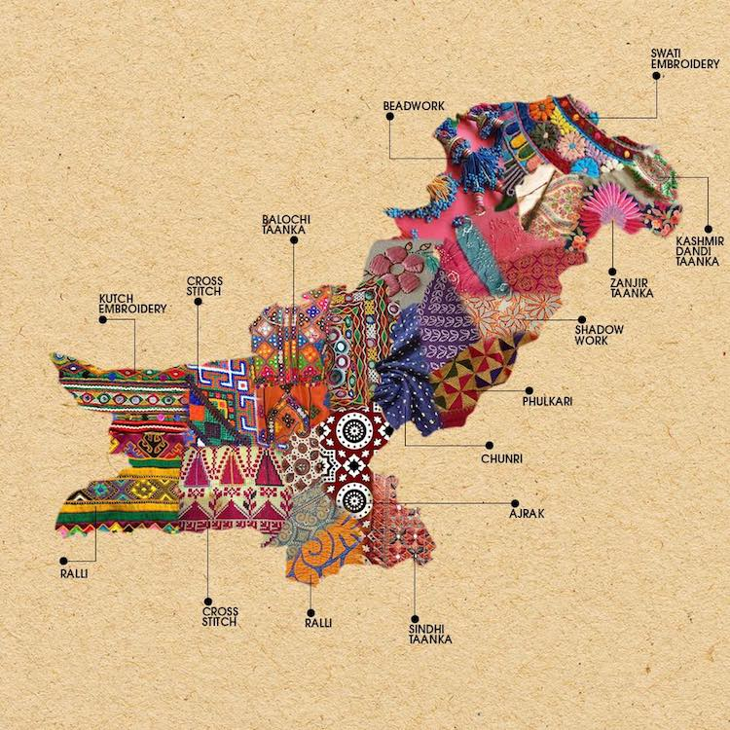
English Skills
Home Learning Booklet
Presents from my Aunts in Pakistan
Name: ___________

Slide 2
Key Words
Write down or look up the definitions for these key English terms. Then write an example for each.
Key Word | Definition | Example
Verb
Noun
Adjective
Simile
Metaphor
Personification

Slide 3
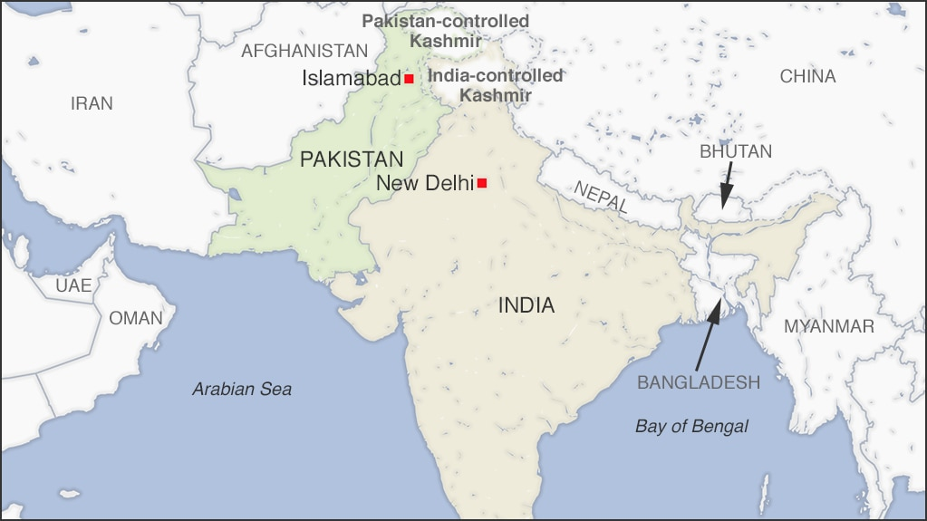
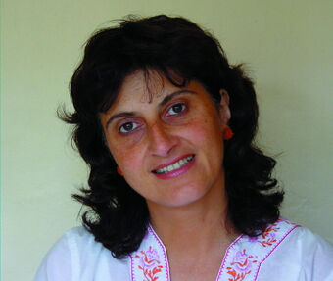
Background
Pakistan
Pakistan was created in 1947. The British Empire used to control India and when they left the divided the land between the Hindus and Muslims. Pakistan is mostly Muslim. Pakistan and India have been at war since the British left. Pakistan lies in the mountains. The capital city is Islamabad and the second largest city is Lahore.
Moniza Alvi
Alvi was born in Lahore in Pakistan, but came to England when she was a young child. Her father is from Pakistan and her mother is English.
This poem can be seen as autobiographical (about the author) as it is about a young girl, now living in English, who was born in Pakistan. She does not know where she belongs.
https://www.bbc.co.uk/bitesize/clips/zc7b4wx

Slide 4
Background
1. Where is Pakistan?
______________________________________________________
2. When did Pakistan become a country?
______________________________________________________
3. Which two religions did the British Empire divide the country between?
______________________________________________________
______________________________________________________
4. What was this process called?
_____________________________________________________
5. What is the main religion in Pakistan?
______________________________________________________
6. What are relations like between India and Pakistan?
_____________________________________________________
_____________________________________________________
7. What city was Moniza Alvi born in?
_____________________________________________________
8. Why can the poem be seen as autobiographical?
_____________________________________________________

Slide 5
Can you find the key words in the word search?
A | D | B | S | A | O | F | O | O | N | P | T | L | P | M
E | D | N | T | V | M | U | M | U | A | V | E | R | B | E
L | Z | J | A | I | K | B | O | K | Z | H | A | Y | K | T
I | B | X | E | L | J | N | I | I | C | Q | O | V | R | A
M | C | A | E | C | G | S | E | R | U | T | L | U | C | P
I | L | M | D | D | T | N | U | V | Z | I | L | N | I | H
S | C | W | H | A | D | I | E | N | L | I | Z | P | Q | O
O | Y | X | N | K | M | R | V | F | X | Y | V | Q | L | R
G | K | T | T | P | U | H | H | E | V | U | S | D | B | V
K | V | D | T | U | N | R | L | Z | O | B | Z | K | D | B
C | Y | E | D | M | D | R | S | X | S | Z | Y | Z | I | Q
M | V | Q | J | R | L | N | B | Z | N | N | M | P | Q | W
T | F | M | D | N | L | O | V | Y | Y | W | R | I | F | C
P | E | R | S | O | N | I | F | I | C | A | T | I | O | N
N | T | I | U | H | Z | I | E | G | S | I | V | P | B | J
ADJECTIVE | CULTURE | ENGLAND
METAPHOR | NOUN | PAKISTAN
PERSONIFICATION | SIMILE | VERB

Slide 6
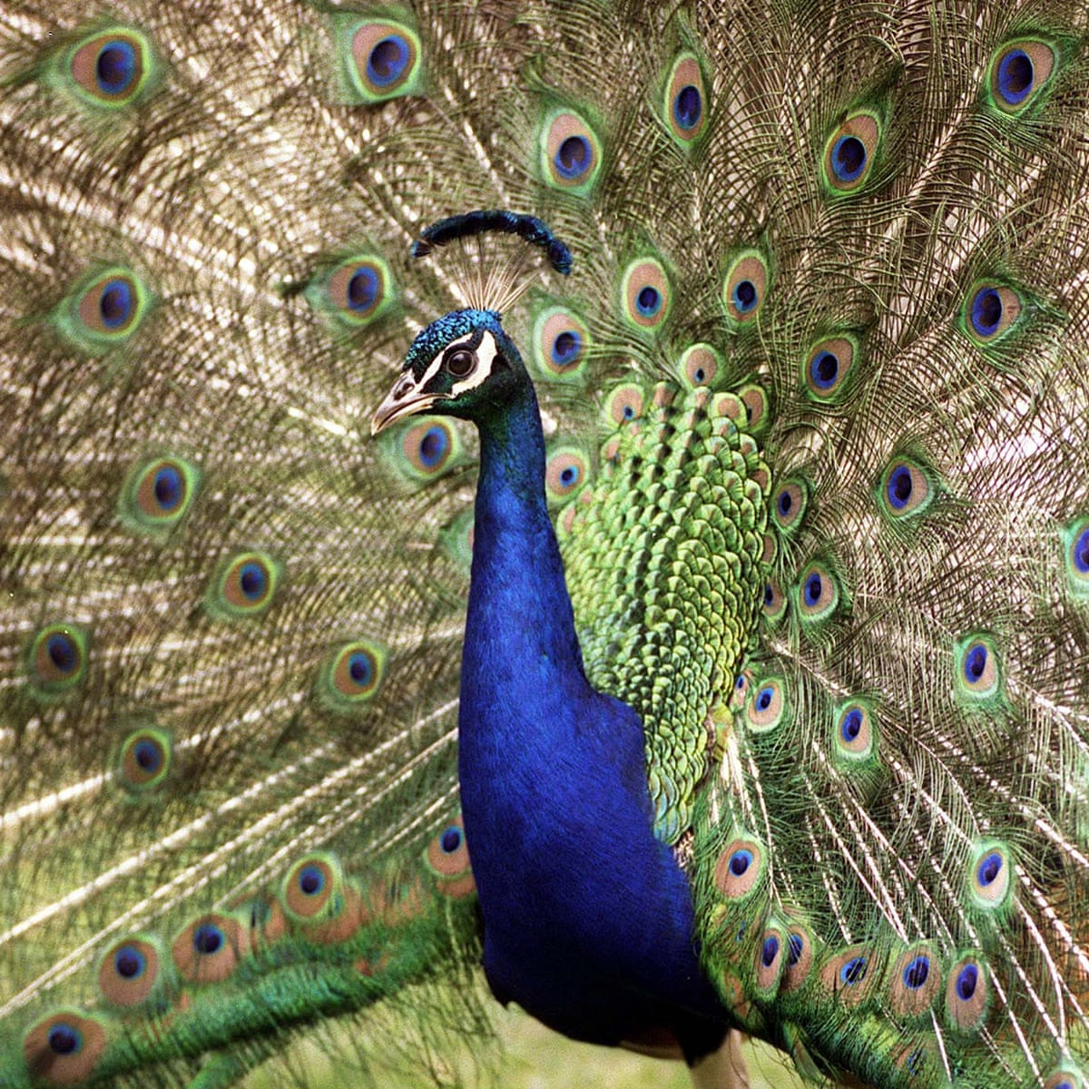
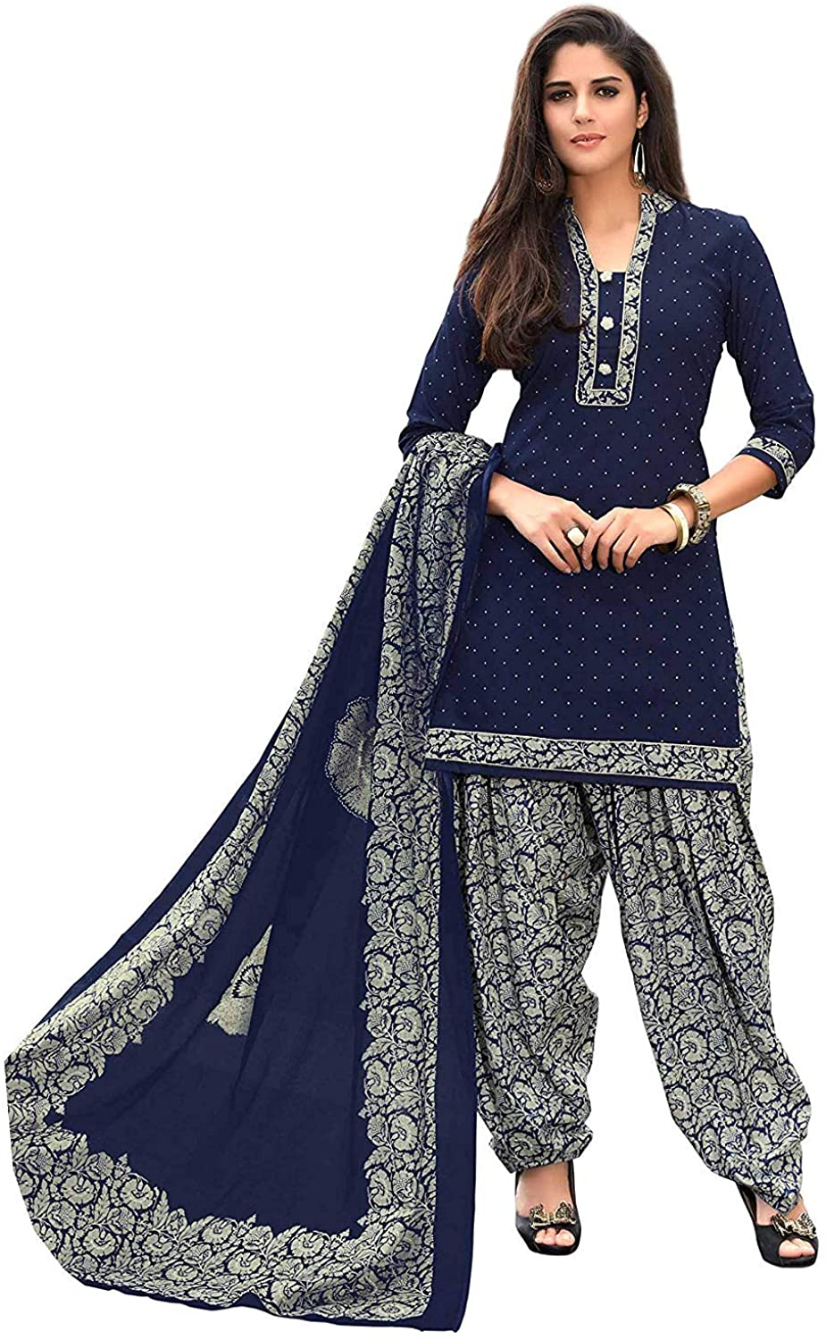
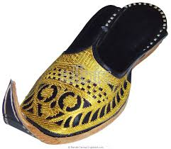
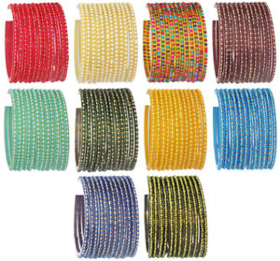
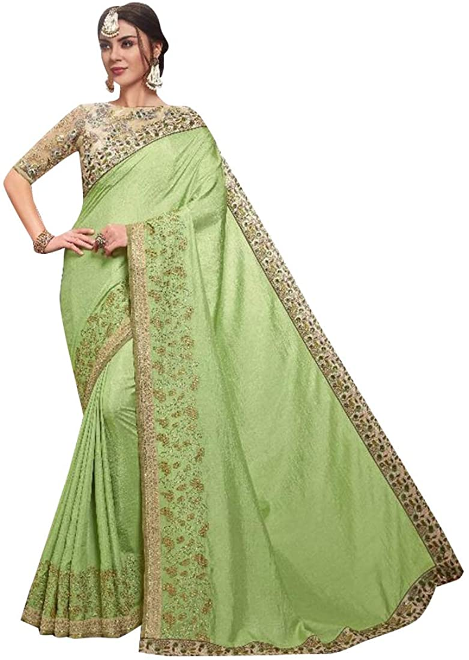

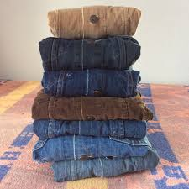
Presents from Aunts in Pakistan
They sent me a salwar kameez
peacock-blue,
and another
glistening like an orange split open,
embossed slippers, gold and black
points curling.
Candy-striped glass bangles
snapped, drew blood.
Like at school, fashions changed
in Pakistan –
the salwar bottoms were broad and stiff,
then narrow.
My aunts chose an apple-green sari,
silver-bordered
for my teens.
I tried each satin-silken top –
was alien in the sitting-room.
I could never be as lovely
as those clothes –
I longed
for denim and corduroy.
My costume clung to me
and I was aflame,
I couldn’t rise up out of its fire,
half-English,
unlike Aunt Jamila.
https://www.youtube.com/watch?v=S15JoaRLWdQ

Slide 7
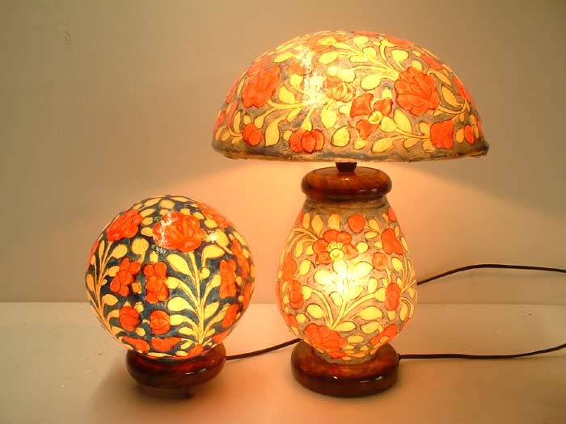
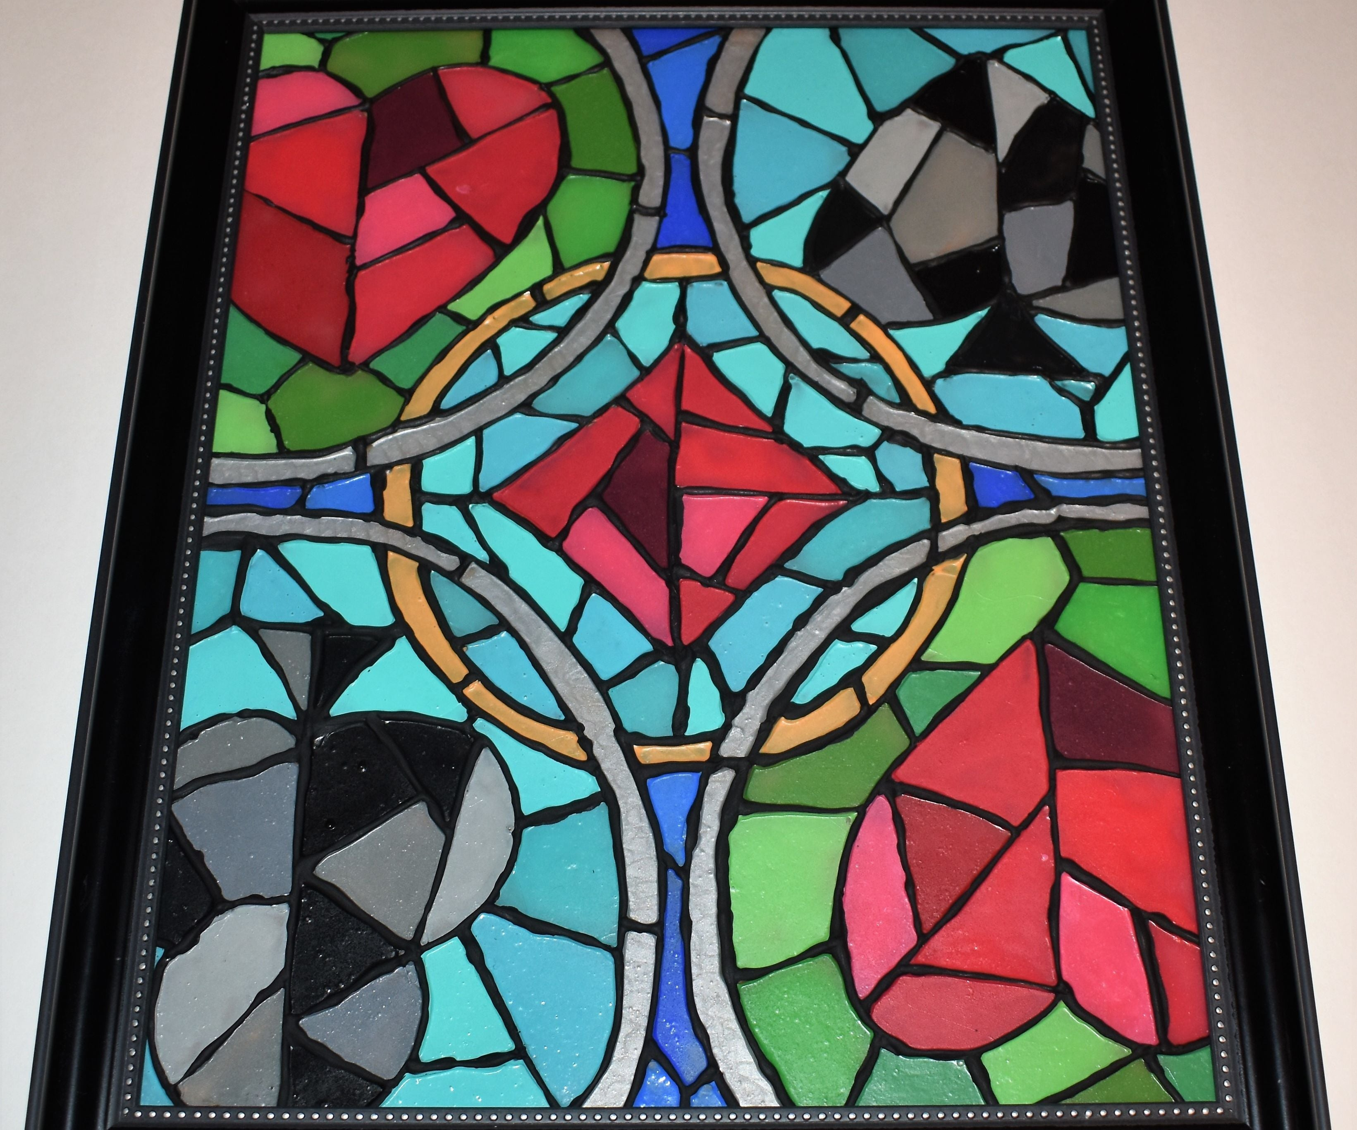
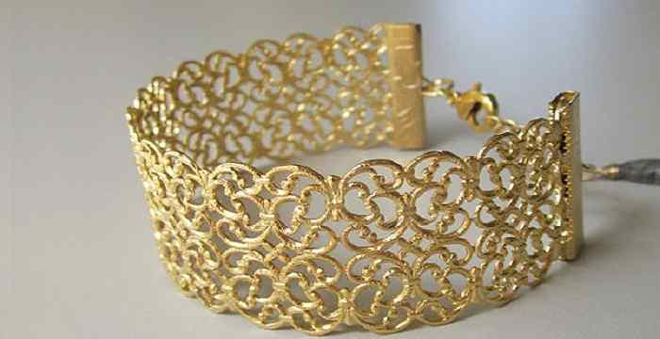
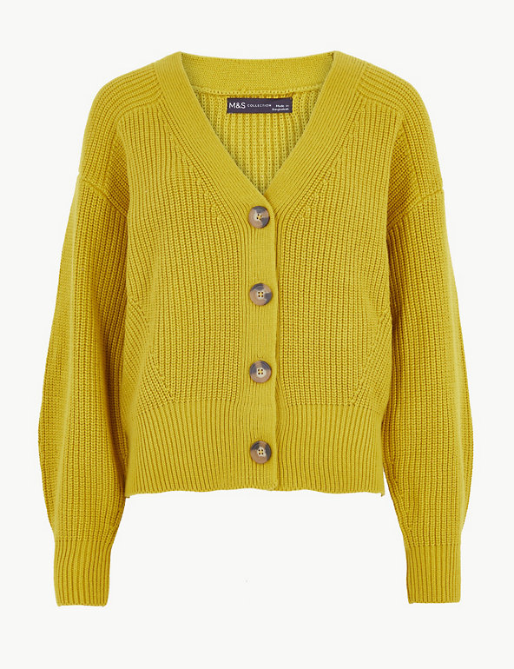
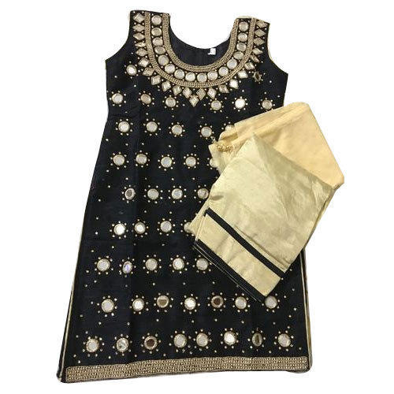
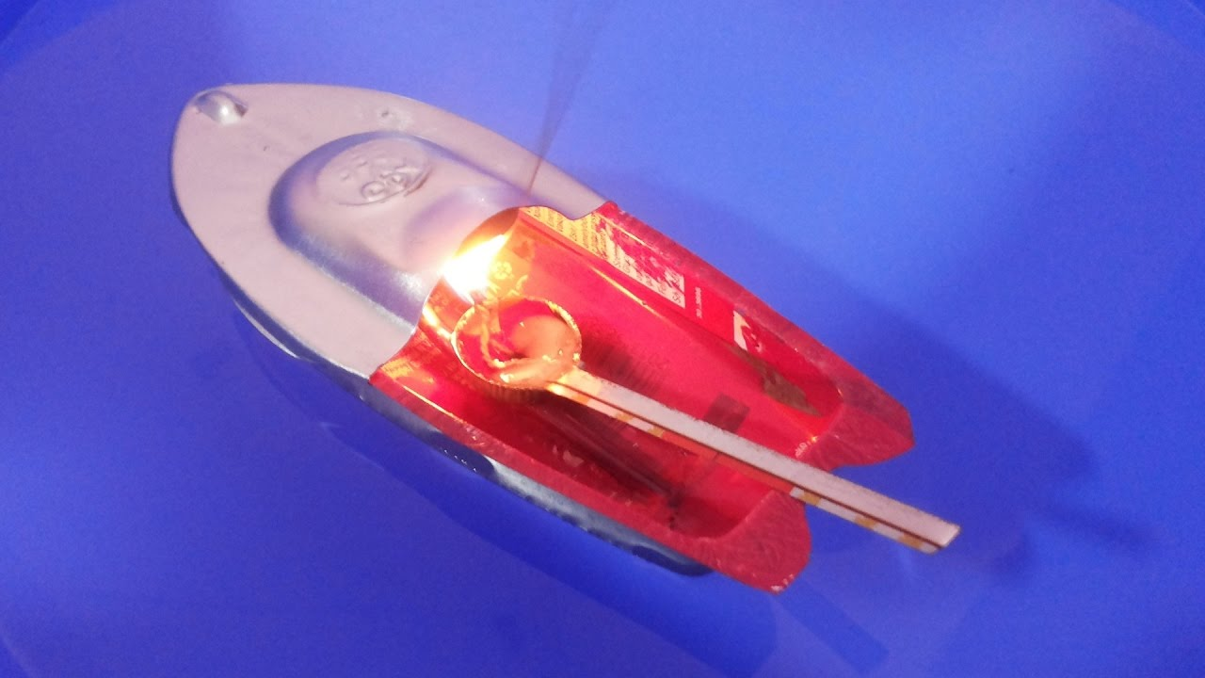
Presents from Aunts in Pakistan
I wanted my parents’ camel-skin lamp –
switching it on in my bedroom,
to consider the cruelty
and the transformation
rom camel to shade,
marvel at the colours
like stained glass.
My mother cherished her jewellery –
Indian gold, dangling, filigree,
But it was stolen from our car.
The presents were radiant in my wardrobe.
My aunts requested cardigans
from Marks and Spencers.
My salwar kameez
didn’t impress the schoolfriend
who sat on my bed, asked to see
my weekend clothes.
But often I admired the mirror-work,
tried to glimpse myself
in the miniature
glass circles, recall the story
how the three of us
sailed to England.
Prickly heat had me screaming on the way.
I ended up in a cot
In my English grandmother’s dining-room,
found myself alone,
playing with a tin-boat.

Slide 8
Presents from my Aunts in Pakistan
1. Who sent the gifts?
______________________________________________________
2. What simile is used?
______________________________________________________
3. What does this suggest about the salwar kameez?
______________________________________________________
______________________________________________________
4. List three colours from the first stanza (verse)?
_____________________________________________________
5. Why does the writer use lots of different colours?
______________________________________________________
______________________________________________________
6. Why does she say felt alien? What technique is this?
_____________________________________________________
_____________________________________________________
7. What does she say she longs for?
_____________________________________________________

Slide 9
Presents from my Aunts in Pakistan
8. Why do you think she talks about the camel skin lamp?
______________________________________________________
______________________________________________________
9. What do her aunts request from England?
______________________________________________________
10. How does this compare with the clothes they send?
______________________________________________________
_____________________________________________________
11. How did her school friend feel about her presents?
______________________________________________________
______________________________________________________
12. How is this different to how she feels?
______________________________________________________
______________________________________________________
13. How do you think the writer feels about her two cultures?
______________________________________________________
______________________________________________________
______________________________________________________

Slide 10
Presents from my Aunts in Pakistan
Task: Which quotes from the poem link to the English culture and which quotes link to the Pakistani culture?
English Culture | Pakistani Culture
Extension Task:
What do you notice about the differences between the descriptions?
____________________________________________________________________________________________________________________________________

Slide 11
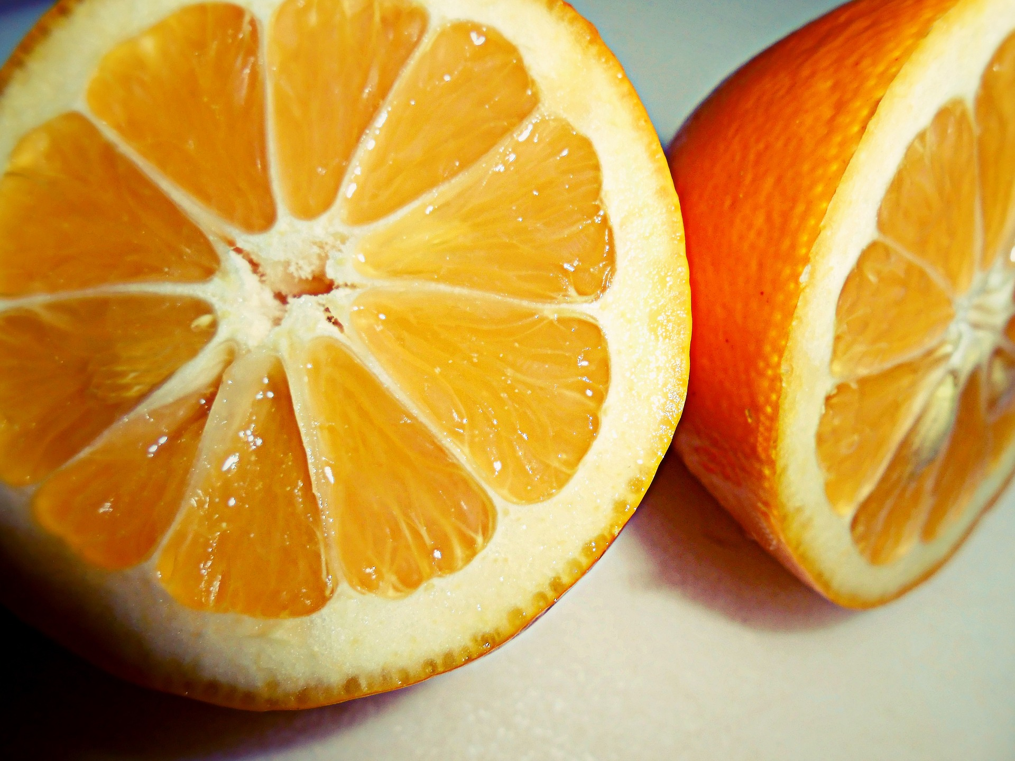
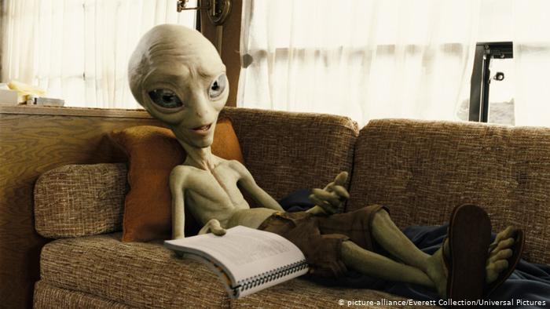
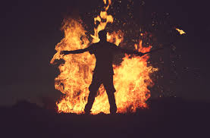
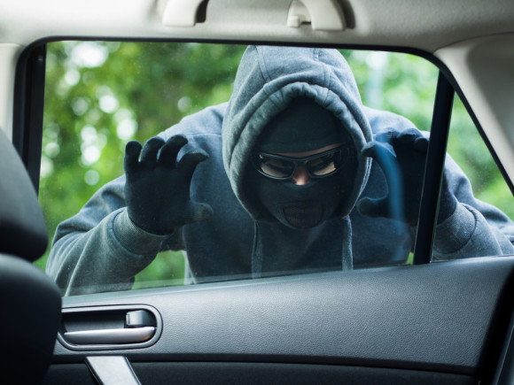
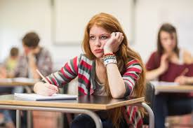
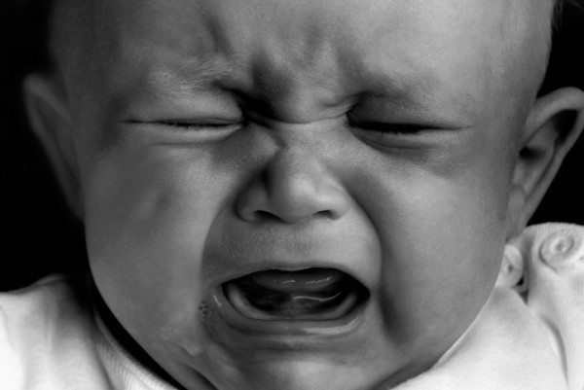
Task: This poem relies heavily on imagery to explore her two cultures. For each image, find the quote and the technique used.
Quote: | Quote:
Technique: | Technique:
Quote: | Quote:
Technique: | Technique:
Quote: | Quote:
Technique: | Technique:

Slide 12
Annotation
You are now going to create a key and annotate the poem. There is a blank copy over the page.
Highlight or underline each item in a different colour (or if you only have one pen, with a different pattern!)
Colour or Pattern | Technique
 | Nouns Highlight all the presents she has been given.
 | Adjectives Highlight the different colours mentioned.
 | Verbs Highlight any interesting verbs used
 | Simile
 | Metaphor
 | Personification

Slide 13
Analysing Quotations
Task: You are going to look at three quotations the writer uses and analyse your quotations, see the example.
Emerging: Choose a quote
Developing: Label with techniques and comment on effect
Secure: Explain the effect using because
Mastered: Explain the effect of a word or words in your quote.
WAGOLL (what a good one looks like)
The word “glistening” makes it sound beautiful and unusual because it would catch he light and sparkle
This quote makes the salwar kameez sound exotic because it uses bright colours to describe it.
“Split makes you think of the inside of the orange, but it also highlights how the writer feels about her two cultures. She is split between them.
Simile
“glistening like an orange split open”

Slide 14
Analysing Quotations

Slide 15
Analysing Quotations

Slide 16
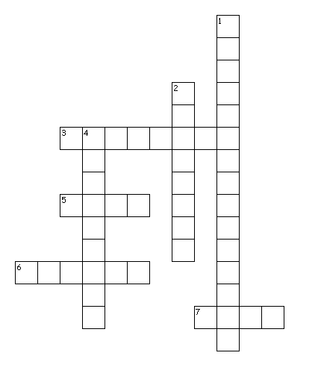
Can you put the key words in the right places?
Across
3. A country near India.
5. Describes an action.
6. Compare two things using like or as.
7. An object, person, place or thing.
Down
When you give something human qualities.
2. Say something is something which it can't be.
4. Describes a noun.

Slide 17


Sensory Description
Sensory Description is when you describe something by appealing to the five senses.
What are the five senses?
Senses
Task: Describe the image over the page in detail.
Emerging: Use 2-3 senses, adjectives and nouns.
Developing: Use all senses .
Secure: Use simile and interesting verbs.
Mastered: Use metaphor and personification.
Don’t forget to check your spelling, punctuation and grammar!

Slide 18
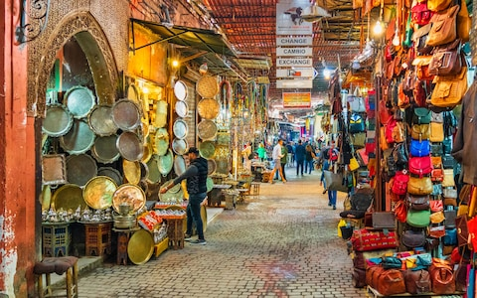
Descriptive Writing
______________________________________________________
______________________________________________________
______________________________________________________
______________________________________________________
______________________________________________________
______________________________________________________
______________________________________________________
______________________________________________________
______________________________________________________
______________________________________________________
______________________________________________________
https://www.youtube.com/watch?v=Y9Rj1qorOKY

Slide 19
Descriptive Writing
______________________________________________________
______________________________________________________
______________________________________________________
______________________________________________________
______________________________________________________
______________________________________________________
______________________________________________________
______________________________________________________
______________________________________________________
______________________________________________________
______________________________________________________
______________________________________________________
______________________________________________________
______________________________________________________
______________________________________________________
______________________________________________________
______________________________________________________
______________________________________________________
______________________________________________________

Slide 20

Self Assessment
Well done! You completed the tasks on Presents from my Aunts in Pakistan.
List three things you have learnt:
_________________________________________
_________________________________________
_________________________________________
What went well this week?
My best piece of work is…
_________________________
because…
_________________________
_________________________

