Slide 1
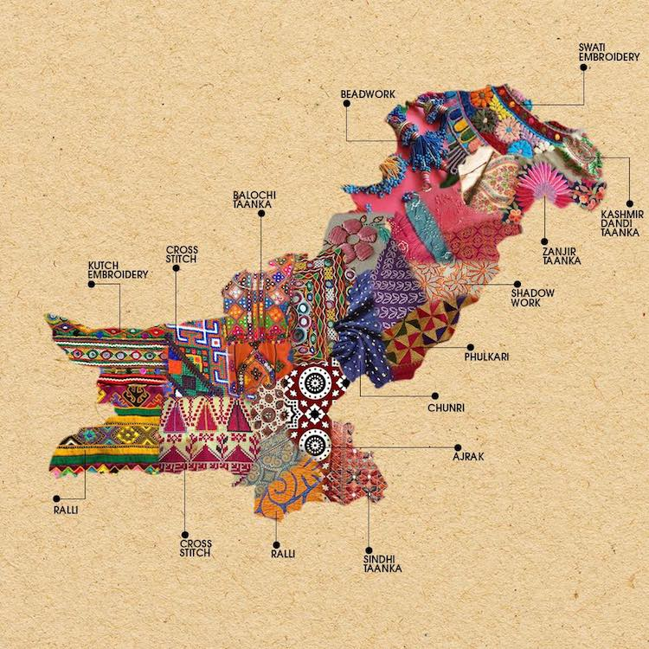
English
Home Learning Booklet
Presents from my Aunts in Pakistan
Name: ___________

Slide 2
Key Words
Match up your definitions with the key words.
Use Google or a dictionary to check your answers
Key Words
Simile
Verb
Noun
Adjective
Definitions
A word which describes a noun.
When you compare two things using like or as.
A word for an action (doing word).
A word for an object, person, place or thing.

Slide 3
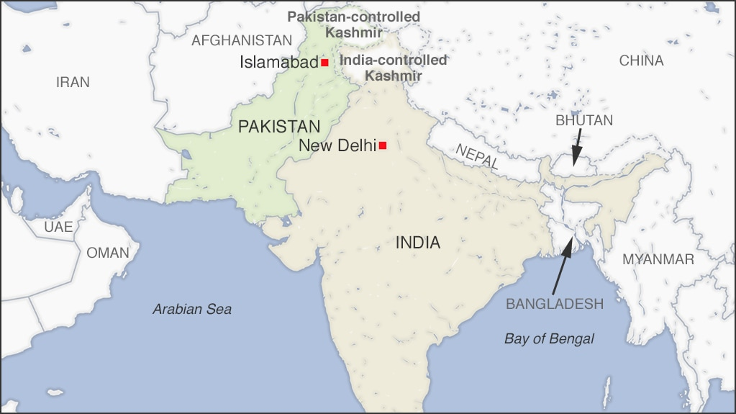
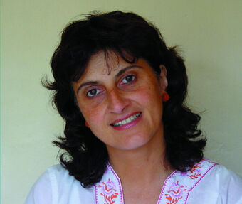
Background
Pakistan
Pakistan was created in 1947. The British Empire used to control India and when they left the divided the land between the Hindus and Muslims. This was called partition. Pakistan is mostly Muslim. Pakistan and India have been at war since the partition. Pakistan lies in the mountains. The capital city is Islamabad and the second largest city is Lahore.
Moniza Alvi
Alvi was born in Lahore in Pakistan, but came to England when she was a young child. Her father is from Pakistan and her mother is English.
This poem can be seen as autobiographical (about the author) as it is about a young girl, now living in English, who was born in Pakistan. She does not know where she belongs.
https://www.bbc.co.uk/bitesize/clips/zc7b4wx

Slide 4
Background
Complete the Cloze Summary on the background of the poem.
Pakistan is a country which has existed since _____________. Before this the ____________ empire had controlled India. The main religion in Pakistan is ______________. Sadly, Pakistan has been at war with _____________ for many years. Pakistan is to the north of India and has lots of _______________.
Moniza Alvi was born in ______________. She moved to _____________ when she was very young. The poem talks about a young _________ who also was from Pakistan, but now lives in England. She does not know which ___________ is hers.
culture India Muslim 1947
British England Lahore
mountains

Slide 5
Can you find the key words?
K | Z | C | Z | R | P | B | S | E | P
M | Q | Q | U | J | E | C | V | Y | J
K | A | R | D | L | Q | I | V | Z | E
P | A | K | I | S | T | A | N | N | N
F | J | V | N | C | H | U | O | S | G
O | G | M | E | F | F | U | R | F | L
D | X | J | K | A | N | Q | R | E | A
H | D | Y | P | X | Q | A | D | D | N
A | O | O | B | R | E | V | R | H | D
E | W | R | X | P | B | Y | U | G | M
ADJECTIVE | CULTURE | ENGLAND
NOUN | PAKISTAN | VERB

Slide 6
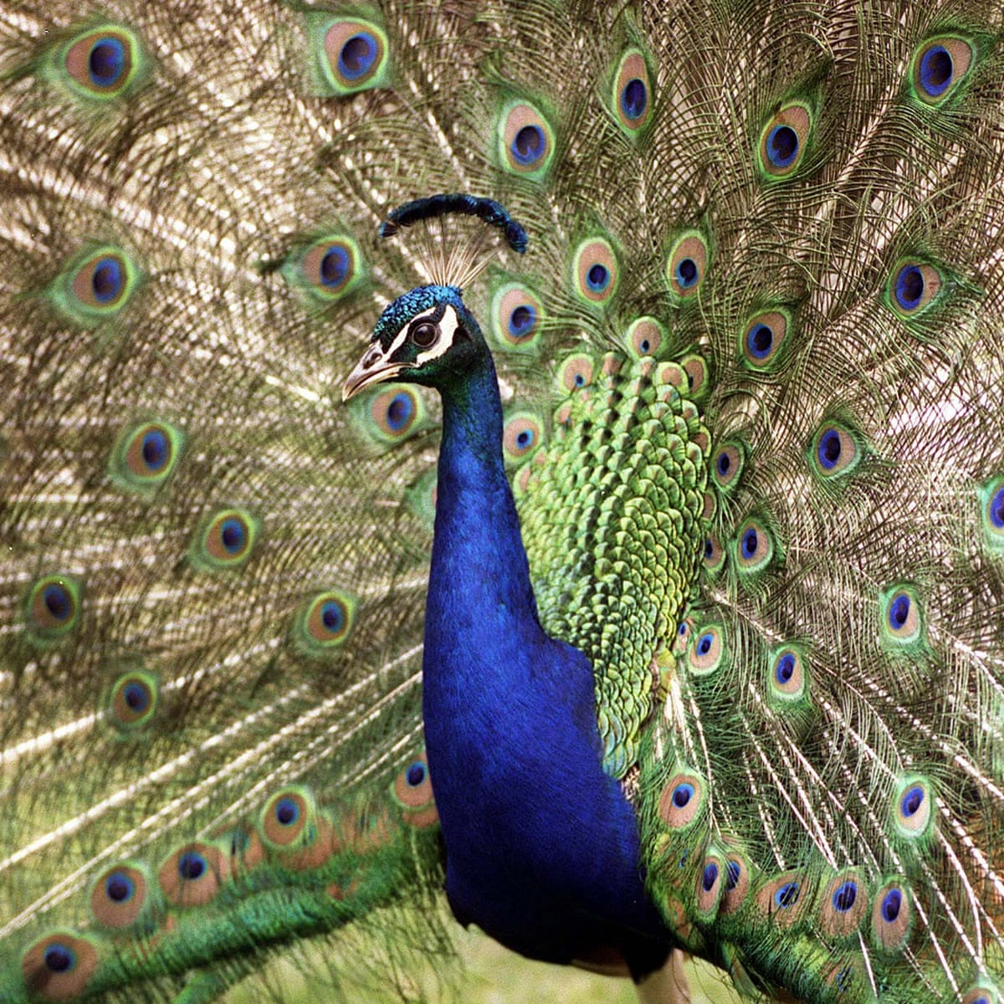
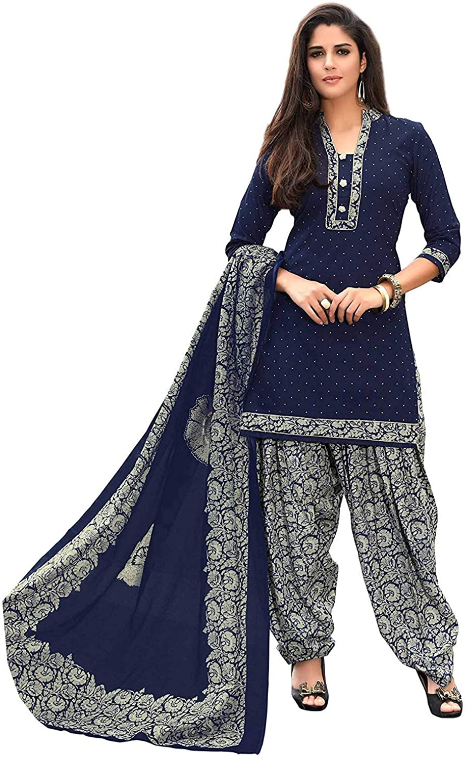
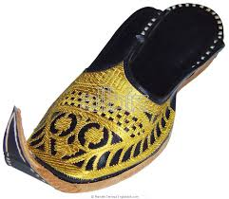
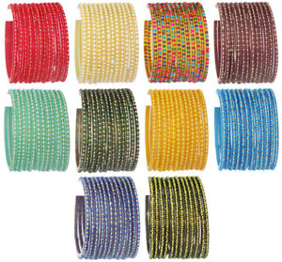
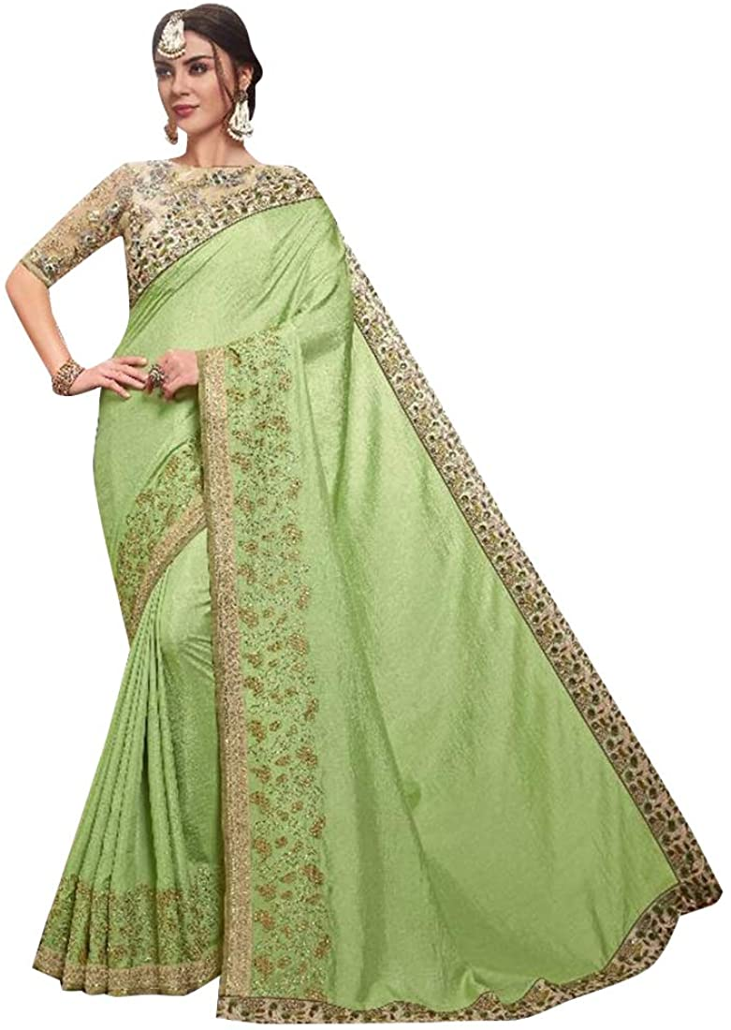

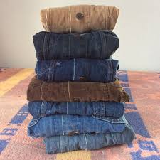
Presents from Aunts in Pakistan
They sent me a salwar kameez
peacock-blue,
and another
glistening like an orange split open,
embossed slippers, gold and black
points curling.
Candy-striped glass bangles
snapped, drew blood.
Like at school, fashions changed
in Pakistan –
the salwar bottoms were broad and stiff,
then narrow.
My aunts chose an apple-green sari,
silver-bordered
for my teens.
I tried each satin-silken top –
was alien in the sitting-room.
I could never be as lovely
as those clothes –
I longed
for denim and corduroy.
My costume clung to me
and I was aflame,
I couldn’t rise up out of its fire,
half-English,
unlike Aunt Jamila.
https://www.youtube.com/watch?v=S15JoaRLWdQ

Slide 7
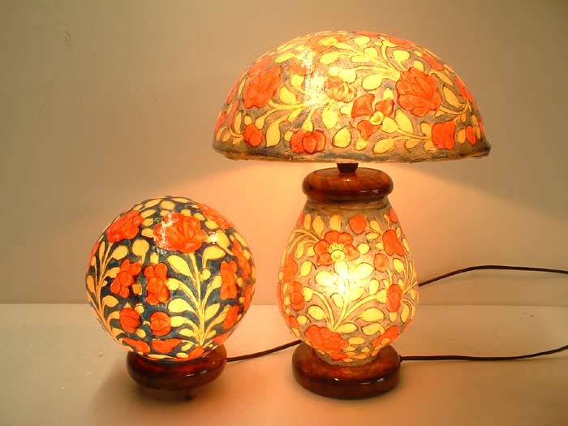
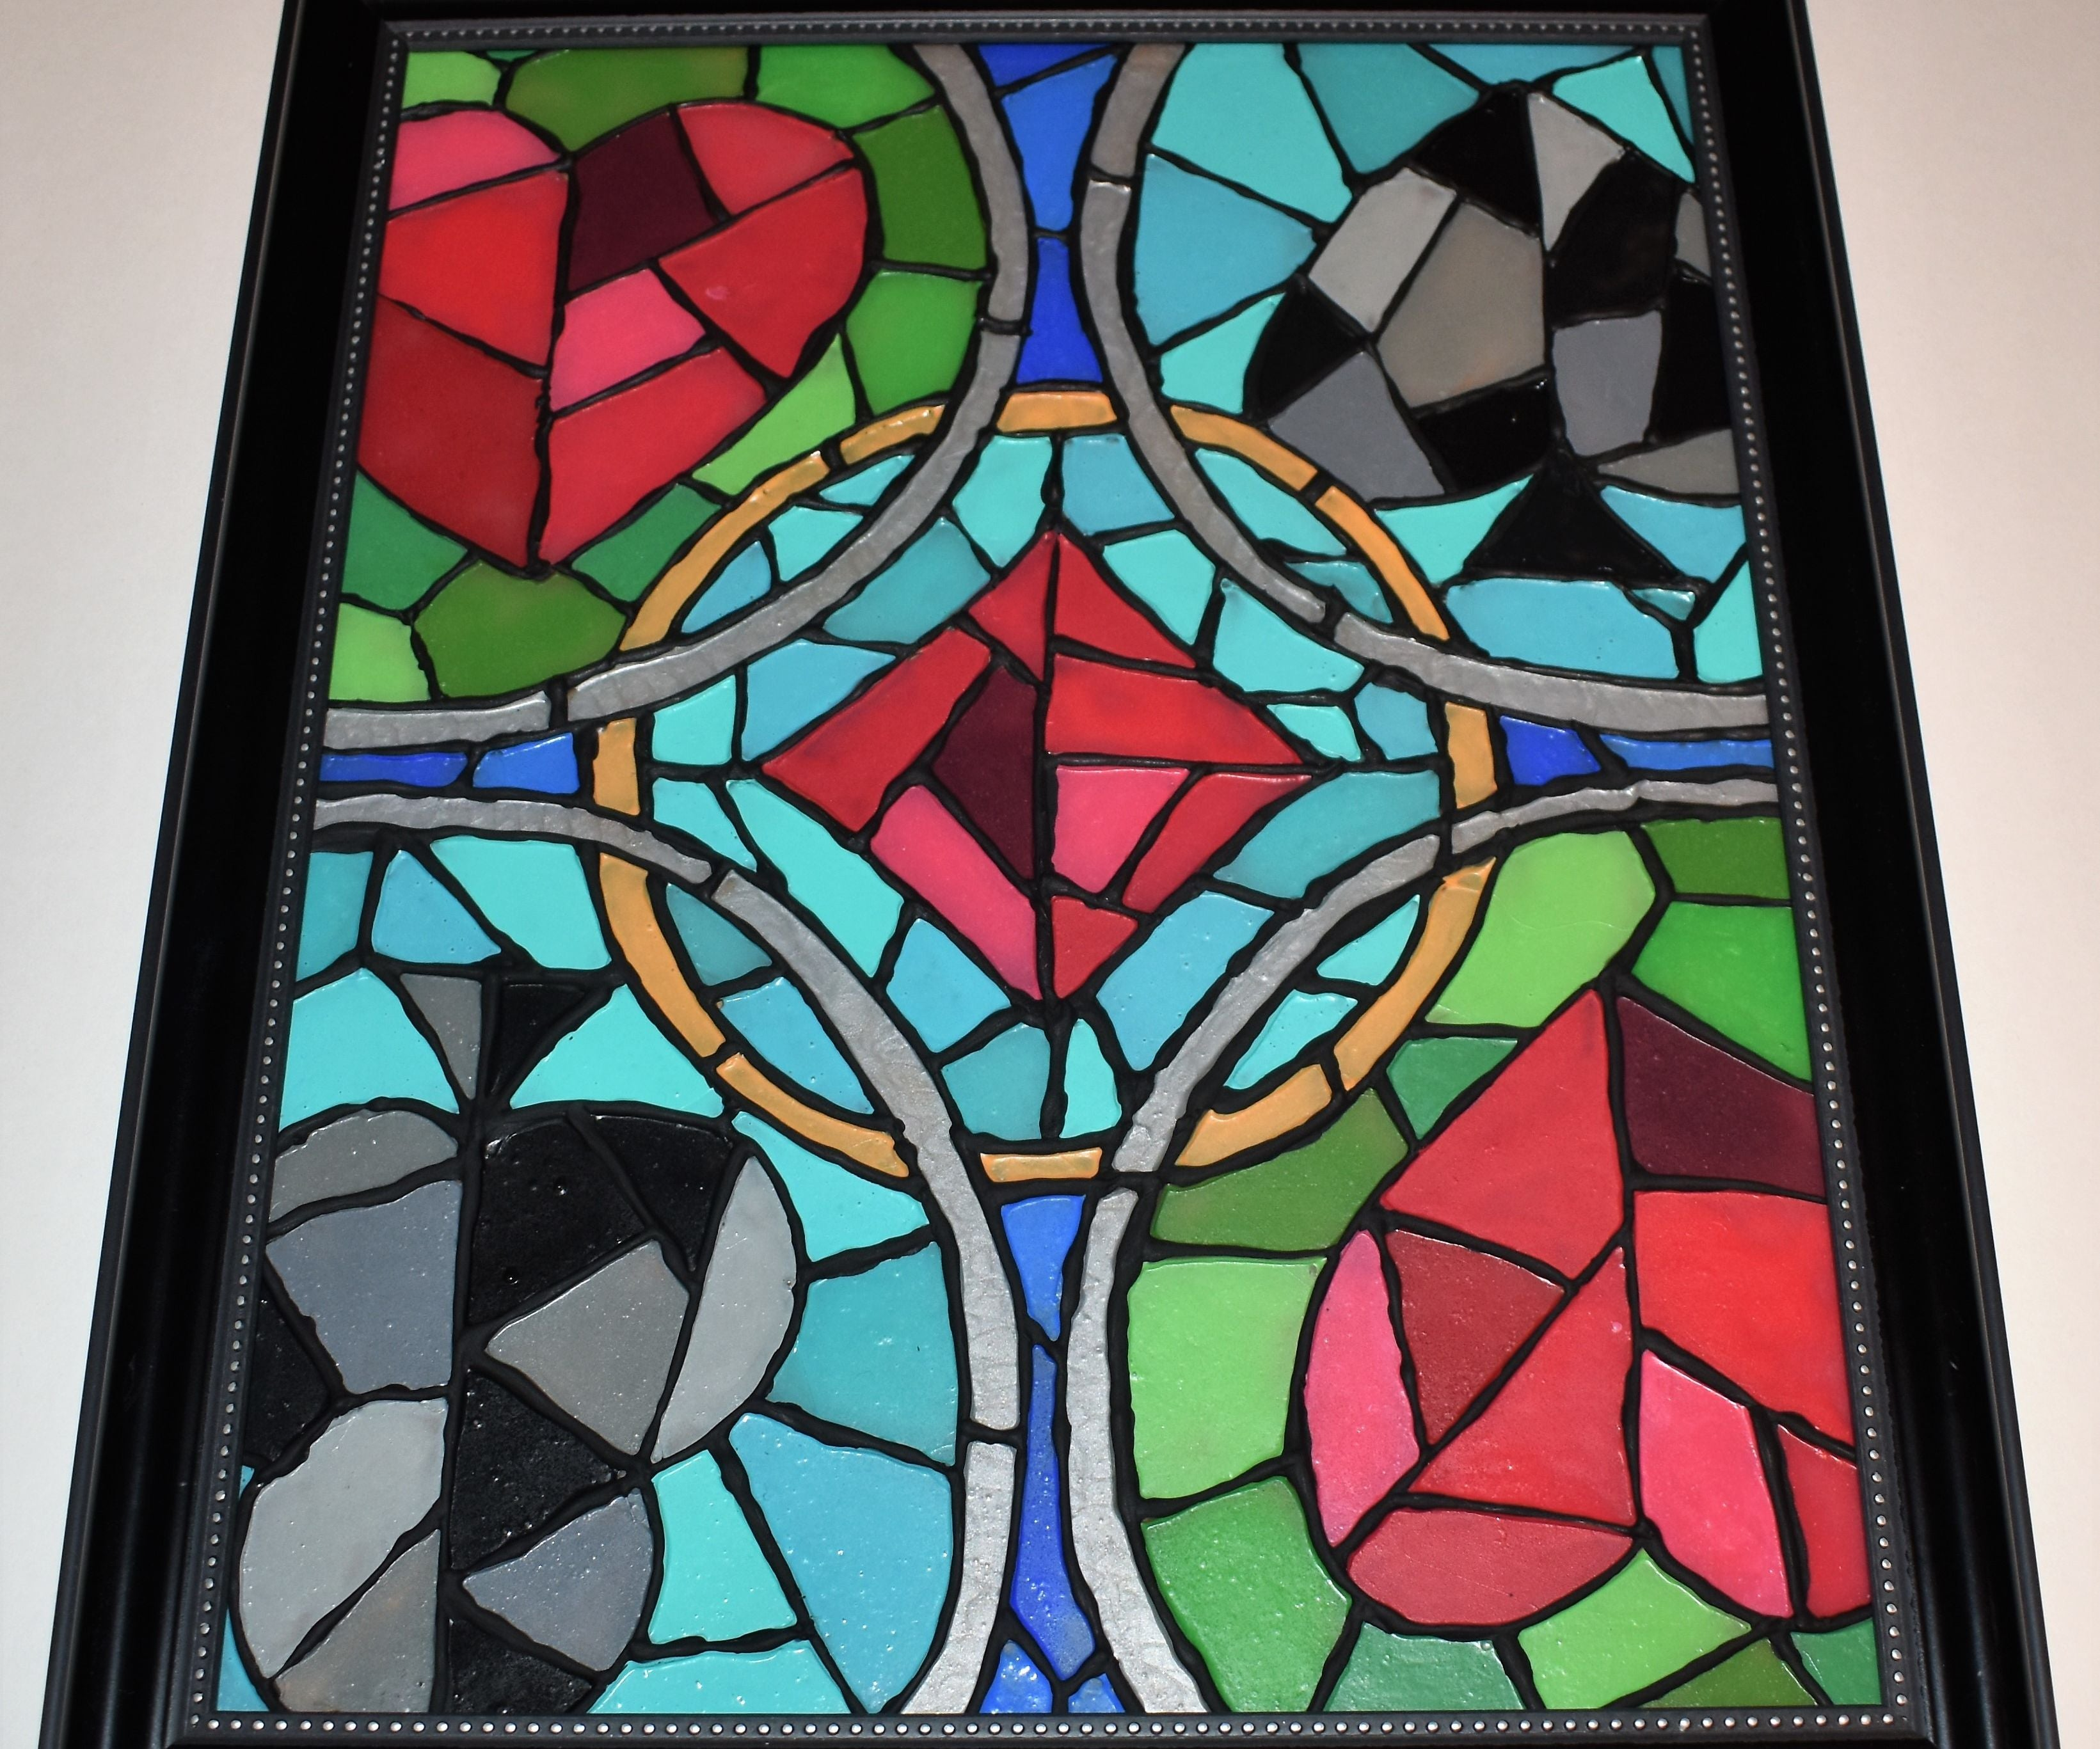
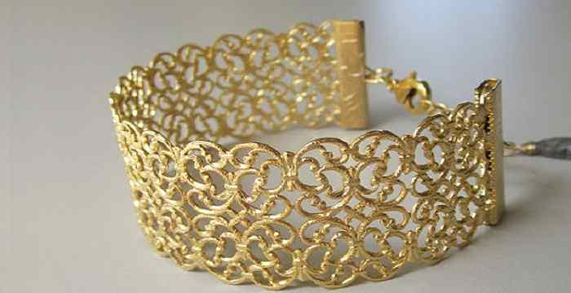
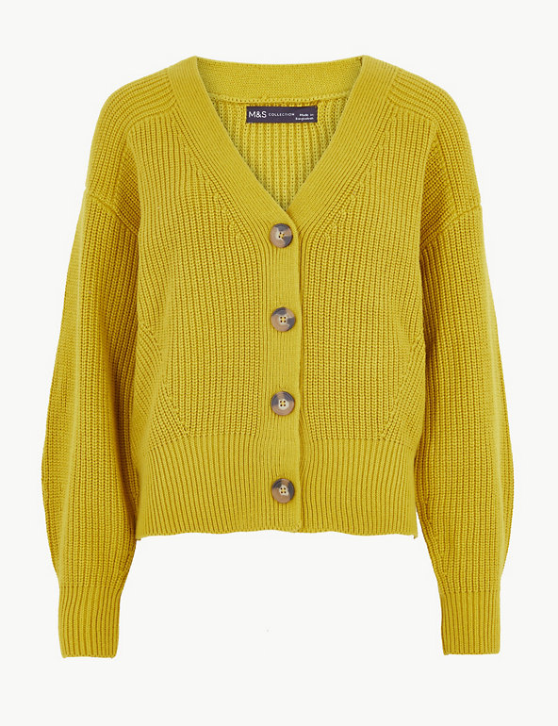
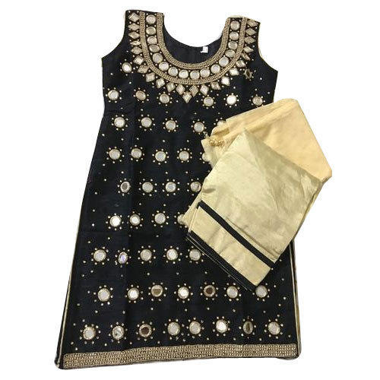
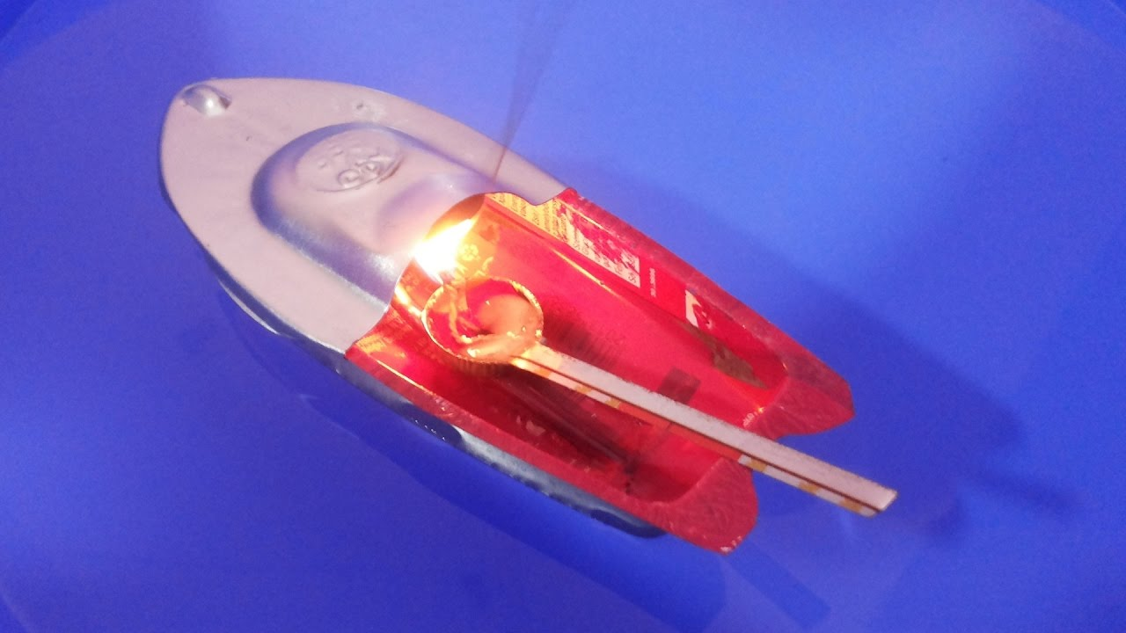
Presents from Aunts in Pakistan
I wanted my parents’ camel-skin lamp –
switching it on in my bedroom,
to consider the cruelty
and the transformation
rom camel to shade,
marvel at the colours
like stained glass.
My mother cherished her jewellery –
Indian gold, dangling, filigree,
But it was stolen from our car.
The presents were radiant in my wardrobe.
My aunts requested cardigans
from Marks and Spencers.
My salwar kameez
didn’t impress the schoolfriend
who sat on my bed, asked to see
my weekend clothes.
But often I admired the mirror-work,
tried to glimpse myself
in the miniature
glass circles, recall the story
how the three of us
sailed to England.
Prickly heat had me screaming on the way.
I ended up in a cot
In my English grandmother’s dining-room,
found myself alone,
playing with a tin-boat.

Slide 8
Presents from my Aunts in Pakistan
1. Who sent the gifts?
______________________________________________________
2. List three items they sent her from the first stanza (verse)
______________________________________________________
______________________________________________________
3. List three colours mentioned when describe the gifts?
______________________________________________________
______________________________________________________
4. How does she say she feels wearing them in the sitting room?
_____________________________________________________
5. What was stolen from her mother?
______________________________________________________
6. What do her aunts request from England?
_____________________________________________________
7. How does her schoolfriend react to her clothes from Pakistan?
_____________________________________________________
8. How do you think she feels about her presents? Why?
_____________________________________________________
_____________________________________________________

Slide 9
Presents from my Aunts in Pakistan
Task: Put the quotes under either English Culture or Pakistani Culture.
“They sent me a salwar kameez”
“I longed for denim and corduroy”
“Embossed slippers, gold and black.”
“Candy stripped glass bangles.”
“apple green sari”
“cardigans from Marks and Spencers”
English Culture | Pakistani Culture

Slide 10
Annotation
You are now going to create a key and annotate the poem.
Highlight or underline each item in a different colour (or if you only have one pen, with a different pattern!)
Colour or Pattern | Technique
 | Colours (adjectives)
 | Presents (nouns)
 | Similes

Slide 11
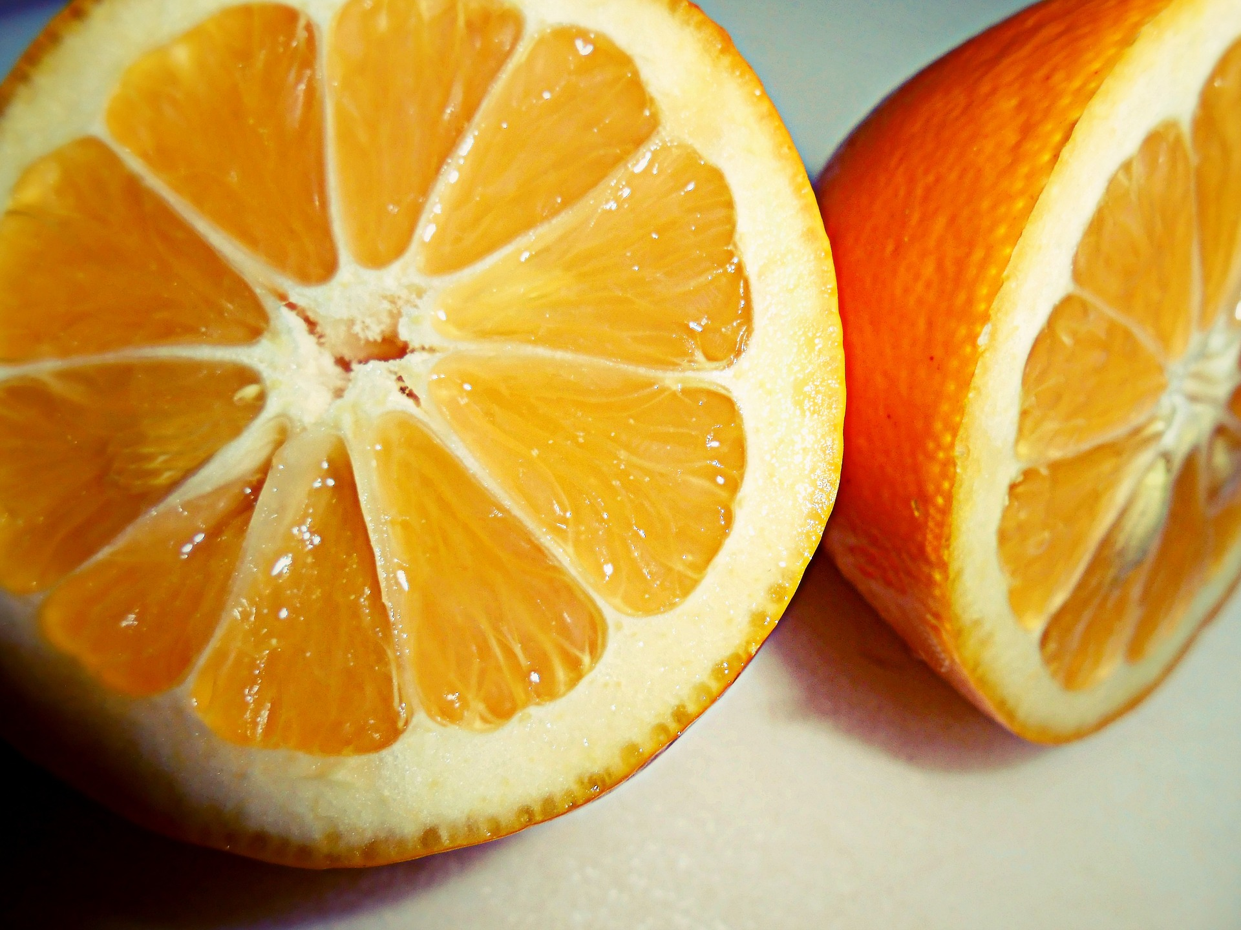
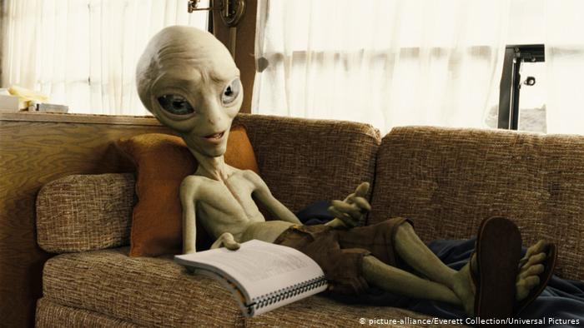
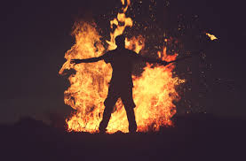
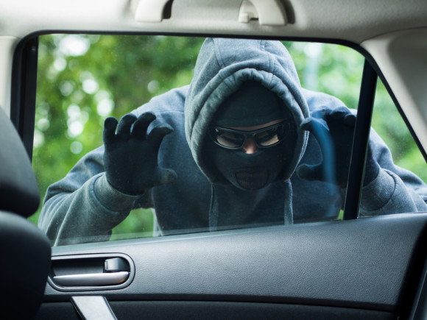
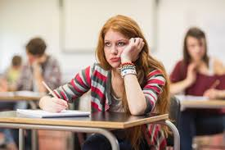
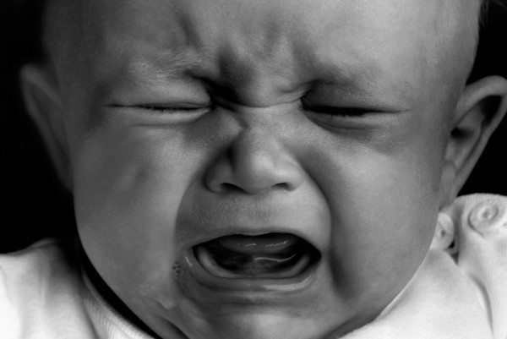
Task: This poem creates images in the reader’s mind. Can you find quotes to match each picture?
Quote: | Quote:
Quote: | Quote:
Quote: | Quote:

Slide 12
Response to Poem
Complete the table.
Point | Quote | Explanation
The writer makes the gifts sound beautiful and exotic | “glistening like an orange split open” | This makes the clothes sound exotic and beautiful because they sparkle in the light and are brightly coloured.
The speaker doesn’t feel right wearing the clothes. | “was alien in the living room”
They feel torn between the two cultures.

Slide 13
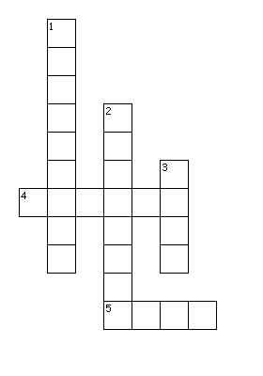
Can you put the key words in the right places?
Across
4. Compare two things using like or as.
5. An object, person, place or thing.
Down
Describes a noun.
A country near India.
3. Describes an action.

Slide 14


Sensory Description
Sensory Description is when you describe something by appealing to the five senses.
What are the five senses?
Senses
Task: Imagine you are in the market from the image (watch the video to help!) Describe walking through the market.
Emerging: Say what you can see, use adjectives and nouns. .
Developing: Use 2-3 senses.
Secure: Use all senses.
Mastered: Use simile and interesting verbs.
Don’t forget to check your spelling, full stops and capital letters.

Slide 15

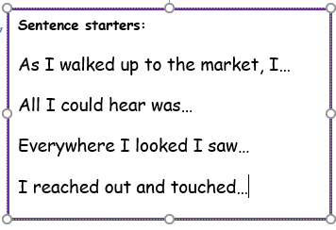
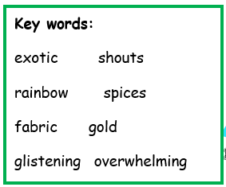
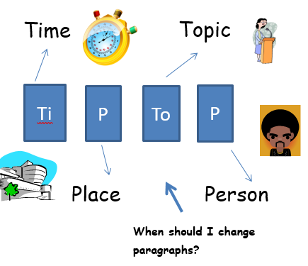
Help Sheet

Slide 16
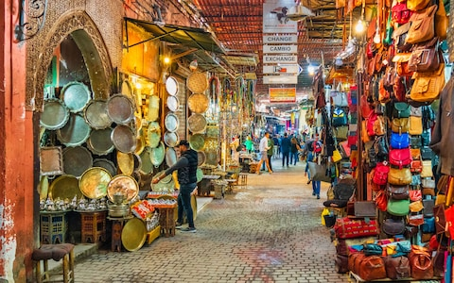
Descriptive Writing
______________________________________________________
______________________________________________________
______________________________________________________
______________________________________________________
______________________________________________________
______________________________________________________
______________________________________________________
______________________________________________________
______________________________________________________
______________________________________________________
______________________________________________________
https://www.youtube.com/watch?v=Y9Rj1qorOKY

Slide 17
Descriptive Writing
______________________________________________________
______________________________________________________
______________________________________________________
______________________________________________________
______________________________________________________
______________________________________________________
______________________________________________________
______________________________________________________
______________________________________________________
______________________________________________________
______________________________________________________
______________________________________________________
______________________________________________________
______________________________________________________
______________________________________________________
______________________________________________________
______________________________________________________
______________________________________________________
______________________________________________________

Slide 18

Self Assessment
Well done! You completed the tasks on Presents from my Aunts in Pakistan.
List three things you have learnt:
_________________________________________
_________________________________________
_________________________________________
What went well this week?
My best piece of work is…
_________________________
because…
_________________________
_________________________

