Slide 1
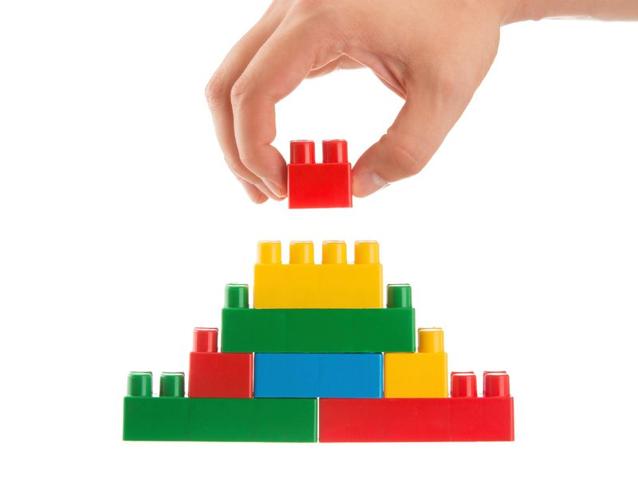
English
Home Learning Booklet
Writer’s Use of Structure
AO2: Explain how writer’s use structure, using relevant subject terminology.
Name: ___________

Slide 2
Writer’s Use of Structure
AO2: Explain how writers use structure, using relevant subject terminology.
What is the difference between language and structure?
Language is the words the writer uses.
Structure is how the text is organised or presented.

Slide 3
Key Words
Write down or look up the definitions for these key structural terms.
Key Word | Definition
Title
Sub-Heading
Image
List
Review
Text

Slide 4
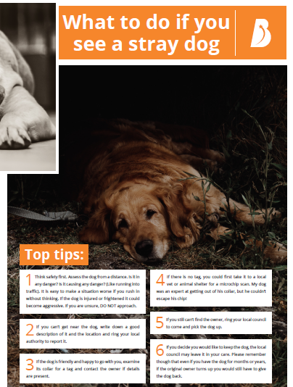
Text A
For each text, fill in the boxes with the structural feature used.

Slide 5

Text B
For each text, fill in the boxes with the structural feature used.

Slide 6

Text C
For each text, fill in the boxes with the structural feature used.

Slide 7
Structural Features
Why do writer’s use structural features?
Explain the use of some of the structural features you have identified in the text.
Example:
In text A the writer uses a subheading “top tips”. This is used to make the reader aware that this is key information because it tells you these are the most important bits of advice.
In text ……………the writer uses a………………………………………………..
This is used to make the reader …………………………………………………
because …………………………………………………………………………………………………
………………………………………………………………………………………………………………
text ……………the writer uses a………………………………………………..
This is used to make the reader …………………………………………………
because …………………………………………………………………………………………………
………………………………………………………………………………………………………………
text ……………the writer uses a………………………………………………..
This is used to make the reader …………………………………………………
because …………………………………………………………………………………………………
………………………………………………………………………………………………………………

Slide 8
Can you find the key words in the word search?

Slide 9
Key Words
Write down or look up the definitions for these key structural terms. Answers over the page, but in the wrong order!
Structural Feature | What is it?
Foreshadowing
Dialogue
Opening Paragraph
Closing Paragraph
One Sentence Paragraph
Climax
Atmosphere
Setting
Shift
Perspective

Slide 10
Key Words
Put the answers in the right places and cross off.
A paragraph of only one sentence at a dramatic point.
The first paragraph.
The person who the text focuses on.
The mood or tone of the extract.
Hints at events to come.
The most intense point of the extract.
A change in focus.
Characters speaking to each other.
The time or place where the text is happening
The last paragraph.

Slide 11
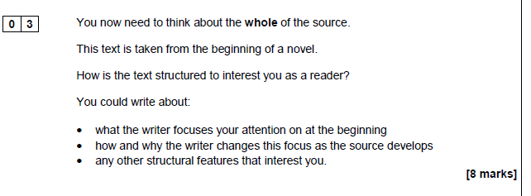
Effective Openings
For Paper 1 Question 3, you are going to be asked about the structure of the text.
The first bullet point talks about the beginning of the text.
What grabs your attention when watching the opening to a film?

Slide 12
Effective Openings
Watch the example openings & complete the table:
Emerging: Will watch the videos and give at least one reason someone would watch them.
Developing: Will give more than one way they have tried to appeal to their audience.
Secure: Will refer to specific techniques or features used.
Mastered: Evaluate which one you would choose to watch and why.
Key Words:
Music
Action
Audience
Mystery
Questions
Horror
Lighting
Camera Angles
Characters
Costumes
Opening
Foreshadowing
Atmosphere
Setting
Perspective
Dialogue
Batman Dark Night Opening https://www.youtube.com/watch?v=xLcHPsWK5xg
Enduring Love Opening https://www.youtube.com/watch?v=YAe08lJXAb4
Woman in Black Opening
https://www.youtube.com/watch?v=oCR4tfQBd6w
4. Fast and Furious Opening
https://www.youtube.com/watch?v=rcKbt9my_WI

Slide 13
Effective Openings
Title | How does it try to interest the viewer?
Extension: Which one do you think is most effective? Why?
_____________________________________________________________________________________
______________________________________________________________________________________

Slide 14
Effective Openings
For Paper 1 Question 3, you are going to be asked about the structure of the text.
The first bullet point talks about the beginning of the text.
What would grab your attention at the beginning of a text?

Slide 15
Effective Openings
Read the opening extracts & complete table:
Emerging: Will read the openings and give at least one reason they are effective.
Developing: Will give more than one way they have tried to appeal to the reader.
Secure: Will refer to specific techniques or features used.
Mastered: Evaluate which one you would choose to read and why.
Key Words:
Action
Mystery
Read
Questions
Horror
Characters
Vocabulary
Simile
Withholding information
Opening
Foreshadowing
Atmosphere
Setting
Perspective
Dialogue
1. Brighton Rock by Graham Greene
HALE knew, before he had been in Brighton three hours, that they meant to murder him. With his inky fingers and his bitten nails, his manner cynical and nervous, anybody could tell he didn't belong – belong to the early summer sun, the cool Whitsun wind off the sea, the holiday crowd.

Slide 16
Effective Openings
2. Glass, Bricks and Dust by Claire Dean
One evening, the boy was crouched on top of the mound making a new town out of a heap of broken glass. He liked this time of day best – after tea, before bed. The air seemed to get grainy as its colour changed from vinegary yellow to candyfloss blue. He could rub it between his fingers like dust and slow time down. At the top of the mound he was in charge and he didn’t want to go home to bed. He collected green glass shards and broken brown bottle necks. He tumbled fragments of old window in his hands like shattered marbles. He pushed the glass into the mound, making houses, balancing roofs on them, building towers. The last of the sunlight caught and glinted in the tiny glass walls.
3. Farenheit 451 by Ray Bradbury
It was a pleasure to burn. It was a special pleasure to see things eaten, to see things blackened and changed. With the brass nozzle in his fists, with this great python spitting its venomous kerosene upon the world, the blood pounded in his head, and his hands were the hands of some amazing conductor playing all the symphonies of blazing and 5 burning to bring down the tatters and charcoal ruins of history. With his symbolic helmet numbered 451 on his solid head, and his eyes all orange flame with the thought of what came next, he flicked the igniter and the house jumped up in a gorging fire that burned the evening sky red and yellow and black. He strode in a swarm of fireflies. He wanted above all, like the old joke, to shove a marshmallow on a stick in the 10 furnace, while the flapping pigeon-winged books died on the porch and lawn of the house. While the books went up in sparkling whirls and blew away on a wind turned dark with burning.
4. The Curious Incident of the Dog in the Night Time
It was 7 minutes after midnight. The dog was lying on the grass in the middle of the lawn in front of Mrs Shears' house. Its eyes were closed. It looked as if it was running on its side, the way dogs run when they think they are chasing a cat in a dream. But the dog was not running or asleep. The dog was dead. There was a garden fork sticking out of the dog. The points of the fork must have gone all the way through the dog and into the ground because the fork had not fallen over. I decided that the dog was probably killed with the fork because I could not see any other wounds in the dog and I do not think you would stick a garden fork into a dog after it had died for some other reason, like cancer for example, or a road accident. But I could not be certain about this.

Slide 17
Effective Openings
Title | How does it try to interest the reader?
Extension: Which one do you think is most effective? Why?
_____________________________________________________________________________________
______________________________________________________________________________________

Slide 18
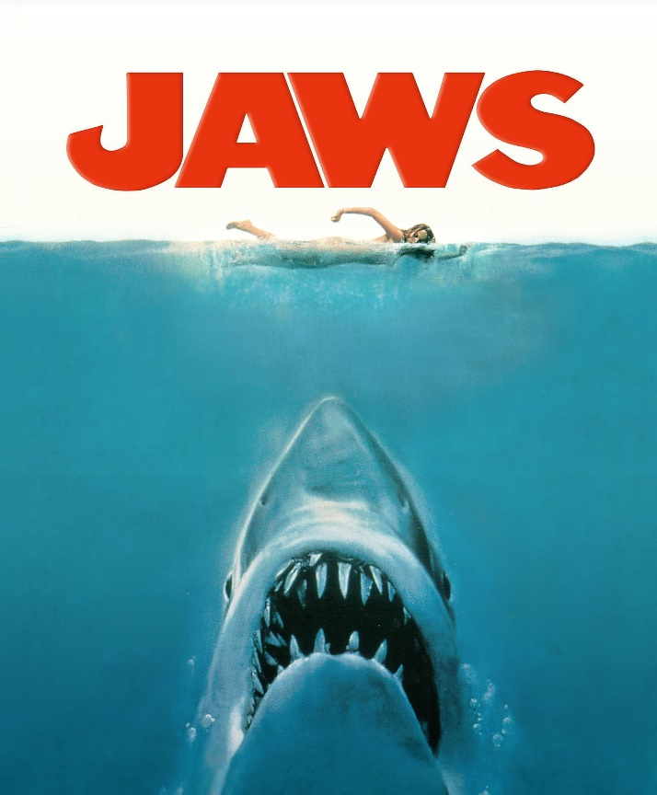
Change of Focus
For Paper 1 Question 3, you are going to be asked about the structure of the text.
The second bullet point asks you about the change of focus as the extract goes on.
Read the extract from Jaws, a film about a shark who attacks unsuspecting swimmers.

Slide 19
Jaws
In thirty-five feet of water, the great fish swam slowly, its tail waving just enough to maintain motion. It saw nothing, for the water was murky with motes of vegetation. The fish had been moving parallel to the shoreline. Now it turned, banking slightly, and followed the bottom gradually upward. The fish perceived more light in the water, but still it saw nothing.
The boy was resting, his arms dangling down, his feet and ankles dipping in and out of the water with each small swell. His head was turned towards shore, and he noticed that he had been carried out beyond what his mother would consider safe. He could see her lying on her towel, and the man and child playing in the wavewash. He was not afraid, for the water was calm and he wasn’t really very far from shore – only forty yards or so. But he wanted to get closer; otherwise his mother might sit up, spy him, and order him out of the water. He eased himself back a little bit so he could use his feet to help propel himself. He began to kick and paddle towards shore. His arms displaced water almost silently, but his kicking feet made erratic splashes and left swirls of bubbles in his wake.
The fish did not hear the sound, but rather registered the sharp and jerky impulses emitted by the kicks. They were signals, faint but true, and the fish locked on them, homing. It rose, slowly at first, then gaining speed as the signals grew stronger.
The boy stopped for a moment to rest. The signals ceased. The fish slowed, turning its head from side to side, trying to recover them. The boy lay perfectly still, and the fish passed beneath him, skimming the sandy bottom. Again it turned.
The boy resumed paddling. He kicked only every third or fourth stroke; kicking was more exertion than steady paddling. But the occasional kicks sent new signals to the fish. This time it needed to lock onto them only an instant, for it was almost directly below the boy. The fish rose. Nearly vertical, it now saw the commotion on the surface. There was no conviction that what thrashed above was food, but food was not a concept of significance. The fish was impelled to attack: if what it swallowed was digestible, that was food; if not, it would be later regurgitated. The mouth opened, and with a final sweep of the sickle tail, the fish struck.
The boy’s last – only – thought was that he had been punched in the stomach. The breath was driven from him in a sudden rush. He had no time to cry out, nor, had he had the time, would he have known what to cry, for he could not see the fish. The fish’s head drove the raft out of the water. The jaws smashed together, engulfing head, arms, shoulders, trunk, pelvis and most of the raft. Nearly half the fish had come clear of the water, and it slid forward and down in a belly flopping motion, grinding the mass of flesh and bone and rubber. The boy’s legs were severed at the hip, and they sank, spinning slowly to the bottom.

Slide 20
Jaws
Who does the text focus on first?
____________________________________________________________________
How do you know?
____________________________________________________________________
Who does the text then focus on?
____________________________________________________________________
How do you know?
____________________________________________________________________
What is the writer suggesting will happen to the boy by looking at the two different viewpoints?
____________________________________________________________________
____________________________________________________________________
____________________________________________________________________
6. . What happens at the end of the text?
____________________________________________________________________
____________________________________________________________________
7. How do you know?
____________________________________________________________________
____________________________________________________________________

Slide 21
Jaws
Task: Find quotes which show the two different perspectives
Shark | Boy
Extension Task:
Why do you think the writer changes focus between the two different perspectives?
____________________________________________________________________________________________________________________________________

Slide 22

Self Assessment
Well done! You completed the tasks on structure.
List three things you have learnt:
_________________________________________
_________________________________________
_________________________________________
What went well this week?
My best piece of work is…
_________________________
because…
_________________________
_________________________

