Slide 1
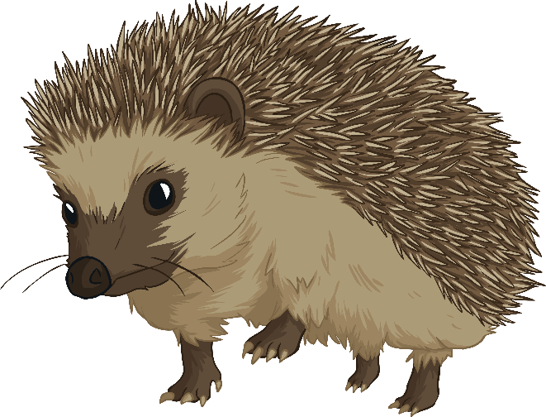
Name: | Date:
Flowcharts & Pseudocode Lesson Two
Flowchart Challenge 1
Flo the hedgehog is very hungry! Using your knowledge of flowcharts, put these instructions
into the right order to help her make her recipe for Slimy Snail Soup.
Stir well, serve and enjoy!
Add a splash of slippery slug juice.
Put slimy snails into pot.
Boil for 15 minutes.
Find slimy snails in garden.
Add a dash of wriggly worm.
Start
Get a large cooking pot.
Stop
Top tip: You can drag the steps into order on this page OR write the steps in on the next page

Slide 2


Flowchart Task 1: If you can’t drag the instructions into the write order you can write them in on this page
Yay, thanks guys,
I was starving!

Slide 3
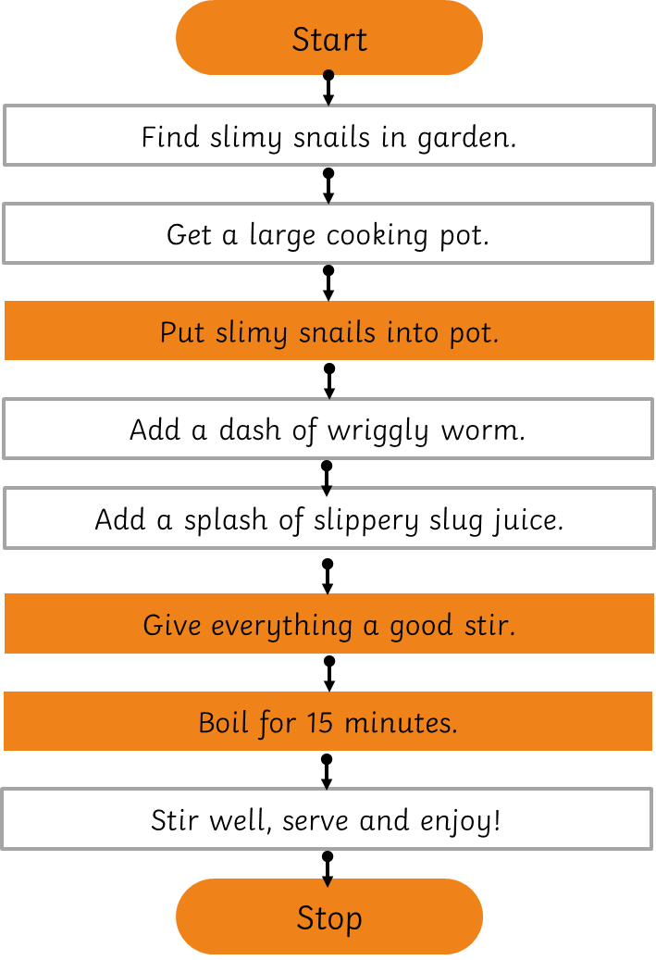
Flowchart Task 2: You might have put some of the instructions into a slightly different order to this (e.g. add a splash of slippery slug juice before the dash of wriggly worm). That’s ok.
However, some instructions must be in the right order. Which ones do you think these are?
Put a (M) for moveable next to instructions that you think could be switched around. Put a (F) for fixed next to instructions that must stay exactly where they are.

