Slide 1
Flowcharts and Pseudocode
Lesson Two

Slide 2
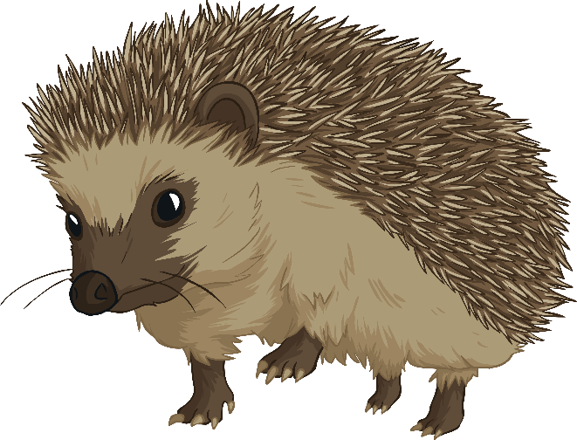
Hungry Hedgehog
Flo the hedgehog is very hungry!
Using your knowledge of flowcharts, put these instructions
into the right order to help her make her recipe for
Slimy Snail Soup.
Give everything a good stir.
Stir well, serve and enjoy!
Add a splash of slippery slug juice.
Put slimy snails into pot.
Boil for 15 minutes.
Find slimy snails in garden.
Add a dash of wriggly worm.
Start
Get a large cooking pot.
Stop
Now do Flowchart task 1

Slide 3


Hungry Hedgehog
Start
Here’s the answer.
Find slimy snails in garden.
You might have put some of the instructions into a slightly different order to this (e.g. add a splash of slippery slug juice before the dash of wriggly worm).
Get a large cooking pot.
Put slimy snails into pot.
Add a dash of wriggly worm.
That’s okay.
Add a splash of slippery slug juice.
However, some instructions must be in the right order. Which ones do you think these are?
Give everything a good stir.
Boil for 15 minutes.
Yay, thanks guys,
I was starving!
Stir well, serve and enjoy!
Stop
Now do Flowchart task 2

Slide 4
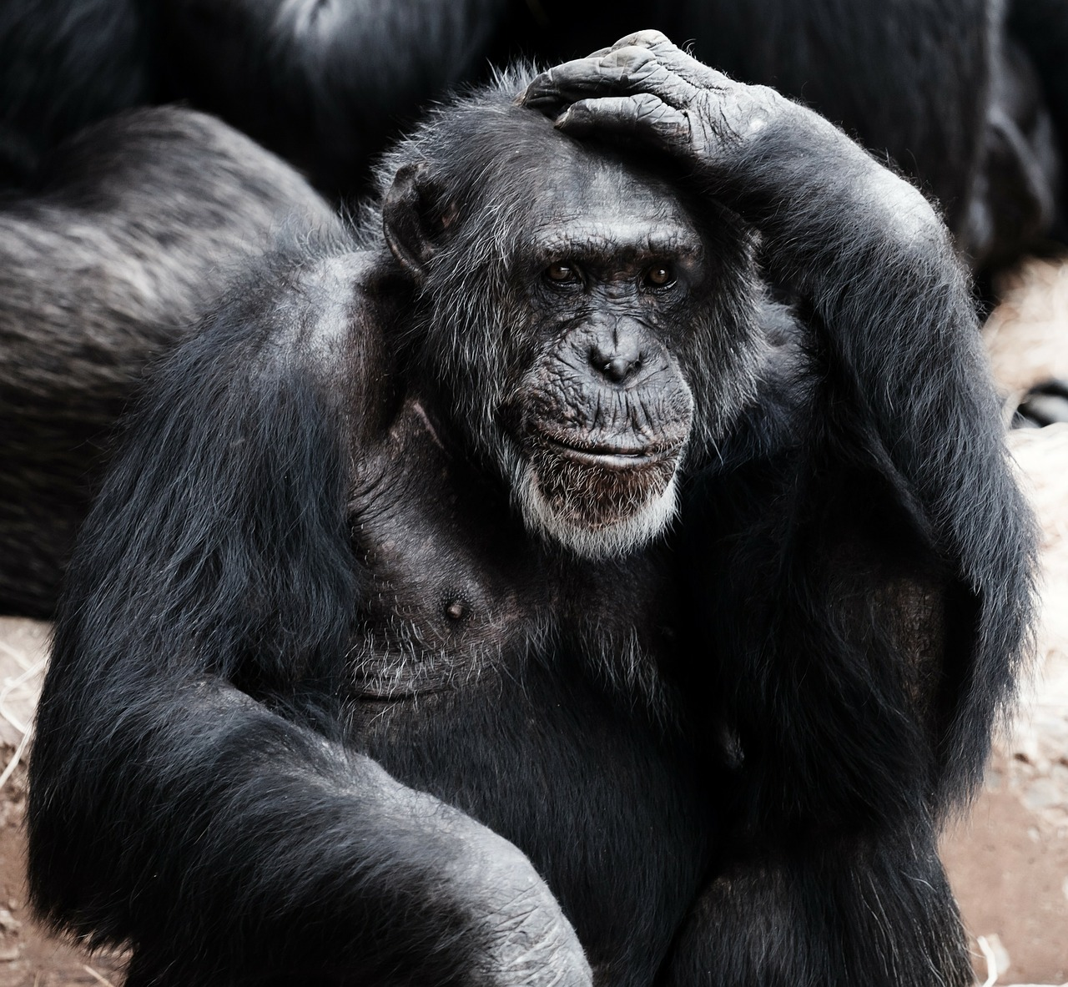
Selection
How do computers make decisions?
Computers make decisions in a similar way to humans. And hedgehogs.
Let’s see how this works:
Next Slide

Slide 5


Selection
Imagine that Flo wakes up one day and looks up at the sky.
Her thought-process goes something like this…
What is the weather like today?
Is it sunny?
If the answer is YES, then Flo will put on her sunglasses.(What, haven’t
you seen a hedgehog with
sunglasses before?)
If the answer is NO, then Flo
will put on her woolly hat.
Next Slide

Slide 6



Selection
Now do question 1 on the worksheet
We can write this in a more precise way:
IF it is sunny, THEN
Flo will put on her sunglasses
ELSE
Flo will put on her woolly hat.
END IF
This method of writing the steps of a process is called pseudocode
(soo – dough – code).
Notice these words in CAPITALS – they are special pseudocode words.
Key Term
Pseudocode is a simple but structured way of writing
algorithms. It is not a real programming language.
Programmers often use pseudocode when they are
designing computer programs.

Slide 7

Selection
We can also show Flo’s thinking by using a new flowchart symbol.
This flowchart symbol is called a decision box.
Notice how it has one input (the top flowline), and two
outputs. The outputs are either YES and NO.
Is it sunny today?
No
Yes
Next Slide

Slide 8
Selection
Let’s put our flowchart and pseudocode side-by-side:
IF it is sunny, THEN
Flo will put on her sunglasses
ELSE
Flo will on her woolly hat.
END IF
Is it sunny
today?
No
Yes
Flo will put on her woolly hat.
Which do you prefer –
the flowchart or
the pseudocode?
Flo will put on her sunglasses.

Slide 9
Now do question 2 on the worksheet
Selection
“Is it sunny today?”
This question is called a condition. There are two possible outcomes:
YES or NO
“Is it sunny today?”
This question is called a condition. There are two possible outcomes:
YES or NO
Is it sunny
today?
IF it is sunny, THEN
Flo will put on her sunglasses
No
Yes
Key Terms
Selection is when computers make decisions.
A computer can be programmed to make a selection
between two or more choices, depending
on the condition (the question).

Slide 10
Flowchart and Pseudocode Challenges
Let’s put your knowledge into action. You are female, super strong and you can fly. According to this flowchart, which superhero are you?
Start
No
Yes
Can you fly?
Yes
Yes
Do you have
super strength?
Do you have
super strength?
Yes
No
No
Are you female?
Are you female?
You are Falcon
Yes
You’re not a Superhero
No
You are She-Hulk
No
You are
Wonder Woman
You are Spiderman
Stop
Stop
You are Superman
Stop
Stop
Stop
Stop
Now do question 3 on the worksheet

Slide 11
Flowchart and Pseudocode Challenges
Let’s try that again. You are female, super strong but you can’t fly.
According to this flowchart, which superhero are you?
Start
No
Yes
Can you fly?
Yes
Yes
Do you have
super strength?
Do you have
super strength?
Yes
No
No
Are you female?
Are you female?
You are Falcon
Yes
You’re not a Superhero
No
You are She-Hulk
No
You are
Wonder Woman
You are Spiderman
Stop
Stop
You are Superman
Stop
Stop
Stop
Stop
Now do question 4 on the worksheet

Slide 12
Flowchart and Pseudocode Challenges
One more time. You are male, super strong but you can fly.
According to this flowchart, which superhero are you?
Start
No
Yes
Can you fly?
Yes
Yes
Do you have
super strength?
Do you have
super strength?
Yes
No
No
Are you female?
Are you female?
You are Falcon
Yes
You’re not a Superhero
No
You are She-Hulk
No
You are
Wonder Woman
You are Spiderman
Stop
Stop
You are Superman
Stop
Stop
Stop
Stop
Now do question 5 on the worksheet

Slide 13
Network Login
Most computer systems require that users enter a username and a password.
What happens if a wrong username is entered?
What happens if a wrong password is entered?
What happens if both username and password are wrong?
What happens if both username and password are correct?
Next Slide

Slide 14

Network Login
Need help getting started?
Start
ENTER Username
ENTER Password
IF Username and Password are correct THEN
…what comes next?
Enter Username
Enter Password
Is Username correct?
No
Yes
… what comes next … ?
Now do Lesson 2 Flowchart Tasks (Extension)

Slide 15


Recap knowledge
Key Terms
Pseudocode is a simple but structured way of writing algorithms.
Key Terms
Selection is when computers make decisions. A computer can be
programmed to make a selection between two or more choices,
depending on the condition (the question).
Pause for Thought
Computers can be programmed to make decisions.
Computers can often work much faster than humans can.
Do you think that computers will therefore one day replace
humans and take over all of our jobs? Why / why not?

Slide 16

Nailing It Down
We have learned a lot today about selection and pseudocode.
Next lesson we’ll learn how computers store information and do things again and again.
Did you know that you can use your computer to draw flowcharts?
Try out this free website to draw flowcharts online:
https://www.draw.io/
With most word processors such as Microsoft
Word, you can insert flowchart shapes.
See if you can improve your flowcharts by
drawing them on a computer.
Now do Nailing it down (Extension)

