Slide 1

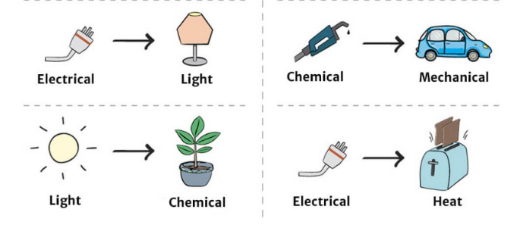
Science: Tidal and Geothermal
If want to do some work online please visit SENECA learning and sign up using the class code: 4ggjlziov
Use: https://www.bbc.co.uk/bitesize/guides/zggk87h/revision/1
to help if you get stuck or contact me!
Recap
What are fossil fuels?
How does a wind turbine work?
Name 3 things that are solar powered.
Name the energy transfers below!
The first one has been done for you
Have a go at the saving energy game!
http://jointhepod.org/assets/games/power-patrol/index.html

Slide 2
What is the difference between a renewable and non-renewable energy resource?
The energy transfers in a coal power station are:
Chemical _________ + _________ + __________
The energy transfers in wind turbine are:
Coal power station diagram(with labels)
Wind turbine diagram (with labels)
 | Advantages | Disadvantages
Coal power station
Wind turbine
Heat kinetic steam renewable non-renewable turbine electrical generator chemical electricity

Slide 3
Self assessment
emerging | Show simply how electricity is generated from coal Give simple advantages and disadvantages for each
developing | Diagrams to show how electricity is generated using coal and a wind Identify which is renewable and which is non-renewable Say where the energy comes from for coal and wind
Secure/ mastered | Describe the difference between renewable and non-renewable energy resources Label the energy transfers on the diagrams Evaluate(say how important) the advantages and disadvantages of each
Look at your work of the previous page
What have you done well?
Looking at the criteria above would you say you are emerging, developing, secured or mastered?
Give a reason for your answer
What would you do next time to make it even better?

Slide 4
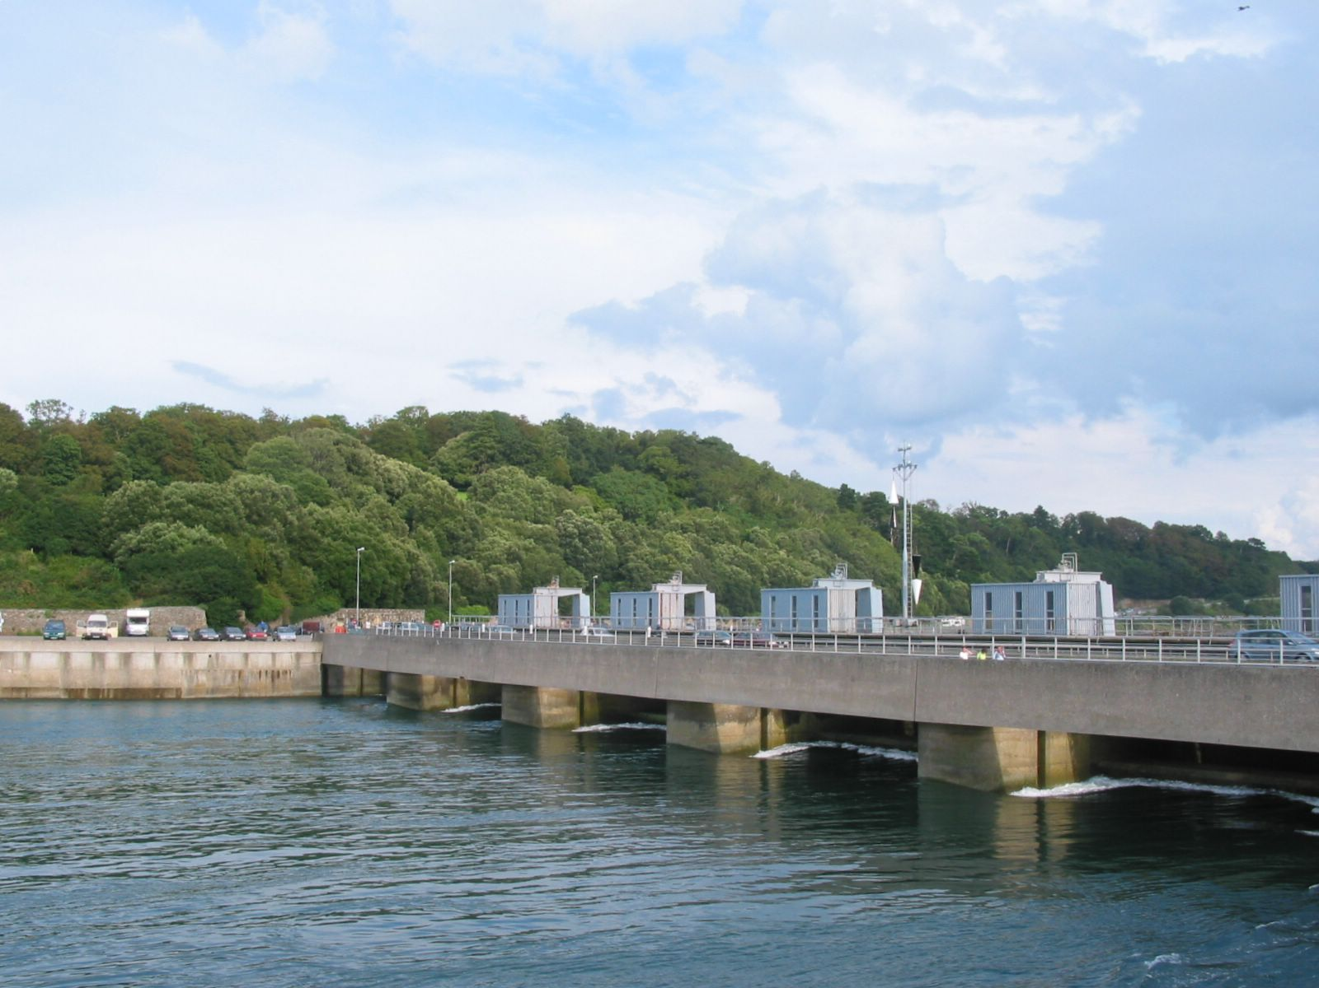
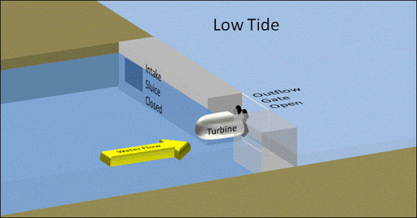
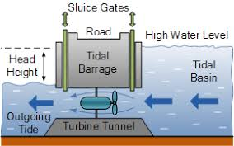
Tidal power
We can use the moving water in the sea to make electricity.
Twice a day, huge amounts of water flow into and out of estuaries as the TIDES go in and out.
Dams called BARRAGES trap the water at high tide.
After the tide goes out, gates in the barrage are opened.
Water rushes through the pipes, spinning turbines.
These turbines turn the generators, making electricity.
When the tide comes in, water rushes in and the turbines spin the other way.
Problems
Very few places have tides strong enough.
Large areas are flooded, destroying habitats and wildlife.
Can you use google maps to find a tidal barrage in Cardiff?

Slide 5
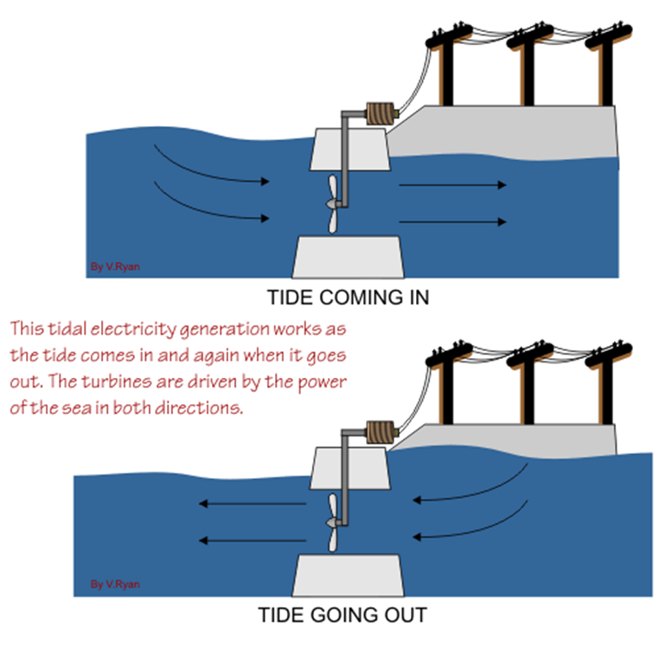
Tidal power
Watch this video: https://www.youtube.com/watch?v=OCpBNQfpKDA
What do we mean by the tide coming in and going out?
What type of energy is tidal power using?
Is this a good way to generate electricity? Why?

Slide 6
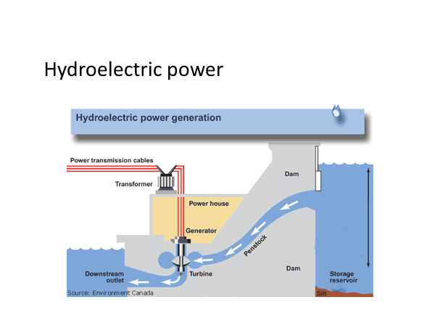

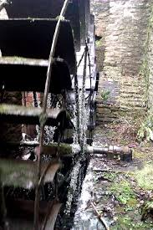
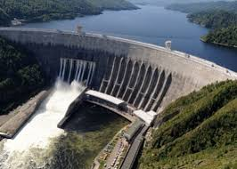
Using water for power has been done for hundreds of years such as the water wheel at snuff mill fishponds.
Hydroelectric power involved building a dam (wall that can let water pass). The water then floods the area behind the wall. Because the water is high up it has gravitational potential energy which means the water moves (kinetic energy) through the turbines in the dam, this turns a generator giving electrical energy. Some energy is transferred to sound and heat which is not needed.
Hydroelectric power is used in the UK.
Research task:
Does England, wales or Scotland have the most hydroelectric power stations?
What are the advantages of hydroelectric power stations?
Why might some people be again hydroelectric power stations?

Slide 7
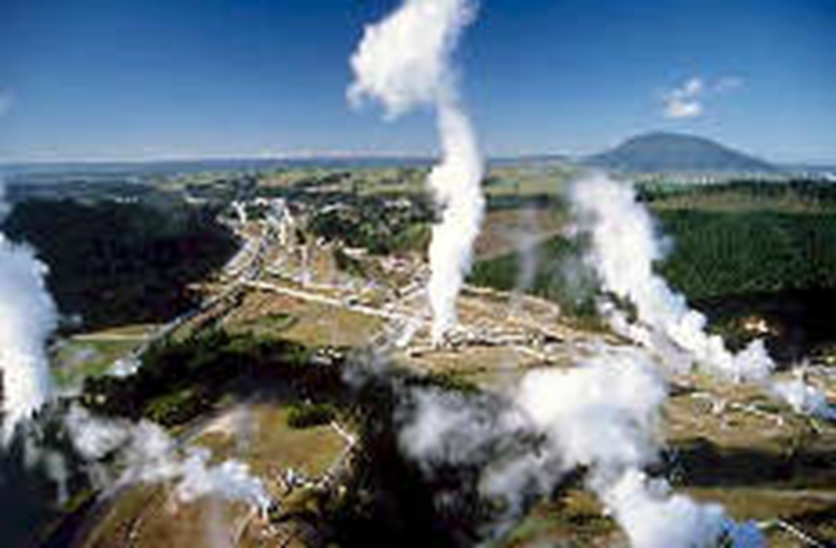
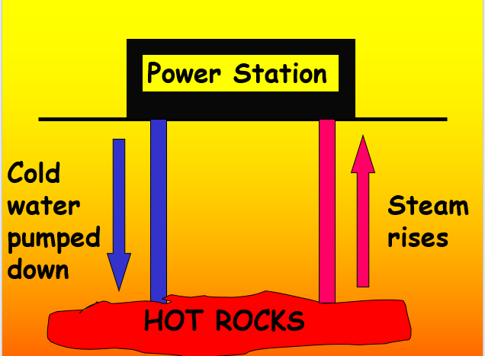
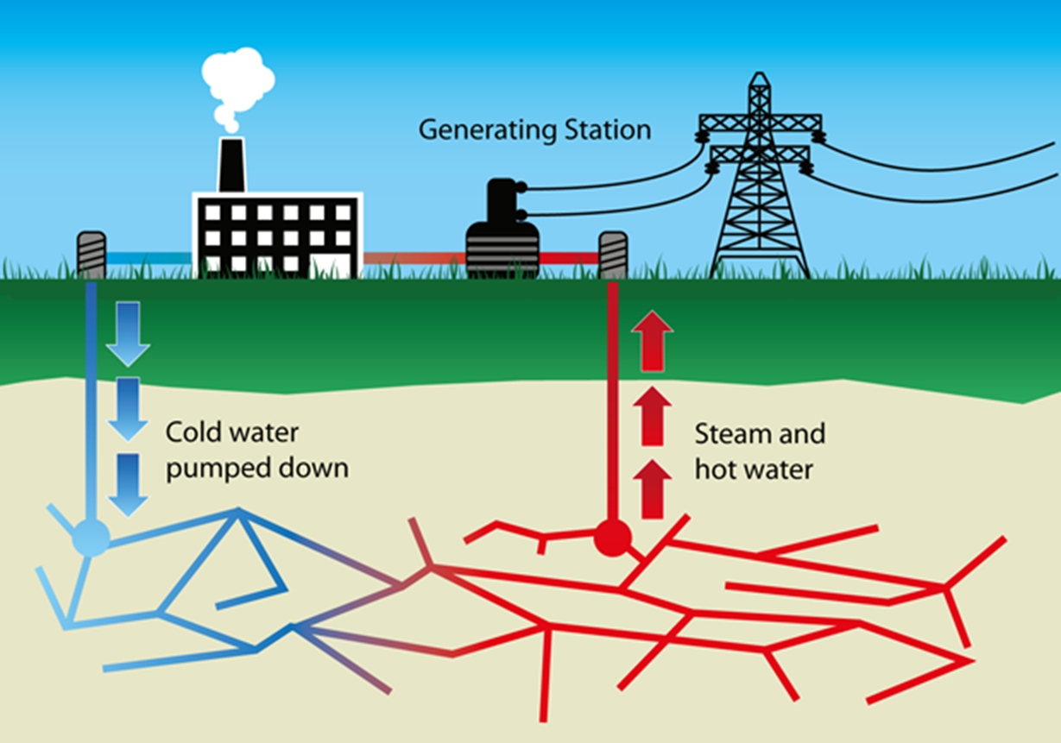
Geothermal energy
In some parts of the world rocks just below the surface are very hot, this heat can be used to heat homes or generate electricity. In Bath hot water from deep underground comes to the surface and used to heat water for spas!
Water is pumped down pipes to the HOT rocks.
Water returns as STEAM which turns a turbine, turning a generator for electricity
Advantages
No pollution
Very low running costs
Disadvantages
Cost of drilling several km down to the hot rocks.
Very few places where this is possible.
Use the internet to find a country that uses geothermal energy and write the country below
How does the country you have found use the heat from the ground?

Slide 8
Match the power source to the advantages
power source
hydroelectric dam
solar cell
tidal barrage
wind turbines
advantages
free energy resource, creates no air pollution
good for remote locations, small objects, no air pollution
no air pollution, reliable and predictable (sea goes in and out), free energy resource
reliable in areas with lots of rain, no air pollution
Match the power source to the disadvantages
power source
hydroelectric dam
solar cell
tidal barrage
wind turbines
disadvantages
affects animals and plants, needs high tides, expensive
floods a large area, expensive, not possible in dry and flat areas
needs to be windy, unsightly, noisy
unreliable, very expensive

Slide 9



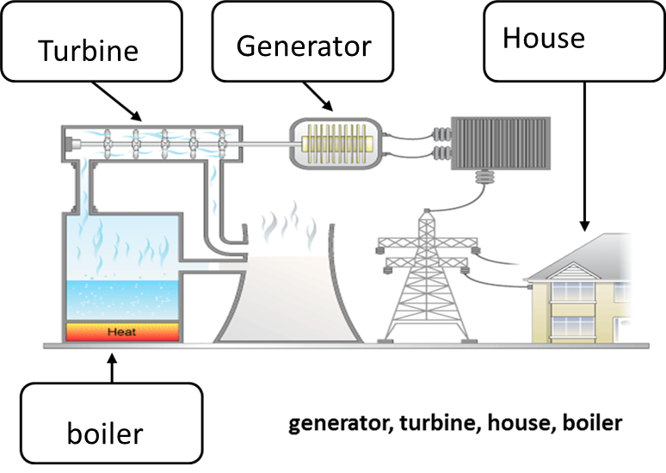
Energy resource | How it works and energy transfer
Gepthermal
Hydroelectric
Tidal
Coal power station
Geothermal energy works by…………………………………….
………………………………………… …………………………………………
h____ K______+ E_______
Hydroelectric energy works by………………………………………
……………………………………………. ………………………………………
G___________ K______+ e_________ + s______
Tidal energy works by…
…………………………………………….………………………………………….
K________ e______ + s______
Coal power stations works by……………………….................
……………………………………………..
c________ h_____ + k______ + e_________
Heat chemical kinetic electrical gravitational potential

Slide 10


