Slide 1

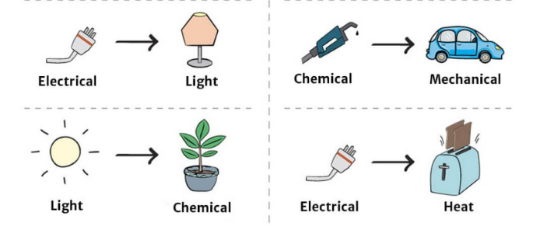
Science: Tidal and Geothermal
If want to do some work online please visit SENECA learning and sign up using the class code: 4ggjlziov
Use: https://www.bbc.co.uk/bitesize/guides/zggk87h/revision/1
to help if you get stuck or contact me!
Recap
What are fossil fuels?
How does a wind turbine work?
Name 3 things that are solar powered.
Name the energy transfers below!
The first one has been done for you, use the words in the yellow box to help
_ _ _ _ _ _ _ _
_ _ _ _ _ _ _
_ _ _ _ _
_ _ _ _ _ _ _ _
_ _ _ _ _ _ _ _ _ _
_ _ _ _
Light chemical electrical heat chemical kinetic
Have a go at the saving energy game!
http://jointhepod.org/assets/games/power-patrol/index.html

Slide 2
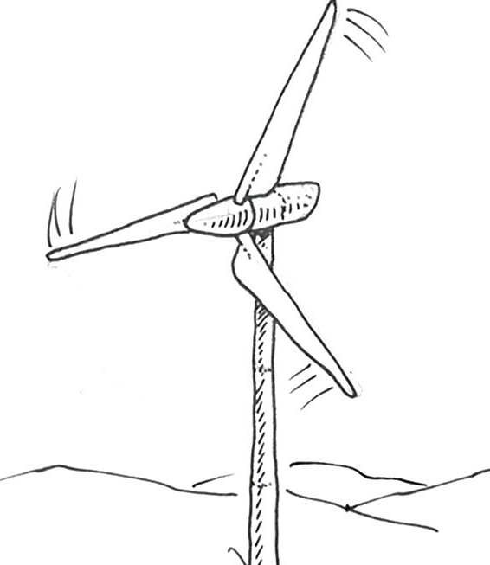
The energy transfers in a coal power station are:
c _ _ _ _ _ _ _ + h _ _ _ k _ _ _ _ _ _ + e _ _ _ _ _ _ _ _ _ _
The energy transfers in a wind turbine are:
K _ _ _ _ _ _ h _ _ _ + e _ _ _ _ _ _ _ _ _ _ + s _ _ _ _
Coal power station diagram, draw a diagram and add labels
wind energy diagram, add labels
 | Advantages | Disadvantages
Coal power station
Wind turbine
Heat kinetic steam renewable non-renewable turbine electrical generator chemical electricity sound

Slide 3
Self assessment
emerging | Show simply how electricity is generated from coal Give simple advantages and disadvantages for each
developing | Diagrams to show how electricity is generated using coal and a wind Identify which is renewable and which is non-renewable Say where the energy comes from for coal and wind
Secure | Describe the difference between renewable and non-renewable energy resources Label the energy transfers on the diagrams Name several advantages and disadvantages
Look at your work of the previous page
The best part of my work is ………………………………………………….
……………………………………………………………………………………………..
I think my work is emerging/developing/secure (circle which you think)
To improve my work I could ………………………………………………
…………………………………………………………………………………………..

Slide 4
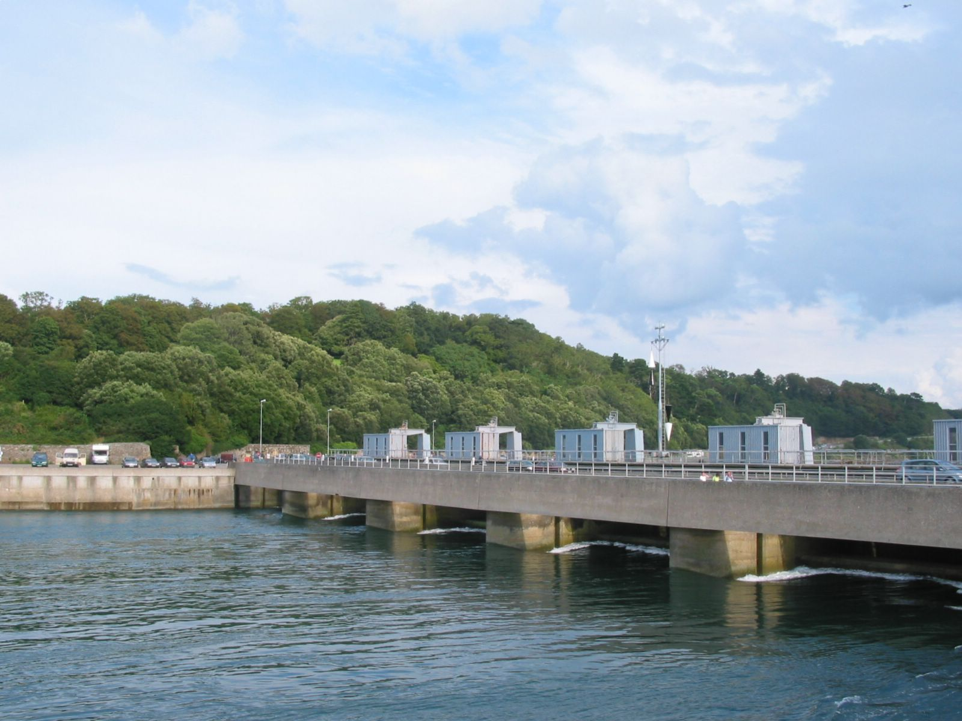
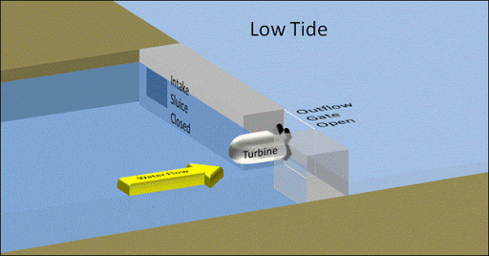
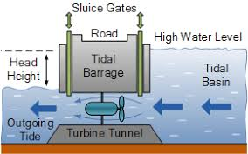
Tidal power
Think of the beach. The water comes in and then goes out. We call this the tide.
When the water comes in, we can use a turbine (like the wind turbine). The water spins this turbine which generates electricity
When the water goes out it then turns the turbine again.
Problems
Very few places have tides strong enough.
Large areas are flooded, destroying habitats and wildlife.
Can you use google maps to find a tidal barrage in Cardiff?

Slide 5
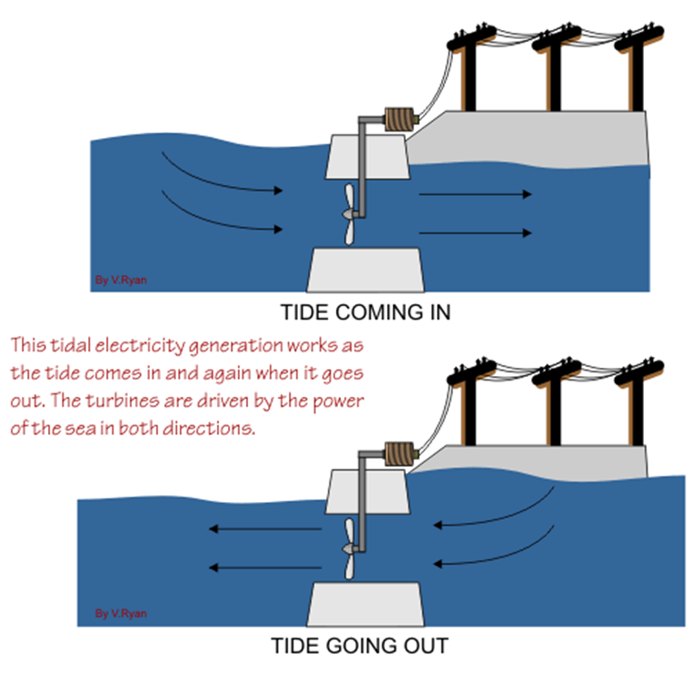
Tidal power
Watch this video: https://www.youtube.com/watch?v=OCpBNQfpKDA
When the tide comes in it has movement energy which we call _ _ _ _ _ _ _ energy.
This _ _ _ _ _ a turbine which spins a generator to make _ _ _ _ _ _ _ _ _ _ _
Putting the turbine in the sea might kill _ _ _ _
Tidal power can only be used in some areas because you need to have strong _ _ _ _ _
Energy transfer
_ _ _ _ _ _ _ + _ _ _ _ _ _ _ _ _ _ _ _ _ _ _ + _ _ _ _ _
Spins kinetic tides fish electricity

Slide 6
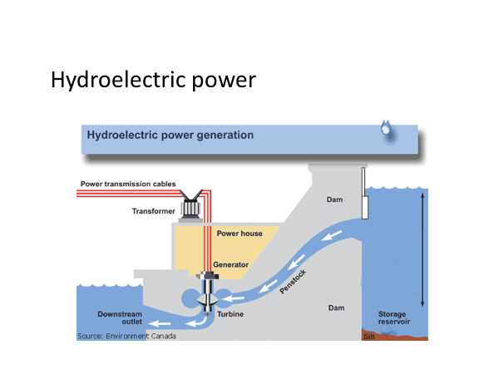

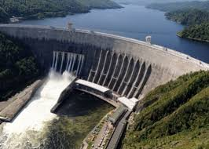
Hydroelectric power involved building a dam (wall that can let water pass). The water then floods the area behind the wall. Because the water is high up it has gravitational potential energy which means the water moves (kinetic energy) through the turbines in the dam, this turns a generator giving electrical energy. Some energy is transferred to sound and heat which is not needed.
Hydroelectric power uses _ _ _ _ _
A big _ _ _ _ is built, this is called a dam
Water is let through this wall causing turbines to _ _ _ _
This spins a generator to make _ _ _ _ _ _ _ _ _ _
Energy transfers
G _ _ _ _ _ _ _ _ _ _ _ _ potential K _ _ _ _ _ _
K _ _ _ _ _ _ e _ _ _ _ _ _ _ _ _ + s _ _ _ _
Water wall spin electricity gravitational kinetic sound electrical kinetic

Slide 7
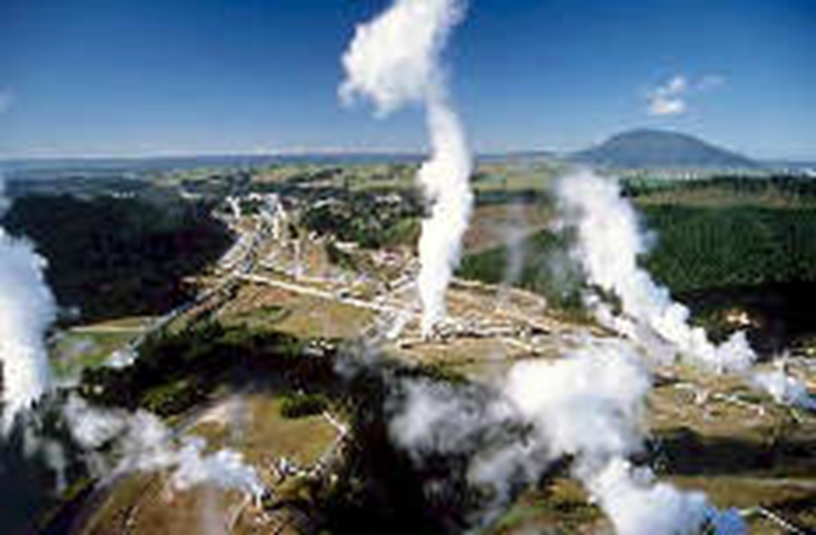
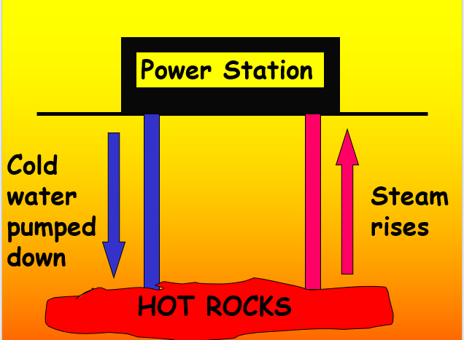
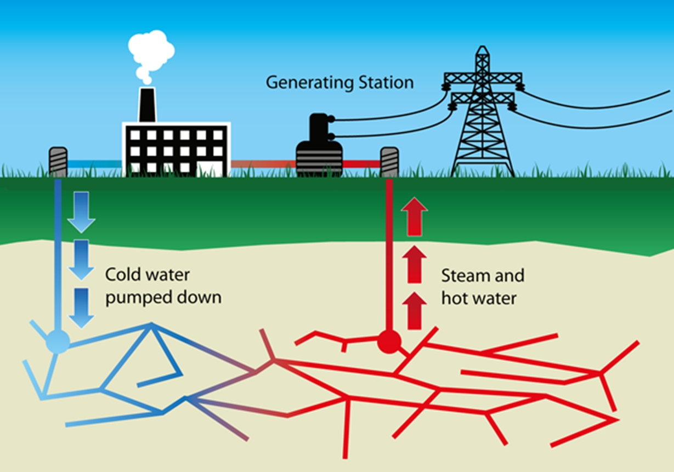
Geothermal energy
In some parts of the world rocks just below the surface are very hot, this heat can be used to heat homes or generate electricity.
Water is pumped down pipes to the HOT rocks.
Water returns as STEAM which turns a turbine, turning a generator for electricity
Advantages
No pollution
Very low running costs
Disadvantages
Cost of drilling several km down to the hot rocks.
Very few places where this is possible.
Use the internet to find a country that uses geothermal energy and write the country below
How does the country you have found use the heat from the ground?

Slide 8
Match the power source to the advantages
power source
hydroelectric dam
solar cell
tidal barrage
wind turbines
advantages
free energy resource, creates no air pollution
good for remote locations, small objects, no air pollution
no air pollution, reliable and predictable (sea goes in and out), free energy resource
reliable in areas with lots of rain, no air pollution
Match the power source to the disadvantages
power source
hydroelectric dam
solar cell
tidal barrage
wind turbines
disadvantages
affects animals and plants, needs high tides, expensive
floods a large area, expensive, not possible in dry and flat areas
needs to be windy, unsightly, noisy
unreliable, very expensive

Slide 9



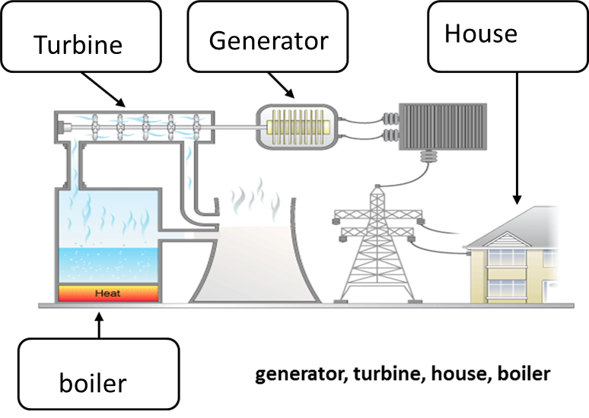
Energy resource | How it works and energy energy transfers
Geothermal | Rocks under the ground are h_____. Water can be heated by p________ it through the rocks
Hydroelectric | Fast flowing w____________ is used to turn the turbine thus generating electricity Water is often collected behind a d_____
Tidal | As the tide comes in it turns a t_________ this turns a generator to make electricity
Coal power station | Coal is burnt to heat up water to turn it into s______ to turn a turbine to make electricity
h____ K______+ E_______
G___________ K______+ e_________ + s______
K________ e______ + s______
c________ h_____ + k______ + e_________
steam turbine dam water hot pump
Heat chemical kinetic electrical gravitational potential sound

Slide 10


